Slide 1

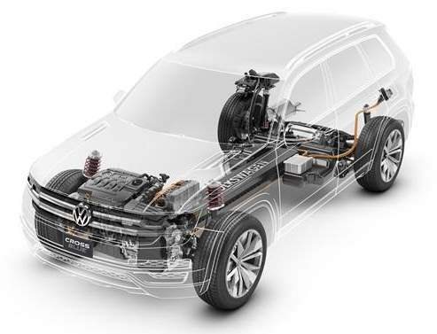
AUE 817 Final Project Presentation
Clemson University CU-ICAR
Sizing and Controlling of a Parallel Hybrid SUV Powertrain
Team 3:
Darui Zhang, Bin Xu, Liang Li
April 30 2014

Slide 2

Project Overview
Process Flow
Components sizing need to consider the competing requirements of fuel economy and power. Bigger engine means higher power and lower efficiency.
Iteration is needed due to the change of one component will affect other components and total weight.
Components Sizing
Iteration
Fuel Economy
(MPG<34.6 MPG)
Power
(0-60 mph time<9s)
Updating Control Strategy

Slide 3
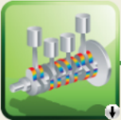

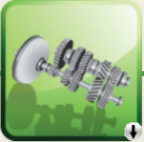




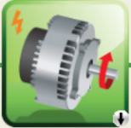

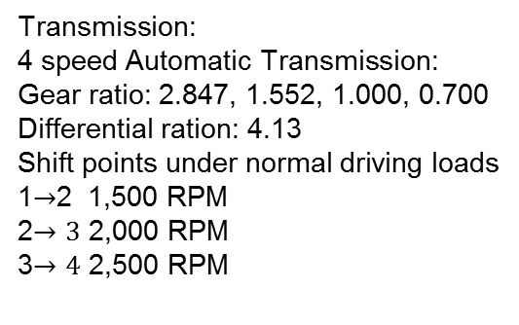
Vehicle Configuration
Project Overview
Engine
Torque
Converter
Gear box
Differential
Front wheels
Vehicle
Battery
Electric
motor
Gear
Differential
Rear wheels
Note: Engine and electric motor are connected by road
Vehicle parameters:
Frontal area A = 2.48 m^2
Curb weight = 1300 kg, GVWR = 1750 kg
Rolling resistance coefficient = 0.008
Aerodynamic drag coefficient Cd = 0.32
Tire size: 255/55R18, dynamic rolling radius = 357mm
Rotating inertia: 1.4 kgm2 (per wheel)
Transmission:
4 speed Automatic Transmission:
Gear ratio: 2.847, 1.552, 1.000, 0.700
Differential ration: 4.13
Shift points under normal driving loads
1$→$2 1,500 RPM
2$→3$ 2,000 RPM
3$→4$ 2,500 RPM

Slide 4









Powertrain Sizing
Engine
$$P_{me}=eP_{ma}−P_{ml}$$
$$e=\left(c_{1}+c_{2}C_{m}+c_{3}C_{m}^{2}\right)−\left(c_{4}+c_{5}C_{m}\right)P_{ma}$$
$$P_{ml}=c_{6}+c_{7}C_{m}^{2}$$
Linear extrapolation method
Excel data
$w T m$_dot B S
$C_{m}{ P}_{ma}$ $P_{ml}$
New engine
$c_{1} c_{2}$ $c_{3}$……
$B^{∗}$ $S^{∗}$
$${ P}_{ma}^{∗}$$
$m^{∗}_dot$
$${eta}^{∗}$$

Slide 5
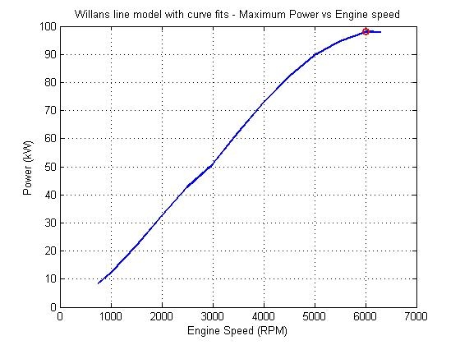
Powertrain Sizing
Engine
Maximum Power:
98 kW @6000 RPM
Maximum torque:
174 Nm @4400 RPM

Slide 6



Powertrain Sizing
Motor
1. Willan’s line model: Convert initials motor efficiency map from Torque and RPM to pme (mean effective pressure) and cm (mean piston speed).
1.Convert Initial map to pme and cn
$$c_{m}=rω, p_{me}=\frac{T_{e}}{2πr^{2}l}$$
$$P=T_{e}ω= 2π r l c_{m} p_{me}$$
2. Curve fitting (Least square method): parameterize e and ploss with polynomial functions of cm.
$$e= α_{0}+α_{1}c_{m}+α_{2}c_{m}^{2}$$
$$p_{loss}= β_{0}+β_{1}c_{m}+β_{2}c_{m}^{2}$$
$$α_{0}=\text{0.554}; α_{1}=\text{0.00806}, α_{2}=\text{−4.84}\text{e}\text{−05}$$
$$β_{0}=\text{−605.6}; β_{1}=\text{13.3}; β_{2}=\text{−0.08218}$$
3. Sizing: Convert dimensionless model back to dimensional model to acquire the efficiency map of a machine of new size
3.Dimensional model
2. Curve fitting
Dimensionless model

Slide 7
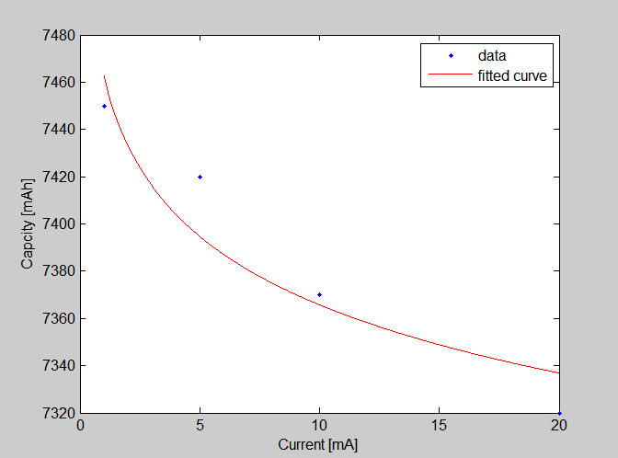
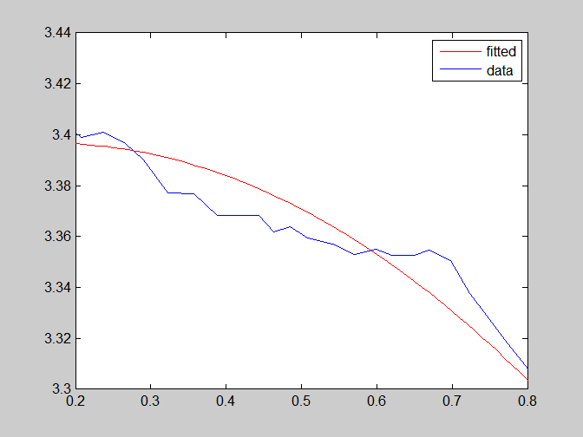
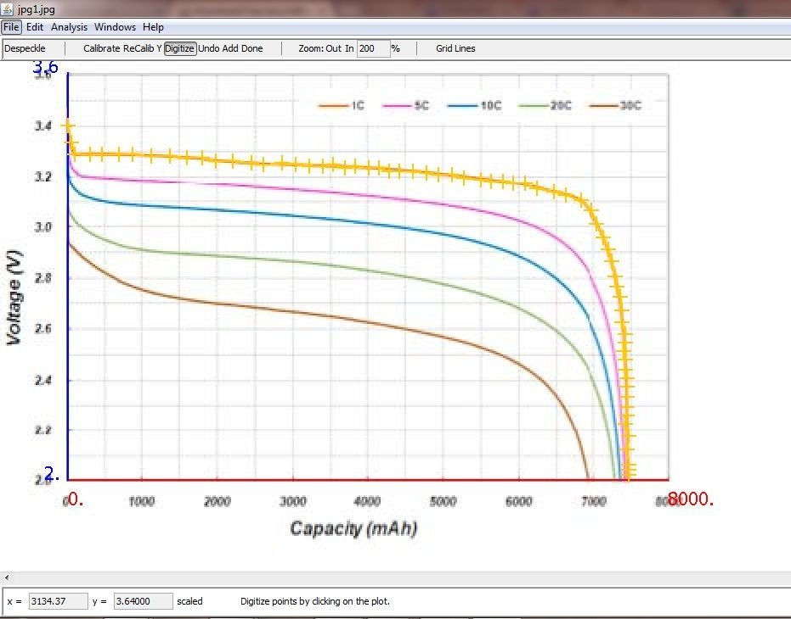
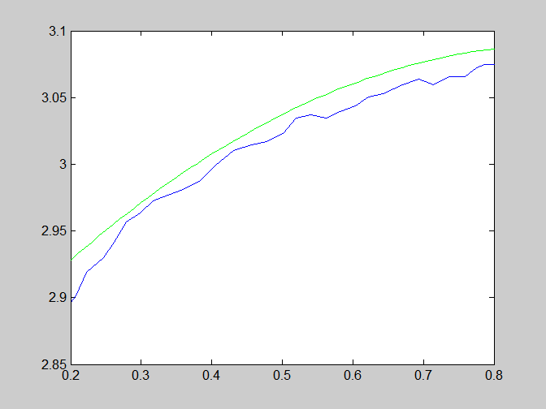
Powertrain Sizing
Battery Pack
Peukert Equation Fitting
As is done in HW4, peukert effect is taken into consideration, and the least square fitting method is implemented when building up the battery model. Validation is executed, and the results show the fitting is acceptable.
Validation for both discharge & charge
Picking points using Plot Digitizer

Slide 8
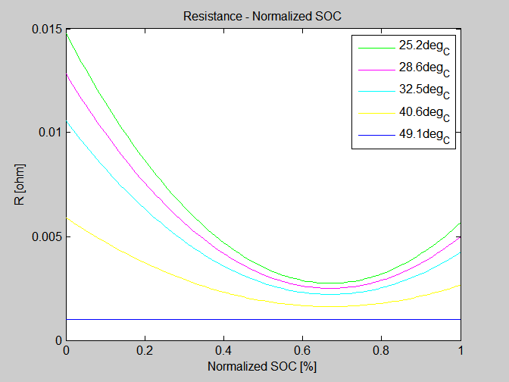
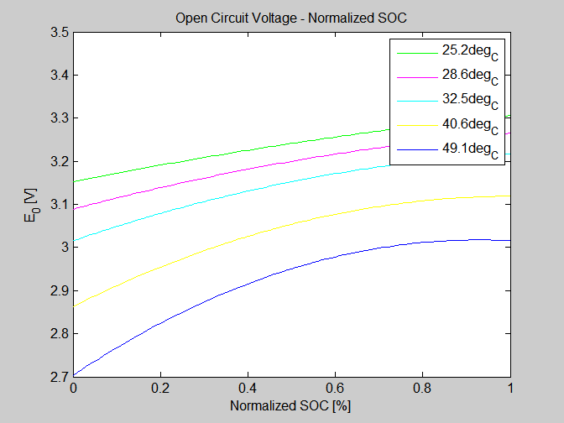
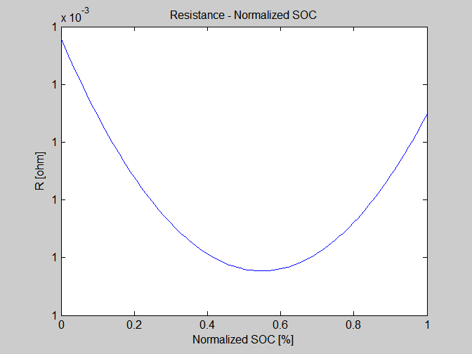
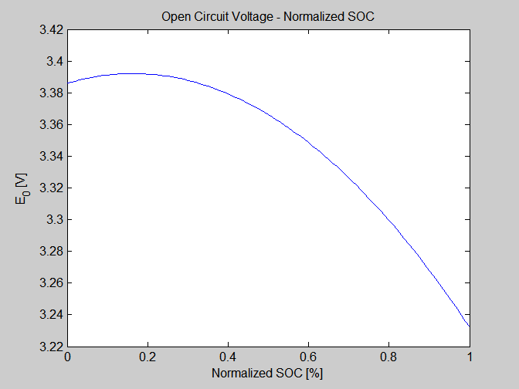
Powertrain Sizing
Battery Pack
Results
R_vs_SOC_disch
V_oc_vs_SOC_disch
R_vs_SOC_ch
V_oc_vs_SOC_ch

Slide 9
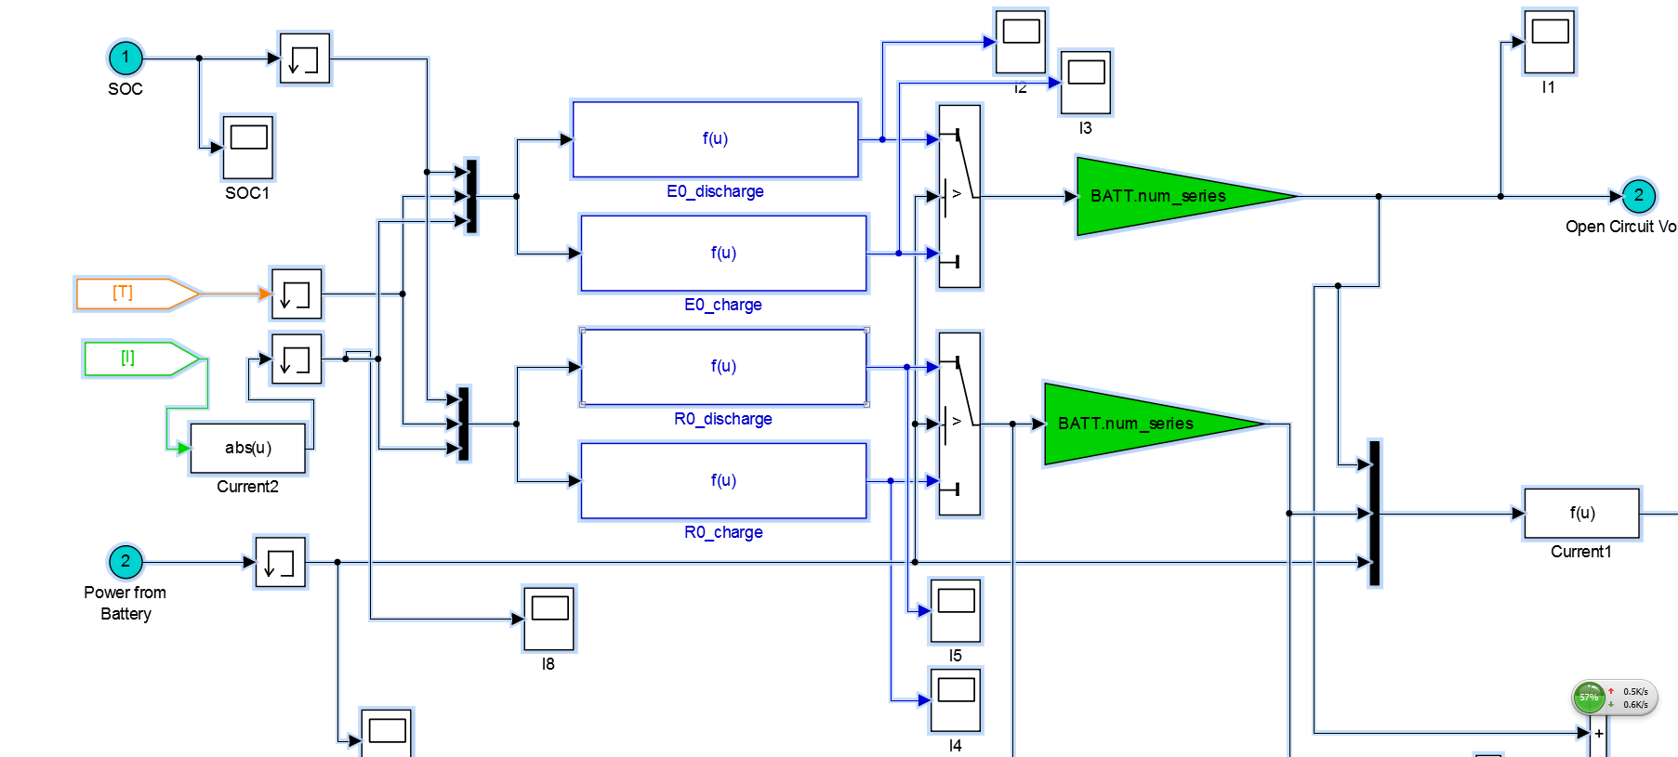
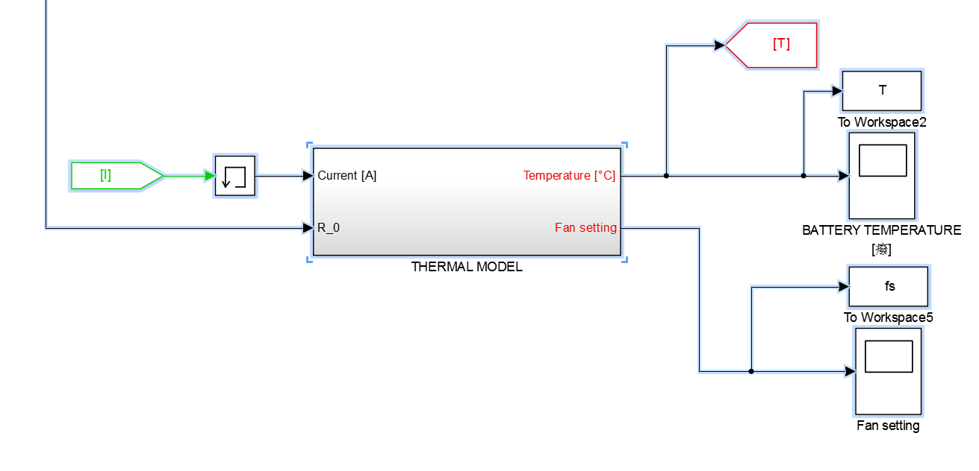
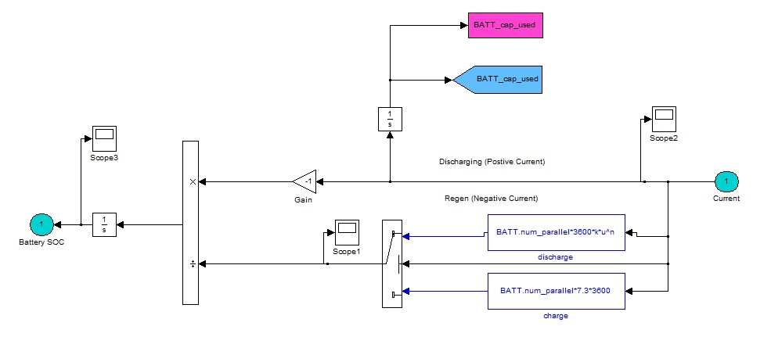
Powertrain Sizing
Battery Pack
Thermal Model Description
E=fcn(SOC, T, I)
Determine which map to use
Three inputs
Thermal Model added
Subsystem: Obtain SOC

Slide 10
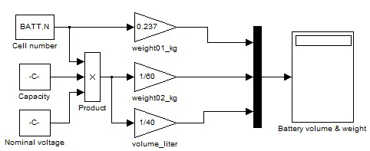
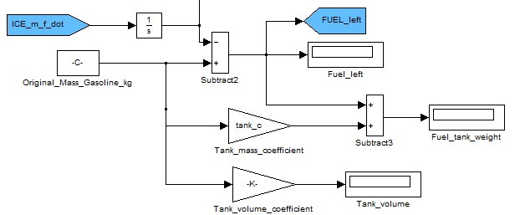
Powertrain Sizing
Battery&Fuel tank Pack
Battery sizing
Volume: 144 Litrers
Mass: 105 kg
Cell: 247
Fuel tank sizing
Volume: 8.5 gallon with 350 miles UDDS&HWFET combined cycle

Slide 11

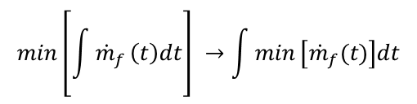


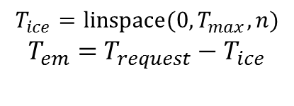
Control Strategy
ECMS
Equivalent Consumption Minimization Strategy (ECMS):
Minimize instantaneous fuel consumption instead of global
$$min\left[\int{{\dot{m}}_{f}}\left(t\right)dt\right] →\int{min}\left[{\dot{m}}_{f}(t)\right]dt$$
Steps:
1. Calculate motor speed at a given engine speed by gear ratio.
2. Discretization: Split torque between engine an motor
$$T_{ice}=linspace(0,T_{max}, n)$$
$T_{em}=$ $T_{request}−T_{ice}$
3. Calculation Equivalent fuel consumption of electrical motor
$${m_{equ em} }_{ }=f_{penalty}∗\left(\frac{gamma}{s_{chag}}+\frac{1−gamma}{s_{dischg}}\right)∗\frac{em_{trq}∗ice_{w}}{QHLV}$$
$gamma=\frac{1+sign(em_{trq})}{2}$ ;
$$f_{penalty}={(1−x_{soc}}^{3}/2)∗weight$$
4. Minimize fuel consumption of Engine and Motor combined
$$min(m_{ice}+m_{equ_em})$$

Slide 12
Control Strategy
Lookup Table
A 3+1D look up ( engine speed, torque request, x_soc + gear) table of motor torque request is pre-computed to reduce online computational cost.
Note: X_SOC is mapping of SOC between [-1, 1]
As x _soc decreases, less is requested from electrical motor due to the penalty function on low SOC

Slide 13
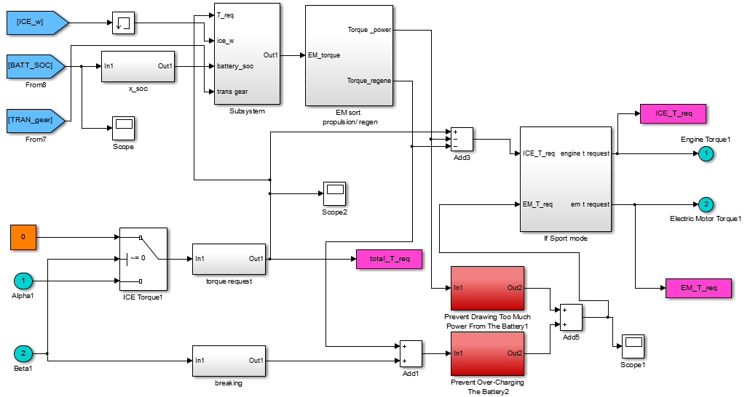
Control Strategy
Simulink Implement
Motor torque request
Lookup table
Sport mode for
(acceleration test)
Torque Split
Powering
Breaking

Slide 14
Results
Urban (UDDS) Cycle
MPG: 56.18
SOC

Slide 15
Results
Highway (HWFET) Cycle
MPG: 53.61
SOC

Slide 16
Results
Accelerating (0-60 MPH)
Time: 8.29s

Slide 17

Summary
Downsizing + EM Boosting
Specifications:
Engine specs
Max power | 64.7 kW @ 6000 RPM
Max Torque | 114.9 Nm @4400 RPM
Displacement | 1.3 L
Battery pack
Single battery capacity | 1729 Ah
Max power | 187 Kw
Battery cell weight | *105 kg
Number of cells | 247
*Note:
Weight factor 1.8
Motor specs
Max Hp | 143 kW
Max Torque | 400 Nm (0-357 rad/s)
Radius | 57.6 mm
Length | 392 mm
Vehicle weight
Curb wieght | 1720 kg
Battery | 105 kg
Driver | 75 kg
Total | 1900 kg
Testing Results:
Fuel economy test
Cycles | MPG
UDDS | 56.18
HWFET | 53.61
combined | 54.99
US06 | **25.34
Cycle4.87 miles | 49.53
Cycle10.6 miles | 42.85
Acceleration test
Top speed | 103 mph
0-60 MPH | 8.29 sec
0-20 | 2.32 sec
20-40 | 2.50 sec
30-50 | 2.94 sec
50-70 | 3.89 sec
1/4 mi time | 19 sec
1/4 mi exit spd | 92 mph
Goal:
Top speed >100 mph
0-60 mph: <9 sec
Goal:
Combined mpg
> 34.6
**Note: low mpg due to aggressive acceleration and deceleration in the cycle. Change exceeds the battery maximum capacity. Battery cannot recuperate all the energy in breaking.

Slide 18
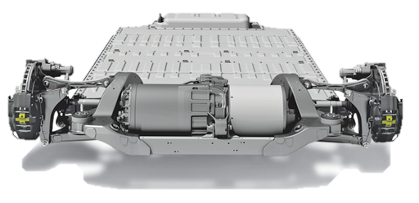
Thank you!
Questions?

