Slide 1


AI as a Study Buddy
The illiterate of the twenty-first century will not be those who cannot read and write, but those who cannot learn, unlearn, and relearn
- ALVIN TOFFLER (1970)
This lecture is a practical, research-backed approach to improving how you learn using modern AI tools. We will explore seven evidence-based study techniques that strengthen long-term retention and map each technique to concrete ways an AI assistant can help. By the end, you will be able to build your own AI-supported study routine, choose the right prompts for each technique, and use AI to diagnose what you know, what you don’t, and what to practice next.
Notes:
CISSP Study Material GitHub: https://github.com/jefferywmoore/CISSP-Study-Resources/blob/main/CISSP-Domain-1-2024%2BObjectives.md

Slide 2
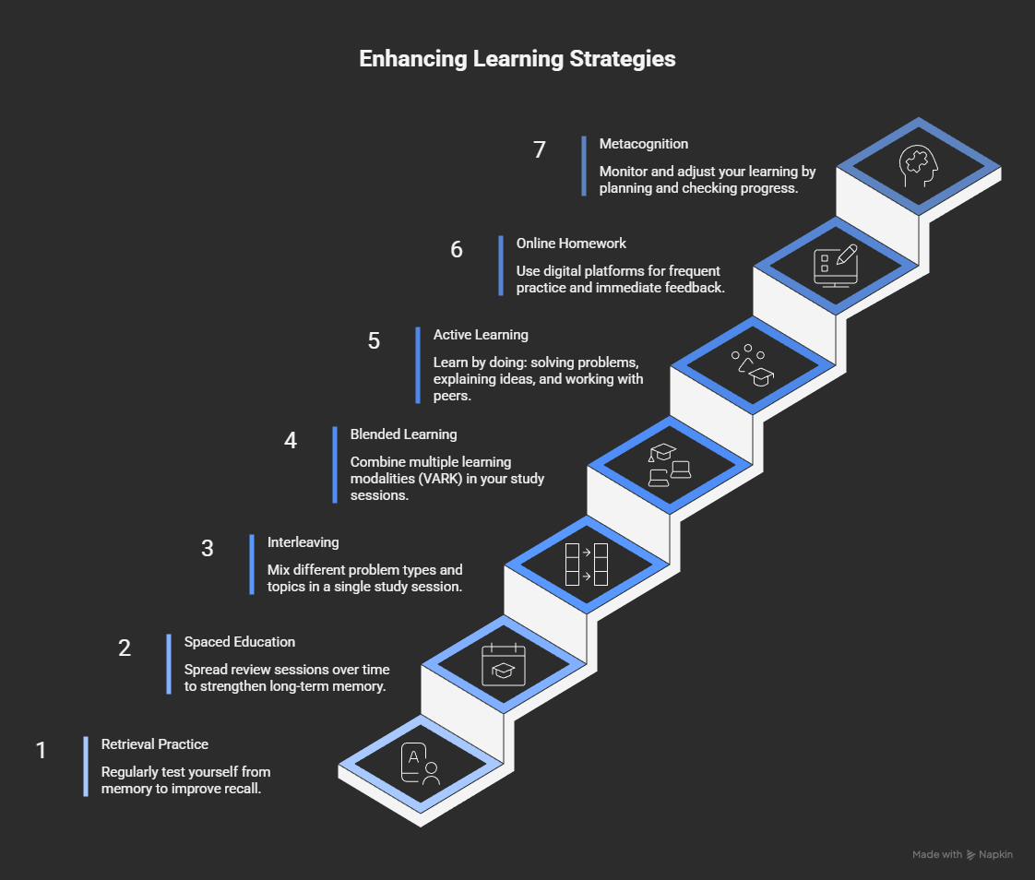
Notes:
The critical role of retrieval practice in long-term retention: https://www.cell.com/trends/cognitive-sciences/abstract/S1364-6613(10)00208-1
Spaced education improves the retention of clinical knowledge by medical students: a randomised controlled trial: https://medicine.wright.edu/sites/medicine.wright.edu/files/page/attachments/Kerfoot%20etal%20spaced%20education%20retention%20knowledge%20MedEduc2007.pdf
A systematic review of interleaving as a concept learning strategy: http://bera-journals.onlinelibrary.wiley.com/doi/full/10.1002/rev3.3266
Active Learning: https://www.researchgate.net/profile/Gertrude-Hewapathirana/publication/359045593_Active_Learning_Compared_With_Lecture-Based_Pedagogies_in_Gender_and_Socio-Cultural_Context-Specific_Major_and_Non-Major_Biology_Classes/links/632975d470cc936cd31fc1f1/Active-Learning-Compared-With-Lecture-Based-Pedagogies-in-Gender-and-Socio-Cultural-Context-Specific-Major-and-Non-Major-Biology-Classes.pdf
Online Homework Put to the Test: A Report on the Impact of Two Online Learning Systems on Student Performance in General Chemistry: https://pubs.acs.org/doi/full/10.1021/ed3006264?casa_token=sIEjz85EsysAAAAA%3AteACCrrsYyehg8UO6vRdfLQVbT3LEJ1_ZDNMvX0waOYL8zwT3jJ4jgPq2dyfv_uDpKMkYgFHJUvTc_U
Metacognition and learning: conceptual and methodological considerations :https://link.springer.com/article/10.1007/s11409-006-6893-0

Slide 3
Retrieval Practice
Regularly test yourself from memory (without looking) to make knowledge easier to recall and to reveal what you still don’t know.
Actively pulling information from memory strengthens long-term retention more than rereading.
LLM Prompt: I am studying for [SUBJECT]. I have uploaded my lecture notes. Act as my professor and ask me questions one at a time that might appear on a test. If I get the answer wrong cite where you found the correct answer in the lecture notes and explain to me what I got wrong.
NotebookLM - Flashcard, Quiz

Slide 4
Spaced Education
Re-study (ideally via retrieval, not rereading) in multiple short sessions separated by time gaps, which improves long-term retention versus “massed” study.
Research suggests a gap between study sessions increases as the final test gets farther away; in proportion terms:
Exam in 7 days: Study on Days 0, 1, 3, 6
LLM Prompt: I am studying for [SUBJECT] my test is in [# of days] days. I have uploaded my lecture notes. Create a spaced study plan including which topics I will study on each day.
Notes:
Spacing effects in learning: a temporal ridgeline of optimal retention: https://pubmed.ncbi.nlm.nih.gov/19076480/

Slide 5
Interleaving
Instead of doing 20 problems of the same type in a row (“blocked practice”), you mix problem types/topics so you must decide which strategy applies each time.
Interleaving improves learning partly by strengthening discrimination (recognizing what kind of problem it is) and linking each problem type to its correct strategy—skills that matter on real exams.
LLM Prompt: I am studying for [SUBJECT]. I have uploaded my lecture notes/problem sets. Create an interleaved practice session with 3–4 categories (label them). For each question: (1) ask me to identify the category and the strategy/formula I’ll use, (2) then let me solve it, (3) grade my answer. If I’m wrong, cite where the correct method is found in the notes and explain my mistake. Keep an error log by category and prioritize the categories I confuse most.

Slide 6
Blended Learning
Use multiple modalities (visuals + +audio + reading + audio + kinesthetic) because different representations and activities support understanding and transfer
ChatGPT - Conversations
NotebookLM - Audio, Video, Infographic
Napkin AI - Infographic
Gemini - Learning Coach

Slide 7
Active Learning
Learn by doing and explaining: solve problems, answer questions, and “teach back” concepts so you generate understanding instead of passively rereading or listening.
LLM Prompt: I am studying [SUBJECT] and I have uploaded my lecture notes. I’m going to explain [CONCEPT] out loud as if teaching a class. Ask me 1–2 Socratic questions after I have answered those ask me for a worked example and provide constructive feedback
ChatGPT - Conversations
Quizlet Q-Chat

Slide 8
Online Homework - Instant Feedback
Online/homework platforms can function as formative assessment when they provide frequent practice plus timely, actionable feedback (what’s wrong, why, and what to do next), which is strongly linked to improved learning.
LLM Prompt: I am studying [SUBJECT]. I will paste each homework question (and my attempt) one at a time. Act as an instant-feedback tutor:
tell me if my answer is correct,
if wrong, give minimal feedback first (one hint),
if I still miss it, give a worked solution and explain the specific misconception,
create 2 isomorphic practice problems (same skill, different surface details) and quiz me again.
Maintain an error log by skill and surface my weakest skills first in future practice.

Slide 9
Metacognition
Metacognition is “thinking about your thinking”
Planning, monitoring, and evaluating your learning so you can choose better strategies and study more efficiently
Planning and goal-setting (forethought) - Turn this syllabus/topic list into a study plan with spaced review and built-in retrieval checks.
Exam Wrapper - What topics did I lose points on and why (knowledge vs strategy vs time management)?
Error Correction - Ask me: ‘What did you think the question was asking?’ and ‘What rule did you apply?’ then correct me.
Metacognition Coach - Act as my metacognition coach. Ask me questions to help me better think about how I am studying, including how I plan, monitor, and evaluate my learning

