Slide 1

AI Image Generation Lab
The Analytical Engine has no pretensions whatever to originate anything. It can do whatever we know how to order it to perform
- ADA LOVELACE (1970)
This lecture explores how to generate AI image through a series of 4 lab assignments. First you are challenged to generate AI images from text alone. Next you are challenged to turn a sketch into a work of art. The next challenge is to edit a picture. The final challenge is to take what you have learned from the previous 3 challenges and create an infographic.

Slide 2
Task 1 - Create an Image for these Slides
Subject
Setting
Action
Composition
Camera/framing
Lighting
Mood
Style
Constraints

Slide 3
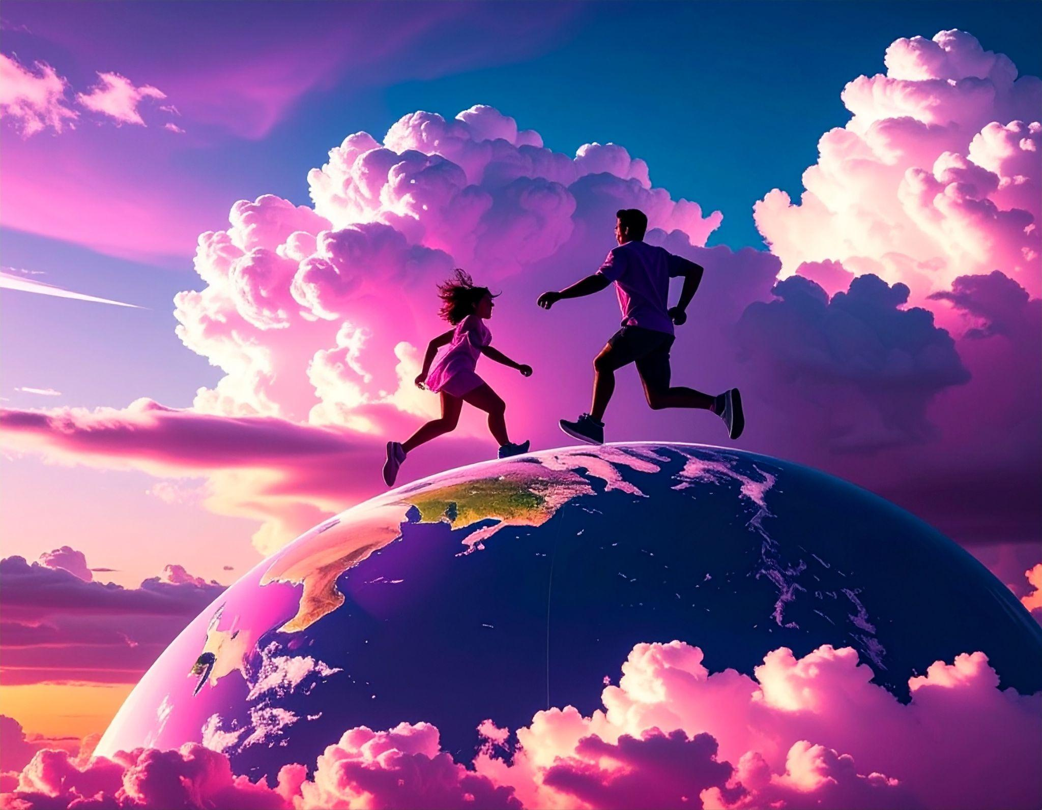
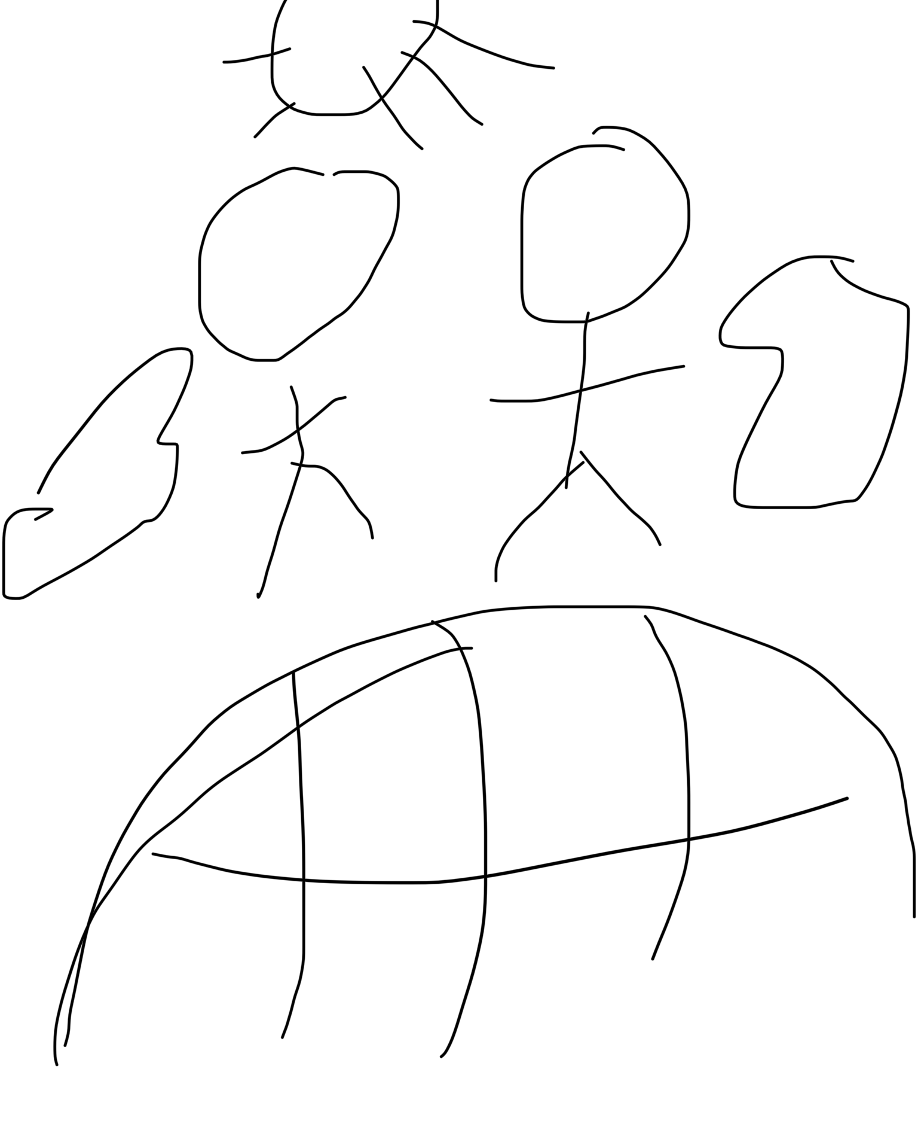
Task 2: Outline to Image

Slide 4
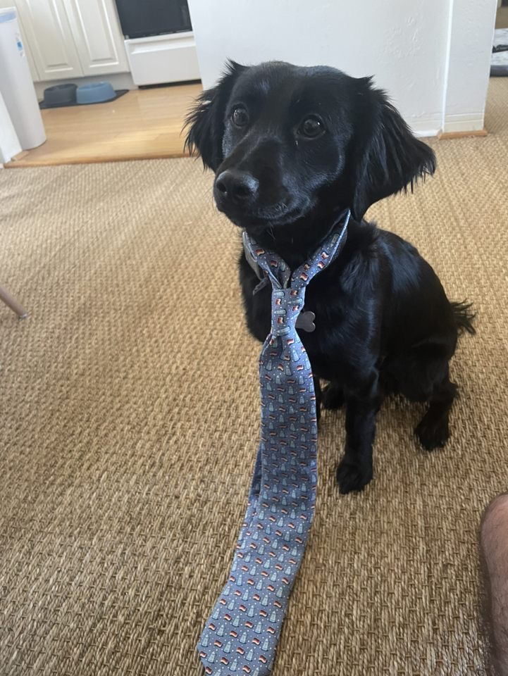
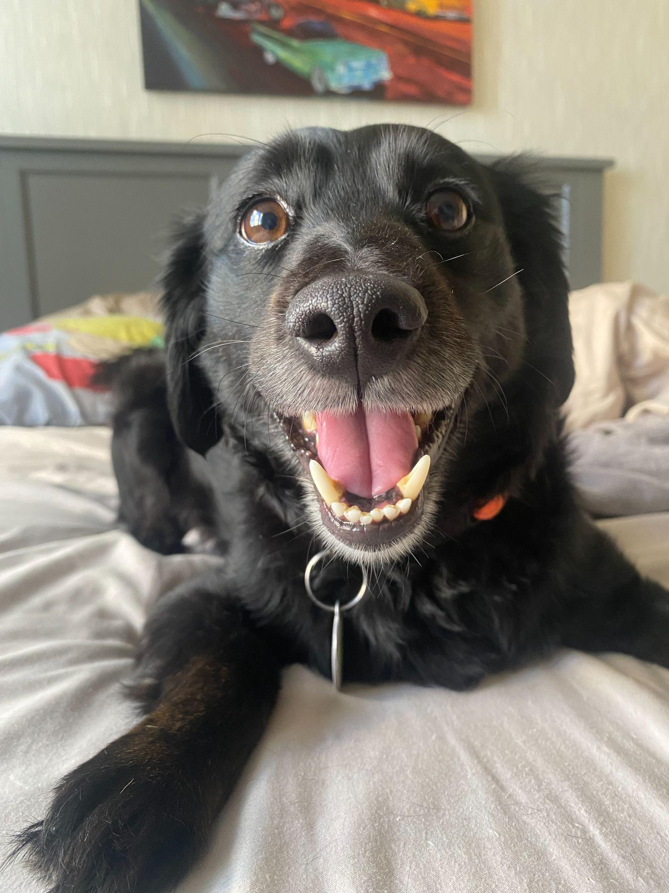
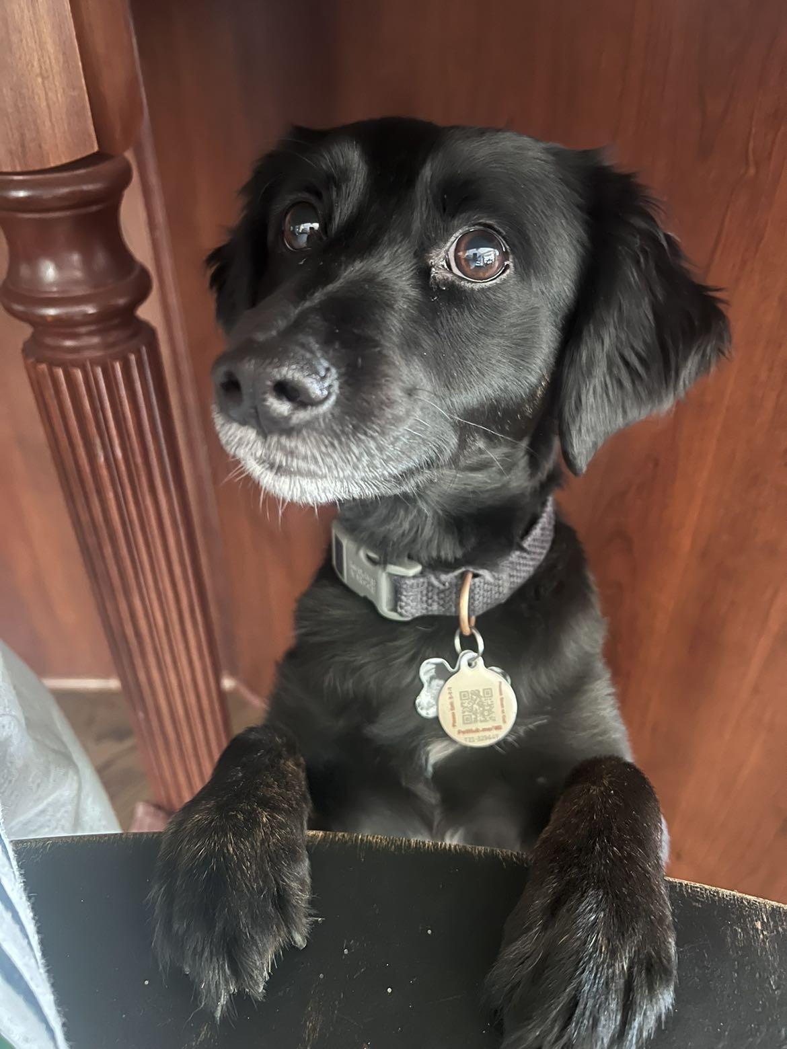
Task 3: Edit an Image

Slide 5
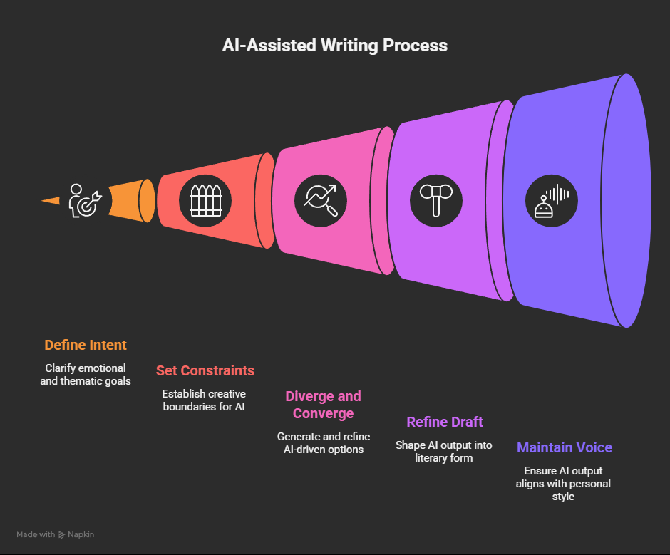
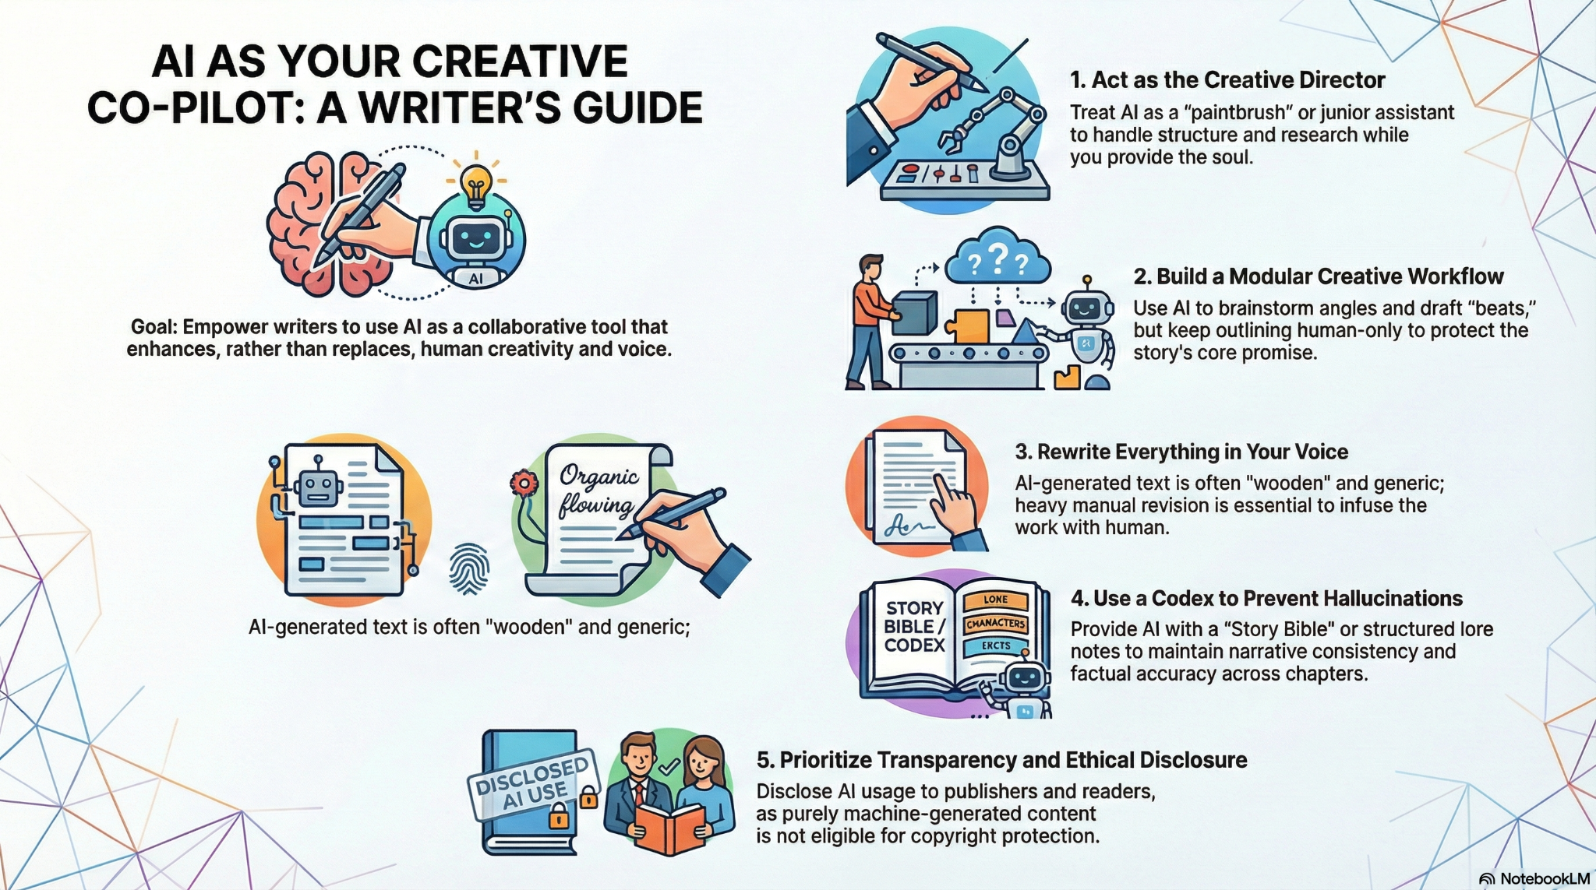
Task 4: Create an Infographic on “How to Create AI Images”

