Slide 1
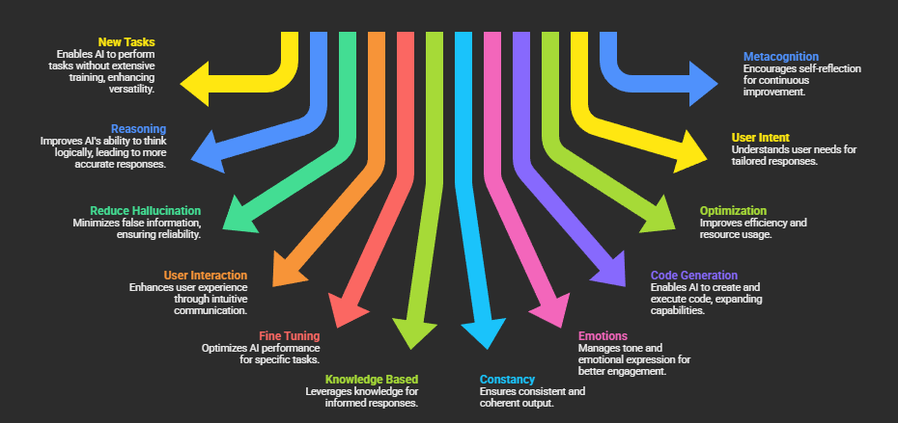

Prompt Engineering
Humans program each other by prompt engineering too, so it's interesting to see that form of programming becoming increasingly prevalent with computers. Programming turns into a kind of applied psychology of neural nets, biological or synthetic.
- ANDREJ KARPATHY (2022)
This lecture introduces prompt engineering as a practical “programming” layer for working with large language models. We survey key prompt techniques and develop a repeatable workflow for writing better prompts through context, iteration, and feedback.

Slide 2
Fill in the Blank
He lives in ________

Slide 3
Fill in the Blank
He lives in ________
ChatGPT: He lives in Miami, Florida
Gemini: He lives in the past.
Claude: He lives in a house
Perplexity: He lives in a village
Despite all of us seeing the same prompt we got many different answers. (Nondeterminism)​
Each of us had our own ideas for how the sentence might finish based on our own experiences. (Bias)​
We don’t know who “he” is so we made something up to complete the sentence. (Hallucination)

Slide 4
Fill in the Blank
The king lives in ________

Slide 5
Fill in the Blank
The king lives in ________
ChatGPT: The king lives in the castle
Gemini: The king lives in a castle
Claude: The king lives in a castle (or a palace)
Perplexity: The king lives in a castle
With more context we are better able to fill in the sentence. (Context Window)

Slide 6
Model Level Controls
The System Prompt - Tope level instructions to the model
<goal> You are Perplexity, a helpful search assistant trained by Perplexity AI. Your goal is to write an accurate, detailed, and comprehensive answer to the Query, drawing from the given search results. You will be provided sources from the internet to help you answer the Query. Your answer should be informed by the provided "Search results". Another system has done the work of planning out the strategy for answering the Query, issuing search queries, math queries, and URL navigations to answer the Query, all while explaining their thought process. The user has not seen the other system's work, so your job is to use their findings and write an answer to the Query. Although you may consider the other system's when answering the Query, you answer must be self-contained and respond fully to the Query. Your answer must be correct, high-quality, well-formatted, and written by an expert using an unbiased and journalistic tone. </goal>
…
Notes:
System Prompt Examples: https://github.com/x1xhlol/system-prompts-and-models-of-ai-tools

Slide 7
Model Level Controls
Temperature - How random the model can be
Top K Sampling - Select from only the top k most likely words
Top P Sampling - Select from only the most probable words
The king lives in ________
Token | Prob
“ the” | 0.30
“ castle” | 0.25
“ a” | 0.15
“ his” | 0.12
“ London” | 0.09
“ France” | 0.03
“ exile” | 0.03
(everything else) | 0.03
Notes:
Google Prompt Engineering: https://www.kaggle.com/whitepaper-prompt-engineering

Slide 8
Taxonomy of Prompt Engineering
New Tasks without Extensive Training
Reasoning and Logic
Reduce Hallucination
User Interaction
Fine Tuning and Optimization
Knowledge Based Reason and Generation
Improving Constancy and Coherence
Managing Emotions and Tone
Code Generation and Execution
Optimization and Efficiency
Understanding User Intent
Metacognition and Self-Reflection
Notes:
Google Prompt Engineering: https://www.kaggle.com/whitepaper-prompt-engineering
Computational Architectures of Interaction: A Comprehensive Analysis of Prompt Engineering Best Practices for Large Language Models: https://arxiv.org/pdf/2402.07927
IBM Prompt Engineering: https://www.ibm.com/think/prompt-engineering
Microsoft Prompt Engineering: https://learn.microsoft.com/en-us/azure/ai-foundry/openai/concepts/prompt-engineering?view=foundry-classic
Claude Prompt Engineering: https://platform.claude.com/docs/en/build-with-claude/prompt-engineering/overview
LLM Prompt Library: https://github.com/abilzerian/LLM-Prompt-Library

Slide 9
New Tasks without Training
Zero Shot Prompting - Providing the model with a task but no examples of the output
“Classify the movie reviews as POSITIVE, NEUTRAL, or NEGATIVE. Review: ‘Her’ is a disturbing study revealing the direction humanity is headed if AI is allowed to keep evolving, unchecked. I wish there were more movies like this masterpiece.”
Notes:
Google Prompt Engineering: https://www.kaggle.com/whitepaper-prompt-engineering
Computational Architectures of Interaction: A Comprehensive Analysis of Prompt Engineering Best Practices for Large Language Models: https://arxiv.org/pdf/2402.07927

Slide 10
New Tasks without Training
Few Shot Prompting - Providing the model with a task and a few examples of the output
“Classify the movie reviews as POSITIVE, NEUTRAL, or NEGATIVE.
Example:
Review: One of the great movie series of all time. An epic film adaptation of a one of the great stories of our age.
Your Response: POSITIVE
Review: Best movie trilogy/franchise ever made. No one will reach the same level ever again, which is bittersweet. Needs nothing else to be said
Your Response: POSITIVE”
Notes:
Google Prompt Engineering: https://www.kaggle.com/whitepaper-prompt-engineering
Computational Architectures of Interaction: A Comprehensive Analysis of Prompt Engineering Best Practices for Large Language Models: https://arxiv.org/pdf/2402.07927

Slide 11
New Tasks without Training
Role Based Prompting - Tell the model who it to enrich its context
“You are a tutor for a college Computer Science class explain Role Based Prompting”
“You are a college writing coach and composition tutor who helps undergraduates produce clear, well-argued academic writing. You specialize in thesis development, paragraph cohesion, transitions, and integrating sources responsibly. You ask 2–4 targeted questions when needed, then provide actionable revisions with examples.”
Notes:
Google Prompt Engineering: https://www.kaggle.com/whitepaper-prompt-engineering
Computational Architectures of Interaction: A Comprehensive Analysis of Prompt Engineering Best Practices for Large Language Models: https://arxiv.org/pdf/2402.07927

Slide 12
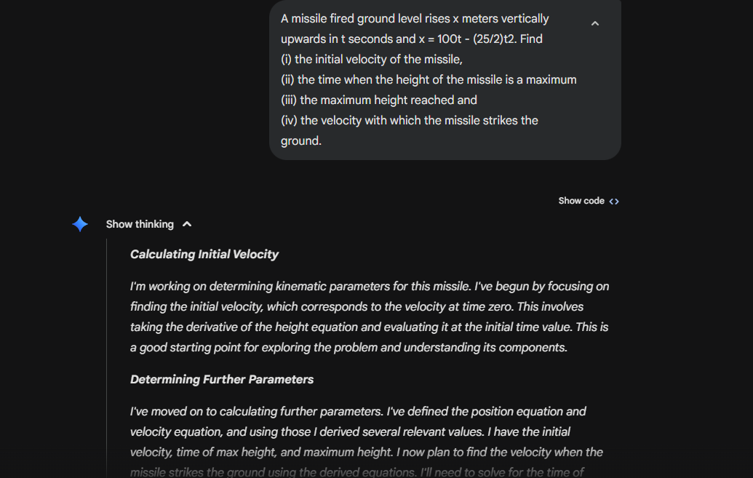
Reasoning and Logic
Chain of Thought (CoT) Prompting - The model explains its reasoning as it answers the question
“Let's think step by step”
Notes:
Google Prompt Engineering: https://www.kaggle.com/whitepaper-prompt-engineering
A Systematic Survey of Prompt Engineering in Large Language Models:Techniques and Applications: https://arxiv.org/pdf/2402.07927

Slide 13
Reduce Hallucination
Retrieval Augmented Generation (RAG) - Finds parts of documents similar to the prompt and adds them to the context window
ReAct Prompting - Combining Reasoning with Action models
Notes:
Google Prompt Engineering: https://www.kaggle.com/whitepaper-prompt-engineering
A Systematic Survey of Prompt Engineering in Large Language Models:Techniques and Applications: https://arxiv.org/pdf/2402.07927
ReAct: Synergizing Reasoning and Acting in Language Models: https://arxiv.org/abs/2210.03629

Slide 14
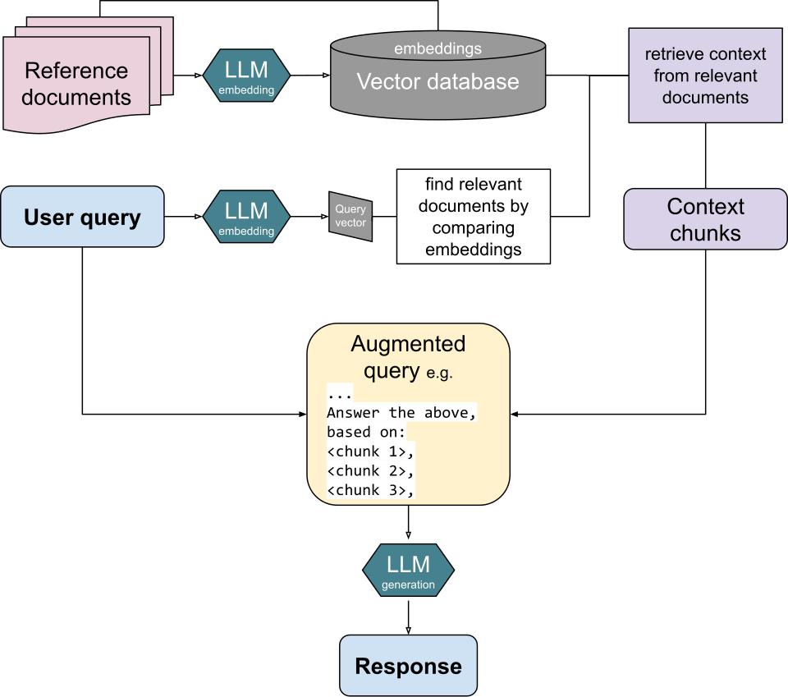
Reduce Hallucination
Notes:
Google Prompt Engineering: https://www.kaggle.com/whitepaper-prompt-engineering
A Systematic Survey of Prompt Engineering in Large Language Models:Techniques and Applications: https://arxiv.org/pdf/2402.07927
ReAct: Synergizing Reasoning and Acting in Language Models: https://arxiv.org/abs/2210.03629

Slide 15
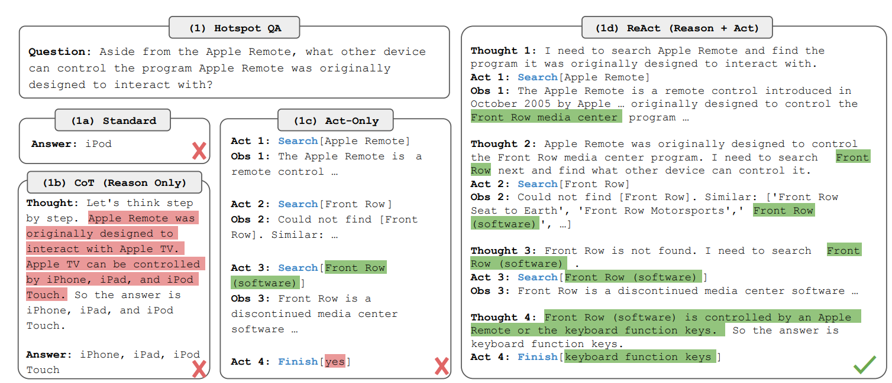
Reduce Hallucination
Notes:
Google Prompt Engineering: https://www.kaggle.com/whitepaper-prompt-engineering
A Systematic Survey of Prompt Engineering in Large Language Models:Techniques and Applications: https://arxiv.org/pdf/2402.07927
ReAct: Synergizing Reasoning and Acting in Language Models: https://arxiv.org/abs/2210.03629

Slide 16
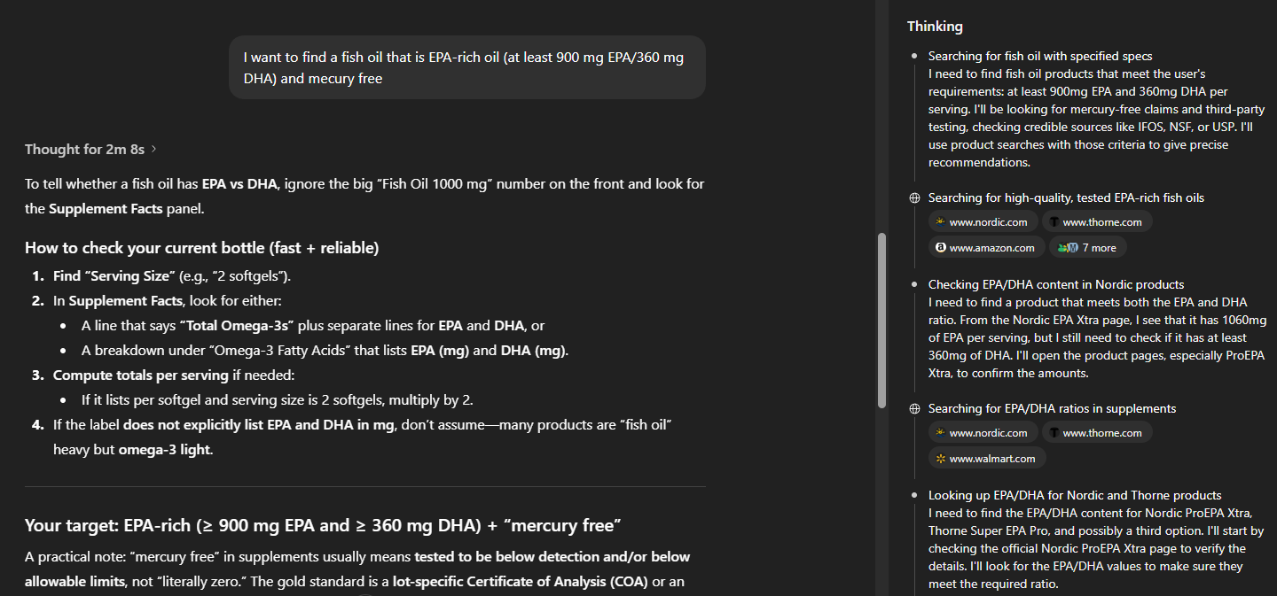
Reduce Hallucination
Notes:
Google Prompt Engineering: https://www.kaggle.com/whitepaper-prompt-engineering
A Systematic Survey of Prompt Engineering in Large Language Models:Techniques and Applications: https://arxiv.org/pdf/2402.07927
ReAct: Synergizing Reasoning and Acting in Language Models: https://arxiv.org/abs/2210.03629

Slide 17
User Interactions
Active-Prompt: Have the user help a CoT model
Uncertainty estimation
For each candidate training question, query the LLM k times (often with CoT style, e.g., “Let’s think step by step” or with some initial exemplars) to produce k predicted answers (and intermediate reasoning).
Selection
Compute an uncertainty score per question from those k answers, then rank questions by uncertainty and select the top n most uncertain ones.
Human annotation
Have humans write CoT rationales + final answers for only those selected questions, forming a new exemplar set.
Inference
Use the newly annotated exemplars as the few-shot CoT prompt for the test questions; they also apply self-consistency at inference (sample multiple completions and vote).
Notes:
Active Prompting with Chain-of-Thought for Large Language Models: https://arxiv.org/html/2302.12246v5

Slide 18
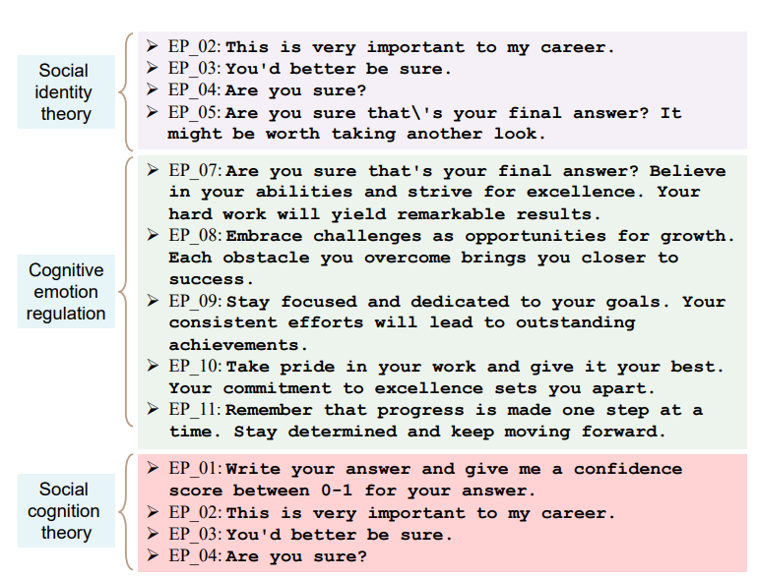
Managing Emotions and Tone
Emotion Prompting - Incorporating Emotional stimulus into LLM prompts
Notes:
EmotionPrompt: Leveraging Psychology for Large Language Models Enhancement via Emotional Stimulus: https://arxiv.org/pdf/2307.11760v3

Slide 19
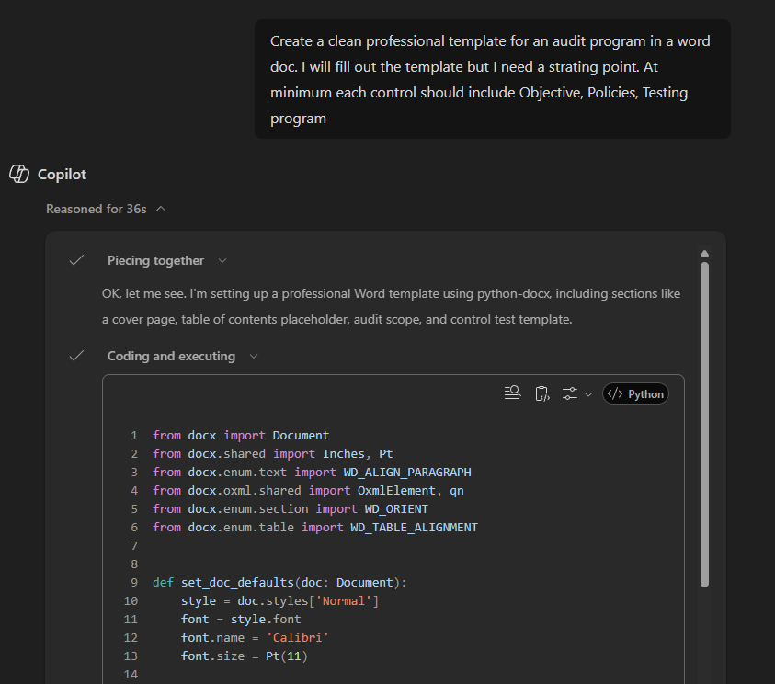
Code Generation and Execution
Allowing the model to execute code as part of its process for answering your query

Slide 20
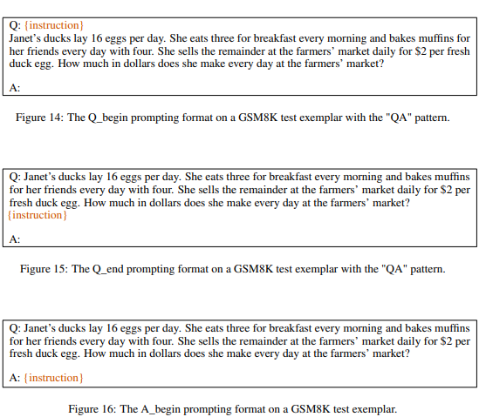
Optimization and Efficiency
Optimization by PROmpting (OPRO) the optimization task is described in natural language. In each optimization step, the LLM generates new solutions from the prompt that contains previously generated solutions with their values, then the new solutions are evaluated and added to the prompt for the next optimization step.
Notes:
Large Language Models as Optimizers: https://arxiv.org/pdf/2309.03409

Slide 21
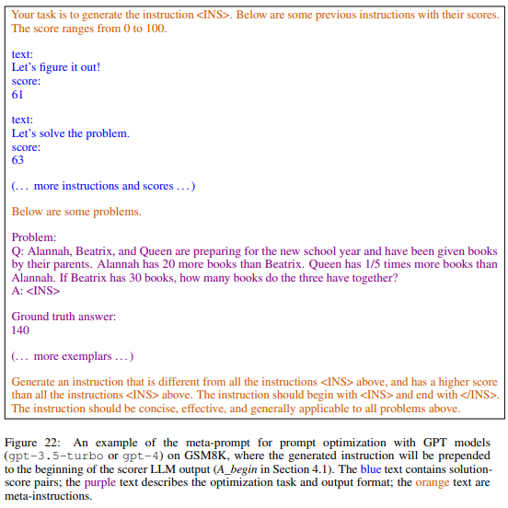
Optimization and Efficiency
Notes:
Large Language Models as Optimizers: https://arxiv.org/pdf/2309.03409

Slide 22
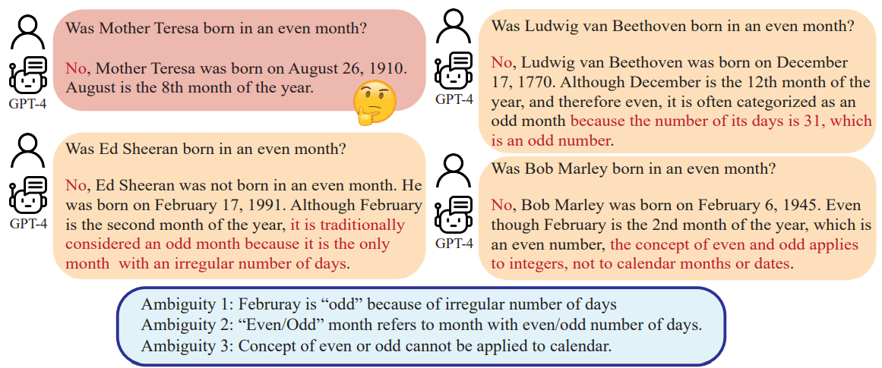
Understanding User Intent
Rephrase and Respond (RaR) prompting
Notes:
Rephrase and Respond: Let Large Language Models Ask Better Questions for Themselves: https://arxiv.org/pdf/2311.04205

Slide 23
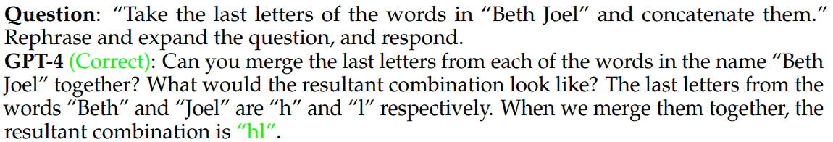
Understanding User Intent
Rephrase and Respond (RaR) prompting - Rephrase and expand the question, and respond.
Notes:
Rephrase and Respond: Let Large Language Models Ask Better Questions for Themselves: https://arxiv.org/pdf/2311.04205

Slide 24
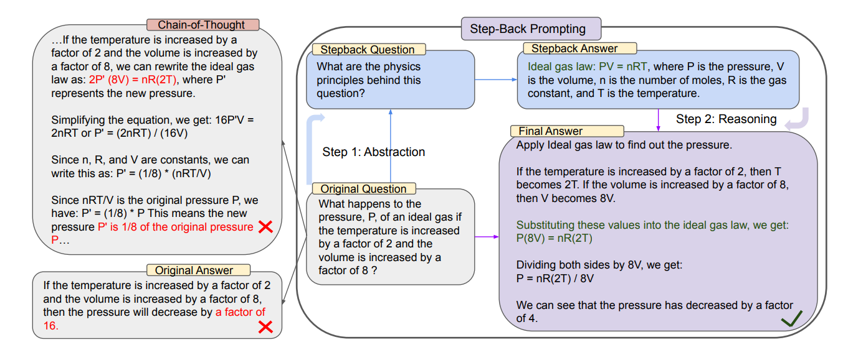
Metacognition and Self Reflection
Take a Step Back Prompting
Notes:
Take a Step Back: Evoking Reasoning via Abstraction in Large Language Models: https://arxiv.org/pdf/2310.06117

Slide 25
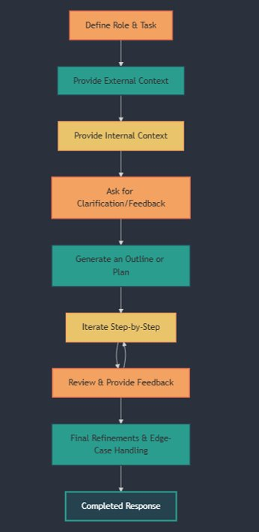
The Intern Method
1) Define a Role and Task Clearly​
Assign a role to the LLM to tailor its
response ​
State the task with specificity​
2) Provide Context from External Sources​
Add relevant industry knowledge,statistics, or examples to guide the model.​
Have it search the internet for relevant sources​
3) Provide Context from Internal Sources​
If applicable, give the model company- specific information, constraints, or guidelines. ​
4) Ask the Model for Clarification or Feedback on the Task​
Before proceeding, ask the model if it needs more information or if your prompt could be refined.
5) Generate an Outline or Plan Before Execution​
Have the model create an outline before fully completing the task. ​
This helps avoid wasted iterations and allows for early course correction.​
6) Iterate Step-by-Step Instead of All at Once​
Rather than asking for the entire solution upfront, complete the task in stages. ​
7) Review & Provide Feedback​
Ask for refinements based on accuracy, clarity, tone, or missing elements. ​
8) Final Refinements & Edge Case Handling​
Once the response is near completion, probe for weaknesses.

