Slide 1
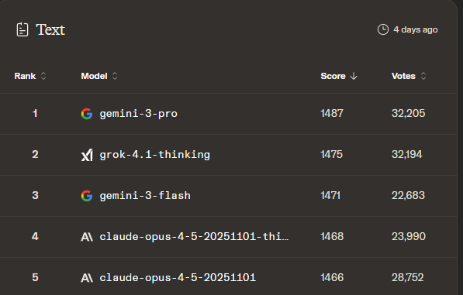

Evaluating Large Language Models
When you can measure what you are speaking about, and express it in numbers, you know something about it
- LORD KELVIN (1883)
This lecture introduces a practical framework for evaluating Large Language Models (LLMs) by combining qualitative judgment with quantitative benchmarks. Students will learn how to compare models using standardized tests. By the end, you will be able to independently research, compare, and critically evaluate LLMs for different use cases.

Slide 2











Why do we Measure

Slide 3
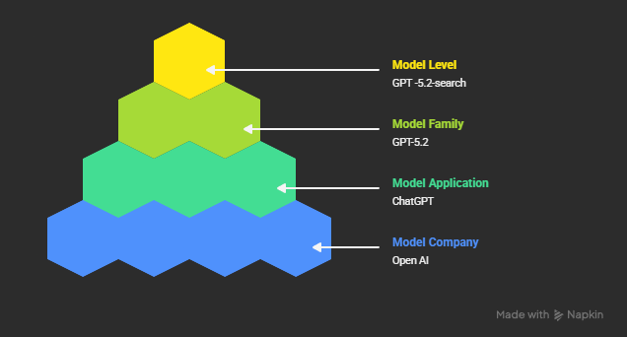
Hierarchy of a Large Language Model
OpenAI - Company that builds and operates the models and products
ChatGPT - End-user app that lets you talk to models with a UI and built-in features
GPT-5.2 - GPT-5.2 is a model family; a particular generation/version of OpenAI’s GPT models
GPT-5.2 Search- A specific model within the GPT-5.2 model framework

Slide 4
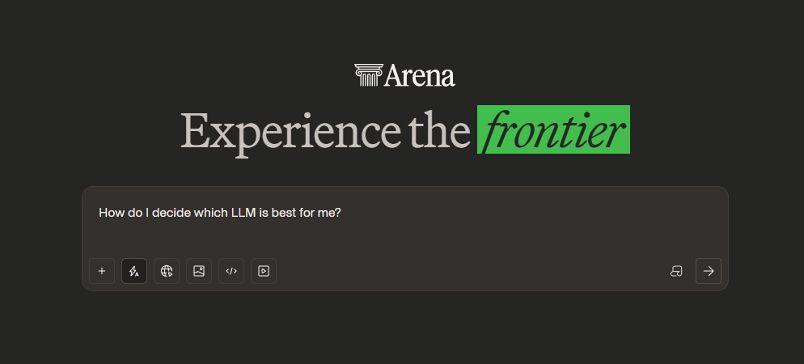
Qualitative Performance
Notes:
LLM Arena: https://arena.ai/

Slide 5
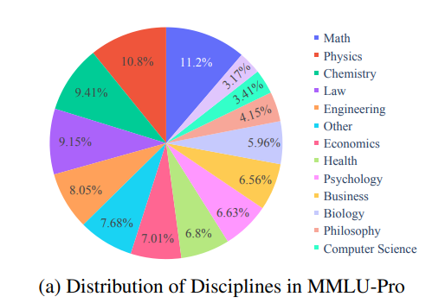
Quantitative Performance
Massive Multitask Language Understanding Pro (MMLU Pro)
8051 multiple choice questions
Gemini 3 Pro: 90.10%
GPT4o 72.6%
Notes:
Awesome AI Benchmarks and Evaluations: https://github.com/awesomelistsio/awesome-ai-benchmarks-evaluation
MMLU-Pro: A More Robust and Challenging Multi-Task Language Understanding Benchmark: https://arxiv.org/abs/2406.01574
MMLU-Pro Github: https://github.com/TIGER-AI-Lab/MMLU-Pro
MMLU-Pro Dataset: https://huggingface.co/datasets/TIGER-Lab/MMLU-Pro
Vals.ai MMLU Pro : https://www.vals.ai/benchmarks/mmlu_pro

Slide 6
Quantitative Performance
Graduate Level Google Proof Question and Answer (GPQA)
448 multiple choice questions
Expert Humans: 72.5%
Non Expert Humans: 34%
Gemini 3 Pro: 30.5%
GPT4 with search - 41.0%
Gemini 3 pro & GPT5.2 91.67%
Notes:
Awesome AI Benchmarks and Evaluations: https://github.com/awesomelistsio/awesome-ai-benchmarks-evaluation
GPQA A Graduate-Level Google-Proof Q&A Benchmark: https://arxiv.org/abs/2311.12022
GPQA Dataset: https://huggingface.co/datasets/Idavidrein/gpqa
vals.ai GPQA: https://www.vals.ai/benchmarks/gpqa

Slide 7
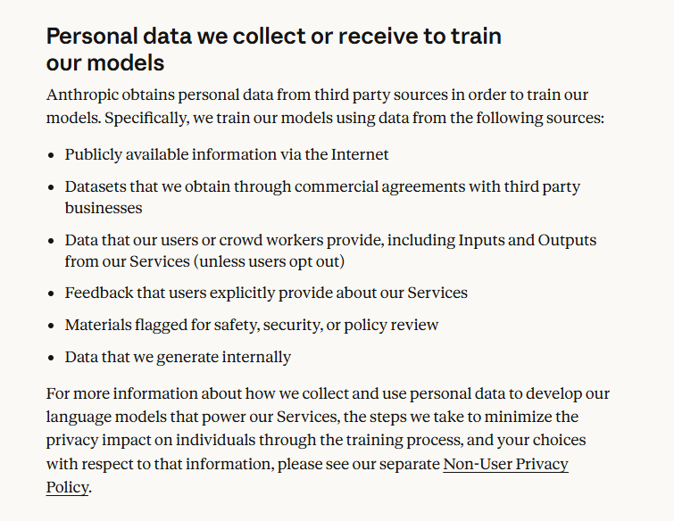
Security, Privacy, Compliance
Where is the company based?
Where does my data live?
What can the company do with my data?
What standards does the company comply with?

Slide 8
Cost for Model
ChatGPT Pro- $20 per month
Google Gemini AI Pro - $20 per month
Claude Pro - $17 per month
Grok SuperGrok - $30 per month
Kimi K2 Moderato - $19 per month
Qwen Chat - Free
Deepseek Chat - Free
Notes:
ChatGPT Pricing: https://chatgpt.com/pricing
Gemini Pricing: https://gemini.google/subscriptions/
Claude Pricing:https://claude.com/pricing
Grok Pricing: https://grok.com/plans
Kimi Pricing: https://kimik2ai.com/pricing/

Slide 9
Cost of using the Model
 | Energy | Water | Carbon | Dollars
Human | 0.85 kWh | 5.68L | 800 grams | $12.08
Llamma3 | 0.0195 kWh | 70.5 ml | 7.6 grams | $0.08
Gemma | 0.00024 kWh | 1.69 ml | 0.18 gram | $0.01
Notes:
Reconciling the contrasting narratives on the environmental impact of large language models: https://www.nature.com/articles/s41598-024-76682-6
HuggingFace Energy Score: https://huggingface.co/spaces/AIEnergyScore/Leaderboard

Slide 10
Cost of training the model
GPT3 Parameters - 175 Billion
GPT3 Energy - 1,287,000 kWh ~120 US homes for 1 year
GPT3 Water- 700,000 liters ~¼ of an olympic swimming pool
GPT3 Carbon - 514,800 kg ~112 years of cars
Notes:
Energy and Policy Considerations for Deep Learning in NLP: https://arxiv.org/abs/1906.02243
Making AI Less Thirsty: https://dl.acm.org/doi/full/10.1145/3724499
The growing energy footprint of artificial intelligence: https://www.cell.com/joule/fulltext/S2542-4351(23)00365-3

Slide 11
Intangibles
Company Reputation
Company ESG and Ethical Posture
Transparency and Openness
Governance and Accountability
Product Stability and Direction
Research and Safety Culture
Notes:
Energy and Policy Considerations for Deep Learning in NLP: https://arxiv.org/abs/1906.02243
Making AI Less Thirsty: https://dl.acm.org/doi/full/10.1145/3724499
The growing energy footprint of artificial intelligence: https://www.cell.com/joule/fulltext/S2542-4351(23)00365-3

