Slide 1
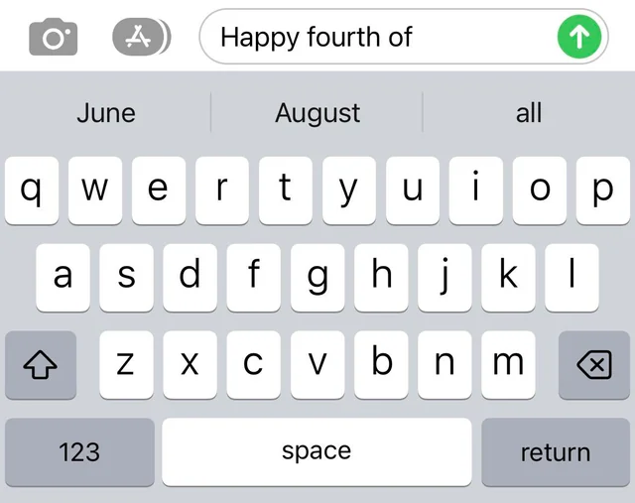

The Large Language Model
ChatGPT and similar programs are, by design, unlimited in what they can “learn” (which is to say, memorize); they are incapable of distinguishing the possible from the impossible.
- NOAM CHOMPSKY (2023)
This lecture explores the foundational concepts behind large language models. We will examine how text is transformed into tokens, how those tokens are represented as embeddings, and how a model uses a context window to reason over sequences of language.

Slide 2
Fill in the Blank Game
Based on everything that was said before you guess what the next word in the story might be
Once upon a time …

Slide 3

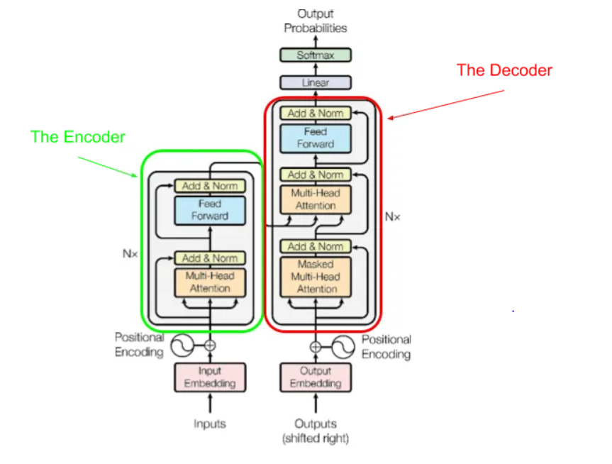
The Transformer – Late 2010’s
“Neural Machine Translation by Jointly Learning to Align and Translate” (2014)
The Attention Mechanism focuses on important parts of the input
“Attention is All You Need” (2017)
The transformer allows for parallel attention
Titan Transformer (2025)
Notes:
2014: https://arxiv.org/abs/1409.0473
2017 Attention is all you Need: https://arxiv.org/abs/1706.03762
2018 BERT: https://arxiv.org/abs/1810.04805
2020 VIT: https://arxiv.org/abs/2010.11929

Slide 4





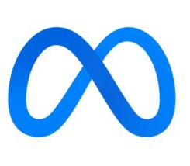

The Large Language Model – 2020’s
A Large Language Model (LLM) is a type of AI trained on huge amounts of text to generate and understand human-like language.
It learns to predict the next word in a sentence, enabling it to answer questions, write stories, translate, and more
GPT-1 (2018)
GPT-2 (2019)
GPT-3 (2020)
GPT-3.5 (2022)
ChatGPT, Copilot, Gemini, Grok, Claude, Llama, Deepseek

Slide 5
What is a Large Language Model
Number of Parameters
  GPT-3: 175B (2020)
  LLAMA4: 400B (2025)
  Gemini Nano: 3.25B (2023)
  DeepSeekR1: 671B (2025)
  Grok: 314B (2023)
Training Size
  GPT-3: 300B Tokens
  LLAMA4: 40T Tokens
  Claude: 400B Tokens
Notes:
https://claude.ai/public/artifacts/0ecdfb83-807b-4481-8456-8605d48a356c
https://en.wikipedia.org/wiki/List_of_large_language_models

Slide 6
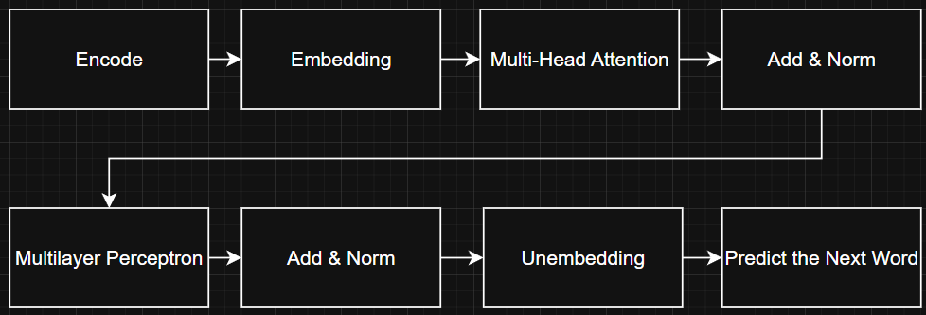
GPT3

Slide 7
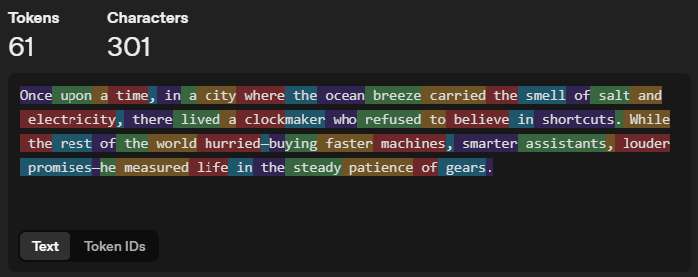
Tokens
Notes:
https://platform.openai.com/tokenizer
https://emaggiori.com/chatgpt-all-tokens/

Slide 8
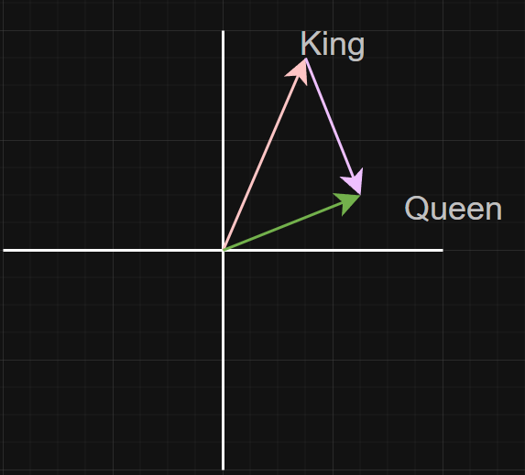
Embedding
Notes:
https://projector.tensorflow.org/
https://dugas.ch/artificial_curiosity/GPT_architecture.html

Slide 9
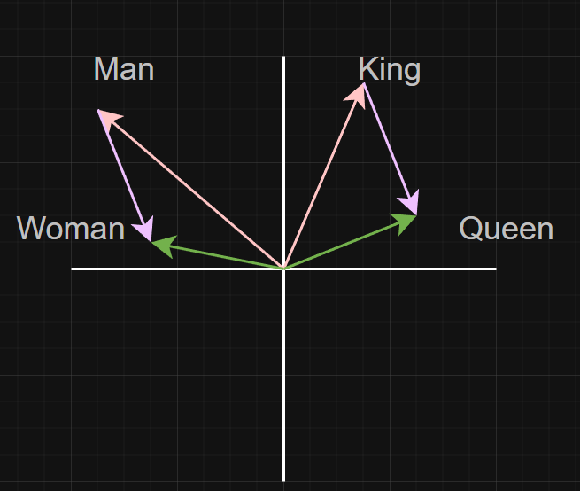
Embedding

Slide 10
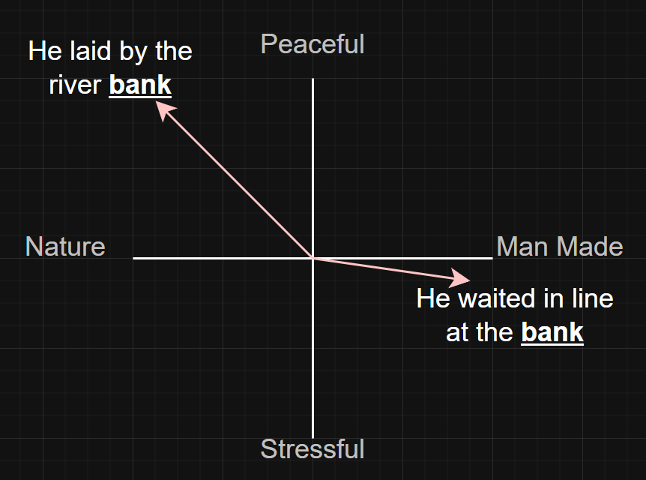
Embedding

Slide 11
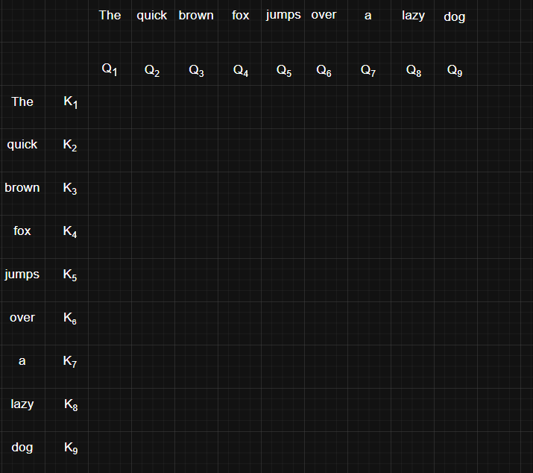
Multi Head Attention
The quick brown fox jumps over the lazy dog

Slide 12
GPT3

