Slide 1
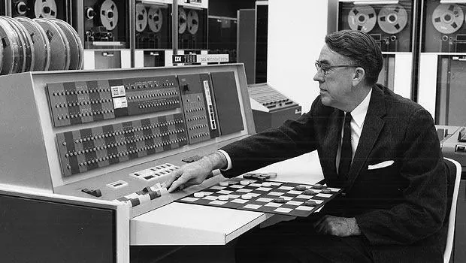

On the Origin of Perceptrons
A computer can be programmed so that it will learn to play a better game of checkers than can be played by the person who wrote the program … given only … a redundant and incomplete list of parameters … whose correct signs and relative weights are unknown and unspecified.
- ARTHUR L. SAMUEL (1959)
This lecture explores the core principles of how machines learn, delving into the mechanics of perceptrons and neural networks, and witnessing their application in recognizing handwritten digits
Notes:
On the Origin of Species: https://en.wikipedia.org/wiki/On_the_Origin_of_Species

Slide 2
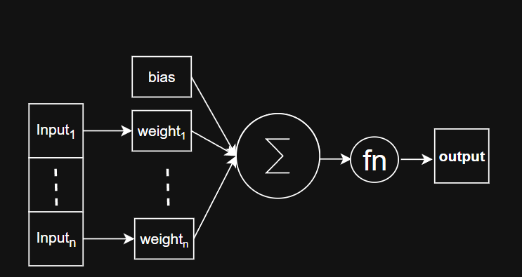
The Perceptron

Slide 3
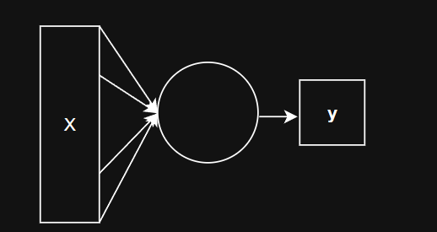
The Perceptron

Slide 4
The Perceptron - Logical AND
 | A is TRUE | A is FALSE
B is TRUE | TRUE | FALSE
B is FALSE | FALSE | FALSE

Slide 5
The Perceptron - Logical AND
 | A is 1 | A is 0
B is 1 | 1 | 0
B is 0 | 0 | 0

Slide 6
The Perceptron - Logical AND
A | B | A AND B
1 | 1 | 1
1 | 0 | 0
0 | 0 | 0
0 | 0 | 0

Slide 7
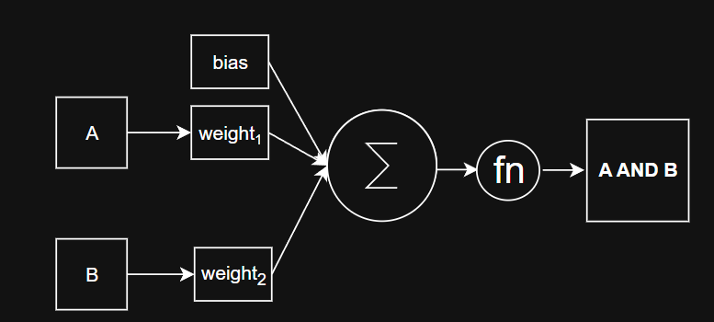
The Perceptron - Logical AND

Slide 8
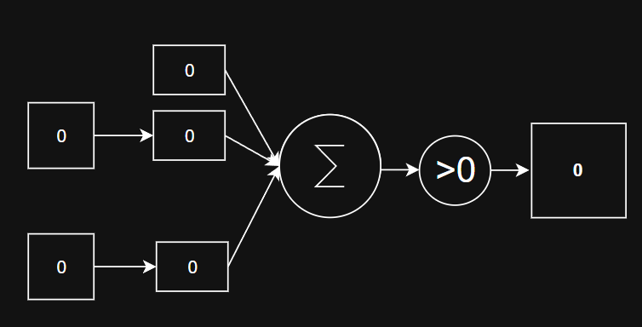
The Perceptron - Logical AND

Slide 9
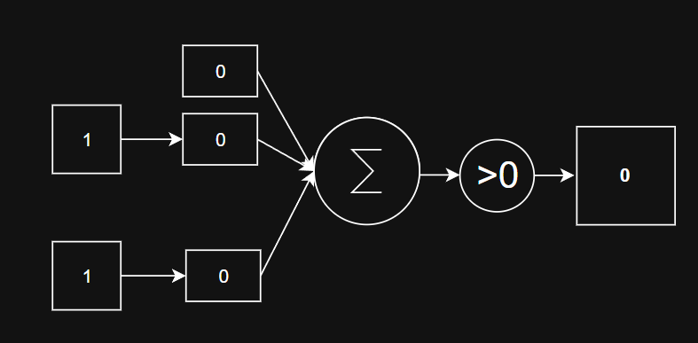
The Perceptron - Logical AND

Slide 10
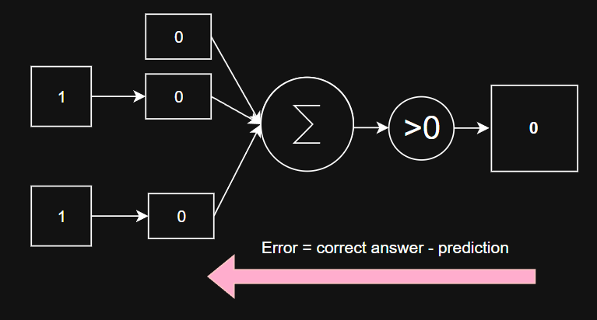
The Perceptron - Logical AND

Slide 11
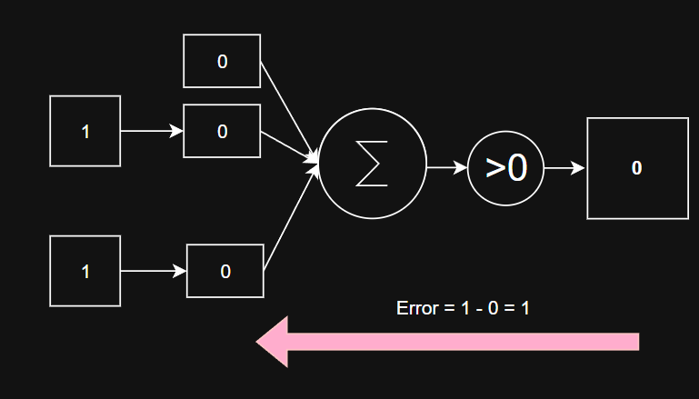
The Perceptron - Logical AND

Slide 12
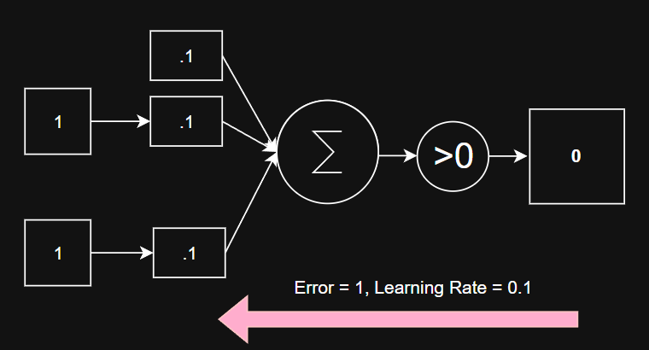
The Perceptron - Logical AND

Slide 13
The Perceptron - Logical AND
Notes:
Epoch 1
Inputs: [0, 0], Predicted: 0, Actual: 0, Error: 0
Updated weights: [0.0, 0.0, 0.0]
Inputs: [0, 1], Predicted: 0, Actual: 0, Error: 0
Updated weights: [0.0, 0.0, 0.0]
Inputs: [1, 0], Predicted: 0, Actual: 0, Error: 0
Updated weights: [0.0, 0.0, 0.0]
Inputs: [1, 1], Predicted: 0, Actual: 1, Error: 1
Updated weights: [0.1, 0.1, 0.1]
Epoch 1 — Total Error: 1
Epoch 2
Inputs: [0, 0], Predicted: 1, Actual: 0, Error: -1
Updated weights: [0.0, 0.1, 0.1]
Inputs: [0, 1], Predicted: 1, Actual: 0, Error: -1
Updated weights: [-0.1, 0.1, 0.0]
Inputs: [1, 0], Predicted: 0, Actual: 0, Error: 0
Updated weights: [-0.1, 0.1, 0.0]
Inputs: [1, 1], Predicted: 0, Actual: 1, Error: 1
Updated weights: [0.0, 0.2, 0.1]
Epoch 2 — Total Error: 3
Epoch 3
Inputs: [0, 0], Predicted: 0, Actual: 0, Error: 0
Updated weights: [0.0, 0.2, 0.1]
Inputs: [0, 1], Predicted: 1, Actual: 0, Error: -1
Updated weights: [-0.1, 0.2, 0.0]
Inputs: [1, 0], Predicted: 1, Actual: 0, Error: -1
Updated weights: [-0.2, 0.1, 0.0]
Inputs: [1, 1], Predicted: 0, Actual: 1, Error: 1
Updated weights: [-0.1, 0.2, 0.1]
Epoch 3 — Total Error: 3
Epoch 4
Inputs: [0, 0], Predicted: 0, Actual: 0, Error: 0
Updated weights: [-0.1, 0.2, 0.1]
Inputs: [0, 1], Predicted: 0, Actual: 0, Error: 0
Updated weights: [-0.1, 0.2, 0.1]
Inputs: [1, 0], Predicted: 1, Actual: 0, Error: -1
Updated weights: [-0.2, 0.1, 0.1]
Inputs: [1, 1], Predicted: 0, Actual: 1, Error: 1
Updated weights: [-0.1, 0.2, 0.2]
Epoch 4 — Total Error: 2
Epoch 5
Inputs: [0, 0], Predicted: 0, Actual: 0, Error: 0
Updated weights: [-0.1, 0.2, 0.2]
Inputs: [0, 1], Predicted: 1, Actual: 0, Error: -1
Updated weights: [-0.2, 0.2, 0.1]
Inputs: [1, 0], Predicted: 0, Actual: 0, Error: 0
Updated weights: [-0.2, 0.2, 0.1]
Inputs: [1, 1], Predicted: 1, Actual: 1, Error: 0
Updated weights: [-0.2, 0.2, 0.1]
Epoch 5 — Total Error: 1
Epoch 6
Inputs: [0, 0], Predicted: 0, Actual: 0, Error: 0
Updated weights: [-0.2, 0.2, 0.1]
Inputs: [0, 1], Predicted: 0, Actual: 0, Error: 0
Updated weights: [-0.2, 0.2, 0.1]
Inputs: [1, 0], Predicted: 0, Actual: 0, Error: 0
Updated weights: [-0.2, 0.2, 0.1]
Inputs: [1, 1], Predicted: 1, Actual: 1, Error: 0
Updated weights: [-0.2, 0.2, 0.1]
Epoch 6 — Total Error: 0
Final predictions:
[0, 0] -> 0
[0, 1] -> 0
[1, 0] -> 0
[1, 1] -> 1
Final weights: [-0.2, 0.2, 0.1]

Slide 14
Things we choose

Slide 15
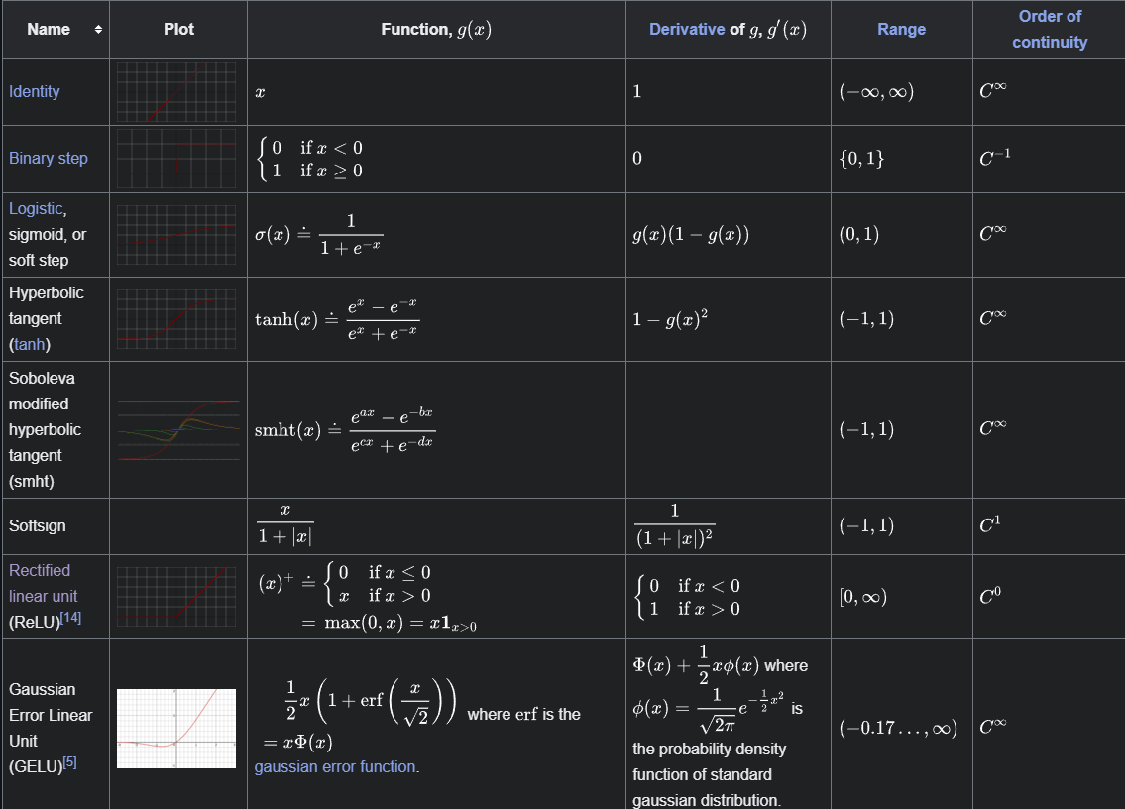
Activation Function
Notes:
https://en.wikipedia.org/wiki/Activation_function

Slide 16
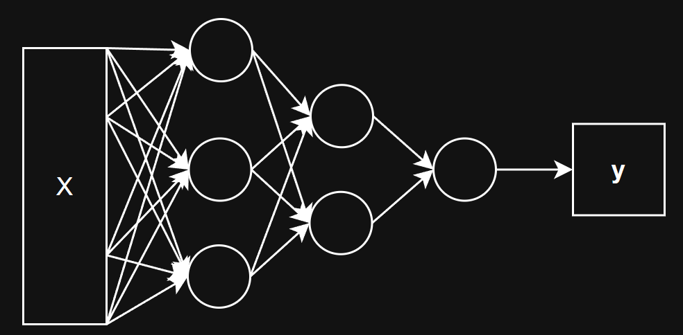
The Multilayer Perceptron (MLP)

Slide 17
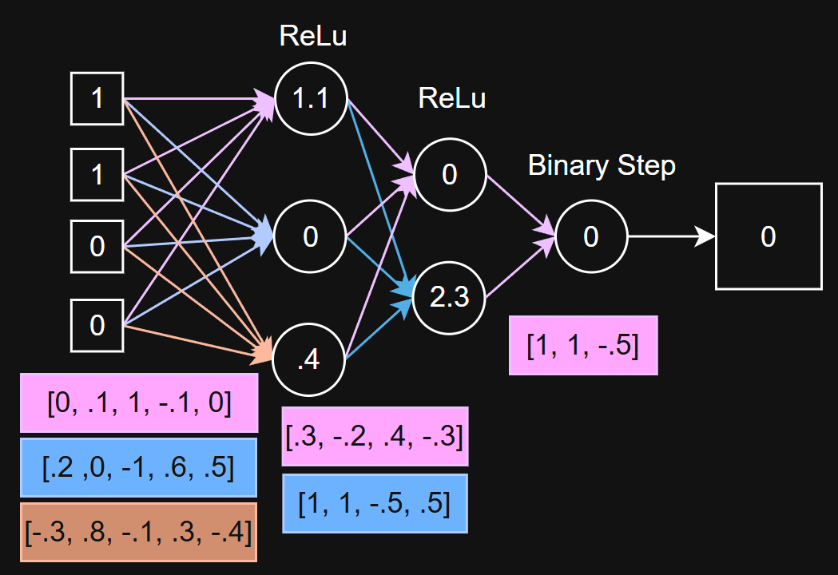
MLP Example - Feed Forward

Slide 18
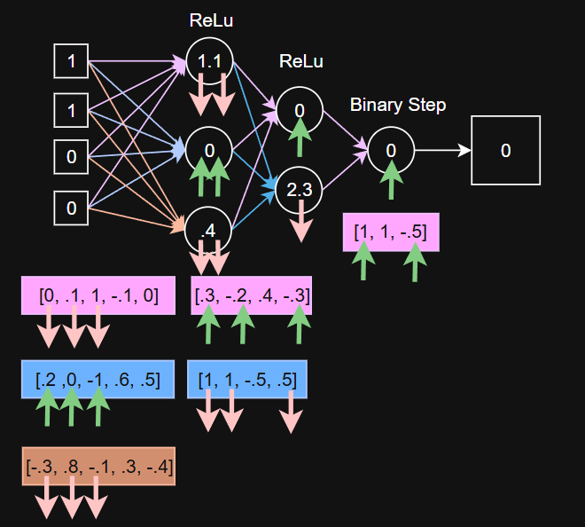
MLP Example - Back Propagation

Slide 19
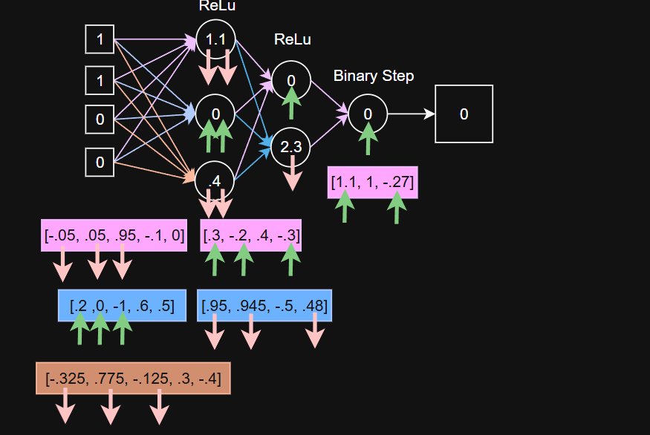
MLP Example - Back Propagation

Slide 20
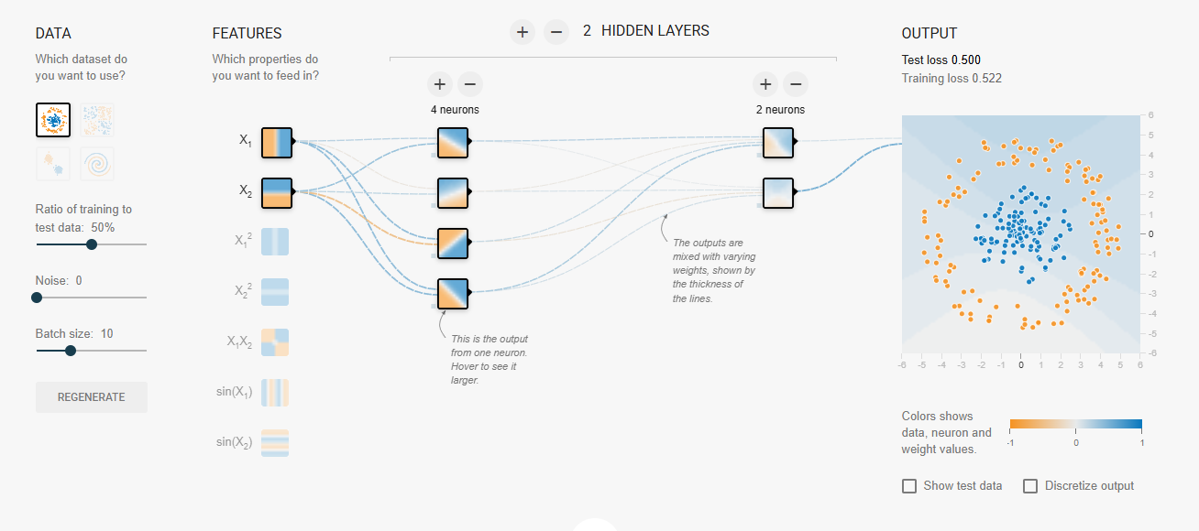
TensorFlow Playground
Notes:
https://playground.tensorflow.org/#activation=tanh&batchSize=10&dataset=circle&regDataset=reg-plane&learningRate=0.03&regularizationRate=0&noise=0&networkShape=4,2&seed=0.55196&showTestData=false&discretize=false&percTrainData=50&x=true&y=true&xTimesY=false&xSquared=false&ySquared=false&cosX=false&sinX=false&cosY=false&sinY=false&collectStats=false&problem=classification&initZero=false&hideText=false

Slide 21
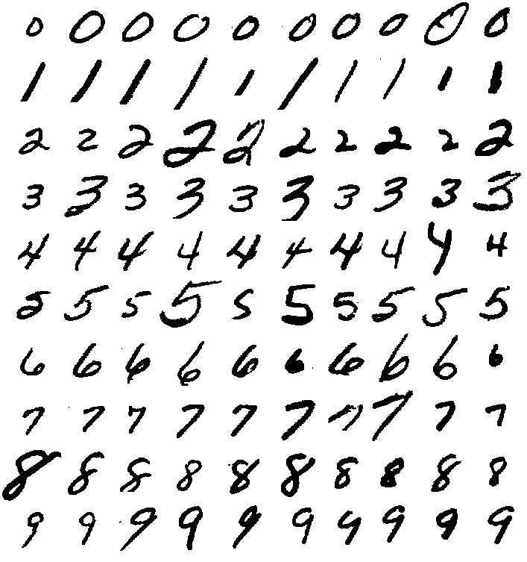
The Expression of the Digits in Machines
The problem of recognizing hand-written digits is of enormous practical and theoretical interest … This is a topic where "neural net" techniques are expected to be relevant, since the task requires closely mimicking human performance
- AT&T BELL LABS (1988)
This lecture focuses on practical application, guiding you through the digit recognition code so you can train and test the model with your very own handwriting.
Notes:
The Expression of the Emotions in Man and Animals: https://en.wikipedia.org/wiki/The_Expression_of_the_Emotions_in_Man_and_Animals

Slide 22
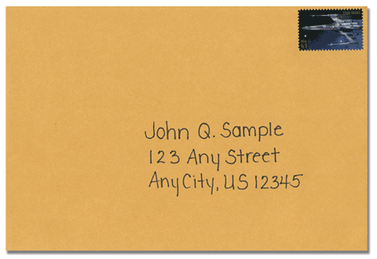
The Problem
You are the US Postal Service
You receive millions of hand addressed envelope each day
You have a human read the address on each letter and send it to the correct place. This is time consuming and expensive.
You want to have an automated system that can read the addresses and sort the mail into the correct bin

Slide 23
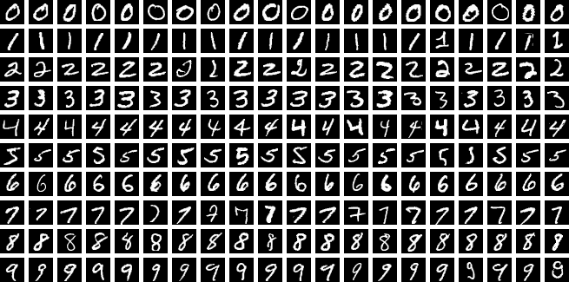
The Solution
You collect nearly 10,000 samples of handwritten digits, digitize them, and label them
You then train a Convolutional Neural Network to classify handwritten digits

Slide 24


Step 1: Handwriting to Digital Sample

Slide 25

Step 1: Handwriting to Digital Sample

Slide 26
Step 2: Digital Sample to List of Numbers
0,
0, 0, 0, …
….
…255, 255, 255, …
….
0, 0, 0

Slide 27
Step 3: Split the X and Y
X (input)
Y (output)
0,
0, 0, 0, …
….
…255, 255, 255, …
….
0, 0, 0
0, 0, 0, …
….
…255, 255, 255, …
….
0, 0, 0
0

Slide 28
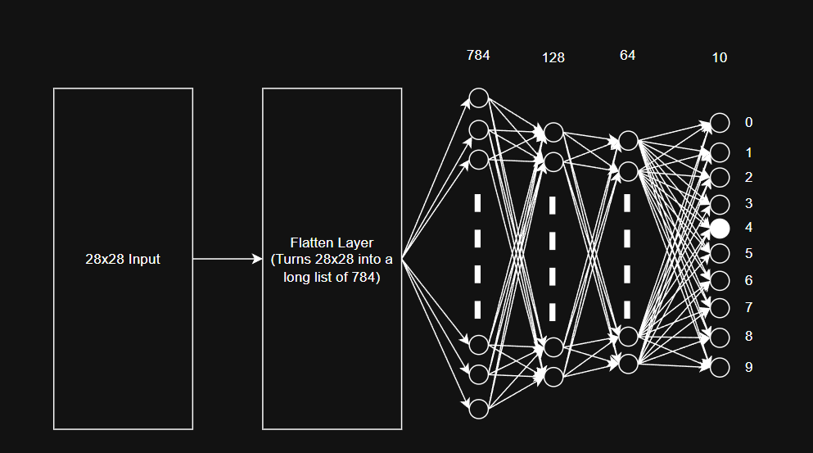
Step 4: Train the Model - Forward Pass

Slide 29
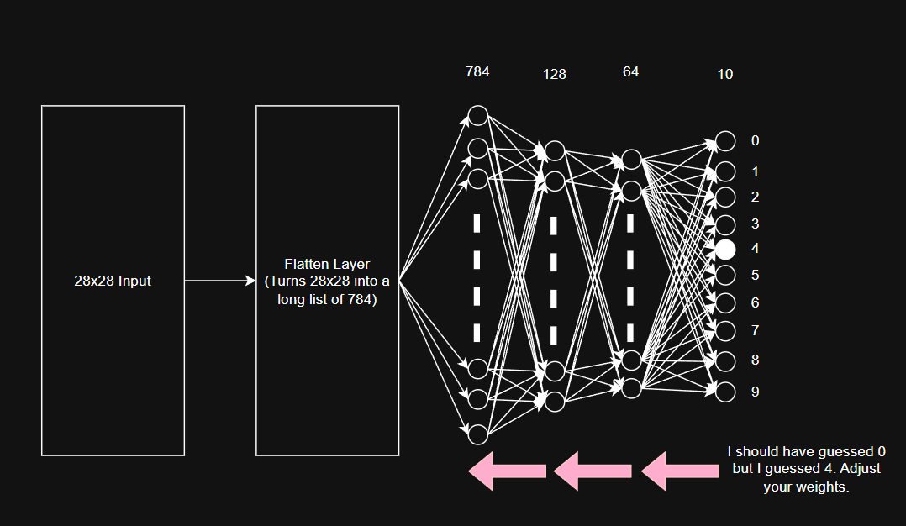
Step 5: Train the Model - Backpropagation

Slide 30
Step 6: Repeat Steps 4 & 5 for 1000’s of examples

Slide 31
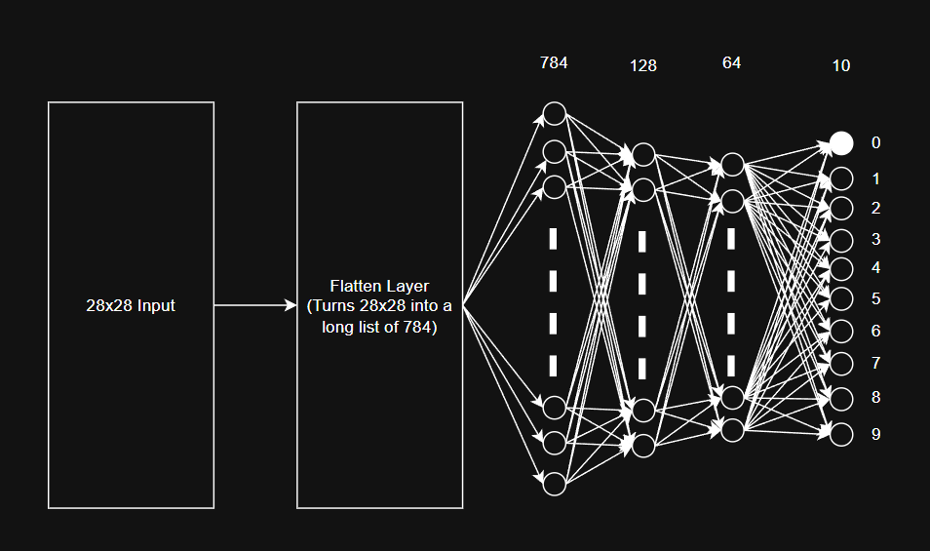
Step 7: Test your model

Slide 32
Let's Build our First AI!
Notes:
https://colab.research.google.com/drive/1mcGhSiEXrl_oUuF85GqW1pjmwXVsk08G?usp=sharing

