Slide 1
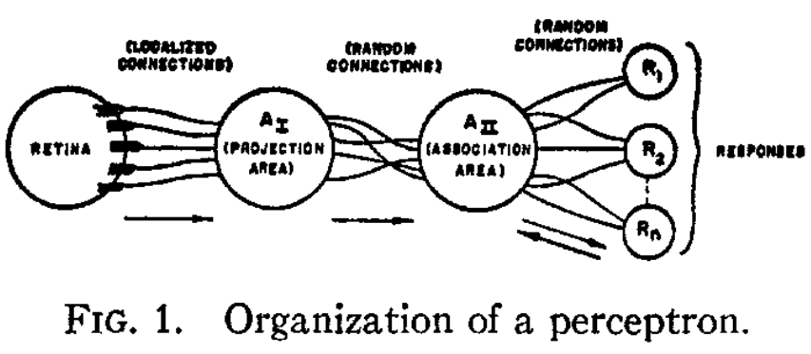

On the Origin of Perceptrons
If we are eventually to understand the capability of higher organisms for perceptual recognition, generalization, recall, and thinking, we must first have answers to three fundamental questions: (1) how is information about the physical world sensed, or detected, by the biological system; (2) in what form is information stored, or remembered; and (3) how does information contained in storage, or in memory, influence recognition and behavior?
- FRANK ROSENBLATT (1957)
This lecture explores the core principles of the perceptron. We will understand the basic structure of the perceptron and cover a simple example to understand how machines learn.
Notes:
On the Origin of Species: https://en.wikipedia.org/wiki/On_the_Origin_of_Species

Slide 2
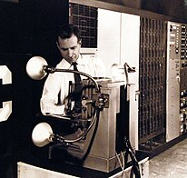
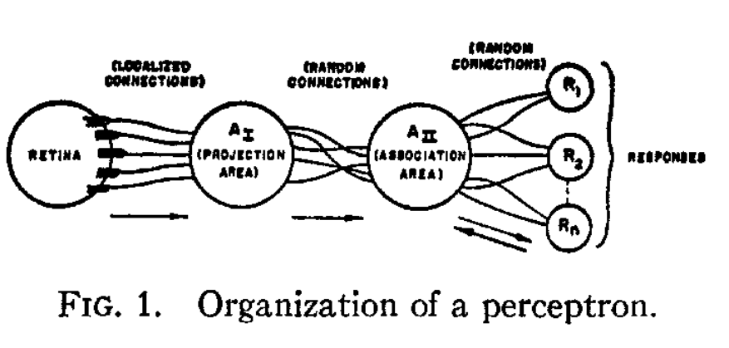
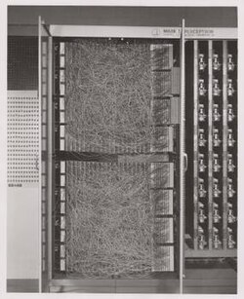
Rosenblatt and The Perceptron – 1957
Based on work by McCulloch and Pitts “Artificial Neuron”
Three Components:
  Sensory units - receive optical input
  Association units - fire based on input from the sensory units
  Response units- fire based on input from association units

Slide 3
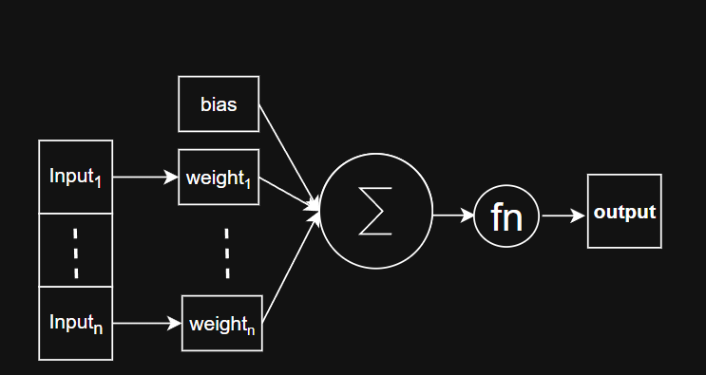
The Perceptron
Weights & Bias
Input
Activation Function
Output Layer

Slide 4
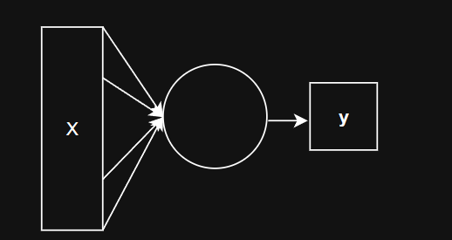
The Perceptron
Input
Weights & Bias
Output Layer
Activation Function

Slide 5
The Perceptron - Logical AND
 | A is TRUE | A is FALSE
B is TRUE | TRUE | FALSE
B is FALSE | FALSE | FALSE

Slide 6
The Perceptron - Logical AND
 | A is 1 | A is 0
B is 1 | 1 | 0
B is 0 | 0 | 0

Slide 7
The Perceptron - Logical AND
A | B | A AND B
1 | 1 | 1
1 | 0 | 0
0 | 0 | 0
0 | 0 | 0

Slide 8
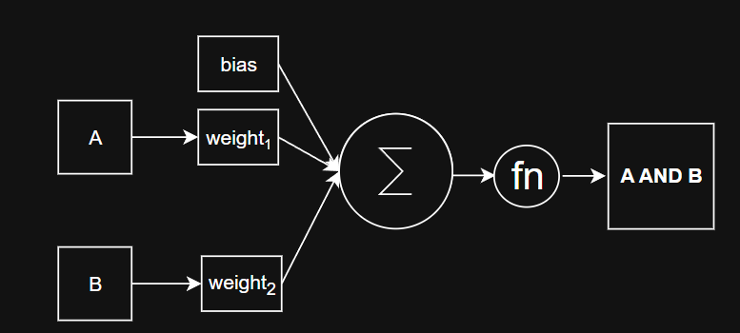
The Perceptron - Logical AND

Slide 9
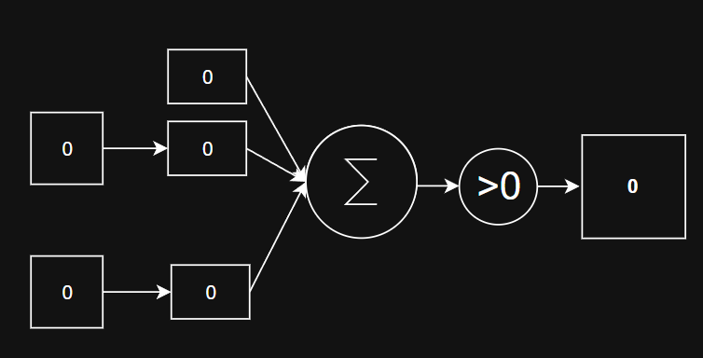
The Perceptron - Logical AND

Slide 10
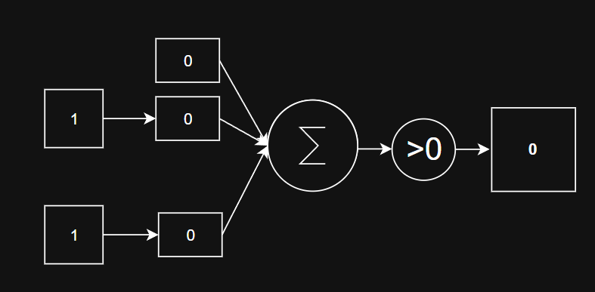
The Perceptron - Logical AND

Slide 11
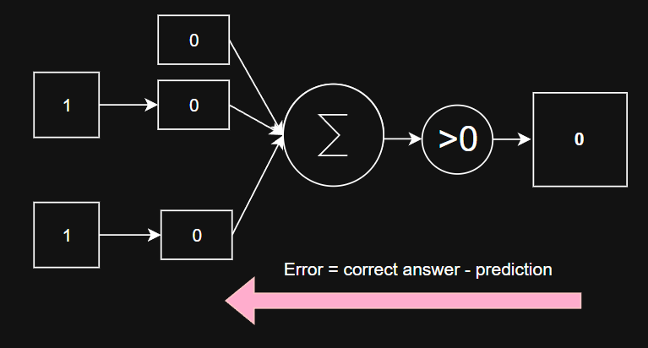
The Perceptron - Logical AND

Slide 12
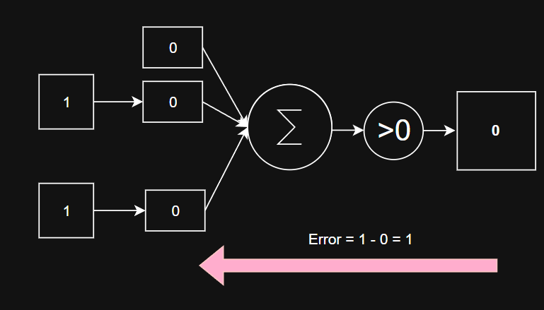
The Perceptron - Logical AND

Slide 13
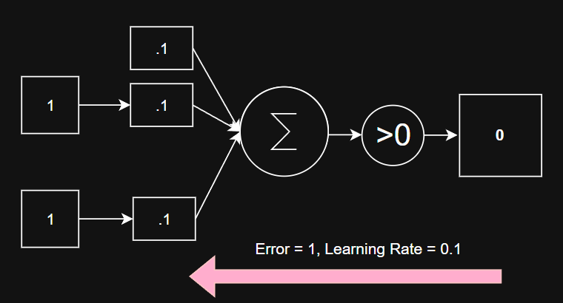
The Perceptron - Logical AND

Slide 14
The Perceptron - Logical AND
Notes:
Epoch 1
Inputs: [0, 0], Predicted: 0, Actual: 0, Error: 0
Updated weights: [0.0, 0.0, 0.0]
Inputs: [0, 1], Predicted: 0, Actual: 0, Error: 0
Updated weights: [0.0, 0.0, 0.0]
Inputs: [1, 0], Predicted: 0, Actual: 0, Error: 0
Updated weights: [0.0, 0.0, 0.0]
Inputs: [1, 1], Predicted: 0, Actual: 1, Error: 1
Updated weights: [0.1, 0.1, 0.1]
Epoch 1 — Total Error: 1
Epoch 2
Inputs: [0, 0], Predicted: 1, Actual: 0, Error: -1
Updated weights: [0.0, 0.1, 0.1]
Inputs: [0, 1], Predicted: 1, Actual: 0, Error: -1
Updated weights: [-0.1, 0.1, 0.0]
Inputs: [1, 0], Predicted: 0, Actual: 0, Error: 0
Updated weights: [-0.1, 0.1, 0.0]
Inputs: [1, 1], Predicted: 0, Actual: 1, Error: 1
Updated weights: [0.0, 0.2, 0.1]
Epoch 2 — Total Error: 3
Epoch 3
Inputs: [0, 0], Predicted: 0, Actual: 0, Error: 0
Updated weights: [0.0, 0.2, 0.1]
Inputs: [0, 1], Predicted: 1, Actual: 0, Error: -1
Updated weights: [-0.1, 0.2, 0.0]
Inputs: [1, 0], Predicted: 1, Actual: 0, Error: -1
Updated weights: [-0.2, 0.1, 0.0]
Inputs: [1, 1], Predicted: 0, Actual: 1, Error: 1
Updated weights: [-0.1, 0.2, 0.1]
Epoch 3 — Total Error: 3
Epoch 4
Inputs: [0, 0], Predicted: 0, Actual: 0, Error: 0
Updated weights: [-0.1, 0.2, 0.1]
Inputs: [0, 1], Predicted: 0, Actual: 0, Error: 0
Updated weights: [-0.1, 0.2, 0.1]
Inputs: [1, 0], Predicted: 1, Actual: 0, Error: -1
Updated weights: [-0.2, 0.1, 0.1]
Inputs: [1, 1], Predicted: 0, Actual: 1, Error: 1
Updated weights: [-0.1, 0.2, 0.2]
Epoch 4 — Total Error: 2
Epoch 5
Inputs: [0, 0], Predicted: 0, Actual: 0, Error: 0
Updated weights: [-0.1, 0.2, 0.2]
Inputs: [0, 1], Predicted: 1, Actual: 0, Error: -1
Updated weights: [-0.2, 0.2, 0.1]
Inputs: [1, 0], Predicted: 0, Actual: 0, Error: 0
Updated weights: [-0.2, 0.2, 0.1]
Inputs: [1, 1], Predicted: 1, Actual: 1, Error: 0
Updated weights: [-0.2, 0.2, 0.1]
Epoch 5 — Total Error: 1
Epoch 6
Inputs: [0, 0], Predicted: 0, Actual: 0, Error: 0
Updated weights: [-0.2, 0.2, 0.1]
Inputs: [0, 1], Predicted: 0, Actual: 0, Error: 0
Updated weights: [-0.2, 0.2, 0.1]
Inputs: [1, 0], Predicted: 0, Actual: 0, Error: 0
Updated weights: [-0.2, 0.2, 0.1]
Inputs: [1, 1], Predicted: 1, Actual: 1, Error: 0
Updated weights: [-0.2, 0.2, 0.1]
Epoch 6 — Total Error: 0
Final predictions:
[0, 0] -> 0
[0, 1] -> 0
[1, 0] -> 0
[1, 1] -> 1
Final weights: [-0.2, 0.2, 0.1]

Slide 15
Things we choose

Slide 16
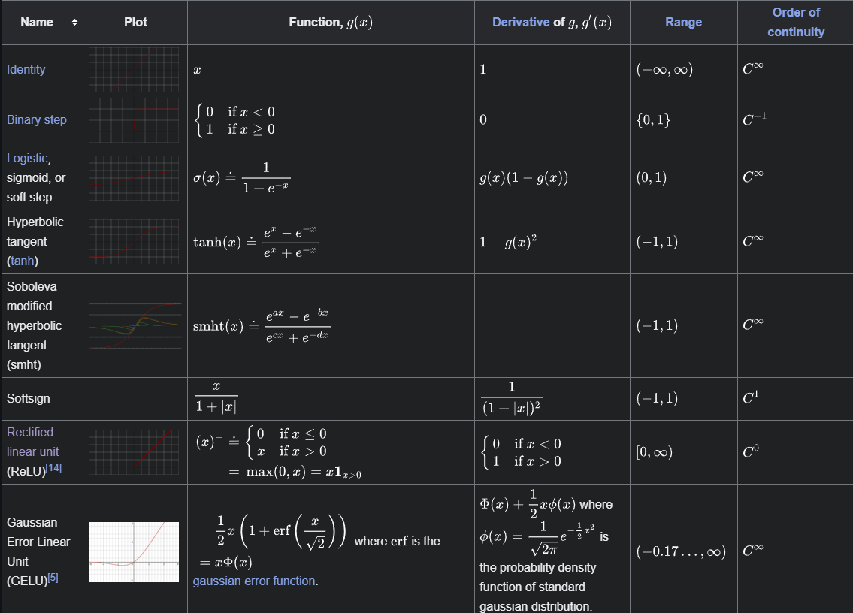
Activation Function
Notes:
https://en.wikipedia.org/wiki/Activation_function

Slide 17
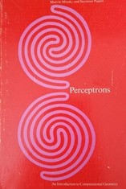
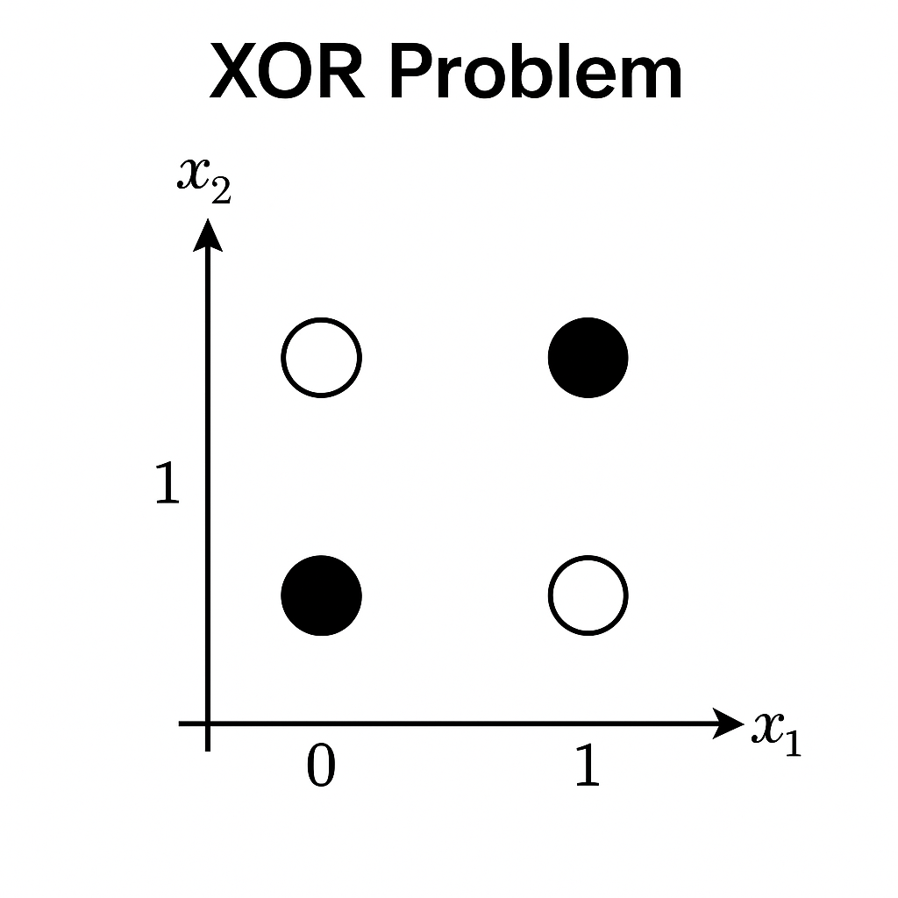
Minsky and The Perceptron – 1969
“Perceptron” Marvin Minsky and Seymour Papert Perceptron (1969)
They showed that the Perceptron had significant weaknesses (XOR Problem)
Training the Perceptron was impractical for many real problems

