Slide 1
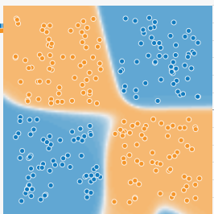

The Multilayer Perceptron
Perceptrons have been widely publicized as “pattern recognition” or “learning” machines and as such have been discussed in a large number of books, journal articles, and voluminous “reports.” Most of this writing...is without scientific value
- MARVIN MINSKY (1988)
This lecture expands the perceptron model into the Multilayer Perceptron (MLP) and examines how the Feedforward and Backpropagation steps change as our model shifts from a single perceptron to the MLP

Slide 2
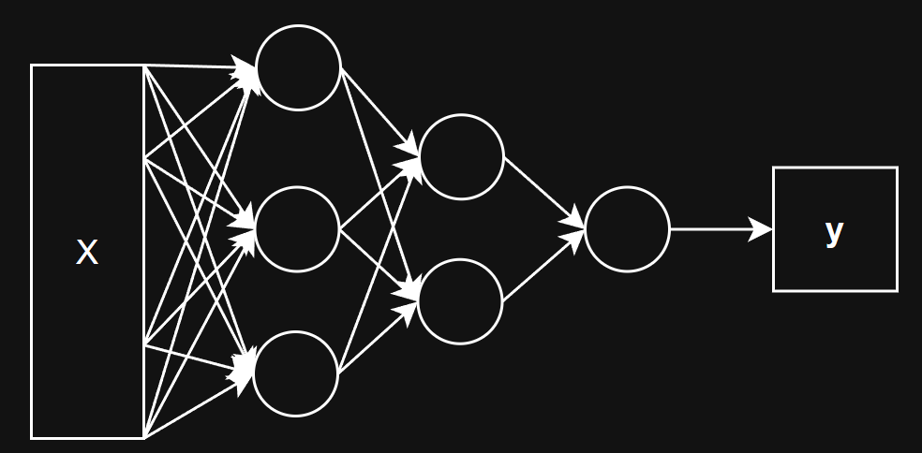
The Multilayer Perceptron (MLP)

Slide 3
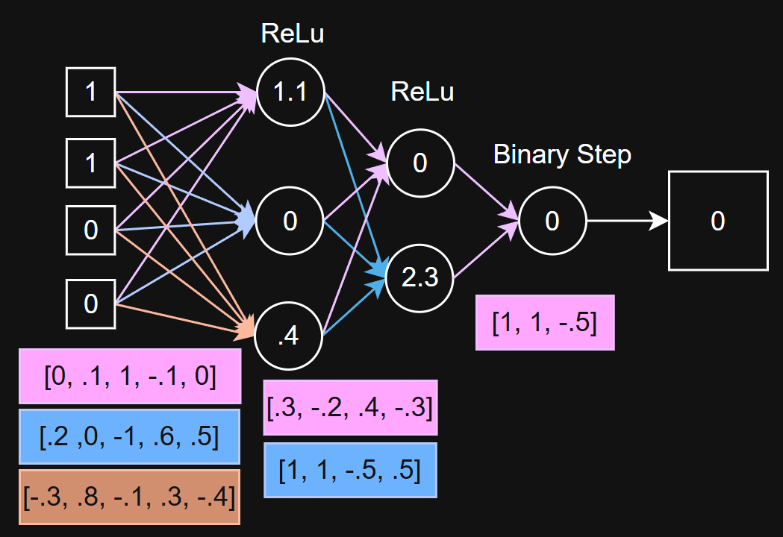
MLP Example - Feed Forward

Slide 4
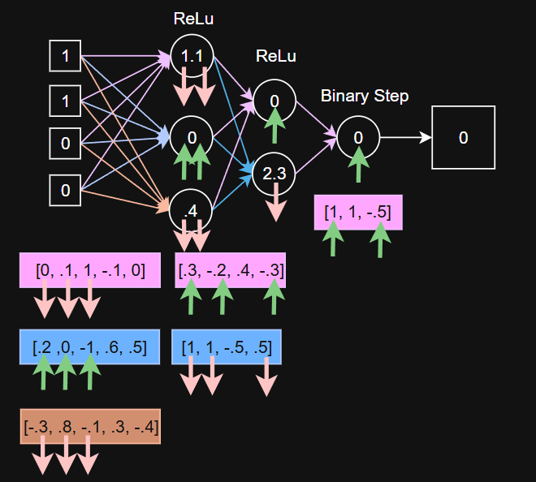
MLP Example - Back Propagation

Slide 5
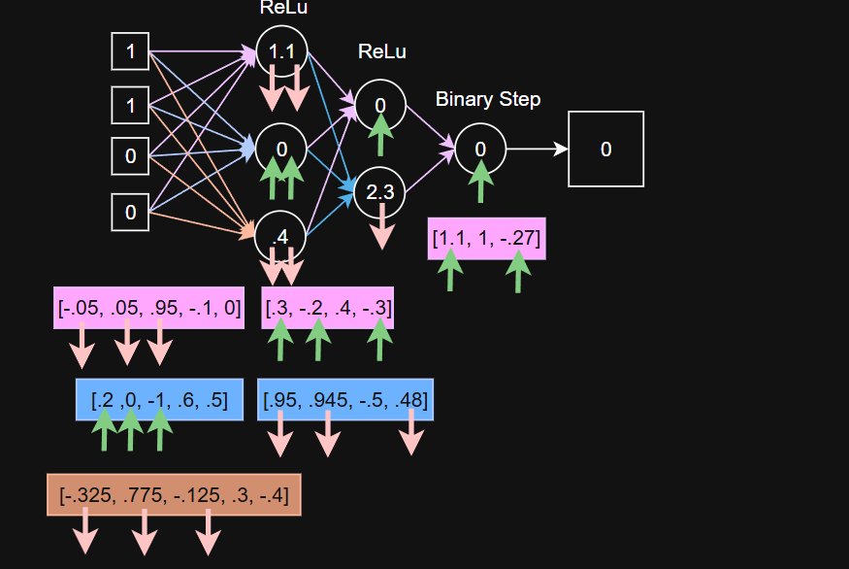
MLP Example - Back Propagation

Slide 6
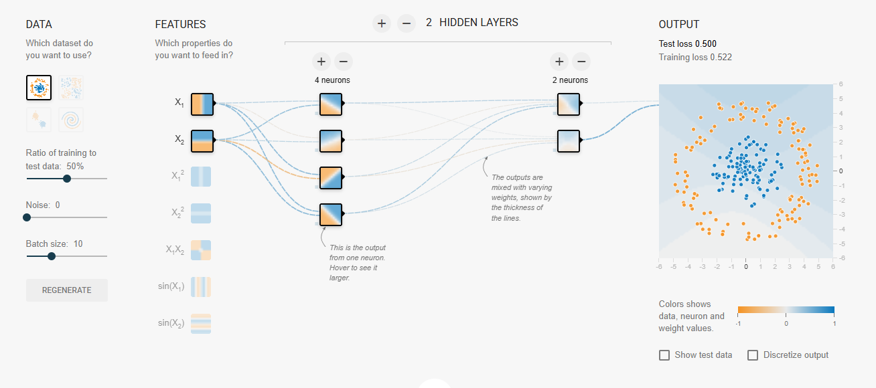
TensorFlow Playground
Notes:
https://playground.tensorflow.org/

