Slide 1
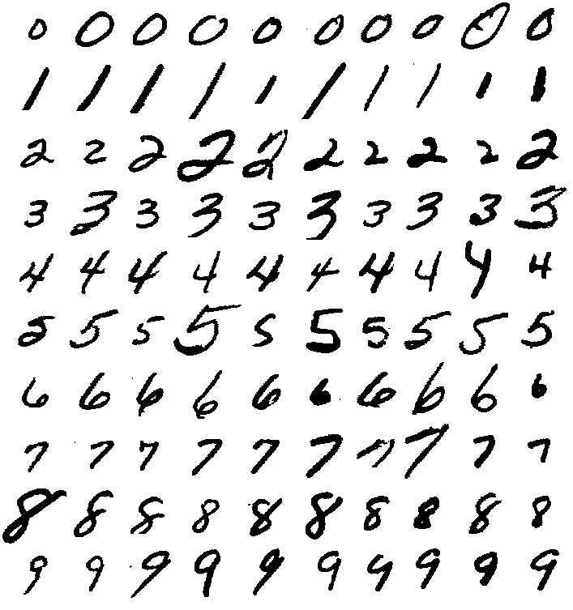

The Expression of the Digits in Machines
The problem of recognizing hand-written digits is of enormous practical and theoretical interest … This is a topic where "neural net" techniques are expected to be relevant, since the task requires closely mimicking human performance
- AT&T BELL LABS (1988)
This lecture focuses on practical application, guiding you through the digit recognition code so you can train and test the model with your very own handwriting.
Notes:
The Expression of the Emotions in Man and Animals: https://en.wikipedia.org/wiki/The_Expression_of_the_Emotions_in_Man_and_Animals

Slide 2
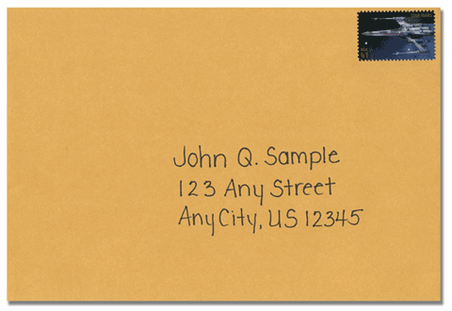
The Problem
You are the US Postal Service
You receive millions of hand addressed envelope each day
You have a human read the address on each letter and send it to the correct place. This is time consuming and expensive.
You want to have an automated system that can read the addresses and sort the mail into the correct bin
Notes:
How Humans Recognize Digits: https://www.youtube.com/watch?v=rA5qnZUXcqo
Michael Neilsen Digit Recognition: http://neuralnetworksanddeeplearning.com/chap1.html
Neural Network Recognizer For Hand-Written Zip Code Digits (1989): https://proceedings.neurips.cc/paper_files/paper/1988/file/a97da629b098b75c294dffdc3e463904-Paper.pdf

Slide 3
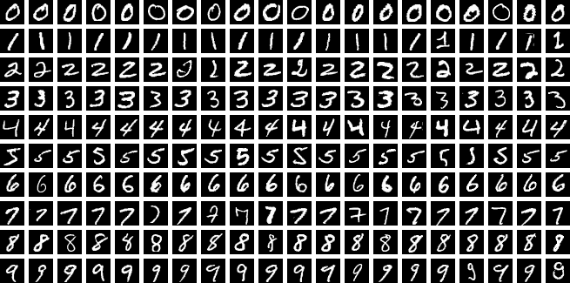
The Solution
You collect nearly 10,000 samples of handwritten digits, digitize them, and label them
You then train a Neural Network to classify handwritten digits

Slide 4

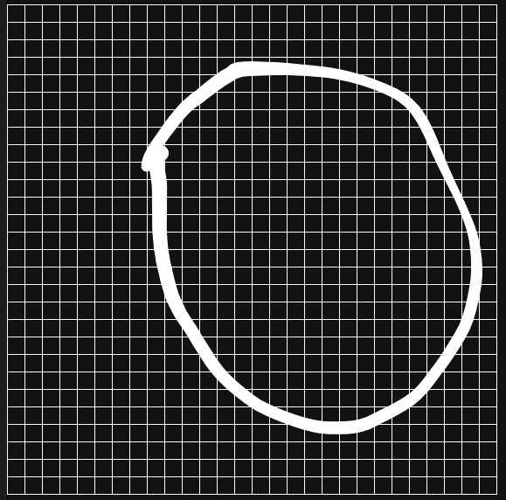
Step 1: Handwriting to Digital Sample

Slide 5

Step 1: Handwriting to Digital Sample

Slide 6
Step 2: Digital Sample to List of Numbers
0,
0, 0, 0, …
….
…255, 255, 255, …
….
0, 0, 0

Slide 7
Step 3: Split the X and Y
X (input)
Y (output)
0,
0, 0, 0, …
….
…255, 255, 255, …
….
0, 0, 0
0, 0, 0, …
….
…255, 255, 255, …
….
0, 0, 0
0

Slide 8
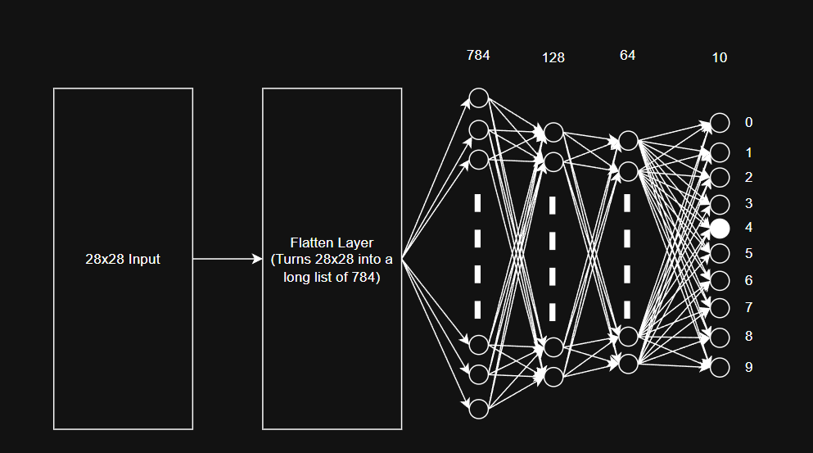
Step 4: Train the Model - Forward Pass

Slide 9
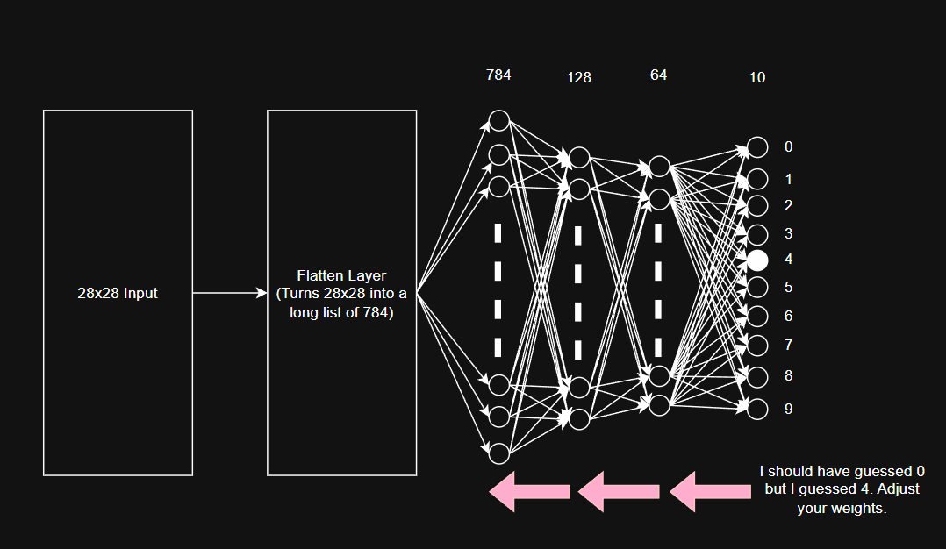
Step 5: Train the Model - Backpropagation

Slide 10
Step 6: Repeat Steps 4 & 5 for 1000’s of examples

Slide 11
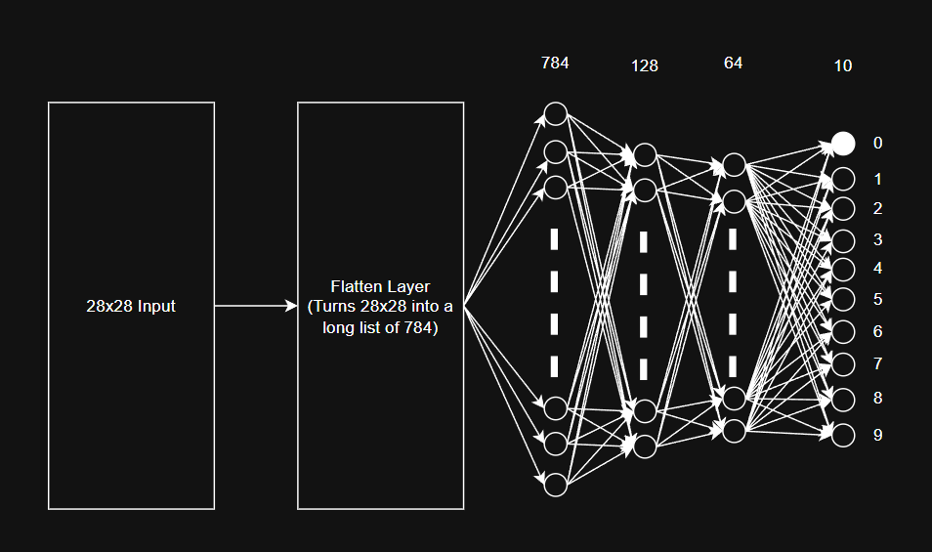
Step 7: Test your model

