Slide 1
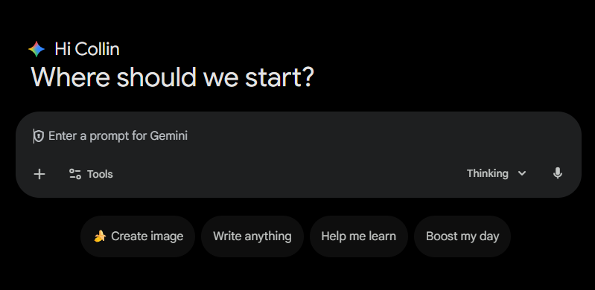

AI at UM
“"It's very hard to predict the future, like 10 years from now, in normal cases. It's even harder today, given how fast AI is changing, even week by week”
- DEMIS HASSABIS (2025)
This lecture introduces students to the AI resources at the University of Miami including how to access Microsoft CoPilot, Google Gemini, and Adobe Firefly
Notes:
Athens Innovation Summit 2025 - https://www.youtube.com/watch?v=RmZlMYmWlJU

Slide 2



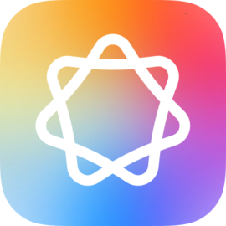
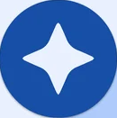
Categories of AI at UM
Green: Only use the University of Miami enterprise version of the tool. Must be logged into UM account to use with sensitive or private data. Never use for confidential or regulated data without first working with IT. To start working with IT for confidential data use, contact the IT Service Desk.
Notes:
UM AI Tools: https://ai.it.miami.edu/ai-tools/index.html#known-ai-tools
Copilot on the Web
Copilot for Microsoft 365
Gemini
Adobe Firefly
Apple Intelligence on Mac
Help Me Write

Slide 3


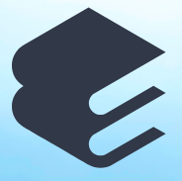

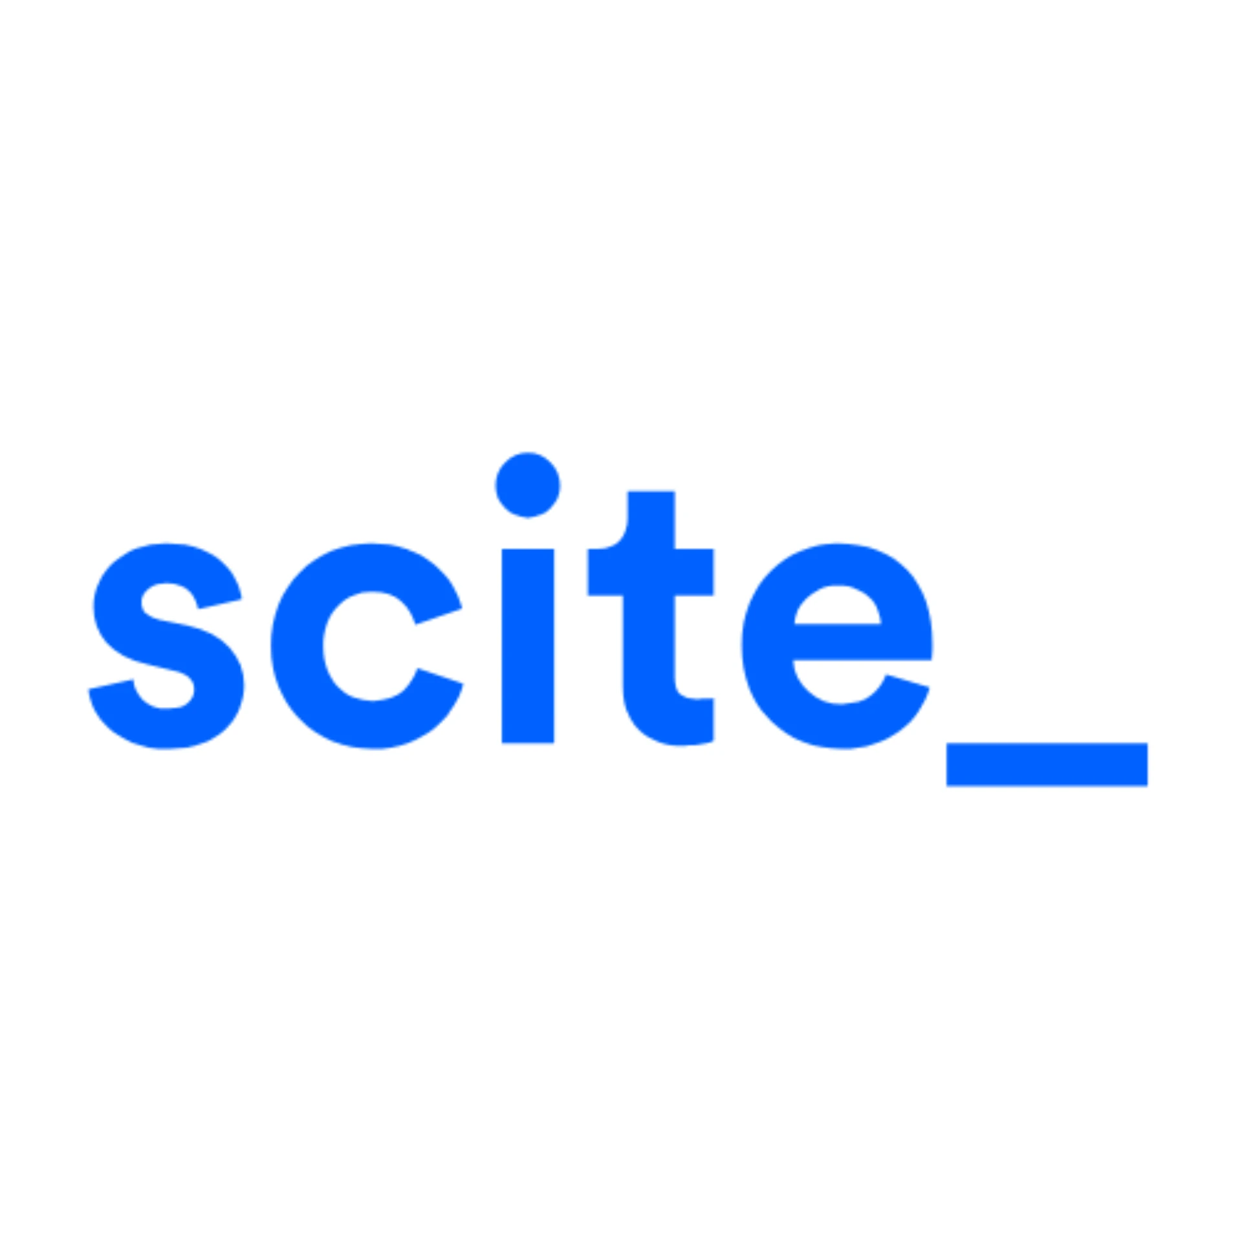
Categories of AI at UM
Yellow: Public data use only. Use with caution as many free tools collect your data such as browser history and IP address. Recommend using in an incognito/private browser.
Notes:
UM AI Tools: https://ai.it.miami.edu/ai-tools/index.html#known-ai-tools
ChatGPT
Claude
Elicit
Sora
Wordtune Spices
Scite

Slide 4
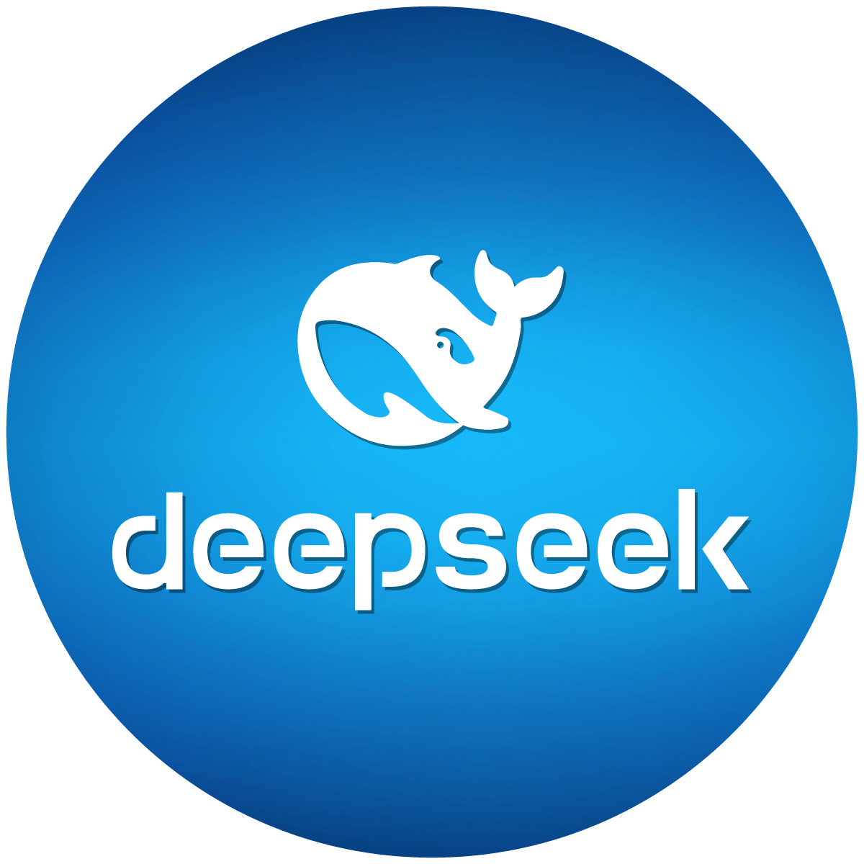
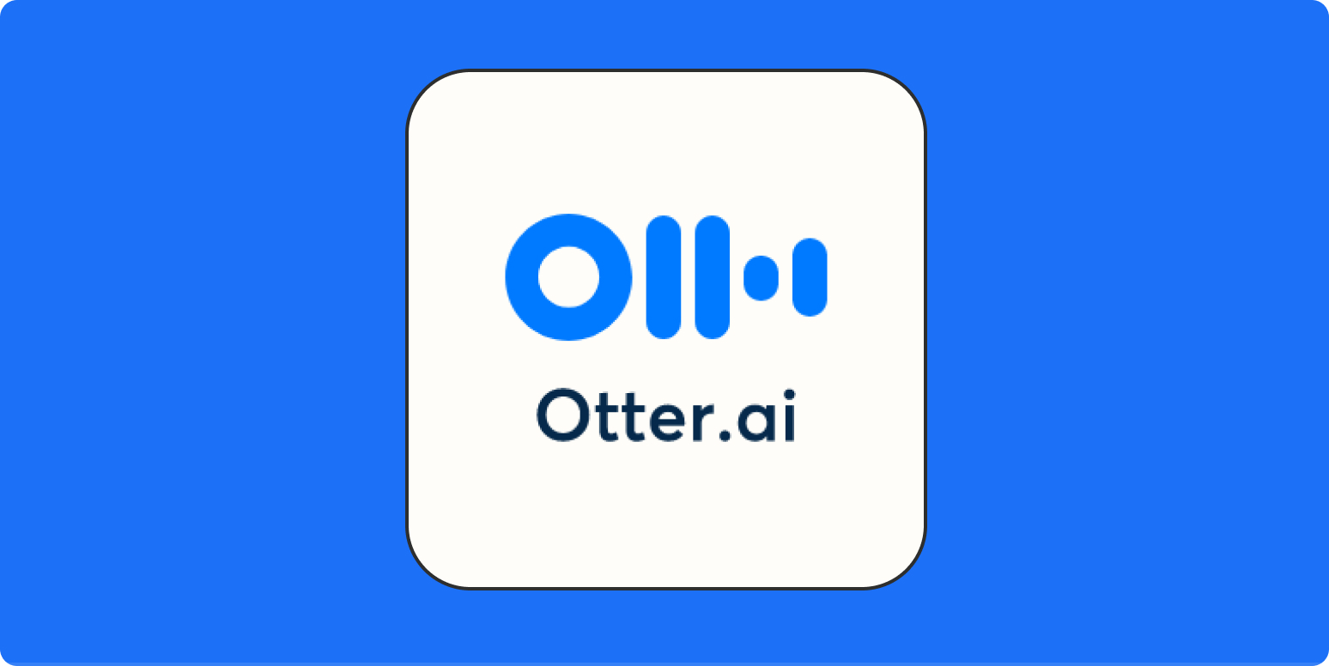
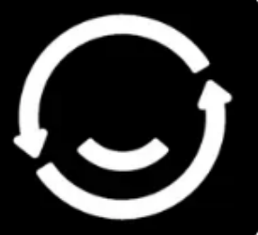

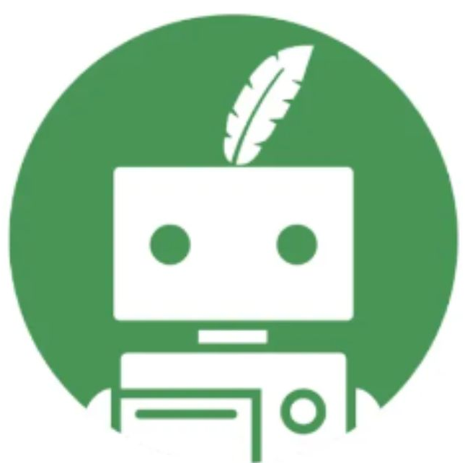
Categories of AI at UM
Red: Do not use due to potential security risks.
Notes:
UM AI Tools: https://ai.it.miami.edu/ai-tools/index.html#known-ai-tools
Deepseek
Otter.ai
DeepfaceLab
QuillBot
Fireflies.ai

Slide 5
Introduction to Microsoft Copilot
Copilot on the web is not HIPAA compliant yet. Copilot unlocks generative AI for capabilities around asking questions and generating responses from the web. It does, however, have some limitations, such as conducting custom searches within University of Miami firewalls.
When using Copilot with Data Protection, exercise care when entering information into the prompt. Copilot with Data Protection is being offered for use with Public data only, as defined in our Data Classification Policy. Confidential (Restricted), Private, or Sensitive data may not be entered into Copilot with Data Protection. As with other services, do not include personal information about yourself or others in prompts. Similarly, when using the service, you must ensure adherence to copyright and intellectual property protections.
Notes:
https://copilot.microsoft.com/

Slide 6
Introduction to Gemini
Gemini was created by Google, and it was built from the ground up to be multimodal; this means that Gemini can generalize and seamlessly understand, operate across, and combine different types of information—including text, code, audio, image, and video.
University of Miami students, faculty, and staff can access Gemini by visiting gemini.google.com. Check for the blue banner that says "You now have added data protection..." on the top of the Gemini experience page. (See example below.) If you do not see the banner, click Sign in, then sign in with your University of Miami Login ID to start the Google Workspace login process.
Gemini is not HIPAA compliant yet. Gemini unlocks generative AI for capabilities around asking questions and generating responses from the web. It does, however, have some limitations, such as conducting custom searches within University of Miami firewalls
Notes:
https://gemini.google.com/

Slide 7
Introduction to NotebookLM
NotebookLM is an AI-powered research assistant designed to help you quickly understand, organize, and generate new content based only on your uploaded source material. It acts as a personalized expert in your documents, helping you turn research, notes, and raw data into polished outlines, study guides, and deep-dive discussions.
To access NotebookLM, visit notebooklm.google.com. Be sure to sign in with your University of Miami Login ID. Once signed in, you will be taken to your NotebookLM dashboard where you can begin creating new notebooks and uploading sources.
NotebookLM is available to all University of Miami faculty, staff, and students as part of the institution's Google Workspace for Education Plus license. When you use NotebookLM with your UM account, your data (uploads, queries, and model responses) is protected under the Google Workspace for Education Privacy Notice. This data is not reviewed by human reviewers and is not used to train Google's general AI models.
Notes:
https://gemini.google.com/

Slide 8
Introduction to Firefly
Use simple text prompts in over 100 languages to make beautiful images, transform text, play with color, and so much more.
University of Miami students, faculty, and staff can access Adobe Firefly by visiting firefly.adobe.com. Ensure you are signed in to the Internet browser* with your University of Miami credentials. You can also use Adobe Firefly within various Adobe Creative Cloud (CC) apps. (Learn more about Adobe Firefly and products it works with.)
Notes:
firefly.adobe.com

