Slide 1
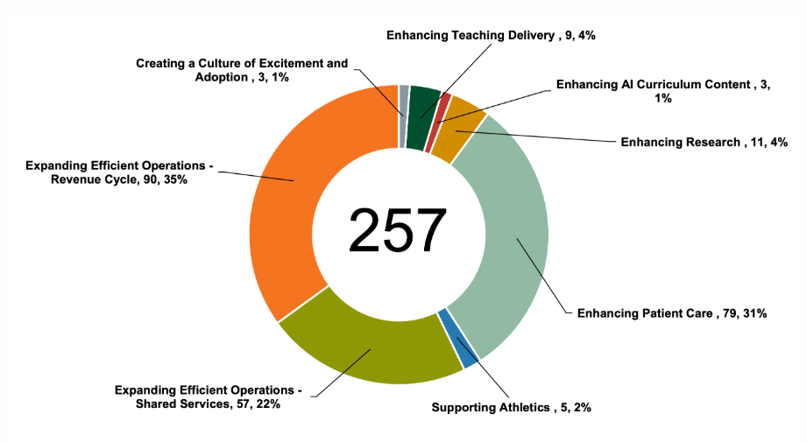

On the Shoulders Of Giants
“If I have seen further, it is by standing on the shoulders of giants.”
- ISAAC NEWTON (1676)
This lecture introduces students to the AI resources at the University of Miami including how to access Microsoft CoPilot, Google Gemini, and Adobe Firefly
Notes:
On the Shoulders of Giants: https://en.wikipedia.org/wiki/Standing_on_the_shoulders_of_giants

Slide 2


Collin Connors
University of Miami / ERMProtect
cdc104@miami.edu
Hüseyin Koçak
University of Miami
hk@cs.miami.edu
Notes:
Charles Babbage: https://en.wikipedia.org/wiki/Charles_Babbage#Early_life
Difference Engine: https://en.wikipedia.org/wiki/Difference_engine
Ada Lovelace on the Analytical Engine: https://www.fourmilab.ch/babbage/sketch.html
Lecture Notes:
Background & Role
English mathematician, inventor, mechanical engineer.
“Father of the Computer” — first to propose a programmable calculating machine.
Aimed to eliminate human error in calculation tables (navigation, engineering).
The Difference Engine (1820s)
Purpose: Automate production of mathematical tables.
Fully mechanical, decimal-based, crank-driven.
Used the method of finite differences — no need for multiplication/division.
Partially built; ran into manufacturing and funding issues.
The Analytical Engine (1837)
First general-purpose computing design — could run any program given enough instructions.
Components analogous to modern computers:
Store – held 1,000 numbers (40-digit precision) → like RAM.
Mill – mechanical computation unit → like CPU.
Punch Cards – program input (borrowed from Jacquard loom weaving patterns).
Control Unit – sequence control through card arrangement.
Output – printer, curve plotter, bell.
Could handle loops and conditional branching — concepts still core to programming.
Would have been Turing-complete if built.
Babbage vs. Joseph Clement
Joseph Clement – master engineer hired to construct the Difference Engine.
Dispute arose over payment and ownership:
Clement insisted Babbage pay for moving heavy machinery to Babbage’s workshop.
Government funded project, but cost overruns led to friction.
Clement halted work in 1833; machines left incomplete.
The falling-out delayed the Analytical Engine — Babbage lacked skilled machinists for precision parts.
Why Important
Defined architecture still recognizable today: input → store → process → output.
Shifted thinking from “calculators” to “computers” — machines that could be reprogrammed for different tasks.
Extra Tidbits
If completed, would’ve been the size of a small steam locomotive.
Planned to be powered by a steam engine.
Babbage published detailed plans but technology of the time struggled with required tolerances.

Slide 3




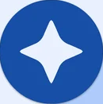
Categories of AI at UM
Green: Only use the University of Miami enterprise version of the tool. Must be logged into UM account to use with sensitive or private data. Never use for confidential or regulated data without first working with IT. To start working with IT for confidential data use, contact the IT Service Desk.
Notes:
UM AI Tools: https://ai.it.miami.edu/ai-tools/index.html#known-ai-tools
Copilot on the Web
Copilot for Microsoft 365
Gemini
Adobe Firefly
Apple Intelligence on Mac
Help Me Write

Slide 4





Categories of AI at UM
Yellow: Public data use only. Use with caution as many free tools collect your data such as browser history and IP address. Recommend using in an incognito/private browser.
Notes:
UM AI Tools: https://ai.it.miami.edu/ai-tools/index.html#known-ai-tools
ChatGPT
Claude
Elicit
Sora
Wordtune Spices
Scite

Slide 5


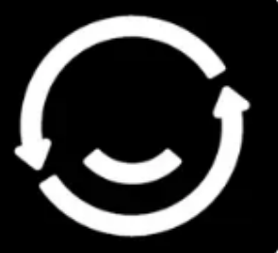

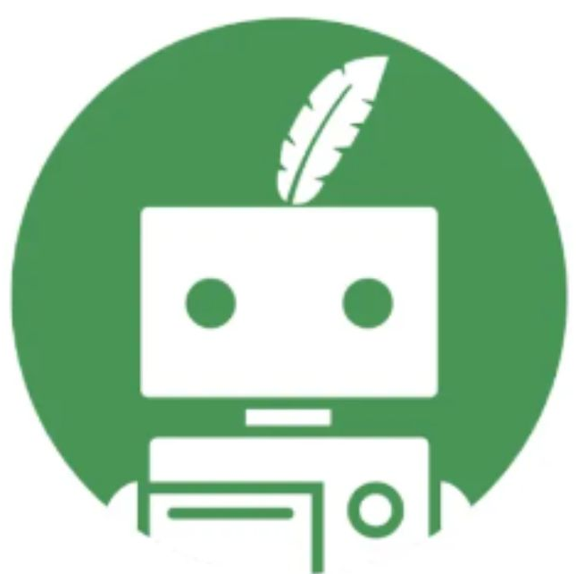
Categories of AI at UM
Red: Do not use due to potential security risks.
Notes:
UM AI Tools: https://ai.it.miami.edu/ai-tools/index.html#known-ai-tools
Deepseek
Otter.ai
DeepfaceLab
QuillBot
Fireflies.ai

Slide 6
Introduction to Microsoft Copilot
Copilot on the web is not HIPAA compliant yet. Copilot unlocks generative AI for capabilities around asking questions and generating responses from the web. It does, however, have some limitations, such as conducting custom searches within University of Miami firewalls.
When using Copilot with Data Protection, exercise care when entering information into the prompt. Copilot with Data Protection is being offered for use with Public data only, as defined in our Data Classification Policy. Confidential (Restricted), Private, or Sensitive data may not be entered into Copilot with Data Protection. As with other services, do not include personal information about yourself or others in prompts. Similarly, when using the service, you must ensure adherence to copyright and intellectual property protections.
Notes:
https://copilot.microsoft.com/
How do I know I am signed in correctly?
Chat
Agents
Custom Agents?
Notebooks
Create

Slide 7
Introduction to Gemini
Gemini is not HIPAA compliant yet. Gemini unlocks generative AI for capabilities around asking questions and generating responses from the web. It does, however, have some limitations, such as conducting custom searches within University of Miami firewalls
Notes:
https://gemini.google.com/
How do I know I have the right one
Models
Deep Research
Guided Learning
Images
Gems
Notebook LLM

Slide 8
Introduction to Firefly
Create Images
Edit Images

Slide 9
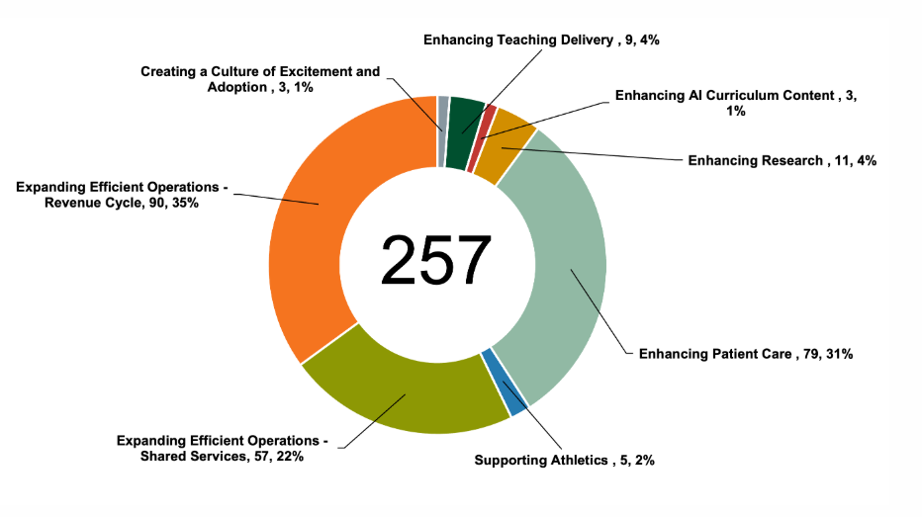
AI Projects at the U

Slide 10
AI in the News
The Economist
Financial Times
The LA Times
New York Times
Wall Street Journal
Washington Post
MIT Technology Review
Hugging Face Trending Papers
AI Servier Provider’s Blogs
AI Newsletters
AI Podcasts
Notes:
https://guides.library.miami.edu/newspapers

