Slide 1
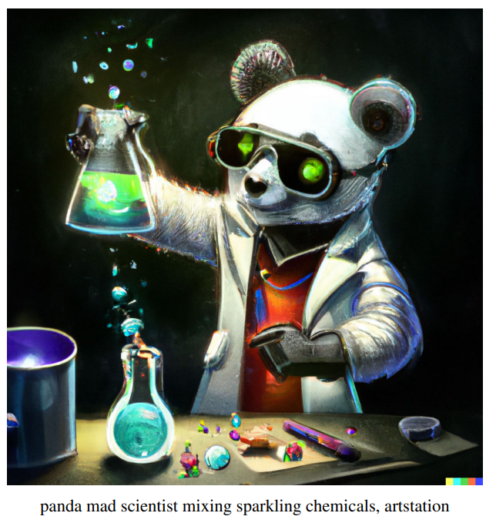

AI Image Generation
[Nano Banna] became the top rated image model in the world, and we were excited to see the overwhelming response from our customers. Nano Banana made it dramatically easier – and more fun – to edit images with natural language and make visuals with consistent characters.
- Google (2025)
This lecture explores how to generate AI image through a series of 4 lab assignments. First you are challenged to generate AI images from text alone. Next you are challenged to turn a sketch into a work of art. The next challenge is to edit a picture. The final challenge is to take what you have learned from the previous 3 challenges and create an infographic.

Slide 2
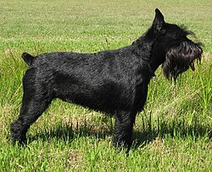
What is this a picture of?
Notes:
Pixel Recurrent Neural Networks: https://arxiv.org/abs/1601.06759

Slide 3
What is this a picture of?
Notes:
Pixel Recurrent Neural Networks: https://arxiv.org/abs/1601.06759

Slide 4
What is this a picture of?
Notes:
Pixel Recurrent Neural Networks: https://arxiv.org/abs/1601.06759

Slide 5
AutoRegressive Image Generation
Notes:
Algorithmic Simplicity Autoregressive: https://www.youtube.com/watch?v=zc5NTeJbk-k
Pixel Recurrent Neural Networks: https://arxiv.org/abs/1601.06759

Slide 6
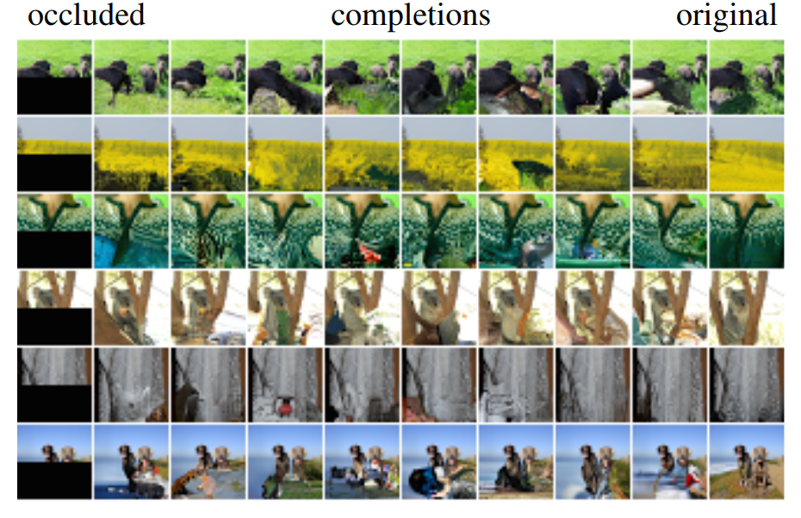
Pixel Recurrent Neural Networks
Notes:
Pixel Recurrent Neural Networks: https://arxiv.org/abs/1601.06759
Diffusion vs Auto Regression: https://www.youtube.com/watch?v=zc5NTeJbk-k

Slide 7
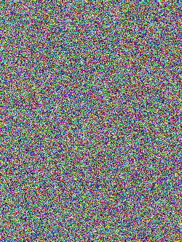
What is this a picture of?

Slide 8
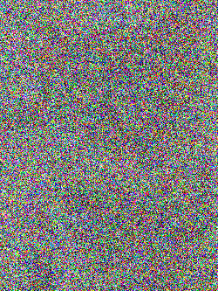
What is this a picture of?

Slide 9
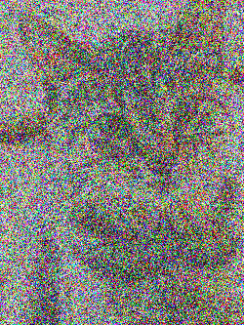
What is this a picture of?

Slide 10
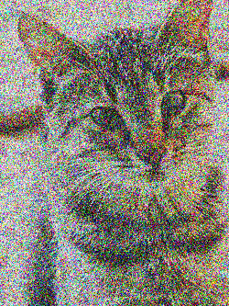
What is this a picture of?

Slide 11
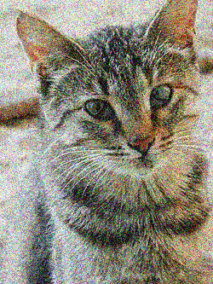
What is this a picture of?

Slide 12
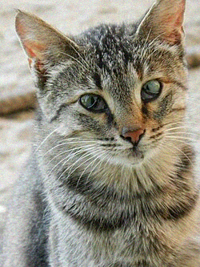
What is this a picture of?

Slide 13
Denoising Diffusion Probabilistic Models
Notes:
Denoising Diffusion Probabilistic Models: https://arxiv.org/abs/2006.11239 (2020)
Diffusion Demo: https://learnopencv.com/denoising-diffusion-probabilistic-models/
3Blue1Brown Diffusion: https://www.youtube.com/watch?v=iv-5mZ_9CPY
Denoising Diffusion Implicit Models: https://arxiv.org/abs/2010.02502
Sorush Mehraban Diffusion Models: https://www.youtube.com/watch?v=r4V0vLhYZIQ

Slide 14
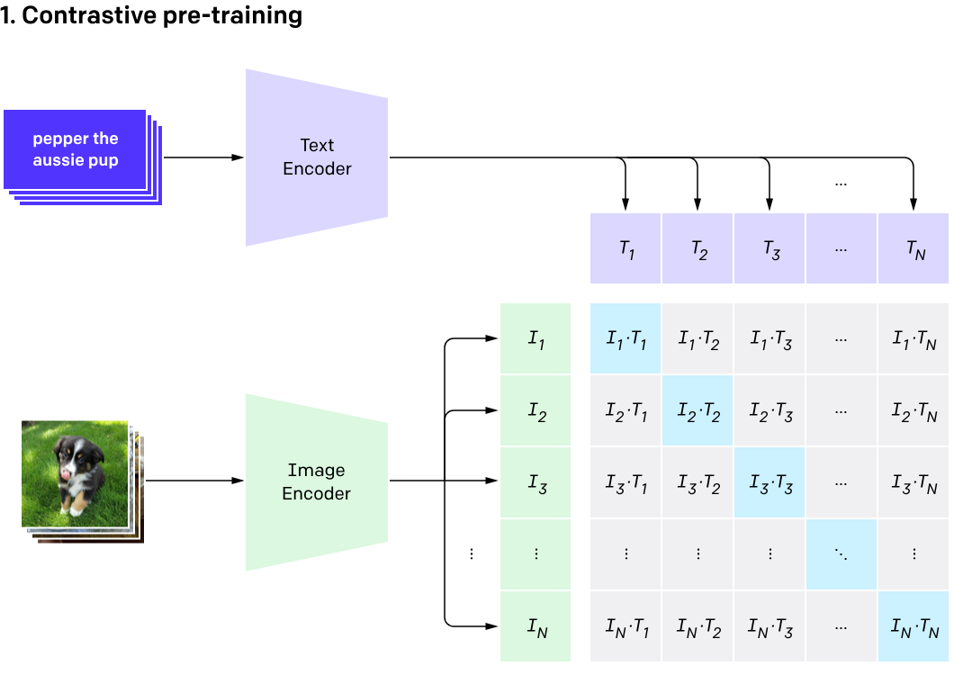
CLIP
Notes:
CLIP: https://openai.com/index/clip/ (2020)

Slide 15
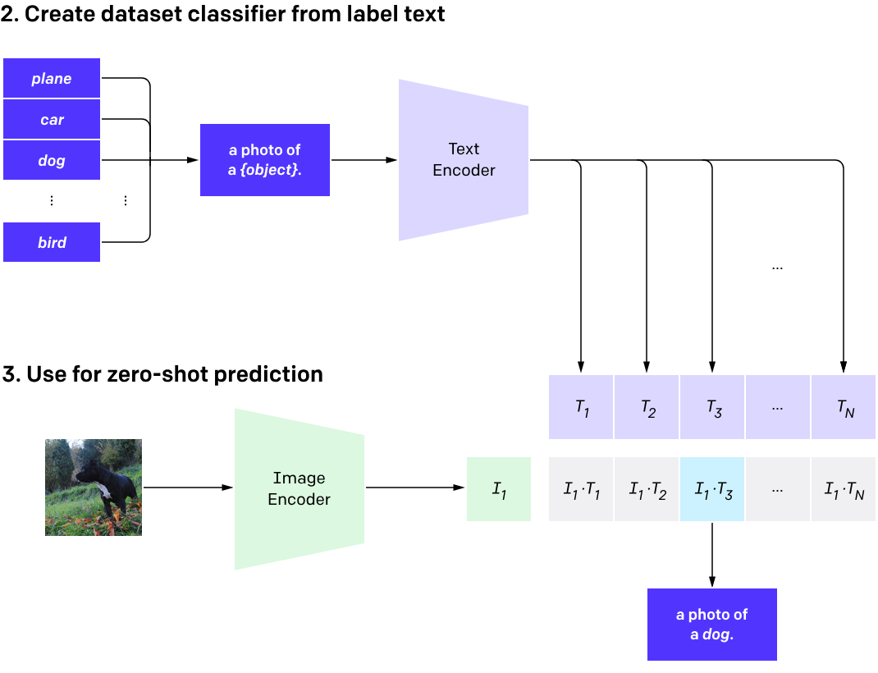
CLIP
Notes:
CLIP: https://openai.com/index/clip/

Slide 16
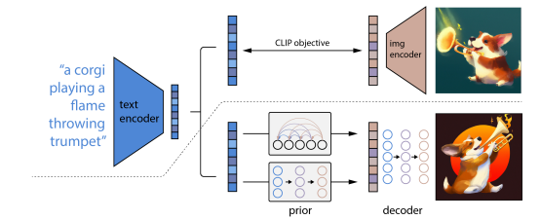
UnCLIP
Notes:
unCLIP (Dalle-2) -https://cdn.openai.com/papers/dall-e-2.pdf (2022)
Dalle 2 Article: https://medium.com/augmented-startups/how-does-dall-e-2-work-e6d492a2667f
Open AI Dalle - https://openai.com/index/dall-e-2/

Slide 17
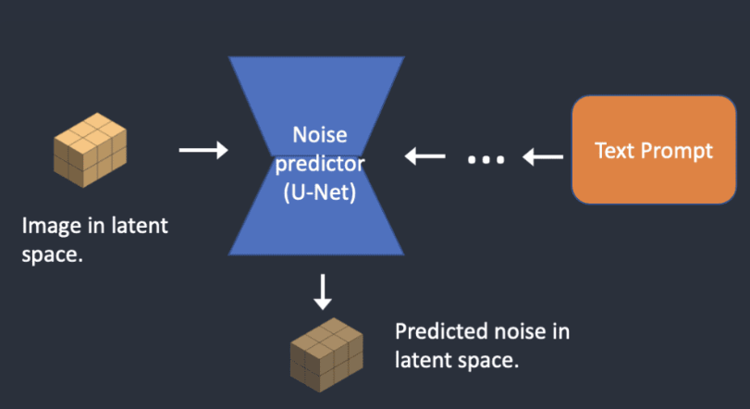
Stable Diffusion
Notes:
Stable Diffusion: https://arxiv.org/abs/2112.10752
Stable Diffusion Demo: https://stability.ai/blog/stable-diffusion-public-release
How SD works: https://stable-diffusion-art.com/how-stable-diffusion-work/#Text-to-image

