Slide 1
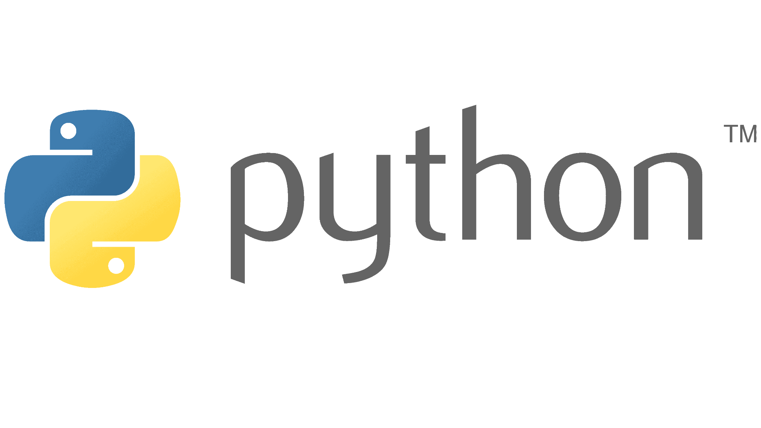

Hello AI
The first example is almost always a program that prints ‘Hello, world!’ on the screen.
- BRIAN KERNIGHAN (1978)
In this lab, you will explore how a computer can learn to recognize handwritten numbers. You will work through the complete process of building, training, and testing an artificial intelligence model that identifies digits from images.
Notes:
The C Programming Language (book): https://en.wikipedia.org/wiki/The_C_Programming_Language
Hello AI Lab: https://colab.research.google.com/drive/1mcGhSiEXrl_oUuF85GqW1pjmwXVsk08G?usp=sharing

Slide 2
Our Objectives
Load and inspect image data from the MNIST dataset
Learn how images are represented as numbers inside a computer
Build a neural network model made up of layers
Train the model using labeled examples
Evaluate how well the model performs on unseen data
Test the trained model on your own handwritten digits

Slide 3
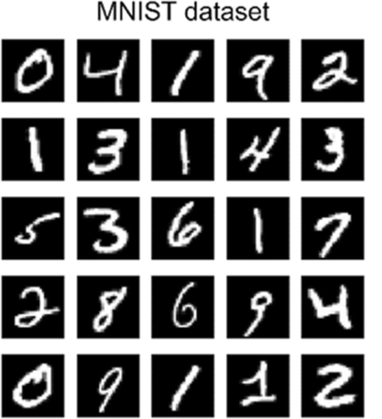
The MNIST Dataset
You will use the MNIST dataset, a classic collection of handwritten digit images, to train a neural network. MNIST provides a clean, well-structured starting point that allows you to focus on learning how AI works rather than struggling with messy data from the start.
MNIST has played an important role in the history of machine learning. It was created to provide a standard way to test and compare learning algorithms. Because the images are small, grayscale, and consistently formatted, MNIST makes it easier to see the core ideas behind image recognition without unnecessary complexity.

Slide 4
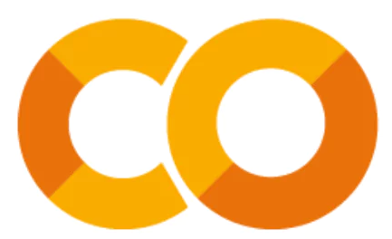
Python and Google Colab
Python is a programming language designed to be easy to read and write. It uses plain, English-like syntax and is widely used in many fields, including data analysis, artificial intelligence, science, engineering, and web development.
Google Colab (Colaboratory) is a web-based environment that lets you write and run Python code directly in your browser. You do not need to install anything on your computer. Colab provides interactive notebooks where text, code, and results (such as numbers, tables, and graphs) appear together in one place.

Slide 5
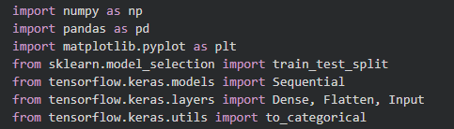
Import
Think of Python as a kitchen.
When you first walk into the kitchen, you have some basic things available—a counter, a sink, a knife. You can do simple tasks, but you cannot cook a michelin star meal without bringing in special specialized tools.
In Python, the word import is how we bring those ingredients and tools into the kitchen.
When you see an import line, you can read it as:
“I am bringing this tool into my kitchen so I can use it later.”
Before we can build our AI we need to get all of our tools ready. Each line below brings in a different tool that we will use at various points in this lab.

Slide 6
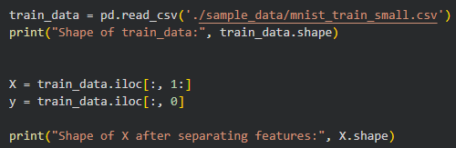
Training Data
Before we can train an AI model, we need training data.
In our kitchen analogy, this data represents the ingredients we will use to cook the final dish (the AI model).
Each row in the data is one example, and each column is a piece of information about that example.
For our task, the original data starts as 28 × 28 grayscale images.
Each image is made up of pixels Each pixel is a number representing how dark or light it is. AI models cannot work directly with images — they work with numbers

Slide 7
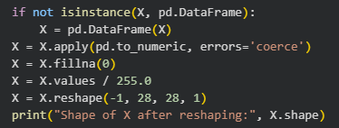
Data Preprocessing
Before we cook, we need to make sure our ingredients are clean, consistent, and ready to use.
Even though our data came from images, once it is loaded into Python it can still contain issues that would confuse an AI model.

Slide 8
Splitting the Data
Now that our ingredients (`X`) and labels (`y`) are prepared, we need to decide **how we will use them**.
If we let the AI learn from *all* the data and then test it on the *same* data, it would be like memorizing the answers to a test instead of learning the material
Instead, we split the data into two groups.

Slide 9
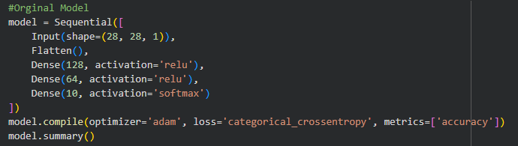
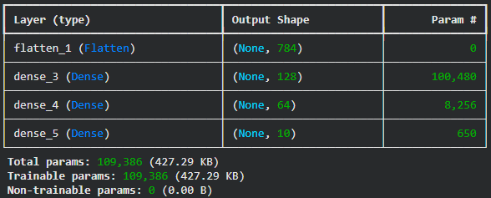
Building the Model

Slide 10
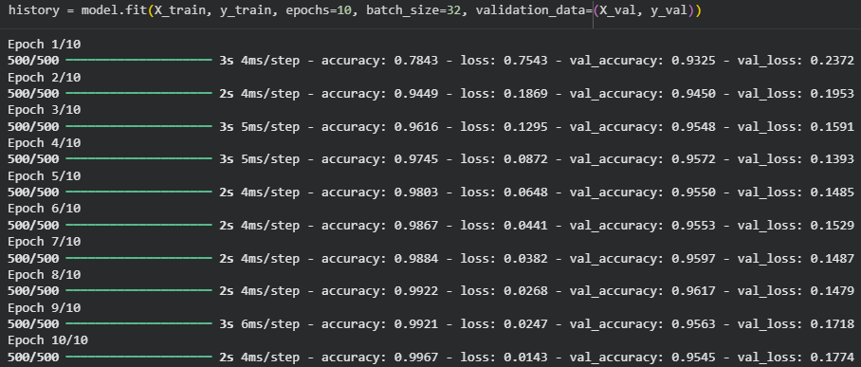
Training the Model

Slide 11
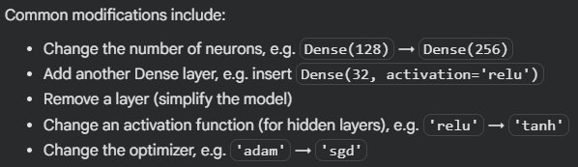
How to Build Your Own Model
Add a new code cell in Google Colab
Copy the original model into the new cell
Modify the model
Recompile after changes
Retrain the model
Keep your results organized

Slide 12
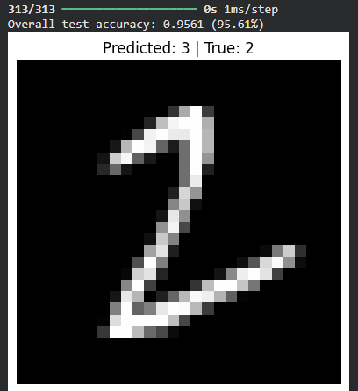
Making Predictions

Slide 13
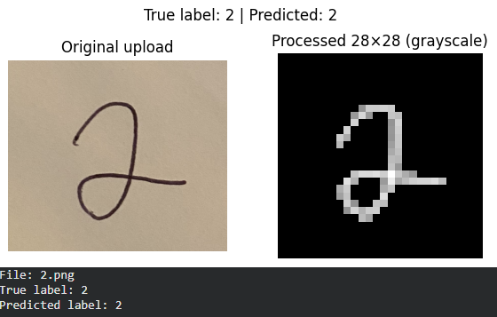
How to Test with Your Own Handwriting
Write the Digits 0-9
Take a Photo of your digits
Crop the images
Name the Files (ie. 0.png)
Upload the Files to Google Colab
Run the Prediction Code
Adjust the Threshold if Needed

