Slide 1
OnScreen Description
Collin Aycock

Slide 2
Revision History
Version | Date | Description | Author
1.0 | 2026.10.06 | First version of this document, for the first submission of OnScreen (app version 1.1.0). | Collin Aycock

Slide 3
Contents
App overview and test accounts
UI Structure
Usage Scenario
Menu & function description
Key policy
How to change languages

Slide 4
App Overview & Test Accounts
OnScreen is the TV app for a self-hosted OnScreen media server. The user runs the server on their own computer or NAS; the app plays the movies, TV shows, music, audiobooks and photos on it. The app ships no content, has no ads, purchases or subscriptions, and needs a server address to work.
Item | Value
Test server URL | https://onscreen-beta.wolverscreen.com (enter it on the app's first screen)
Test accounts (ID) | reviewer1, reviewer2, reviewer3, reviewer4, reviewer5, reviewer6, reviewer7, reviewer8
Passwords | In the account / password fields of the Seller Office submission
Account differences | None. All eight accounts are identical: same content, no ads, no paid tiers, no Live TV, no 4K titles. One account per tester keeps watch progress and favorites separate.
Account validity | The accounts do not expire.
Content on the test server | Openly licensed works only: Blender Foundation open movies and the Caminandes series (CC BY), Kevin MacLeod music (CC BY), LibriVox audiobooks and NASA photos (public domain).
Login, activation, payment | Username and password on the TV's on-screen keyboard. No activation, no payment, no phone or computer needed.

Slide 5
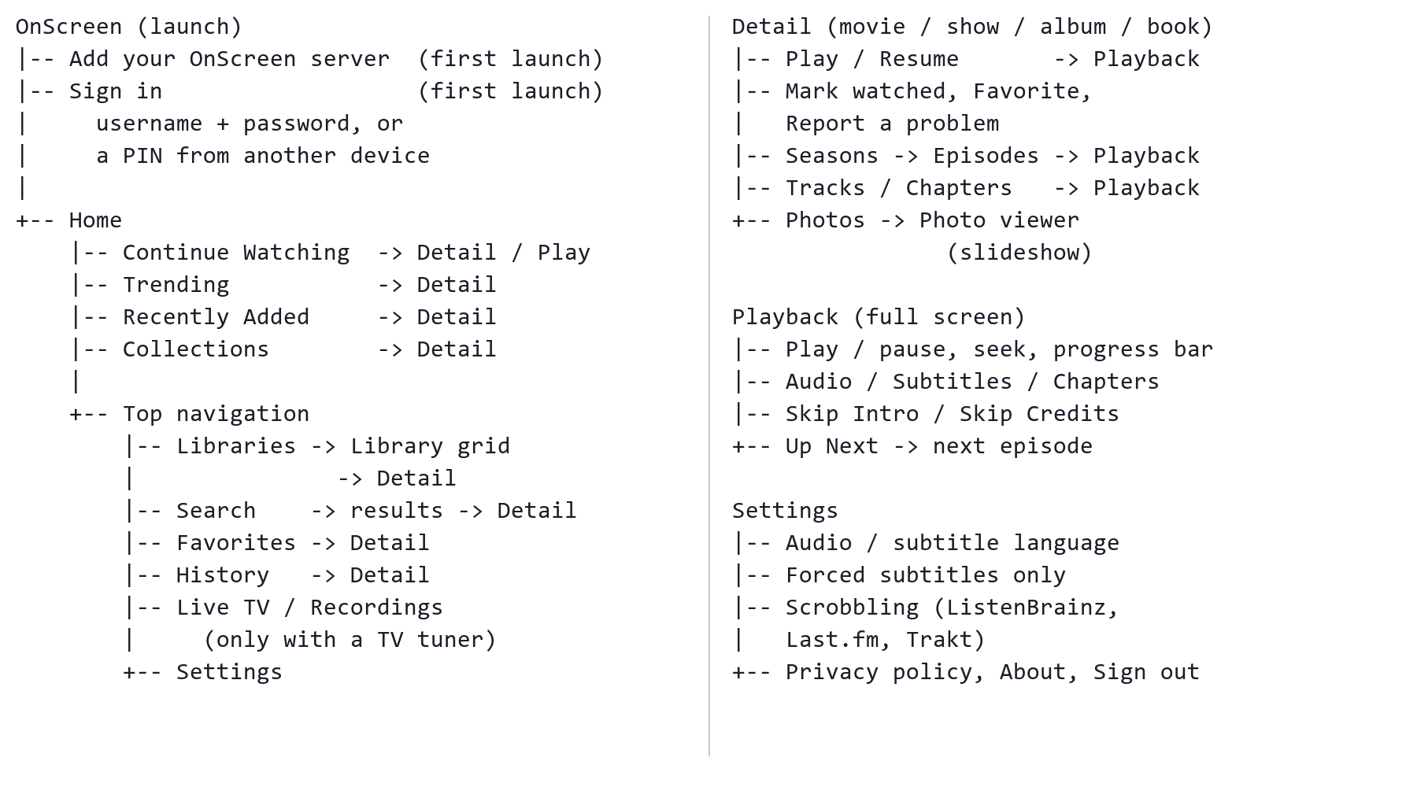
UI Structure
Whole UI structure (tree): every screen and where OK / Return leads.

Slide 6
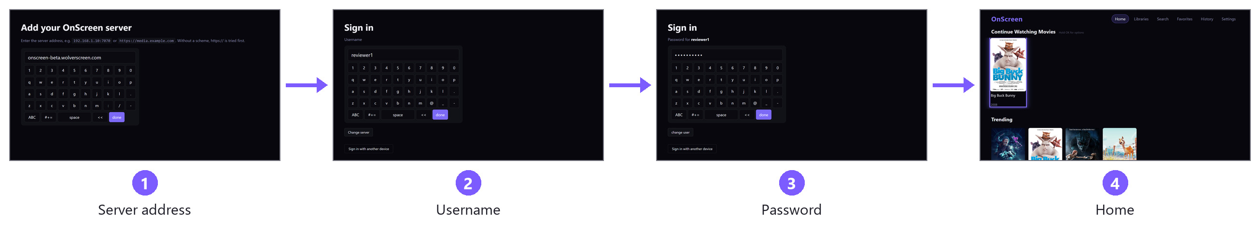
Usage Scenario (1/2)
- First launch and sign-in
1. Launch OnScreen. "Add your OnScreen server" opens. Type onscreen-beta.wolverscreen.com with the on-screen keyboard and select done. The app checks the server.
2. "Sign in": type the username (for example reviewer1) and select done.
3. Type the password and select done.
4. Home opens. The app stays signed in after it is closed; Settings > Sign out signs out, and Settings > Forget server goes back to step 1.
Alternative to steps 2-3: "Sign in with another device" shows a PIN to enter at the server's /pair page from a phone or computer (not needed for testing).
No activation, payment or account creation in the app.

Slide 7
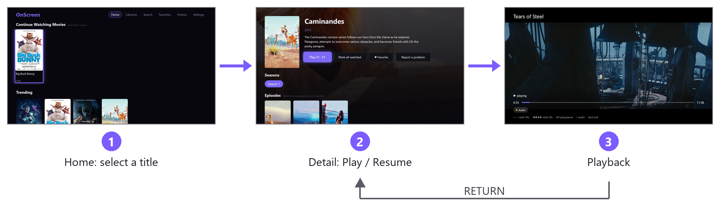
Usage Scenario (2/2)
- Browse and play
1. On Home, move to a title with the arrow keys and press OK (or open Libraries / Search from the top navigation).
2. The detail page opens. Select Play (or Resume). A series lists its seasons and episodes.
3. Playback is full screen. OK / Up / Down show the controls; Left / Right seek 10 s; Down reaches Audio, Subtitles and Chapters. At the end of an episode, Up Next starts the next one.
4. RETURN goes back to the detail page, and again to Home. RETURN on Home closes the app (Smart Hub). EXIT closes the app from anywhere.
Suggested titles: Sintel (subtitle tracks), Big Buck Bunny (two audio tracks), Caminandes (series, Up Next), a Music album, an audiobook (chapters, speed), Photos (OK starts a slideshow).

Slide 8
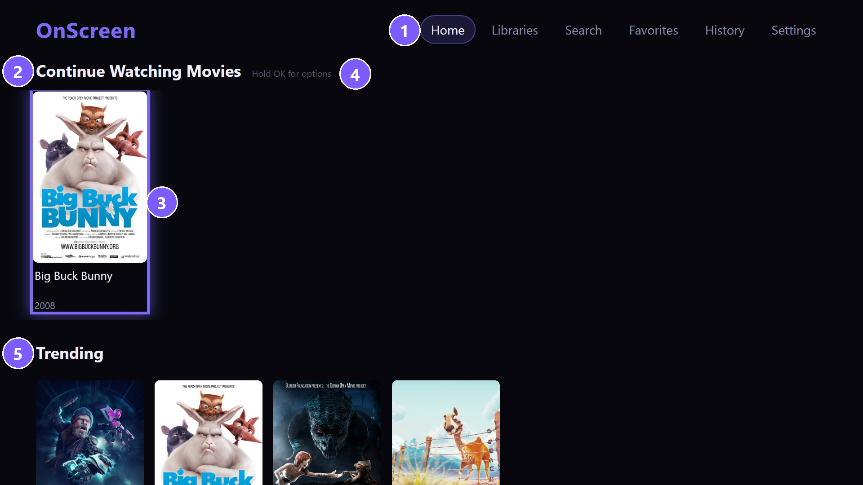
Menu & function description
- Home
No | Element | Attribute
1 | Top navigation | Home, Libraries, Search, Favorites, History, Settings.
2 | Row title | Continue Watching (TV, movies, other), Trending, Recently Added, a row per library, Collections.
3 | Focused card | The purple frame is the focus. OK opens the title; a Continue Watching card resumes playback.
4 | Hint | Hold OK on a Continue Watching card for its options (remove from the row, open).
5 | Trending | Titles others on the server watched in the last 7 days.

Slide 9
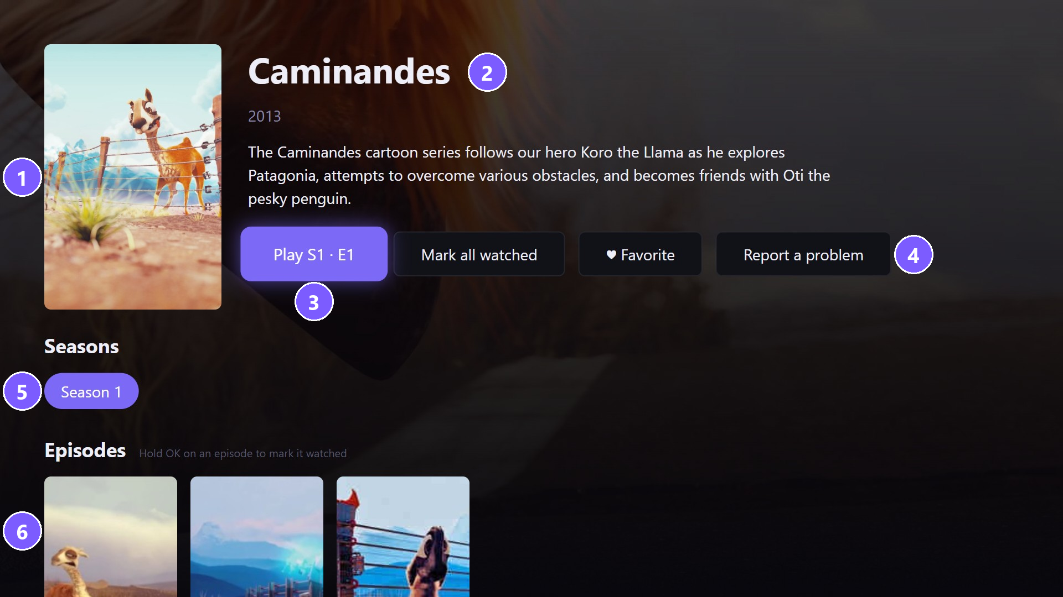
Menu & function description
- Detail (a series)
No | Element | Attribute
1 | Poster | The title's artwork.
2 | Title | Title, year, rating and description.
3 | Play / Resume | Plays the next episode, or resumes where the user stopped.
4 | Actions | Mark (all) watched, Favorite, Report a problem (a note to the server's administrator).
5 | Seasons | Selects the season listed below.
6 | Episodes | OK plays the episode; hold OK to mark it watched.

Slide 10
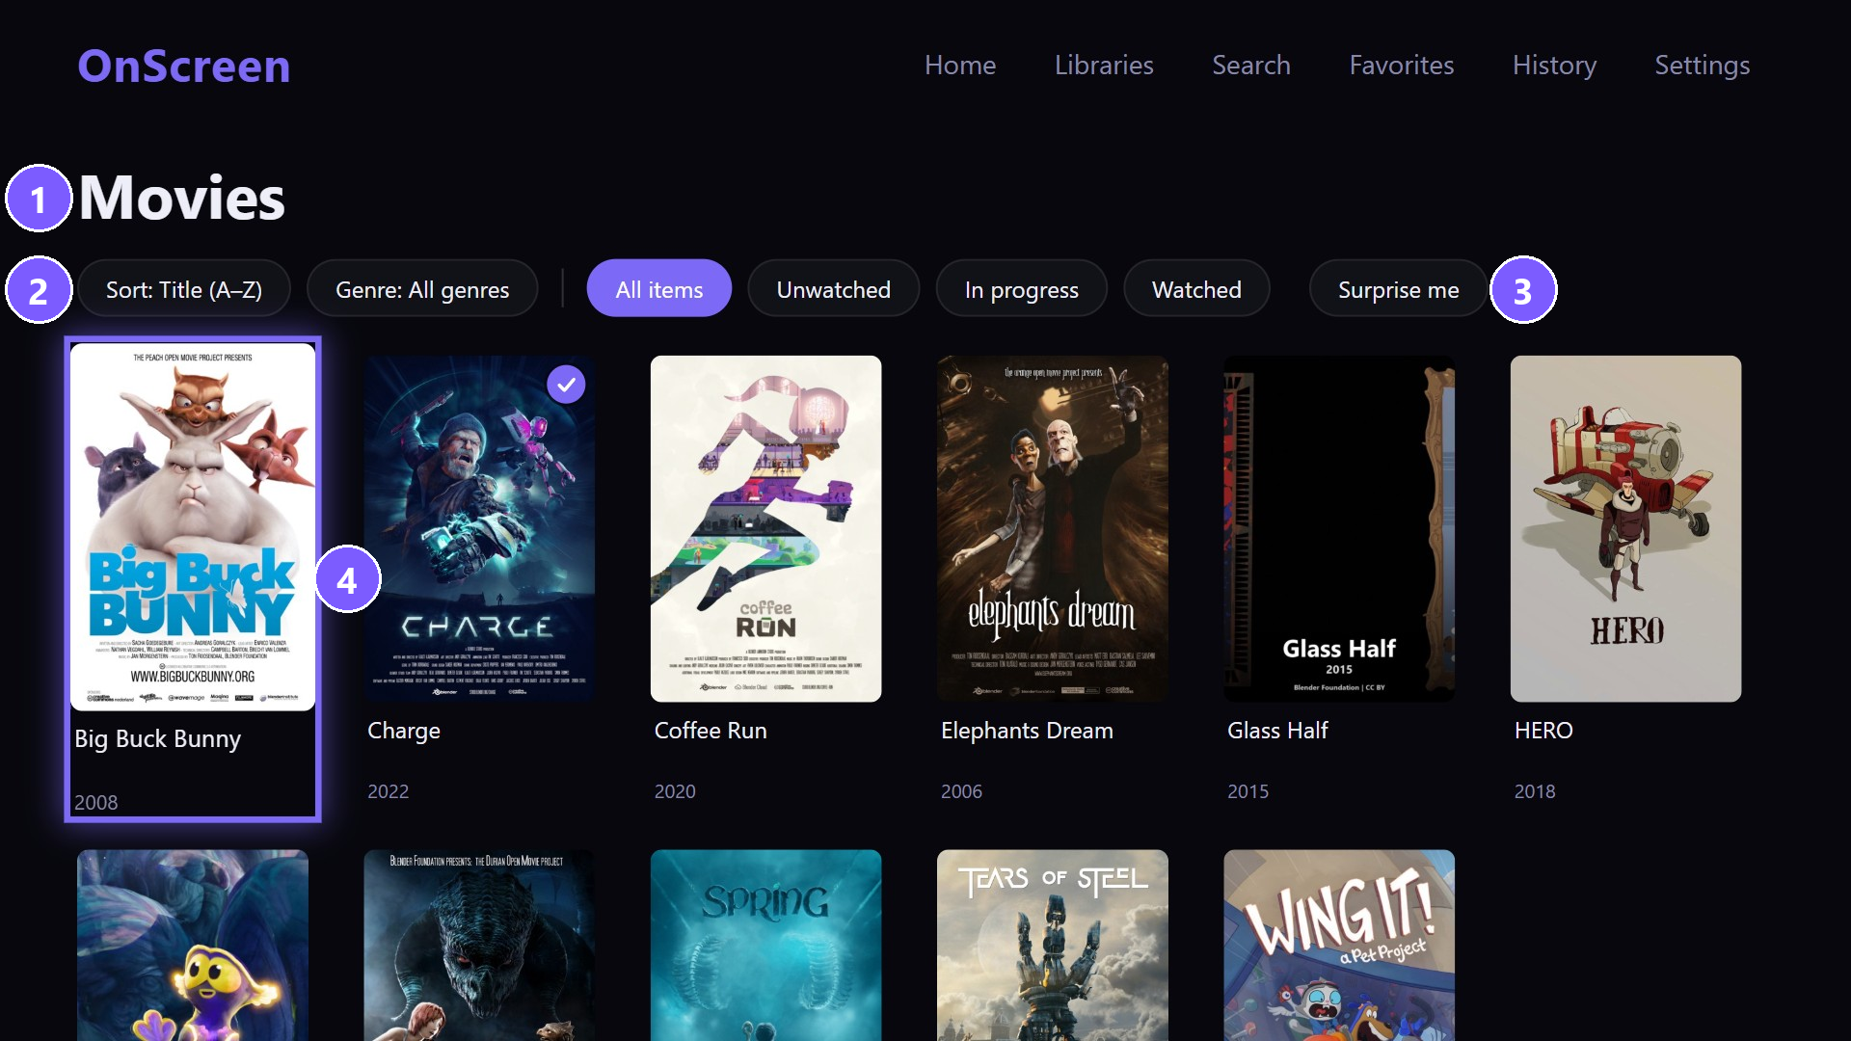
Menu & function description
- Library
No | Element | Attribute
1 | Library name | The library being browsed (opened from Libraries).
2 | Sort / Genre | Changes the order (title, year, added ...) and filters by genre.
3 | Filters | All items / Unwatched / In progress / Watched; Surprise me opens a random title.
4 | Focused card | OK opens the title. More titles load as the focus moves down.

Slide 11
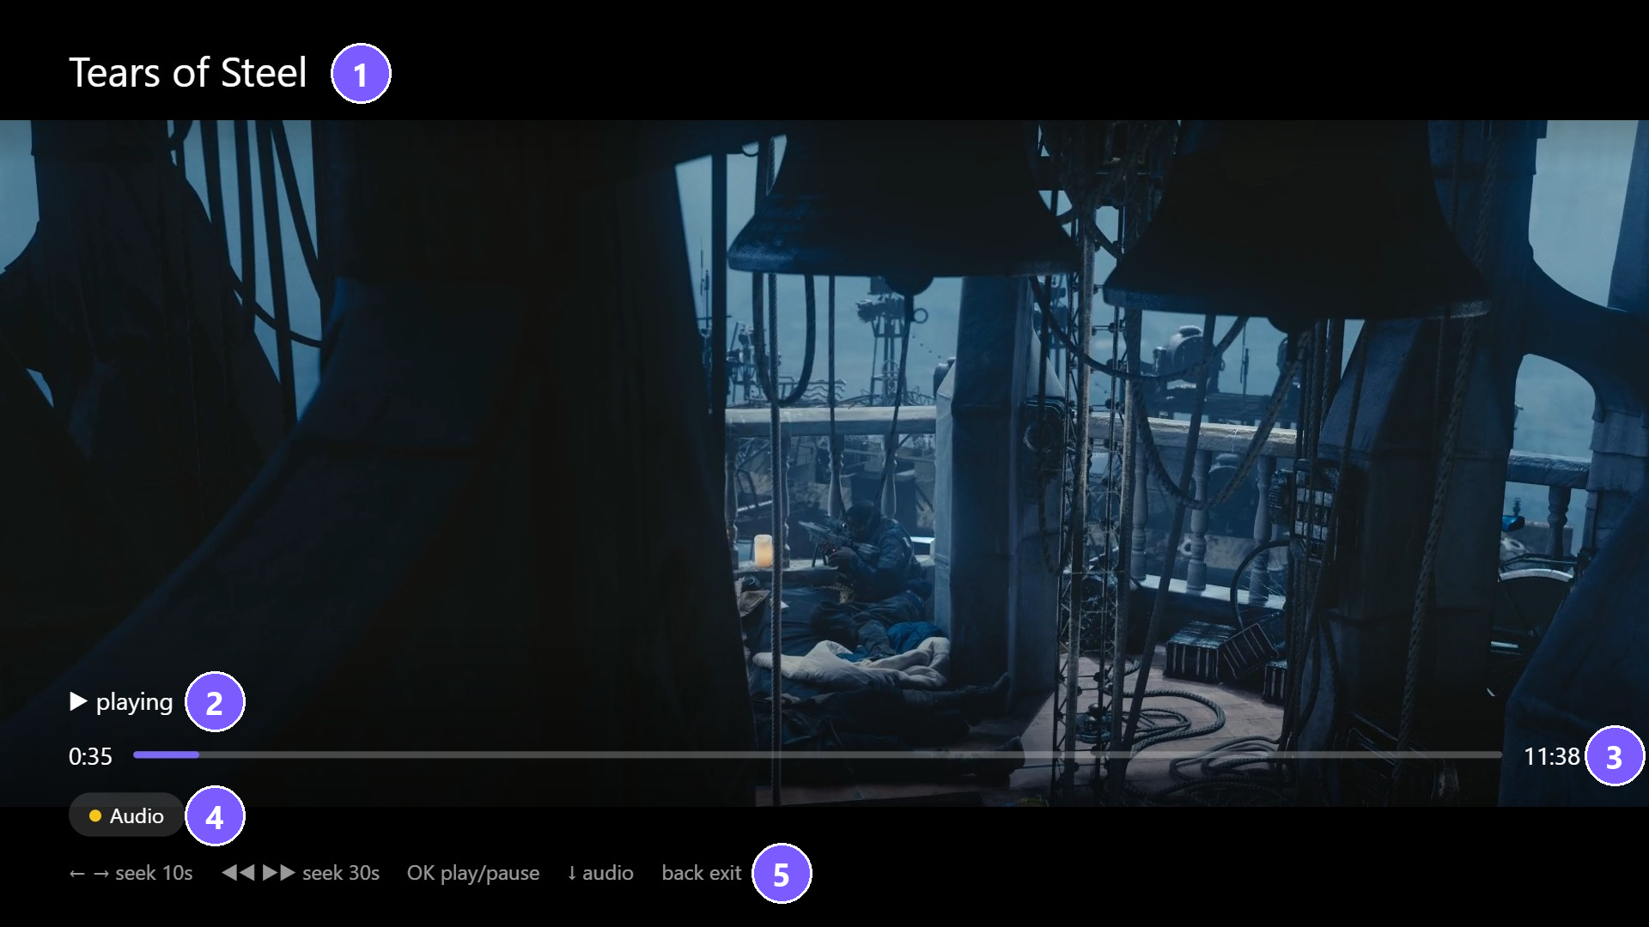
Menu & function description
- Playback
No | Element | Attribute
1 | Title | The title playing.
2 | Play state | Playing / paused, or the seek target while seeking.
3 | Progress bar | Elapsed and remaining time. Left / Right seek 10 s (with thumbnails while seeking).
4 | Track row | Audio, Subtitles and Chapters pickers, when the title has them. Down moves here.
5 | Key help | The remote keys this screen uses.

Slide 12
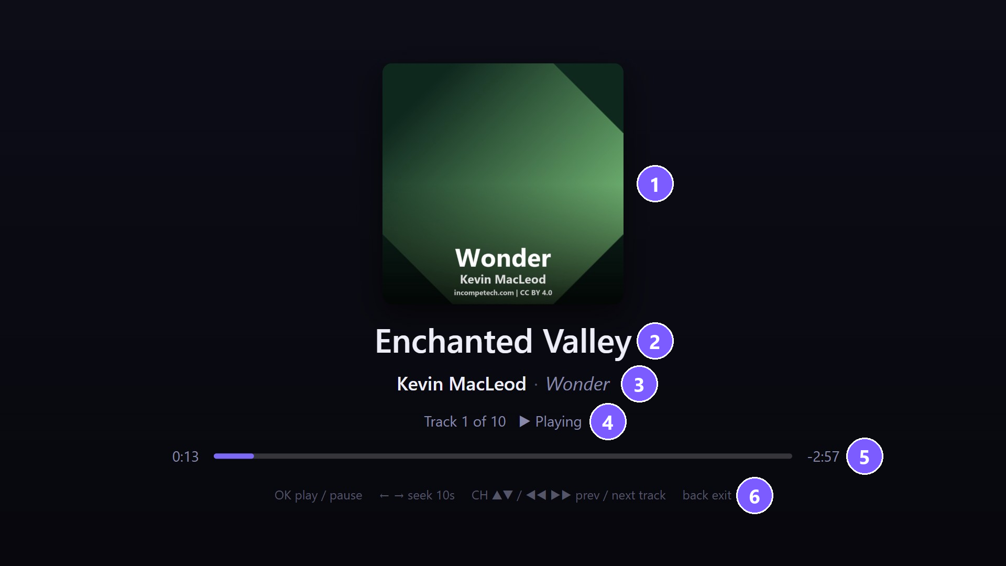
Menu & function description
- Music
No | Element | Attribute
1 | Album art | The album's cover.
2 | Track title | The track playing.
3 | Artist / Album | Artist and album.
4 | Track / state | Track number in the album, and playing / paused.
5 | Progress bar | Elapsed and remaining time; the next track starts by itself.
6 | Key help | OK play/pause, Left/Right seek 10 s, CH / FF / REW previous and next track, RETURN exits.

Slide 13
Menu & function description
- Other screens
Screen | Function
Search | On-screen keyboard; results from the user's own libraries. OK opens a result; RETURN keeps the query.
Favorites | Titles marked with Favorite. OK opens one.
History | What was played recently. OK opens the title.
Photo viewer | Full-screen photo. Left / Right: previous / next photo in the album. OK or PLAY: start / stop the slideshow.
Audiobook player | Like the music player, by chapter; Speed sets 0.5x to 3x.
Settings | Audio language, subtitle language, forced subtitles only; optional ListenBrainz / Last.fm / Trakt link; privacy policy (QR code); About (version); Sign out; Forget server.
Live TV / Recordings | Only when the user's server has a TV tuner. The test server has none, so these screens do not appear.

Slide 14
Key Policy
OnScreen's remote-key behaviour on every screen and in the player.
Button | Action | Remarks
ENTER (OK) | Select the focused item. Hold on a card: options. Player: show the controls / play-pause.
UP / DOWN / LEFT / RIGHT | Move the focus. Player with the controls hidden: LEFT / RIGHT seek 10 s; UP / DOWN show the controls.
RETURN | Previous page. On Home and the first-launch screens: closes the app to Smart Hub. Player: closes an open menu or Up Next first, then back to the detail page. | Samsung Mandatory
EXIT | Close the app. | Samsung Mandatory
PLAY / PAUSE | Player: play, pause (PLAY/PAUSE toggles). Photos: start / stop the slideshow.
STOP | Player: pause.
FF / REW | Video and audiobooks: forward / back 30 s. Music: next / previous track.
CH UP / DOWN | Player: next / previous track, audiobook chapter or episode (or chapter of a film). Live TV: next / previous channel. | Elsewhere: N/R
RED / GREEN | Player: previous / next chapter. | Elsewhere: N/R
YELLOW / BLUE | Player: open the Audio / Subtitles picker. | Elsewhere: N/R
0-9 | N/R
VOLUME / MUTE | Handled by the TV (system volume OSD).

Slide 15
How to change languages
Items | Contents
How to change languages | Not applicable: the app's menus are in English only. With another TV menu language (Settings > General > System Manager > Language) the app stays in English, with no broken layout or missing text. Titles and descriptions come from the user's server in the language of its metadata. Audio and subtitle track languages are chosen in the player or in the app's Settings (Audio language, Subtitle language).

