Slide 1
Browser Attacks
Ch. 4.1 from textbook
Slides adopted from Stanford Web Security Group

Slide 2
Outline
Web security model
Browser attacks
ActiveX
Javascript
Cookies & SOP

Slide 3
Browser and Network
Network
Browser
request
website
reply
OS
Hardware

Slide 4
HTTP: HyperText Transfer Protocol
Used to request and return data
Methods: GET, POST, HEAD, …
Stateless request/response protocol
Each request is independent of previous requests
Statelessness has a significant impact on design and implementation of applications
Evolution
HTTP 1.0: simple
HTTP 1.1: more complex

Slide 5
HTTP Request
Method
File
HTTP version
Headers
GET /default.asp HTTP/1.0
Accept: image/gif, image/x-bitmap, image/jpeg, */*
Accept-Language: en
User-Agent: Mozilla/1.22 (compatible; MSIE 2.0; Windows 95)
Connection: Keep-Alive
If-Modified-Since: Sunday, 17-Apr-96 04:32:58 GMT
Blank line
Data – none for GET

Slide 6
HTTP Response
HTTP version
Status code
Reason phrase
Headers
HTTP/1.0 200 OK
Date: Sun, 21 Apr 1996 02:20:42 GMT
Server: Microsoft-Internet-Information-Server/5.0
Connection: keep-alive
Content-Type: text/html
Last-Modified: Thu, 18 Apr 1996 17:39:05 GMT
Content-Length: 2543
<HTML> Some data... blah, blah, blah </HTML>
Data

Slide 7
Website Storing Info In Browser
A cookie is a file created by a website to store information in the browser
POST login.cgi
username and pwd
Server
Browser
HTTP Header:
Set-cookie: NAME=VALUE ;
domain = (who can read) ;
expires = (when expires) ;
secure = (send only over HTTPS)
If expires = NULL,
this session only
GET restricted.html
Server
Browser
Cookie: NAME=VALUE
HTTP is a stateless protocol; cookies add state

Slide 8
What Are Cookies Used For?
Authentication
Personalization
Tracking
Notes:
Authentication
The cookie proves to the website that the client previously authenticated correctly
Personalization
Helps the website recognize the user from a previous visit
Tracking
Follow the user from site to site; learn his/her browsing behavior, preferences, and so on

Slide 9
Goals of Web Security
Safely browse the Web
Support secure Web applications
Notes:
Safely browse the Web
A malicious website cannot steal information from or modify legitimate sites or otherwise harm the user…
… even if visited concurrently with a legitimate site - in a separate browser window, tab, or even iframe on the same webpage
Support secure Web applications
Applications delivered over the Web should have the same security properties we require for standalone applications (what are these properties?)

Slide 10
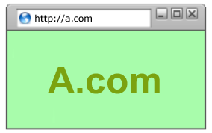
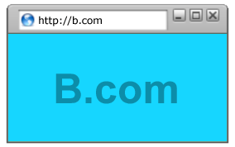
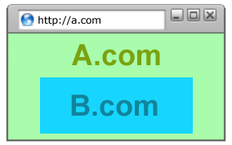
All of These Should Be Safe
Safe to visit a website
Safe to visit two pages
at the same time
Safe delegation

Slide 11
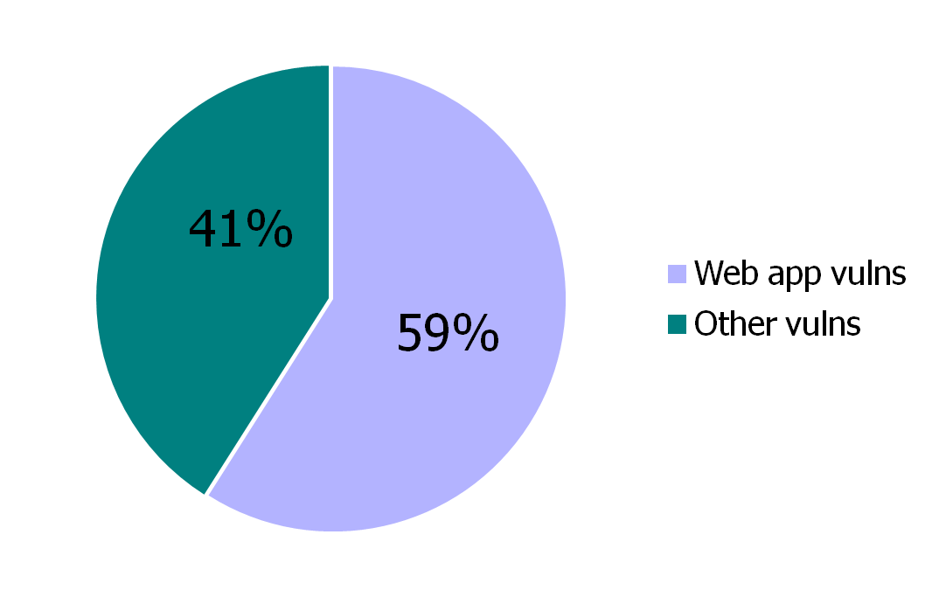
Security Vulnerabilities in 2011
Source: IBM X-Force

Slide 12
Two Sides of Web Security
Web browser
Web applications
Notes:
Web browser
Responsible for securely confining Web content presented by visited websites
Web applications
Online merchants, banks, blogs, Google Apps …
Mix of server-side and client-side code
Server-side code written in PHP, Ruby, ASP, JSP… runs on the Web server
Client-side code written in JavaScript… runs in the Web browser
Many potential bugs: XSS, XSRF, SQL injection

Slide 13
Where Does the Attacker Live?
Network attacker
Browser
website
Web attacker
Malware attacker
OS
Hardware
Notes:
Browser – tackle browser and its components
OS – go after OS to impede browser operation
Sniffing network – intercept communication

Slide 14
Web Threat Models
Web attacker
Network attacker
Passive: wireless eavesdropper
Active: evil Wi-Fi router, DNS poisoning
Malware attacker
Malicious code executes directly on victim’s computer
To infect victim’s computer, can exploit software bugs (e.g., buffer overflow) or convince user to install malicious content (how?)
Masquerade as an antivirus program, video codec, etc.

Slide 15
Web Attacker
Controls a malicious website (attacker.com)
User visits attacker.com – why?
Attacker has no other access to user machine!
Variation: “iframe attacker”
Notes:
Controls a malicious website (attacker.com)
Can even obtain an SSL/TLS certificate for his site ($0)
User visits attacker.com – why?
Phishing email, enticing content, search results, placed by an ad network, blind luck …
Attacker’s Facebook app
Attacker has no other access to user machine!
Variation: “iframe attacker”
An iframe with malicious content included in an otherwise honest webpage
Syndicated advertising, mashups, etc.

Slide 16
Dangerous Websites
Microsoft’s 2006 “Web patrol” study identified hundreds of URLs that could successfully exploit unpatched Windows XP machines
“But I never visit risky websites”
11 exploit pages are among top 10,000 most visited
Trick: put up a page with popular content, get into search engines, page then redirects to the exploit site
Notes:
Microsoft’s 2006 “Web patrol” study identified hundreds of URLs that could successfully exploit unpatched Windows XP machines
Many interlinked by redirection and controlled by the same major players
“But I never visit risky websites”
11 exploit pages are among top 10,000 most visited
Trick: put up a page with popular content, get into search engines, page then redirects to the exploit site
One of the malicious sites was providing exploits to 75 “innocuous” sites focusing on (1) celebrities, (2) song lyrics, (3) wallpapers, (4) video game cheats, and (5) wrestling

Slide 17
Outline
Web security model
Browser attacks
ActiveX
Javascript
Cookies & SOP

Slide 18
Browser attack types
Man-in-the-Browser
Keystroke Logger
Page-in-the-Middle
Program Download Substitution
User-in-the-Middle
https://workplacetablet.com/2015/09/14/the-man-in-the-browser-attack-why-no-one-is-safe-when-banking-online/
Notes:
Man-in-the-Browser
Trojan horse that intercepts data – silent banker, even authentication cannot protect what it cannot control. Devastating bcz data is sent as valid, authenticated user
Keystroke Logger – hw or sw
Page-in-the-Middle – redirect to another page
Program Download Substitution – users are usually wary
User-in-the-Middle – CAPTCHA and having humans solve them for bots, Google reCAPTCA uses computer behavior

Slide 19
How do browser attacks succeed?
Human Authentication
Computer Authentication
Notes:
Human Authentication – something you are, know or have
Computer Authentication – Computer address, serial number, initial authentication vs continuous authentication
Phishing: unsuspecting user submits information to a malicious system
Authentication vulnerabilities: usability, computer to computer allows limited base – stored key, malicious sw eavesdropping, assurance
Success: shared secret, one time password, out of band authentication, continuous

Slide 20
Outline
Web security model
Browser attacks
ActiveX
Javascript
Cookies & SOP

Slide 21
ActiveX
ActiveX “controls” are compiled binaries that reside on the client machine
Security model relies on three components
Digital signatures
Browser policy
Controls
Once accepted, installed and started, no control over execution!
Notes:
ActiveX “controls” are compiled binaries that reside on the client machine
Downloaded and installed, like any other executable
Activated by an HTML object tag on the page
Run as native binaries, not interpreted by the browser
Security model relies on three components
Digital signatures to verify the source of the control
Browser policy can reject controls from network zones
Controls can be marked by author as “safe for initialization” or “safe for scripting”

Slide 22
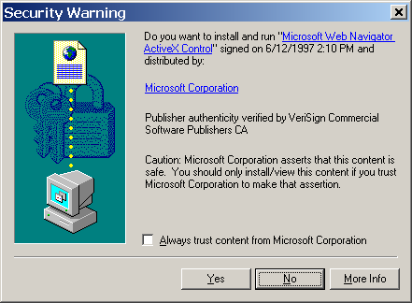
Installing ActiveX Controls
If you install and run, no further control over the code,
same access as any other program you installed

Slide 23
ActiveX Risks
From MSDN:
“An ActiveX control can be an extremely insecure way to provide a feature. Because it is a Component Object Model (COM) object, it can do anything the user can do from that computer. It can read from and write to the registry, and it has access to the local file system. From the moment a user downloads an ActiveX control, the control may be vulnerable to attack because any Web application on the Internet can repurpose it, that is, use the control for its own ends whether sincere or malicious.”
How can a control be “repurposed?”
Notes:
How can a control be “repurposed?”
Once a control is installed, any webpage that knows the control’s class identifier (CLSID) can access it using an HTML object tag embedded in the page

Slide 24
Outline
Web security model
Browser attacks
ActiveX
Javascript
Cookies & SOP

Slide 25
Browser: Basic Execution Model
Each browser window or frame:
Loads content
Renders
Processes HTML and executes scripts to display the page
May involve images, subframes, etc.
Responds to events
Events
User actions: OnClick, OnMouseover
Rendering: OnLoad, OnUnload
Timing: setTimeout(), clearTimeout()

Slide 26
HTML and Scripts
Browser receives content,
displays HTML and executes scripts
<html>
…
<p> The script on this page adds two numbers
<script>
var num1, num2, sum
num1 = prompt("Enter first number")
num2 = prompt("Enter second number")
sum = parseInt(num1) + parseInt(num2)
alert("Sum = " + sum)
</script>
…
</html>

Slide 27
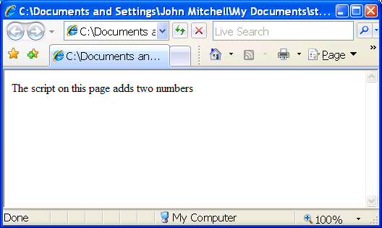
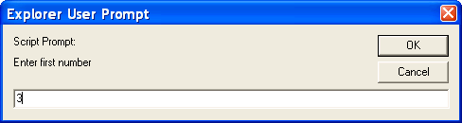
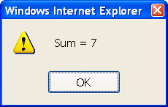

Slide 28
Event-Driven Script Execution
Script defines a
page-specific function
<script type="text/javascript">
function whichButton(event) {
if (event.button==1) {
alert("You clicked the left mouse button!") }
else {
alert("You clicked the right mouse button!")
}}
</script>
…
<body onmousedown="whichButton(event)">
…
</body>
Function gets executed
when some event happens

Slide 29
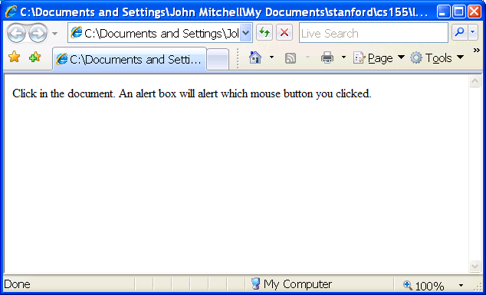
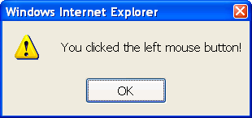

Slide 30
JavaScript
“The world’s most misunderstood programming language”
Language executed by the Web browser
Used to implement “active” webpages and Web applications
A potentially malicious webpage gets to execute some code on user’s machine
Notes:
Language executed by the Web browser
Scripts are embedded in webpages
Can run before HTML is loaded, before page is viewed, while it is being viewed, or when leaving the page

Slide 31
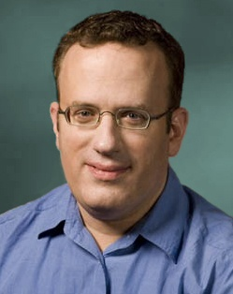
JavaScript History
Developed by Brendan Eich at Netscape
Scripting language for Navigator 2
Later standardized for browser compatibility
ECMAScript Edition 3 (aka JavaScript 1.5)
Related to Java in name only
Name was part of a marketing deal
“Java is to JavaScript as car is to carpet”
Various implementations available
SpiderMonkey, RhinoJava, others

Slide 32
Common Uses of JavaScript
Page embellishments and special effects
Dynamic content manipulation
Form validation
Navigation systems
Hundreds of applications
Google Docs, Google Maps, dashboard widgets in Mac OS X, Philips universal remotes …

Slide 33
JavaScript in Webpages
Embedded in HTML as a <script> element
Written directly inside a <script> element
<script> alert("Hello World!") </script>
In a file linked as src attribute of a <script> element
<script type="text/JavaScript" src=“functions.js"></script>
Event handler attribute
<a href="http://www.yahoo.com" onmouseover="alert('hi');">
Pseudo-URL referenced by a link
<a href=“JavaScript: alert(‘You clicked’);”>Click me</a>

Slide 34
Document Object Model (DOM)
HTML page is structured data
DOM is object-oriented representation of the hierarchical HTML structure
Properties: document.alinkColor, document.URL, document.forms[ ], document.links[ ], …
Methods: document.write(document.referrer)
These change the content of the page!
Also Browser Object Model (BOM)
Window, Document, Frames[], History, Location, Navigator (type and version of browser)

Slide 35
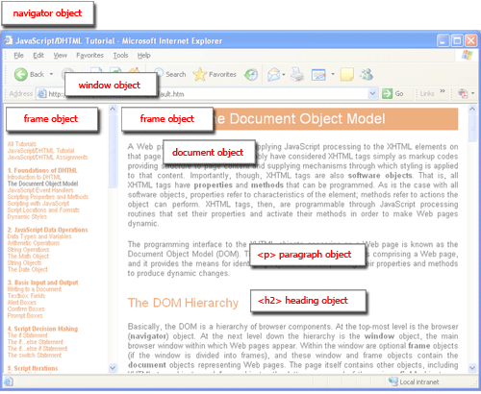
Browser and Document Structure
W3C standard differs from models supported in existing browsers

Slide 36
Reading Properties with JavaScript
Sample HTML
Sample script
<ul id="t1">
<li> Item 1 </li>
</ul>
1. document.getElementById('t1').nodeName
2. document.getElementById('t1').nodeValue
3. document.getElementById('t1').firstChild.nodeName
4. document.getElementById('t1').firstChild.firstChild.nodeName
5. document.getElementById('t1').firstChild.firstChild.nodeValue
Notes:
Example 1 returns "ul"
Example 2 returns "null"
Example 3 returns "li"
Example 4 returns "text"
A text node below the "li" which holds the actual text data as its value
Example 5 returns " Item 1 "

Slide 37
Page Manipulation with JavaScript
Sample HTML
Some possibilities
createElement(elementName)
createTextNode(text)
appendChild(newChild)
removeChild(node)
Example: add a new list item
<ul id="t1">
<li> Item 1 </li>
</ul>
var list = document.getElementById('t1')
var newitem = document.createElement('li')
var newtext = document.createTextNode(text)
list.appendChild(newitem)
newitem.appendChild(newtext)

Slide 38

A JavaScript “Rootkit”
[“Rootkits for JavaScript environments”]
if (window.location.host == "bank.com")
doLogin(password);
JavaScript bookmark
Malicious page defines a global variable named “window” whose value is a fake “location” object
var window = { location: { host: "bank.com" } };
A malicious webpage
Notes:
Bavlets
Script stored by the browser as a bookmark
Executed in the context of the current webpage
Typical uses:
Submit the current page to a blogging or bookmarking service
Query a search engine with highlighted text
Password managers
One-click sign-on
Automatically generate a strong password
Synchronize passwords across sites

Slide 39
Let’s Detect Fake Objects
[“Rootkits for JavaScript environments”]
window.location = “#”;
If window.location is a native object,
new value will be “https://bank.com/login#”
JavaScript bookmark
window.__defineGetter__("location",
function () { return "https://bank.com/login#"; });
window.__defineSetter__("location", function (v) { });
A malicious webpage

Slide 40
Let’s Detect Emulation
[“Rootkits for JavaScript environments”]
Use reflection API
typeof obj.__lookupGetter__(propertyName) !== "undefined"
typeOf and !== avoid asking for the value of
“undefined” (could be redefined by attacker!)
JavaScript bookmark
Attacker emulates reflection API itself!
Object.prototype.__lookupGetter__ =
function() { ... };
A malicious webpage

Slide 41
Outline
Web security model
Browser attacks
ActiveX
Javascript
Cookies & SOP

Slide 42
Same Origin Policy
protocol://domain:port/path?params
Same Origin Policy (SOP) for DOM:
Origin A can access origin B’s DOM if A and B have same (protocol, domain, port)
Same Origin Policy (SOP) for cookies:
Generally, based on ([protocol], domain, path)
optional

Slide 43
Setting Cookies by Server
GET …
Server
Browser
HTTP Header:
Set-cookie: NAME=VALUE;
domain = (when to send);
path = (when to send);
secure = (only send over HTTPS);
expires = (when expires);
HttpOnly
scope
if expires=NULL:
this session only
Delete cookie by setting “expires” to date in past
Default scope is domain and path of setting URL

Slide 44
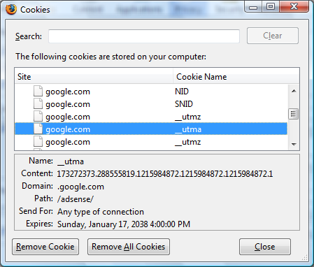
Viewing Cookies in Browser

Slide 45
Cookie Identification
Cookies are identified by (name, domain, path)
cookie 1
name = userid
value = test
domain = login.site.com
path = /
secure
cookie 2
name = userid
value = test123
domain = .site.com
path = /
secure
distinct cookies
Both cookies stored in browser’s cookie jar,
both are in scope of login.site.com

Slide 46
SOP for Writing Cookies
domain: any domain suffix of URL-hostname,
except top-level domain (TLD)
Which cookies can be set by login.site.com?
login.site.com can set cookies for all of .site.com but not for another site or TLD
Problematic for sites like .utexas.edu
path: anything
allowed domains
login.site.com
.site.com
disallowed domains
user.site.com
othersite.com
.com
✓
✗
✓
✗
✗

Slide 47
SOP for Sending Cookies
GET //URL-domain/URL-path
Cookie: NAME = VALUE
Server
Browser
Browser sends all cookies in URL scope:
cookie-domain is domain-suffix of URL-domain
cookie-path is prefix of URL-path
protocol=HTTPS if cookie is “secure”
Goal: server only sees cookies in its scope

Slide 48
Examples of Cookie SOP
cookie 1
name = userid
value = u1
domain = login.site.com
path = /
secure
cookie 2
name = userid
value = u2
domain = .site.com
path = /
non-secure
both set by login.site.com
http://checkout.site.com/
http://login.site.com/
https://login.site.com/
cookie: userid=u2
cookie: userid=u2
cookie: userid=u1; userid=u2
(arbitrary order; in FF3 most specific first)

Slide 49
Cookie Protocol Issues
What does the server know about the cookie sent to it by the browser?
Server only sees Cookie: Name=Value
… does not see cookie attributes (e.g., “secure”)
… does not see which domain set the cookie
RFC 2109 (cookie RFC) has an option for including domain, path in Cookie header, but not supported by browsers

Slide 50
Who Set The Cookie?
Alice logs in at login.site.com
login.site.com sets session-id cookie for .site.com
Alice visits evil.site.com
Overwrites .site.com session-id cookie with session-id of user “badguy” - not a violation of SOP! (why?)
Alice visits cs361s.site.com to submit homework
cs361s.site.com thinks it is talking to “badguy”
Problem: cs361s.site.com expects session-id from login.site.com, cannot tell that session-id cookie has been overwritten by a “sibling” domain

Slide 51
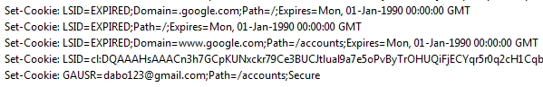
Overwriting “Secure” Cookies
Alice logs in at https://www.google.com https://www.google.com/accounts
Alice visits http://www.google.com
Automatically, due to the phishing filter
Network attacker can inject into response
Set-Cookie: LSID=badguy; secure
Browser thinks this cookie came from http://google.com, allows it to overwrite secure cookie
LSID, GAUSR are
“secure” cookies

