Slide 1
Donation Predictive Analysis
Modeling
MBAN 5210 GROUP EIGHT

Slide 2

Agenda
MBAN 5210
Introduction
Overview Problem
Targeted Population
Data Preparation
MBAN 5210
Assumptions
Variables selection
Model Approach
Logistic Regression
Multi-linear Regression
Conclusion
Conclusion
Recommendations & Future Considerations

Slide 3

Introduction
MBAN 5210
Business Problem
Maximum Net Operating Surplus
Contact Potential Members
Analytical Problem
MBAN 5210
Two-Stage Modeling
Uplift Modeling
Donation Predictive Modeling
Target Population
All Members in Database
First Step
10%

Slide 4
General
Assumption
Assumptions
MBAN 5210
Missing Value Interpretation
As
b. Assumption
For Donation Triggers
2020
MBAN 5210
Higher educated people live in urban area would be more encouraged by donation-raising events.
Middle-aged people have higher salary are more likely to donate.
People used to have higher amounts donation records will tend to donate continuously.
Presuppositions
Axioms
Taking for Granted

Slide 5

Logarithm
Salary
AmtLastYear
Referrals
Total Gift
Significant Variables
Transformation
Predictors
MBAN 5210
Variable Reduction
Max Gift
Min Gift
Total Gift
Salary
AmtLastYear
Age
Referrals
MBAN 5210
Greenacre’s Method
Senior List
Recency
Seniority

Slide 6
Model Approaches
MBAN 5210
MBAN 5210
LOGISTIC REGRESSION
LINEAR REGRESSION
TWO WAY
APPROACH
MODEL PERFORMANCE

Slide 7
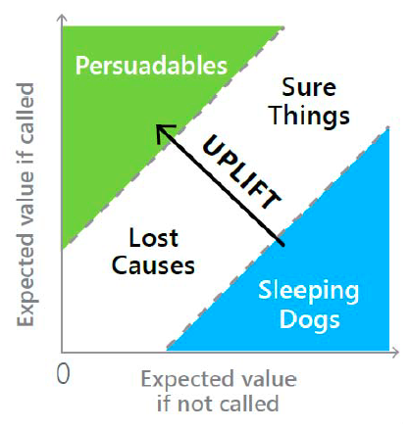
TWO-WAY APPROACH
MBAN 5210
01
Estimated Probability
Whether people will make a donation,
if contacted or not
02
Estimated Value
MBAN 5210
What will be the expected donation values, given contacted or not
Uplift = Probability * Value > $30 contact all
keep balance between risk and reward

Slide 8
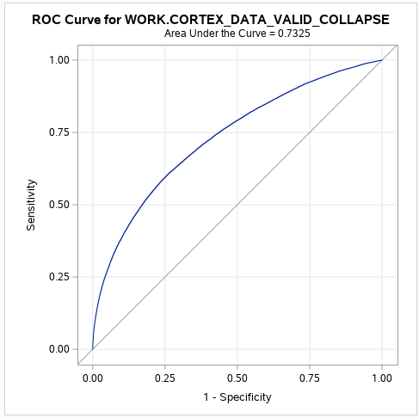
LOGISTIC REGRESSION
MBAN 5210
Overfitting Issue
01
Splitting into training data set and validation data set
MBAN 5210
Interaction
02
Automated Forward Selection Technique
Model Performance
03
ROC Curve on Validation Dataset

Slide 9
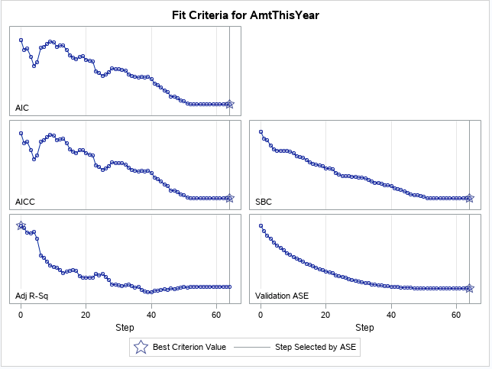
Linear Regression
MBAN 5210
01
Pearson Correlation
MBAN 5210
02
Multicollinearity
03
Backward selection with interactions and 2nd order terms

Slide 10

Insights and Recommendations
MBAN 5210
Advanced Regression Models
GLM
Low R²
MBAN 5210
More Continuous Variables
“Idle Money”
Solicitation -> Donation

Slide 11




Donors
94% of Donors are Women
Age Average: 33
MBAN 5210
Most of donors with University Background
Suburban > City > Downtown > Rural

Slide 12
Thank You !
MBAN 5210 GROUP EIGHT

