Slide 1

Incognoto
Michael Burke, Jessica Denney, Collin Guarino, Alex Hahn, Luke Roosje

Slide 2

A Worthy Adversary

Slide 3
The State of Privacy
Corporations are constantly collecting your private, personal information.
In fact, many companies track your behavior and collect your data as part of their business model (lookin’ at you Zuck). User privacy continues to be a concern, but individuals do not have the right tools to take complete control of their data.
Incognoto, the secure notes app, is a solution to this growing problem.
Leveraging advanced cryptographic tools and strict security policies, your ideas, thoughts, and secrets are safe with Incognoto.
Notes:
Alex

Slide 4
Project Requirements
Develop a cryptographically secure mobile application
Provide multiple user authentication methods for private content
Establish a set of security and privacy guidelines for mobile apps
Document and audit code libraries for other developers to utilize in their applications
Supply adequate security to low-end Android devices in developing markets
Notes:
Michael

Slide 5
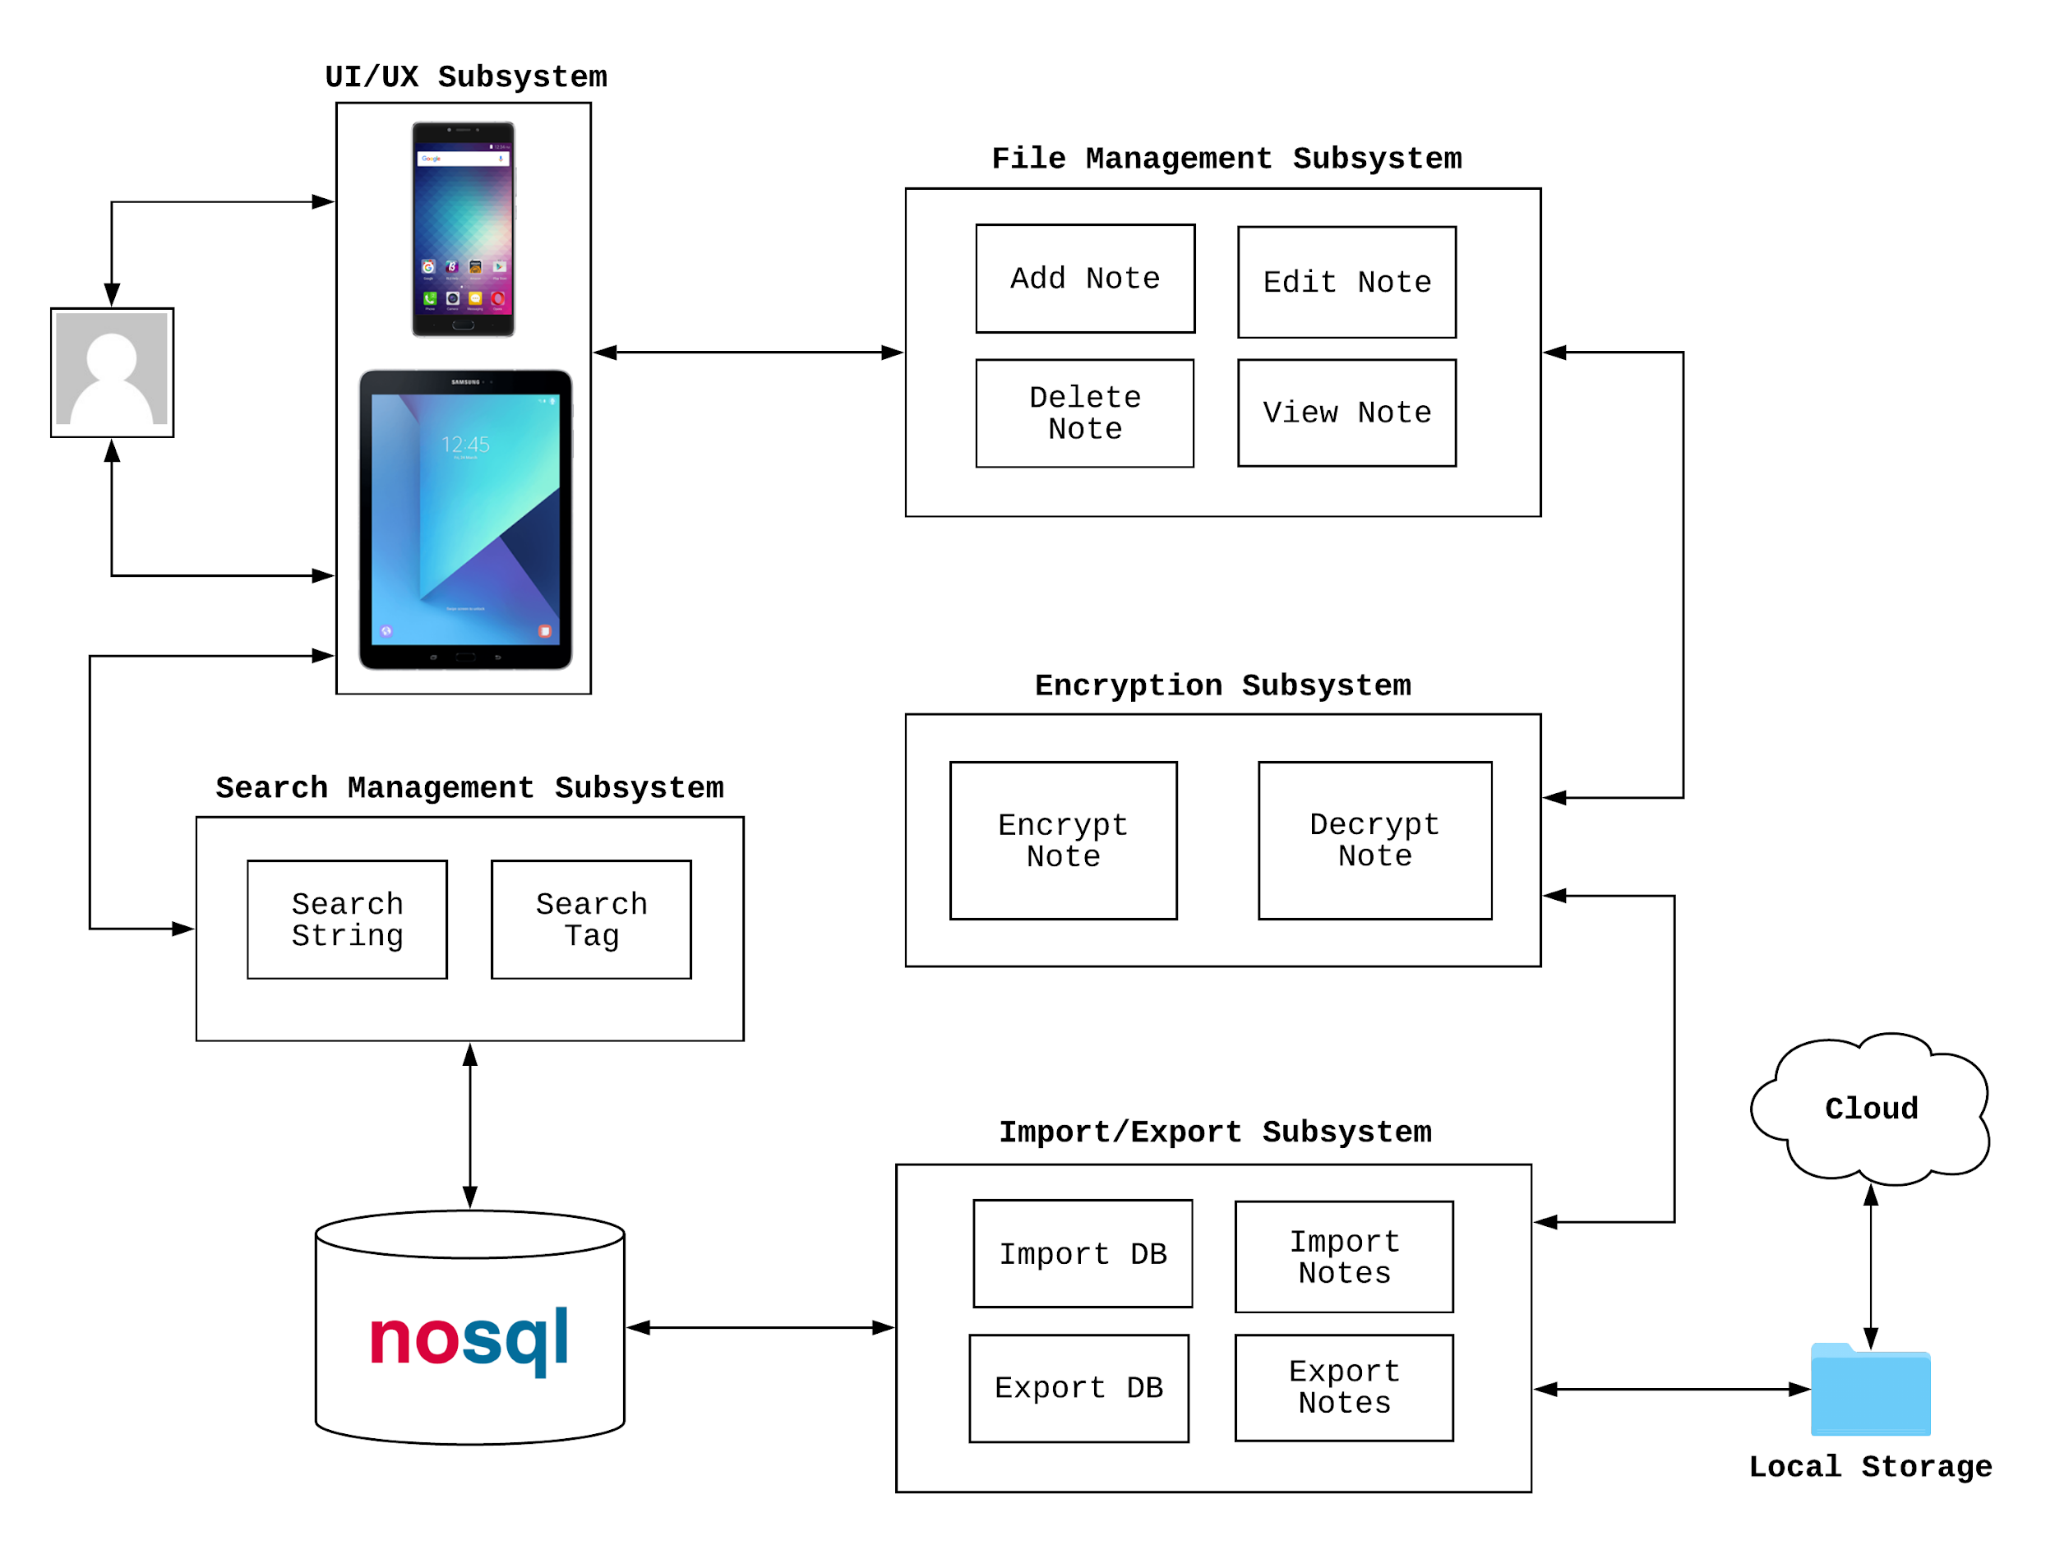
Subsystems
Notes:
Luke

Slide 6
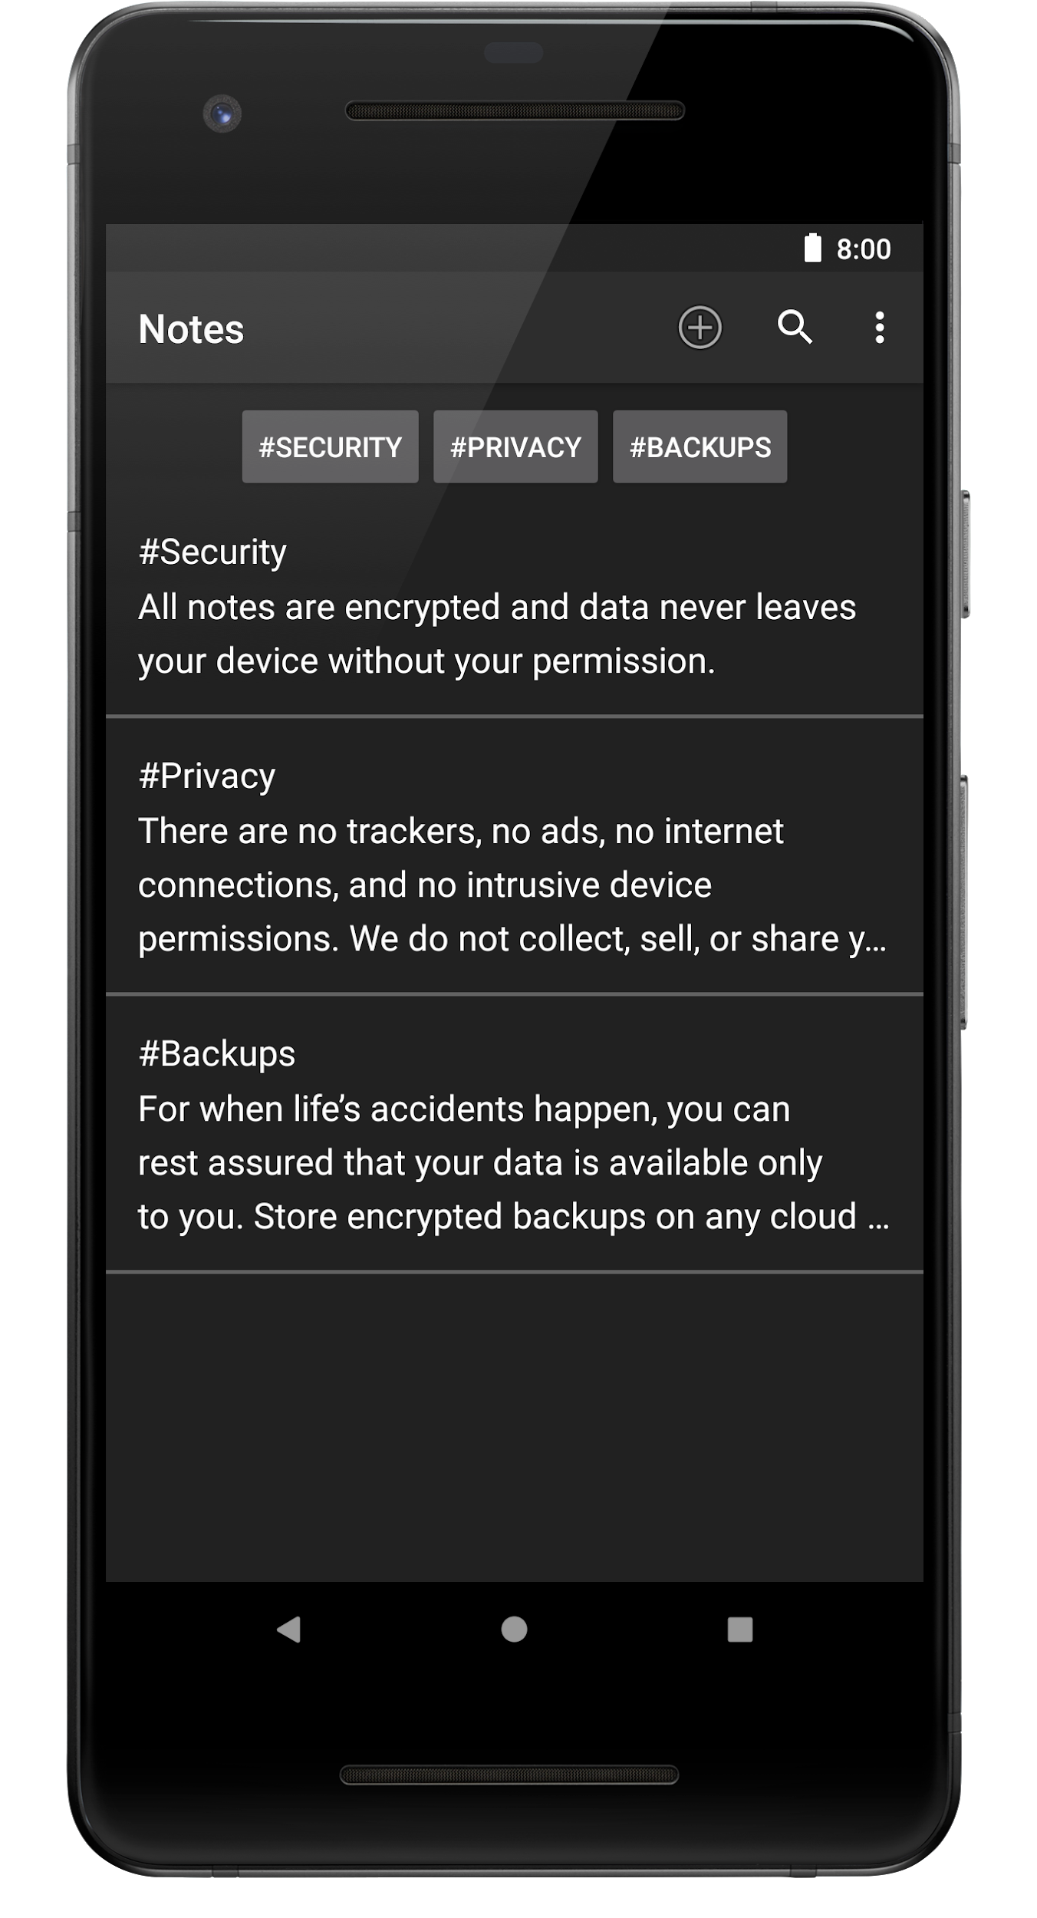
File Management Subsystem
Michael
Add, edit, delete, and view your notes
Simplistic view
Minimal restrictions
No character limits
No restriction on special characters
No button required to add tags
Few taps at most to use all features

Slide 7
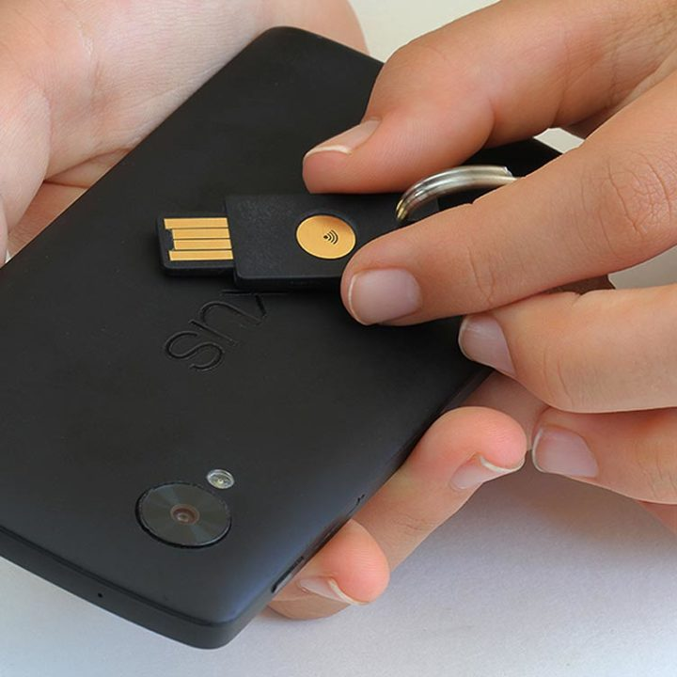
Cryptography & Authentication Subsystem
Collin
Document driven NoSQL database for encrypting and decrypting notes. Handler for data I/O that interfaces with the front end. Uses the native java.crypto and java.security classes, no external libraries. Multiple authentication methods enable ease of use and strong security with AES 256 and a salt. YubiKey NEO compatibility over NFC also makes security convenient.
Ensures Confidentiality, Integrity, and Accessibility of the entire system.
Notes:
Collin

Slide 8
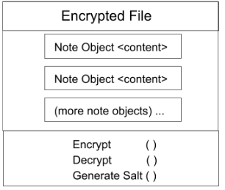
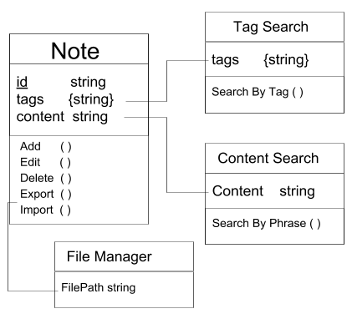
Data I/O

Slide 9
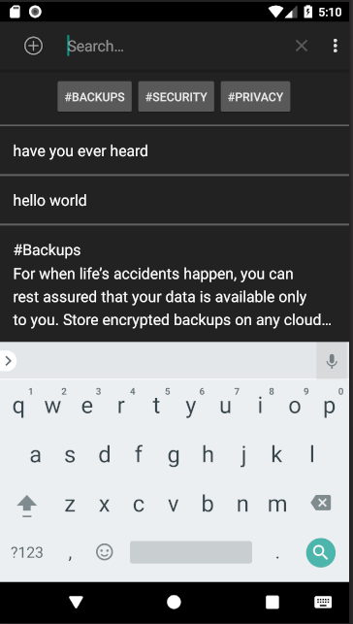
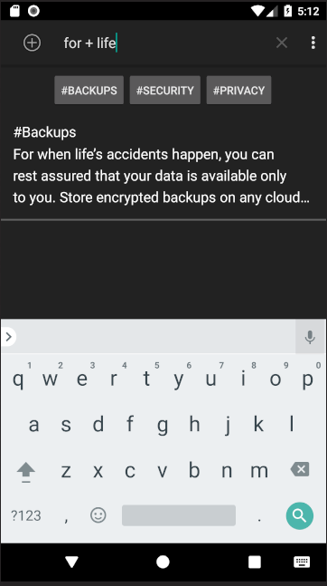
Search Management Subsystem
Luke
Users may have a lot of notes, and finding the one you want might be hard. This subsystem allows users to quickly get the notes that they want to look at.
How it's Used
Users can type what they are looking for in a search bar at the top of the app. They can also include reserved characters to do compound searches with boolean operations.
Tagging allows users to mark notes with hashtags so the most common things can be found even faster
Notes:
Luke

Slide 10
Import/Export Subsystem
Alex
The import/export subsystem allows users to import and export encrypted note content from the local file system.
Design and Model
Allow user to export their notes to a file
Ensures maximum security with minimal app footprint
No external services allowed to access the app
Android Share Intents
Used to share content between Android apps, services, etc.
Cloud Compatibility
Users can move their encrypted notes file to any cloud provider

Slide 11
User and Security Policies
Mitigated Risks
Harvesting (Guessing) Valid Password
Small Attack Surface
Timing Attacks
Terms of Service
GNU General Public License
User Education
Higher Privacy Standards
Data Protection
Use of Application
Security White Page
(OWASP) standards

Slide 12
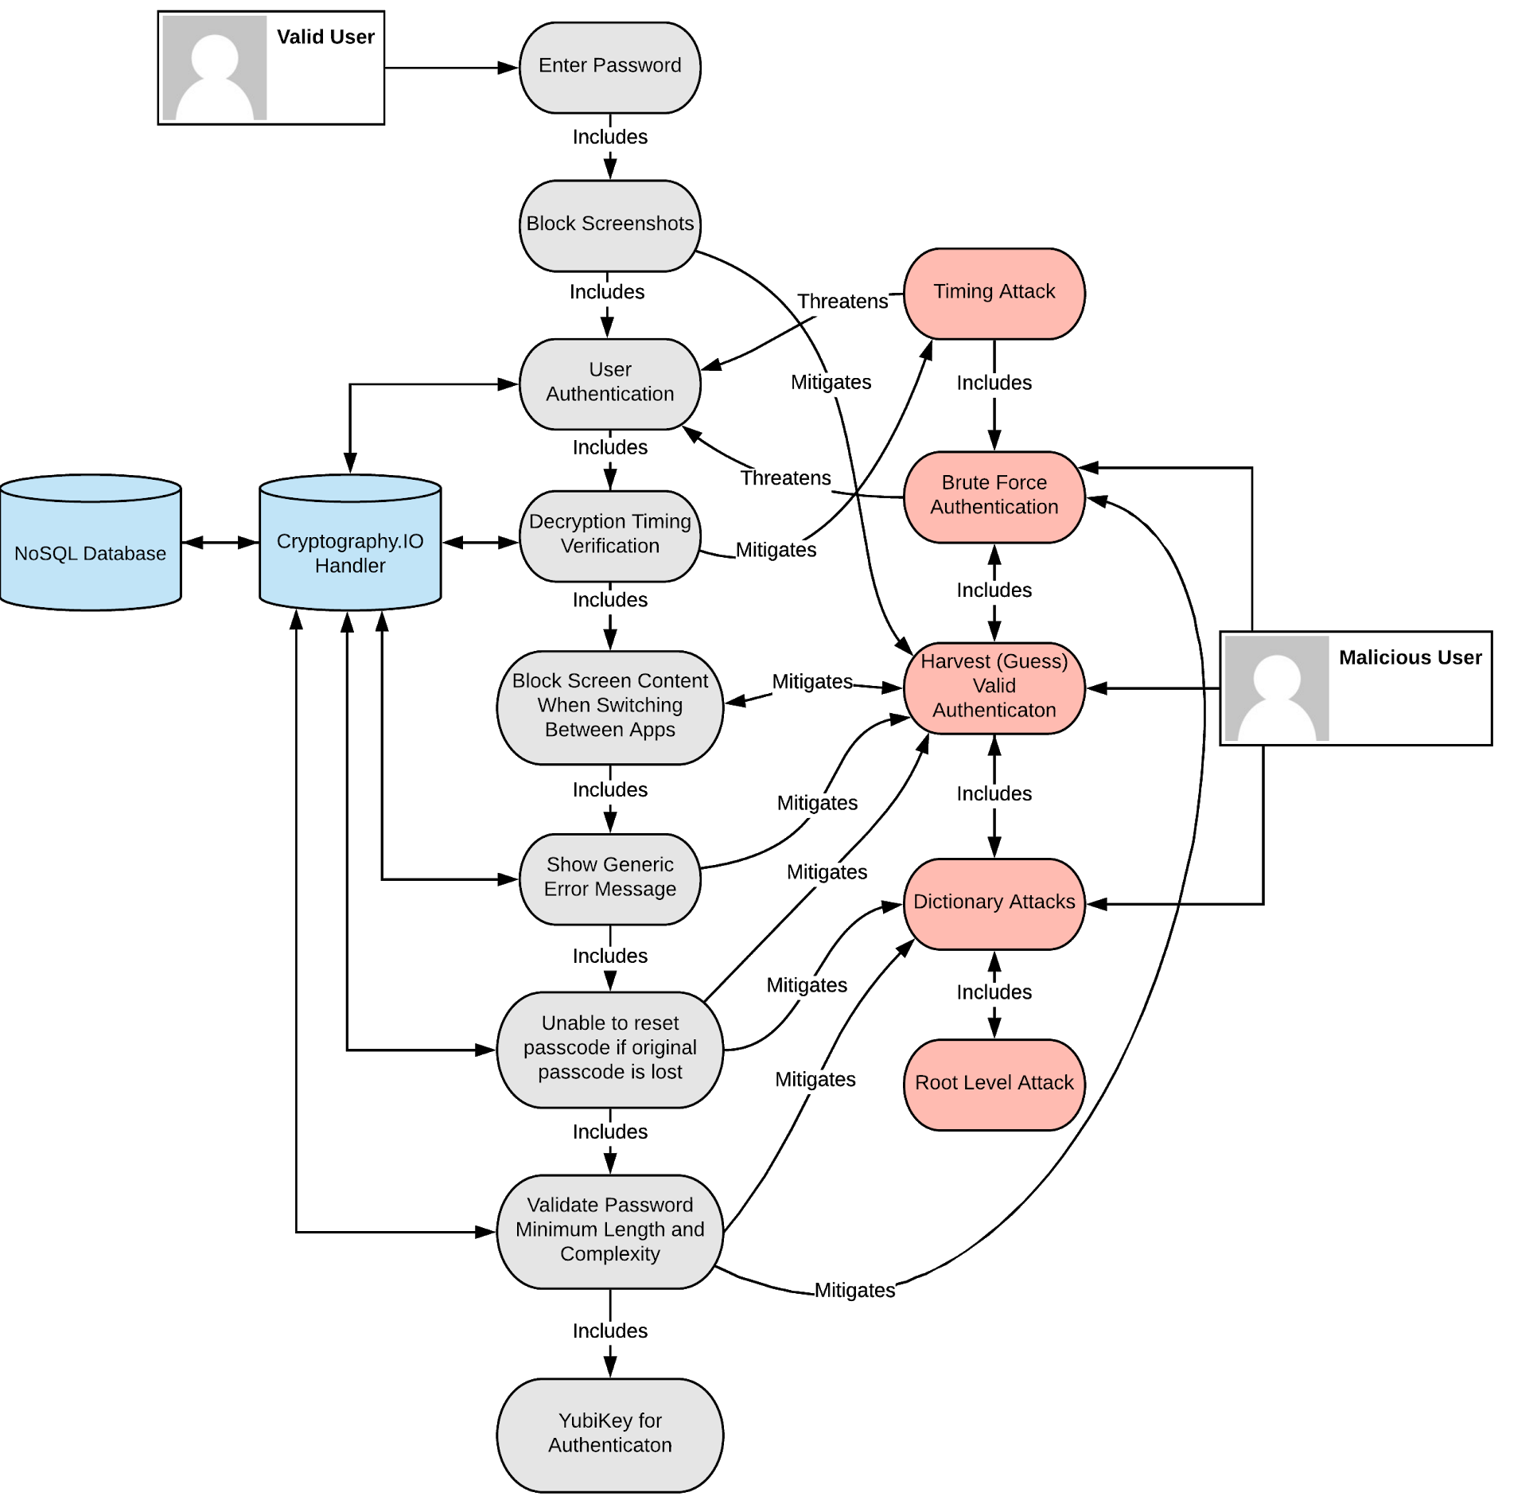
Use and Misuse
Mitigation Case
Graph
Accepted Risks
Use of YubiKey
Allowing Users to Create Passwords
Importing Filess

Slide 14
Future Efforts
High Extensibility
Modular functionality that is both secure and posses high usability across various data types and systems. An inherent focus on design and implementation of applications from file systems, contacts, calendar, passwords, and more.
Platform for User Privacy Education
A downloadable PDF of the Security Policy and a PDF of the User Manual will be hosted on the Github page and linked to from the Google Play Store.
Foundation for Advanced Authentication
The content access control will be expanded to incorporate biometric and two factor authentication.
Notes:
Denney

Slide 15
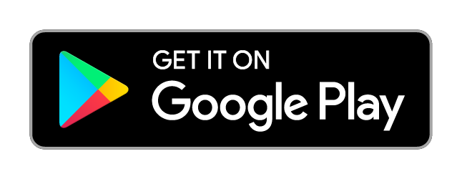
Incognoto
Questions?

