Slide 1
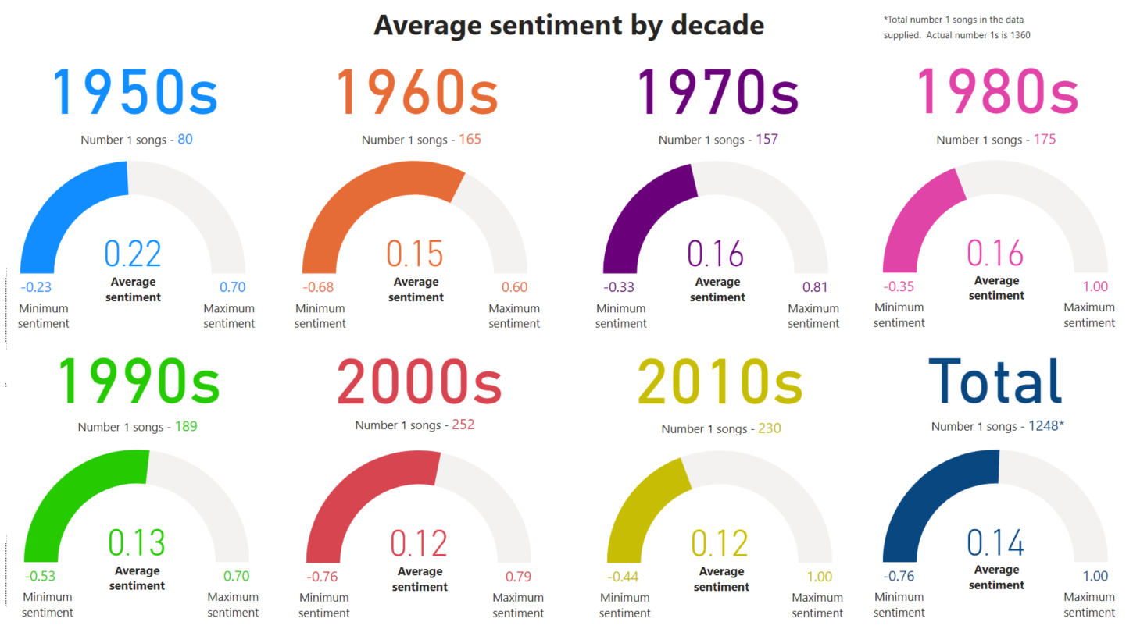


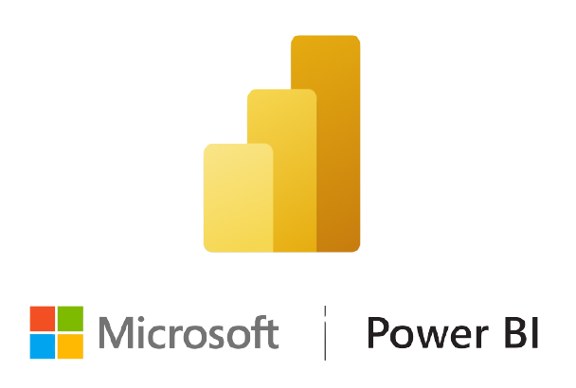
Sentiment Analysis on the UK Music Charts (1952-2020)
Colm Gallagher
B.Sc. (Hons) in Computing with Media Development
Abstract
Sentiment Analysis, also known as opinion mining, is the process of gathering data on the opinions and emotional feelings, in text form, emanating from human behaviour. This process is achieved with techniques such as Machine Learning and Natural Language Processing (NLP), using algorithms to understand the tone of the sentiment being expressed by the user.
Objective
The objective was to establish whether there appeared to be an obvious correlation between music lyrics and society over the period of the UK singles charts (1952-2020). Each set of lyrics were given a polarity score of between -1 (negative) and 1 (positive).
Methods
A prototype was completed on the American Billboard 100 charts using Python code in conjunction with Jupyter Notebook. A web scrape of the official UK charts website was then executed using Beautiful Soup to obtain every UK number one single. This dataset was amended by acquiring the sentiment and associated lyrics to each song from Genius.com. Once the data was cleaned, the sentiment analysis was performed utilising Microsoft Power BI.
Results
Conclusions
The image above evidences that the lyrical content of UK number ones has become gradually more negative across the history of the UK singles chart. On average, a decrease of 0.67% annually.
Number ones performed, solely, by UK artists have an average sentiment of 0.14; exactly the same as the total average of all nations combined.
1954 had the most positive average sentiment (0.31).
1996 had the most negative average sentiment (0.02).
2015 & 2016 are two of the four most negative years.
Although, on the decrease, the average sentiment of UK number ones has remained at a consistently neutral level.
No definitive proof of lyrical content was identified impacting on societal behaviour, or vice versa. However on observing the most commonly used words of each year in the study, they would illustrate an unequivocal trend towards profanity, misogyny, racism, and so forth.
Genius.com supplied several instances or erroneous lyrical data. This is something to consider if revisiting this process.

