Slide 1



Cross-border continuity of care
Track 2
Digital vaccination certificates
Track 1
Private & Confidential
Notes:
Original

Slide 2
Connectathon Activity Objectives:
Create and validate use cases
Facilitate a collaborative environment to discuss, analyze, and build use cases for "cross-border continuity of care" and "digital immunization certificates," identify technical requirements, and adopt interoperability standards to ensure the viability of these cases.
Provide training materials, technical guides, specialized tools, mentoring programs and training to ensure effective and sustainable implementation of cross-border use cases.
Build and Sustain Digital Infrastructure.
Establish a robust digital infrastructure that enables connectivity among LAC countries and is adaptable to future changes, facilitating access, control and portability of personal clinical information through digital services based on common specifications.
To improve cross-border digital health solutions in LAC by developing technical resources and promoting the use of standardized technical specifications for specific use cases, thus ensuring effective interoperability and continuity of care.
To create and strengthen the technical community in LAC.
Encourage collaboration and knowledge sharing among technical teams in LAC through the organization of workshops, training sessions, and networking activities that strengthen local and regional technical capabilities.
Demonstrate the technical and practical feasibility of the use cases through live testing during the Connectathon, simulating real scenarios where continuity of care and digital immunization certificates are effectively used to improve health and save lives, and fostering innovation in the sector.
Private & Confidential

Slide 3
Connectathon tracks:
These activities will advance the adoption of digital health technologies, strengthen regional collaboration, and build technical capacity to ensure that the benefits of digital transformation reach all Latin American and Caribbean citizens through the Pan-American Highway for Digital Health .
Cross-border continuity of care
Generate IPS & VHL
Person-Mediated Data Exchange
Mobile Health Document Sharing
Digital vaccination certificates
Generate DVC - DCC
Person-Mediated Data Exchange
Private & Confidential

Slide 4




Pre-condition: Onboard GDHCN - WHO
MEMBER STATE A
GDHCN
MoH
Public Key
Gazelle Truststore
DEADLINE Sept 15-2024

Slide 5










MEMBER STATE A
MEMBER STATE B
EHR
NCT - Nodo
Wallet
EHR
NCT - Nodo
Wallet
Patient Manager (MPI)
Scan
Terminology Server
Password
IPS
IPS
FHIR Server
IPS
Payload
List Documents
Broadcast Regional Node
Private Key
IPS
QR Library
Private & Confidential
Cross-border continuity of care

Slide 6

MEMBER STATE A
MEMBER STATE B
IR Soft
NCT - Nodo
Wallet
Verifier
Wallet
MPI
Scan
Terminology Server
IPS-VAC
FHIR Server
DVC
DVC
Payload
Private Key
DCC
QR Library
Private & Confidential
Digital vaccination certificates

Slide 7
Detailed version
Cross-border continuity of care
Track 2
Digital vaccination certificates
Track 1
Private & Confidential
Notes:
Original

Slide 8
MEMBER STATE A
MEMBER STATE B
EHR
NCT - Nodo
Wallet
EHR
NCT - Nodo
Wallet
Patient Manager (MPI)
Scan
VHL
Terminology Server
Password
IPS
IPS
FHIR Server
IPS
Payload
List Documents
Broadcast Regional Node
Private Key
IPS
QR Library
VHL
Private & Confidential
Cross-border continuity of care

Slide 9


MEMBER STATE A
EHR
Gazelle
NCT - Nodo
Wallet
ITI 78 PDQm
Gazelle (PM)
Gazelle (Proxy)
ITI 98 y 101 SVCM
Snowstorm Server
Gazelle (EVS Client)
CONTENT_CREATOR_ IPS_FHIR
IPS - LAC
Gazelle (Proxy)
ITI 65 MHD
IPS - LAC
FHIR Server
1st Track: 1.a Generate IPS & SHL
Private & Confidential
Cross-border continuity of care

Slide 10





MEMBER STATE A
Wallet
Gazelle
NCT - Nodo
EHR
Gazelle (Proxy)
ITI 68 MHD
FHIR Server
Gazelle (EVS Client)
CONTENT_CREATOR_ IPS_FHIR
IPS
Api VHL Generator
Payload
Gazelle (Proxy)
Private Key
Api GDHCN Validator
VHL
1st Track: 1.a Generate IPS & SHL
Private & Confidential
Cross-border continuity of care

Slide 11

MEMBER STATE A
EHR
Gazelle
NCT - Nodo
Wallet
Scan
VHL
<URL manifiest>
Password
BD Manifiest
<URL IPS>
FileServer IPS Temporary
Gazelle Manual Verification
IPS
1st Track: 1.b Person-Mediated Data Exchange
Private & Confidential
Cross-border continuity of care

Slide 12
MEMBER STATE A
EHR
Gazelle
NCT - Node
Regional Node
Gazelle (PM)
ITI 78 PDQm
Gazelle (Proxy)
ITI 67 MHD
Broadcast 67
FHIR Server Many Countries
ITI 68 MHD
FHIR Server
Gazelle Manual Verification
1st Track: 1.c Mobile Health Document Sharing
IPS - LAC
Private & Confidential
Cross-border continuity of care

Slide 13
MEMBER STATE A
MEMBER STATE B
IR Soft
NCT - Nodo
Wallet
Verifier
Wallet
MPI
Scan
DCC
Terminology Server
IPS-DVC
FHIR Server
DVC
DVC
Payload
Private Key
DCC
QR Library
Private & Confidential
Digital vaccination certificates

Slide 14
MEMBER STATE A
IR/IIS
Gazelle
NCT - Nodo
Wallet
ITI 78 PDQm
Gazelle (PM)
Gazelle (Proxy)
ITI 98 y 101 SVCM
Snowstorm Server
Gazelle (EVS Client)
CONTENT_CREATOR_ IPS_FHIR
IPS - DVC
Gazelle (Proxy)
ITI 65 MHD
IPS - DVC
FHIR Server
2nd Track: 2.a Generate DVC
Private & Confidential
Digital vaccination certificates

Slide 15
MEMBER STATE A
Wallet
Gazelle
NCT - Nodo
EHR
Gazelle (Proxy)
ITI 68 MHD
FHIR Server
Api DVC Generator
DVC
DVC Payload
Gazelle Manual Verification
Private Key
WHO Universal Validator
DCC
2nd Track: 2.a Generate DVC
Digital vaccination certificates
Private & Confidential
Cross-border continuity of care

Slide 16
MEMBER STATE A
EHR
Gazelle
NCT - Nodo
Wallet
Scan
DCC
Gazelle Manual Verification
DVC
2nd Track: 2.b Person-Mediated Data Exchange
Private & Confidential
Digital vaccination certificates

Slide 17
Verifiable milestones in the connectathon
Generate a IPS_LAC from EHR Send IPS to the Country Node
Generate VHL for IPS-LAC from the Citizen Wallet
Find a patient in the region Recover the IPS of another country Show in EHR viewer
SHL Reading Display IPS in EHR Viewer
30%
30%
20%
20%
IPS Save
Generate VHL
MHDS Find
IPS QR Find
Cross-border continuity of care
Track 2
Digital vaccination certificates
Track 1
Onboard GDHCN
DVC generate
Verifier DVC
Verifier GDHCN
20%
30%
20%
30%
Verify DVC in another country's Citizen Wallet from EHR
Start Country Node Send PK X.509
Check PK from another country on GDHCN
Generate a DVC from IR
Private & Confidential

Slide 18
Road to Connectathon 2024
EVENT
July
August
September
October
1st DEADLINE
10 Aug.
2nd DEADLINE
15 Sep.
3rd DEADLINE
30 Sept.
SQUAD to support countries Argentina – Bahamas – Barbados - Belize – Brasil - Chile – Colombia – Costa Rica - Ecuador – El Salvador – Guatemala – Honduras - Panama – Paraguay – Peru – Suriname – Uruguay Jul 1 - Sept 15
Workshop FHIR 3 Jul
Workshop IPS 18 Jul
Workshop #6 20 Aug
Workshop #8 10 Sept
Workshop #5 10 Aug
Monitors & CountryTeam
Workshop #7 30 Aug
Workshop #9 20 Sept
Workshop FHIR 11 Jul
Workshop GDHCN 25 Jul
Ready-made environments 15 Ago
Registry
Last Test
Onboard
Register Phase
20 Jul – 10 Sept
Pre-Conectatón Testing
23 Sept- 15 Oct
Connectivity
Country Node Published
GDHCN Onboard
Registration Done

Slide 19
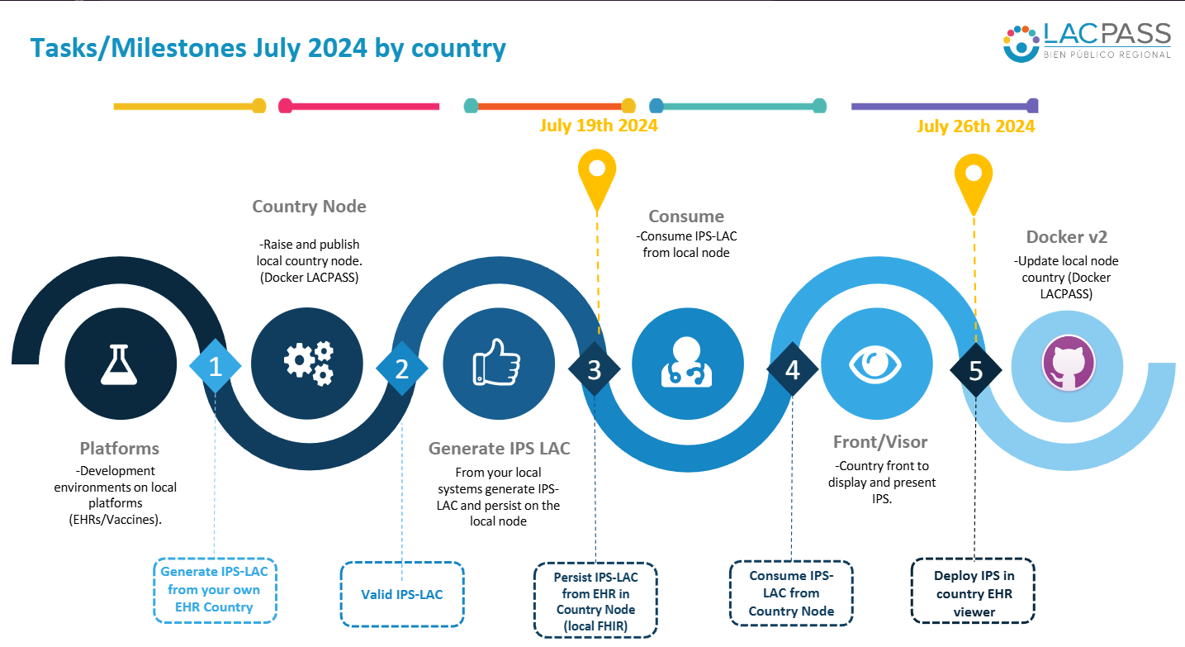


Tasks/Milestones July 2024 by country
July 19th 2024
July 26th 2024
Country Node
Consume
-Raise and publish local country node. (Docker LACPASS)
-Consume IPS-LAC from local node
Docker v2
-Update local node country (Docker LACPASS)
1
2
3
4
5
Platforms
Generate IPS LAC
Front/Visor
-Development environments on local platforms (EHRs/Vaccines).
From your local systems generate IPS-LAC and persist on the local node
-Country front to display and present IPS.
Generate IPS-LAC from your own EHR Country
Persist IPS-LAC from EHR in Country Node (local FHIR)
Consume IPS-LAC from Country Node
Deploy IPS in country EHR viewer
Valid IPS-LAC

Slide 20
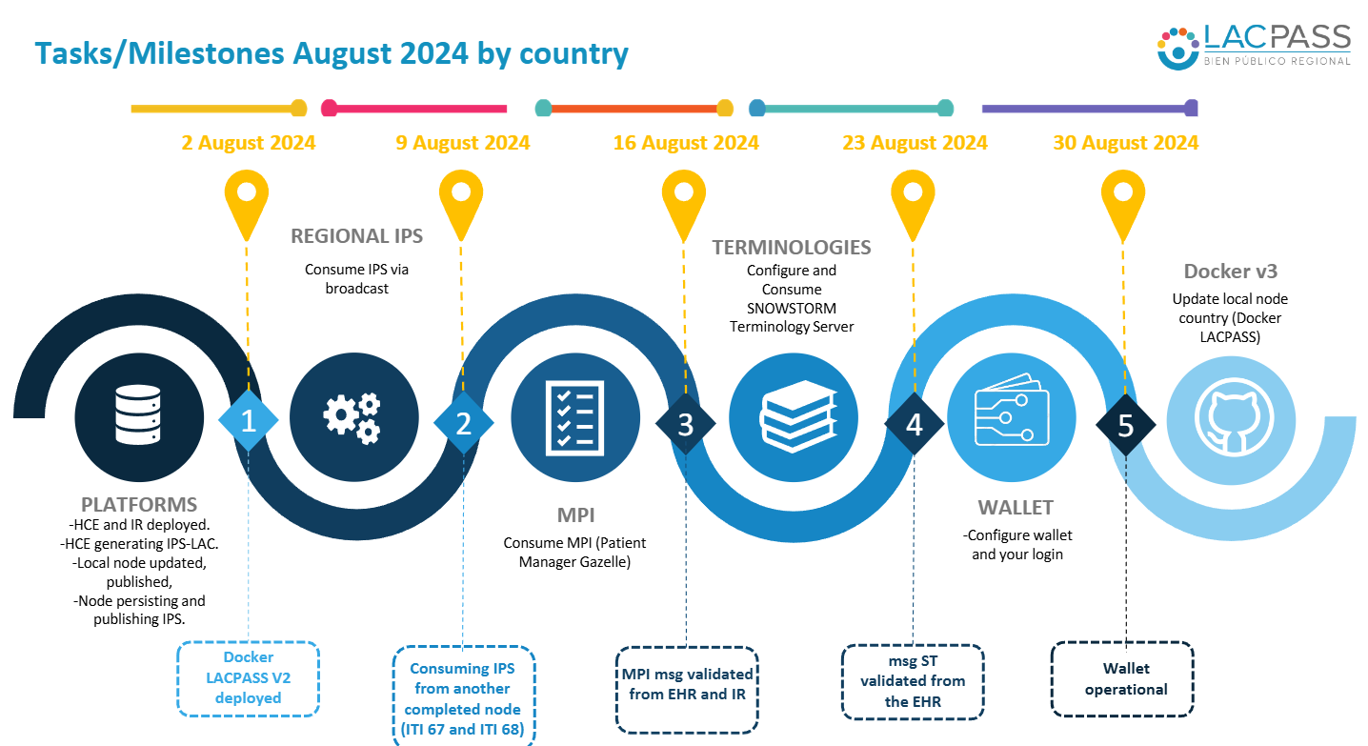

Slide 21







Tasks/Milestones September 2024 by country
6 sept 2024
13 Sept 2024
20 Sept 2024
27 Sept 2024
30 Sept 2024
WALLET + GDHCN
VHL
Keys generation/upload
Wallet with IPS capture and data selection
Wallet with Verifiable health Link (VHL) and QR saving
TRACK 2
DVC Generation
1
2
3
4
5
IPS/MHD
DISPLAY
MPI tests.
Terminology test
MHD test
INMUNIZATION
Vaccine to IPS-DVC from country platforms
EHR scenario 1 visualization
Track 1: MPI-Term-IPS Generate complete &
scenario 2 MHD Complete
Show IPS on Wallet
IPS-DVC Generation and Save
VHL + QR Stored in Wallet
TRACK 1
COMPLETED

Slide 22
Trainning sessions:
Theme | Presenter | Confirmed | Type | Date | Time EST | #
BROADCAST NODE | Create – Albany | S | Cerrada | Agosto 5
MPI IHE Simulator | IHE – TBD | S | Abierta | Agosto 8 |  | 104
Terminology Services II | SNOMED - Alejandro López | S | Cerrada | Agosto 12 | 12hs EST
IHE Registration | Souleyman Thiam | S | Cerrada | AGOST 27 | 9PM
Consent CPF | TBD | P | Abierta | TBD
Smart Health Links | TBD | P | Abierta | TBD
GDHCN | WHO- Carl Leiner | P | Abierta | Agosto 22 | 13HS EST
Terminology Services III | SNOMED - Alejandro López | S | Cerrada | Agosto 21 | 13hs EST | 41
Private & Confidential

Slide 23
Trainning sessions Ago-Sep:
Theme | Presenter | Confirmed | Type | Date | Time EST
GDHCN | WHO- Carl Leiner | S | Abierta | Agosto 22 | 13HS EST
IHE Registration | Souleyman Thiam | S | Cerrada | AGOST 27 | 9PM
MPI SIMULATOR | Albany |  | Cerrada+Caribe
WEB APP | Sergio | P | Abierta | TBD
Smart Health Links | Vinod/Naveen | P | Abierta | TBD
Brazil / Costa Rica |  |  |  | Sep 5
Private & Confidential

Slide 24
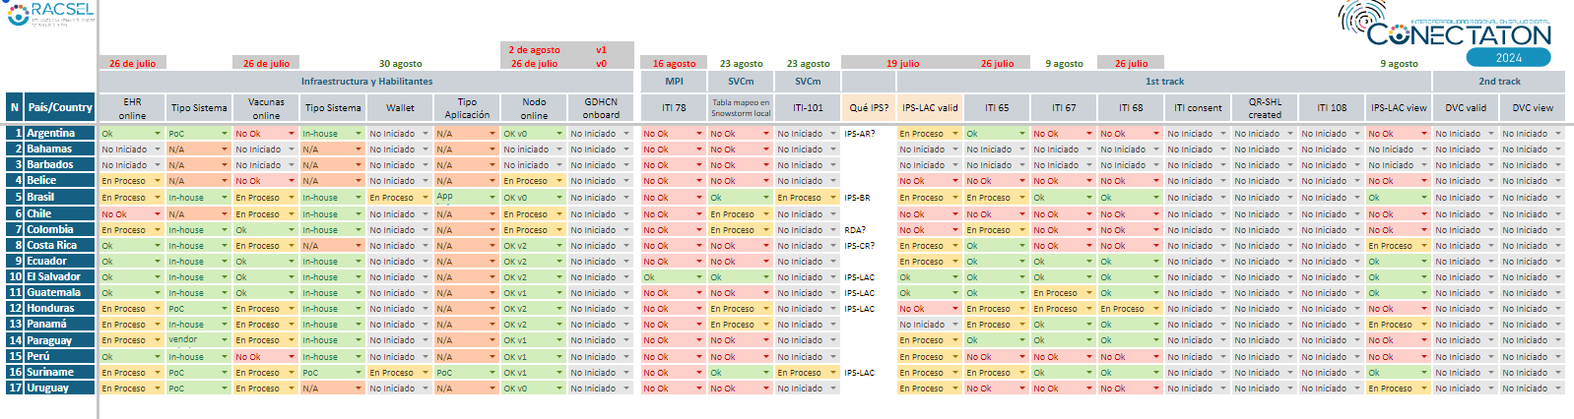
Road to 2024 Connectathon

Slide 25
Connectathon 2024 initial tool list
Tools to cover PH4H Use-cases | Teams in charge of Development/Update and/or Configuration | Comments/agreements
IPS-LAC IG Validator (EVS Client) | IHE Catalyst
IPS-LAC + Sign/Consent (envelope) IG Validator (EVS Client) | IHE Catalyst + IG from Hajj Project
PCF Validator | IHE Catalyst
Patient Manager | IHE Catalyst
SnowStorm (terminology server) | Snomed International
Create GDHCN domain for PH4H | WHO team
GDHCN Validator | WHO team
SHL QR Code Generator | Hajj Project
SHL QR Code Validator | Hajj Project
Simulator PCF????
Gazelle Proxy (for use-cases transactions) | IHE Catalyst | Ig DVC

Slide 26
References:
Smart Health Cards SHC and Smart Health Links:
https://smarthealth.cards/en/how-they-work.html
https://docs.smarthealthit.org/smart-health-links/)
IPS & SHL: https://confluence.hl7.org/plugins/servlet/mobile?contentId=203358469#content/view/203358469
WHO SHL Implementation Guides:
https://smart.who.int/trust/StructureDefinition-SmartHealthLink.html
Others, for uses cases and docummentation:
https://www.devdays.com/wp-content/uploads/2023/08/230607_JohnDAmore_Patient_Mediated_IPS_exchange_with_SMART_Health_Links.pdf
https://docs.smarthealthit.org/smart-health-links/design
IHE : WHO Plugathon
https://connectathon.ihe-europe.net/ihe-europe-plugathons-2024

Slide 27
Continuidad transfronteriza de la atención
Track 2
Certificados digitales de vacunación
Track 1
Notes:
Original

Slide 28
Objetivos de la actividad del Connectathon:
Crear y validar casos de uso
Facilitar un entorno colaborativo para discutir, analizar y crear casos de uso para la "continuidad transfronteriza de la atención" y los "certificados digitales de inmunización", identificar los requisitos técnicos y adoptar estándares de interoperabilidad para garantizar la viabilidad de estos casos. Proporcionar materiales de capacitación, guías técnicas, herramientas especializadas, programas de tutoría y capacitación para garantizar la implementación efectiva y sostenible de casos de uso transfronterizos.
Construir y mantener la infraestructura digital.
Establecer una infraestructura digital robusta que permita la conectividad entre los países de ALC y sea adaptable a los cambios futuros, facilitando el acceso, control y portabilidad de la información clínica personal a través de servicios digitales basados en especificaciones comunes. Mejorar las soluciones transfronterizas de salud digital en ALC mediante el desarrollo de recursos técnicos y la promoción del uso de especificaciones técnicas estandarizadas para casos de uso específicos, asegurando así la interoperabilidad efectiva y la continuidad de la atención.
Crear y fortalecer la comunidad técnica en ALC.
Fomentar la colaboración y el intercambio de conocimientos entre los equipos técnicos de ALC a través de la organización de talleres, sesiones de capacitación y actividades de networking que fortalezcan las capacidades técnicas locales y regionales. Demostrar la viabilidad técnica y práctica de los casos de uso a través de pruebas en vivo durante el Connectathon, simulando escenarios reales donde la continuidad de la atención y los certificados digitales de inmunización se utilizan de manera efectiva para mejorar la salud y salvar vidas, y fomentando la innovación en el sector.

Slide 29
Pistas de Connectathon:
Estas actividades impulsarán la adopción de tecnologías de salud digital, fortalecerán la colaboración regional y desarrollarán capacidades técnicas para garantizar que los beneficios de la transformación digital lleguen a todos los ciudadanos de América Latina y el Caribe a través de la Carretera Panamericana para la Salud Digital.
Continuidad transfronteriza de la atención
Generar IPS y VHL Intercambio de datos mediado por personas Uso compartido de documentos de salud móvil
Certificados digitales de vacunación}
Generar DVC Intercambio de datos mediado por personas

Slide 30
Condición previa: Onboard GDHCN - WHO
MEMBER STATE A
GDHCN
MoH
Public Key
Gazelle Truststore
DEADLINE Sept 15-2024

Slide 31
MEMBER STATE A
MEMBER STATE B
EHR
NCT - Nodo
Wallet
EHR
NCT - Nodo
Wallet
Patient Manager (MPI)
Scan
Terminology Server
Password
IPS
IPS
FHIR Server
IPS
Payload
List Documents
Broadcast Regional Node
Private Key
IPS
QR Library
Private & Confidential
Continuidad transfronteriza de la atención

Slide 32
MEMBER STATE A
MEMBER STATE B
IR Soft
NCT - Nodo
Wallet
Verifier
Wallet
MPI
Scan
DCC
Terminology Server
IPS - DVC
FHIR Server
DVC
DVC
Payload
Private Key
QR Library
DCC
Private & Confidential
Digital vaccination certificates

Slide 33
Versión detallada
Continuidad transfronteriza de la asistencia
Track 2
Certificados digitales de vacunación
Track 1
Privado y confidencial
Notes:
Original

Slide 34
MEMBER STATE A
MEMBER STATE B
EHR
NCT - Nodo
Wallet
EHR
NCT - Nodo
Wallet
Patient Manager (MPI)
Scan
Terminology Server
Password
IPS
IPS
FHIR Server
IPS
Payload
List Documents
Broadcast Regional Node
Private Key
IPS
QR Library
Private & Confidential
Continuidad transfronteriza de la atención

Slide 35
MEMBER STATE A
EHR
Gazelle
NCT - Nodo
Wallet
ITI 78 PDQm
Gazelle (PM)
Gazelle (Proxy)
ITI 98 y 101 SVCM
Snowstorm Server
Gazelle (EVS Client)
CONTENT_CREATOR_ IPS_FHIR
IPS - LAC
Gazelle (Proxy)
ITI 65 MHD
IPS - LAC
FHIR Server
1st Track: 1.a Generate IPS & SHL
Private & Confidential
Cross-border continuity of care

Slide 36
MEMBER STATE A
Wallet
Gazelle
NCT - Nodo
EHR
Gazelle (Proxy)
ITI 68 MHD
FHIR Server
Gazelle (EVS Client)
CONTENT_CREATOR_ IPS_FHIR
IPS
Api VHL Generator
Payload
Gazelle (Proxy)
Private Key
Api GDHCN Validator
VHL
1st Track: 1.a Generate IPS & SHL
Private & Confidential
Cross-border continuity of care

Slide 37
MEMBER STATE A
EHR
Gazelle
NCT - Nodo
Wallet
Scan
VHL
<URL manifiest>
Password
BD Manifiest
<URL IPS>
FileServer IPS Temporary
Gazelle Manual Verification
IPS
1st Track: 1.b Person-Mediated Data Exchange
Private & Confidential
Cross-border continuity of care

Slide 38
MEMBER STATE A
EHR
Gazelle
NCT - Node
Regional Node
Gazelle (PM)
ITI 78 PDQm
Gazelle (Proxy)
ITI 67 MHD
Broadcast 67
FHIR Server Many Countries
ITI 68 MHD
FHIR Server
Gazelle Manual Verification
1st Track: 1.c Mobile Health Document Sharing
IPS - LAC
Private & Confidential
Cross-border continuity of care

Slide 39
MEMBER STATE A
MEMBER STATE B
IR Soft
NCT - Nodo
Wallet
Verifier
Wallet
MPI
Scan
DCC
Terminology Server
IPS - DVC
FHIR Server
DVC
DVC
Payload
Private Key
QR Library
DCC
Private & Confidential
Digital vaccination certificates

Slide 40
MEMBER STATE A
IR/IIS
Gazelle
NCT - Nodo
Wallet
ITI 78 PDQm
Gazelle (PM)
Gazelle (Proxy)
ITI 98 y 101 SVCM
Snowstorm Server
Gazelle (EVS Client)
CONTENT_CREATOR_ IPS_FHIR
IPS - DVC
Gazelle (Proxy)
ITI 65 MHD
FHIR Server
2nd Track: 2.a Generate DVC
IPS - DVC
Private & Confidential
Digital vaccination certificates

Slide 41
MEMBER STATE A
Wallet
Gazelle
NCT - Nodo
EHR
Gazelle (Proxy)
ITI 68 MHD
FHIR Server
Api DVC Generator
DVC
DVC Payload
Gazelle Manual Verification
Private Key
WHO Universal Validator
DCC
2nd Track: 2.a Generate DVC
Digital vaccination certificates
Private & Confidential
Cross-border continuity of care

Slide 42
MEMBER STATE A
EHR
Gazelle
NCT - Nodo
Wallet
Scan
DCC
Gazelle Manual Verification
DVC
2nd Track: 2.b Person-Mediated Data Exchange
Private & Confidential
Digital vaccination certificates

Slide 43
Hitos verificables en el conectatón
Generar un IPS_LAC a partir de EHR Enviar IPS al nodo de país
Generar VHL para IPS-LAC desde la Billetera Ciudadana
Encontrar un paciente en la región Recuperar el IPS de otro país Mostrar en el visor de EHR
Lectura SHL Mostrar IPS en el visor de EHR
30%
30%
20%
20%
IPS Save
Generate VHL
MHDS Find
IPS QR Find
Continuidad transfronteriza de la atención
Track 2
Certificados digitales de vacunación
Track 1
Onboard GDHCN
DCC generate
Verifier DVC
Verifier GDHCN
20%
30%
20%
Verifique DVC en la billetera ciudadana de otro país desde EHR
Comprobar PK de otro país en GDHCN
Nodo de país de inicio Enviar PK X.509
Generar un DVC a partir de IR

Slide 44
Camino a la Conectatón 2024
EVENTO
Julio
Agosto
Septiembre
Octubre
1st DEADLINE
10 Aug.
2nd DEADLINE
15 Sep.
3rd DEADLINE
30 Sept.
SQUAD para apoyar a los países Argentina – Bahamas – Barbados - Belice – Brasil - Chile – Colombia – Costa Rica - Ecuador – El Salvador – Guatemala – Honduras – Panamá – Paraguay – Perú – Surinam – Uruguay 1 de julio - 15 de septiembre
Workshop FHIR 3 Jul
Workshop IPS 18 Jul
Workshop #6 20 Aug
Workshop #8 10 Sept
Workshop #5 10 Aug
Monitores & Equipo de País
Workshop #7 30 Aug
Workshop #9 20 Sept
Workshop FHIR 11 Jul
Workshop GDHCN 25 Jul
Ready-made Entornos 15 Ago
Registro
Última prueba
Onboard
Fase de registro20 Jul – 10 Sept
Pre-Conectatón Testing
Conectividad
Country Node Published
GDHCN Onboard
Registration Done

Slide 45
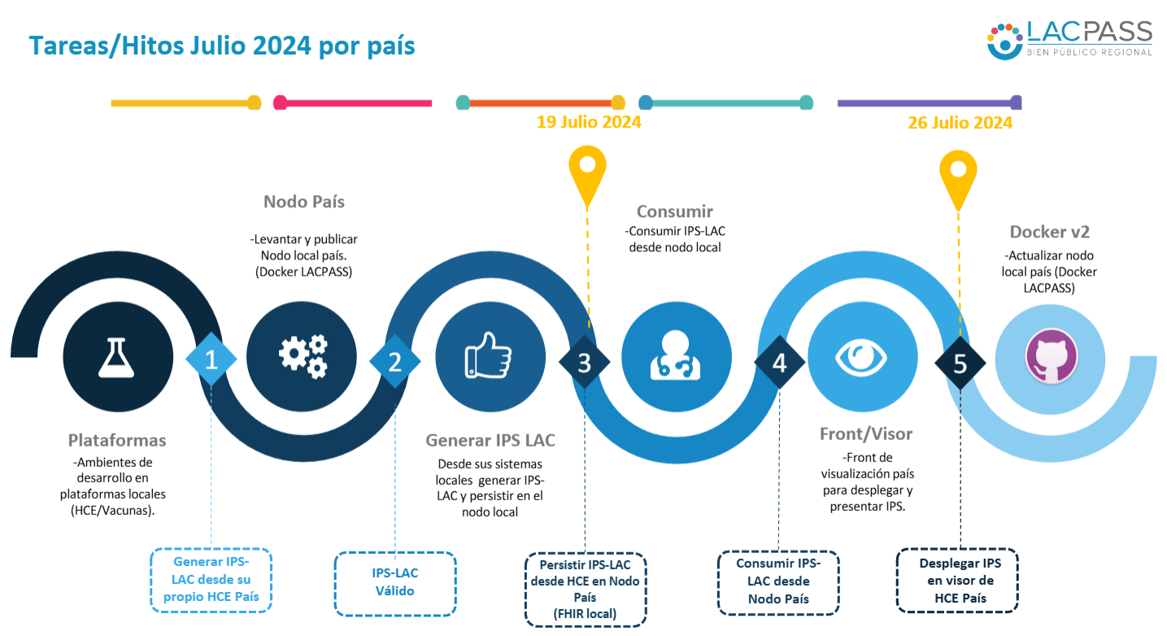

Slide 46
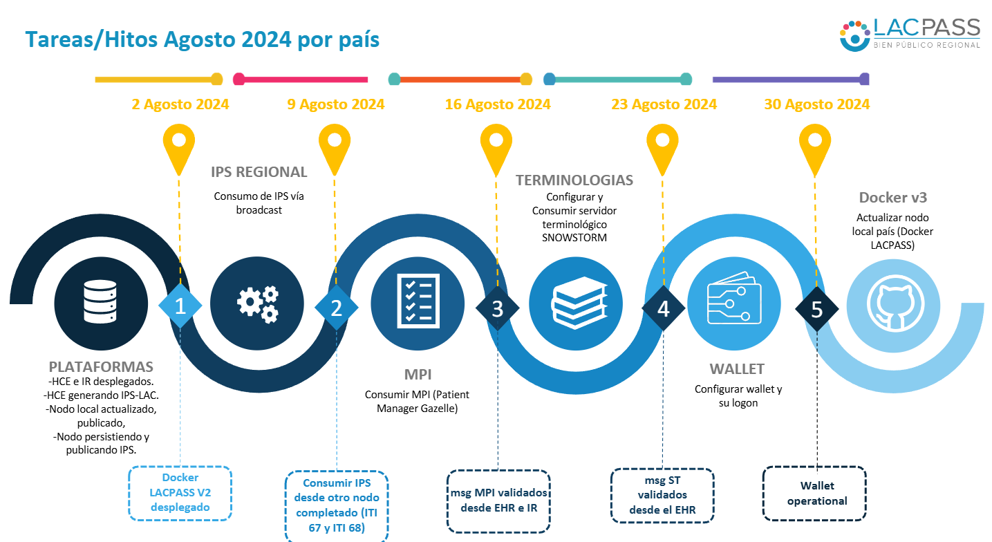

Slide 47
Tareas/Hitos Septiembre 2024 por país
6 sept 2024
13 Sept 2024
20 Sept 2024
27 Sept 2024
30 Sept 2024
WALLET + GDHCN
VHL
Generación/carga de llaves. Wallet con captura de IPS y selección de datos
Wallet con Verifiable health Link (VHL) y QR Code
TRACK 2
Generación DVC
1
2
3
4
5
IPS/MHD
VISUALIZACIÓN
Pruebas MPI. Prueba de terminología Prueba MHD
INMUNIZACIÓN
Vacuna a IPS-DVC desde plataformas nacionales
Visualización del escenario 1 de EHR
Track 1: Generar completo IPS (MPI/Term) y escenario 2 MHD completo.
Mostrar IPS en wallet
Generación y almacenamiento de IPS-DVC
BVSVHL + QR Almacenado en Wallet
TRACK 1 COMPLETADO

Slide 48
Sesiones de capacitación:
Tema | Presenta | Confirmada | Tipo | Fecha | Hora EST
Nodo BROADCAST | Create – Albany | S | Cerrada | Agosto 5
Simulador MPI IHE | IHE – TBD | S | Abierta | Agosto 8
Servicios terminológicos II | SNOMED - Alejandro López | S | Cerrada | Agosto 12 | 12hs EST
IHE Registration | Souleyman Thiam | S | Cerrada | Agosto 27 | 9PM
Consentimiento CPF | TBD | P | Abierta | TBD
SVL Smart Verifiable links | TBD | P | Abierta | TBD
GDHCN | WHO- Carl Leiner | P | Abierta | Agosto 22 | 13hs EST
Servicios terminológicos III | SNOMED - Alejandro López | S | Cerrada | Agosto 21 | 13hs EST
Private & Confidential

Slide 49
Camino a la Conectatón 2024
Workshop | Contenidos
1 | FHIR : Fundamental y Básico
2 | Estándar IPS: General e IPS/LAC
3 | Trust Domain : GDHCN
4 | IHE: MHD, PIXm, PDQm, SVCm, PCF
5 | SHC: VC, SHL
6 | Docker Toolkit: MPI, TS, FHIR Server, otros
7 y 8 | Gazelle Onboard

Slide 50
Camino a la Conectatón 2024

Slide 51
Referencias:
Smart Health Cards SHC and Smart Health Links:
https://smarthealth.cards/en/how-they-work.html
https://docs.smarthealthit.org/smart-health-links/)
IPS & SHL: https://confluence.hl7.org/plugins/servlet/mobile?contentId=203358469#content/view/203358469
WHO SHL Implementation Guides:
https://smart.who.int/trust/StructureDefinition-SmartHealthLink.html
Others, for uses cases and docummentation:
https://www.devdays.com/wp-content/uploads/2023/08/230607_JohnDAmore_Patient_Mediated_IPS_exchange_with_SMART_Health_Links.pdf
https://docs.smarthealthit.org/smart-health-links/design
IHE : WHO Plugathon
https://connectathon.ihe-europe.net/ihe-europe-plugathons-2024

