Slide 1
USA Real Estate Price Prediction
CS 542 — Machine Learning Project
USA Real Estate
Presenter: Group 13

Slide 2
Project Goal
Input: basic home features (beds, baths, size, lot) + location (city, state, ZIP) + time (month, year, season).
Output: a single number — predicted sale price (USD).
Goal: build a leakage-free model that
uses only information available at sale time,
beats a strong ZIP×year median baseline on future data

Slide 3
Data Used — USA Real Estate
Single CSV: data/raw/usa_real_estate.csv with residential sales across the U.S.
Includes sold date, listing price, home characteristics, and location (city, state, ZIP).
Observed sale dates span 1901-01-01 to 2026-04-08.
Quantity | Value
Total labeled sales (train + val + test) | 510,732
Train / Val / Test rows | 50,000 / 460,233 / 499
Date window | 1901-01-01 → 2026-04-08
Features | 14 columns (numeric + categorical + time-features)

Slide 4
Leakage-Safe Train–Val–Test Split
Temporal split by sold_date.year to mimic train-on-past, test-on-future.
Training subset limited to 50,000 rows (≤ 2021) to keep runtime ≈15–20 minutes.
No 2023+ rows used in training or validation — test genuinely represents future sales.
Split | Years (sold_date.year) | # Rows | Purpose
Train | ≤ 2021 | 50,000 | Fit model, feature engineering, calibration
Val | 2022 | 460,233 | Hyperparameter tuning, model selection
Test | ≥ 2023 | 499 | Final unseen evaluation

Slide 5
Features and Models
Features:
  • Raw: bed, bath, house_size, acre_lot, city, state, zip_code
  • Engineered: log_house_size, lot_per_size, bed_per_bath, month, year, season
Target handling: log10(price) during training, Duan smearing to report errors in dollars.
Models compared:
  • Baseline: ZIP×year median price (lookup)
  • Ridge regression: linear baseline with L2 regularization
  • XGBoost: gradient-boosted trees on processed features (final model)
Model | Type | Notes
Baseline | ZIP×year median | No learning, simple lookup
Ridge | Linear regression | Fast, regularized baseline
XGBoost | Boosted trees | Handles non-linear patterns, best overall

Slide 6
Results — Model Performance
Metrics computed on dollars after inverting the log-price transform.
XGBoost clearly improves MAE/RMSE over the ZIP×year median baseline on future (2023+) data.
Model | Split | MAE (USD) | RMSE (USD) | R²
ZIP×year baseline | Val | 203,927 | 449,076 | 0.369
ZIP×year baseline | Test | 145,897 | 279,284 | 0.177
Ridge regression | Val | 204,111 | 1,928,055 | -10.639
Ridge regression | Test | 120,144 | 191,177 | 0.614
XGBoost (final) | Test | 115,261 | 184,728 | 0.640

Slide 7
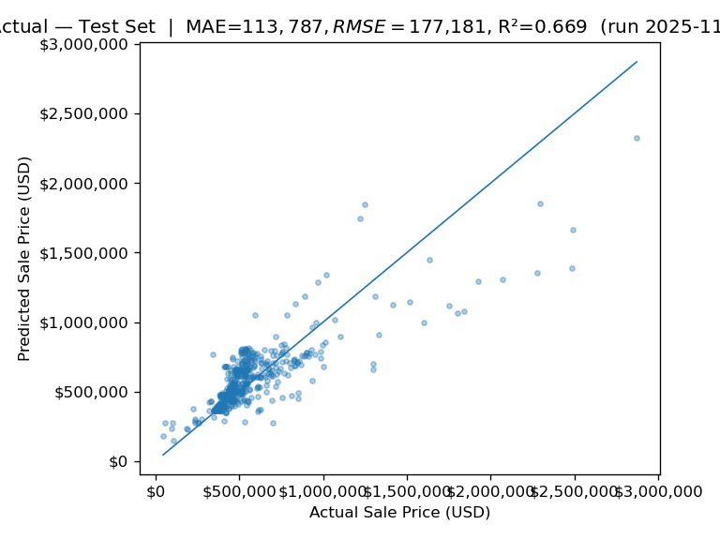
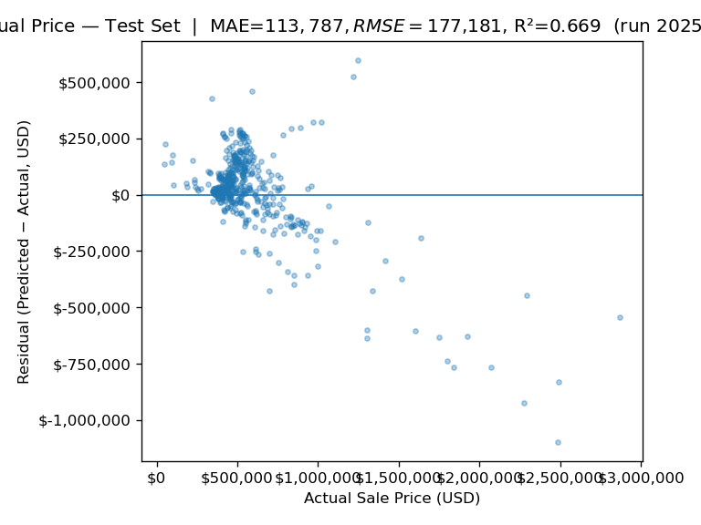
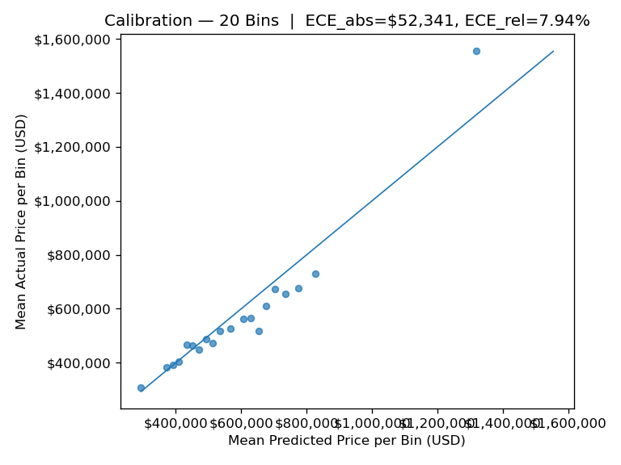
Diagnostic Plots — Clarity and Reliability
We use three plots to understand behaviorand reliability:
  • Predicted vs actual price scatter
  • Residuals vs true price
  • Calibration curve (bin-wise mean prediction vsmean truth)
Predicted vs Actual
Residuals vs Price
Calibration Curve
Quantity | Value
# calibration bins | 20
Test points | 499
Relative ECE | 0.079 ≈ 8%

Slide 8
Error Slices and Interpretability
We analyze error slices by (state, ZIP) on the test set to see where the model struggles.
Example: Several Idaho ZIP codes still have six-figure MAE, which is expected in a noisy market but highlights room for improvement.
State | ZIP | # Test Homes | MAE (USD) | RMSE (USD)
Idaho | 83669 | 37 | 152,297 | 181,461
Idaho | 83607 | 48 | 119,813 | 185,756
Idaho | 83651 | 35 | 113,434 | 166,207

Slide 9
Timing, Clarity, and Final Takeaways
Clarity
  • Simple feature set: home size, rooms, lot, location, and time.
  • Transparent evaluation on a true future test set (2023+).
Timing
  • Training restricted to 50,000 rows with a tuned XGBoost model.
  • Pipeline is lightweight enough to rerun when the dataset is updated.
Data split strategy (recap)
  • Temporal split: train ≤ 2021, val = 2022, test ≥ 2023 with 499 held-out test sales.
Final conclusion
  Using a leakage-safe temporal split and a gradient-boosted tree model, we substantially improve over a strong ZIP×year median baseline on future data, while keeping the pipeline clear, reproducible, and fast enough for practical use.

Slide 10

Q & A

