Slide 1

Molecular Property Prediction with Graph Neural Networks on ESOL
CS 548 – GNN Project Report
Presenter: Angel Daniel Colón

Slide 2
DATA USED – ESOL SOLUBILITY BENCHMARK
Primary dataset: ESOL, a curated benchmark of aqueous solubilities (logS).
Size: 1128 drug-like organic molecules.
Target: log10 solubility in mol/L (more negative = less soluble).
Molecules represented as SMILES and converted to molecular graphs with RDKit.
Field | Value
Dataset | ESOL
# Molecules | 1128
Target | logS (log10 mol/L)
Domain | Small drug-like molecules

Slide 3
GOAL OF THE PROJECT
Main question: How well do graph neural networks (GNNs) predict ESOL solubility compared to classical fingerprint-based models?
Models compared: Ridge regression and Random Forest on Morgan fingerprints; GIN and MPNN on molecular graphs.
Broader goal: Build a reproducible pipeline that can serve as a template for future molecular GNN studies.

Slide 4
TRAIN–TEST SPLITS – RANDOM VS. SCAFFOLD
Partitioning ratio: ~80 / 10 / 10 (Train / Validation / Test).
Random split: molecules assigned i.i.d. to train/val/test; similar molecules can appear in both sets.
Scaffold split (Bemis–Murcko): molecules grouped by core ring scaffold; entire scaffolds assigned to train/val/test.
Scaffold split creates a harder but more realistic generalization setting: test scaffolds are unseen during training.

Slide 5
RESULTS – OVERALL PERFORMANCE ON ESOL
We compare test MAE/RMSE for all four models under random and scaffold splits.
GIN achieves the best performance, especially on the scaffold split.
Model | Random MAE | Random RMSE | Scaffold MAE | Scaffold RMSE
Ridge | 2.78 | 3.78 | 3.30 | 4.51
Random Forest | 0.90 | 1.19 | 1.29 | 1.72
GIN | 0.74 | 0.97 | 0.99 | 1.25
MPNN | 1.54 | 1.95 | 1.71 | 2.21

Slide 6
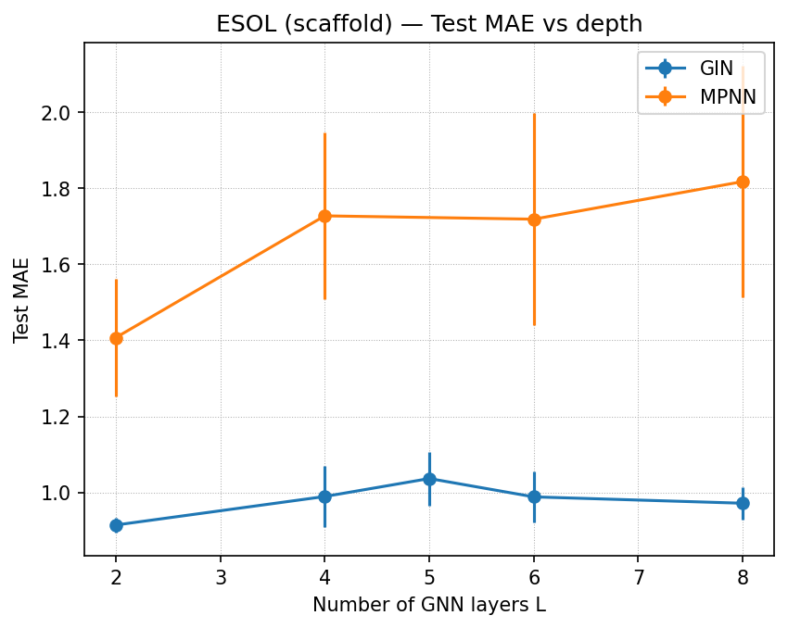
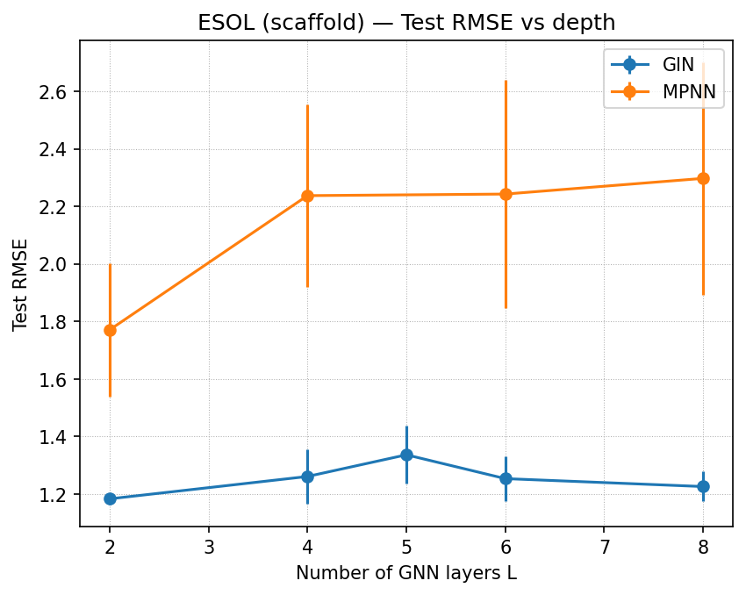
RESULTS – DEPTH & ABLATIONS (GIN VS. MPNN)
We probed depth (number of GNN layers) and regularization (dropout, weight decay).
GIN prefers moderate depth (4–6 layers) on the scaffold split; too shallow underfits, too deep overfits.
Non-trivial dropout and weight decay improve robustness; MPNN is more sensitive and less stable.
See depth and ablation plots for GIN and MPNN on ESOL.

Slide 7
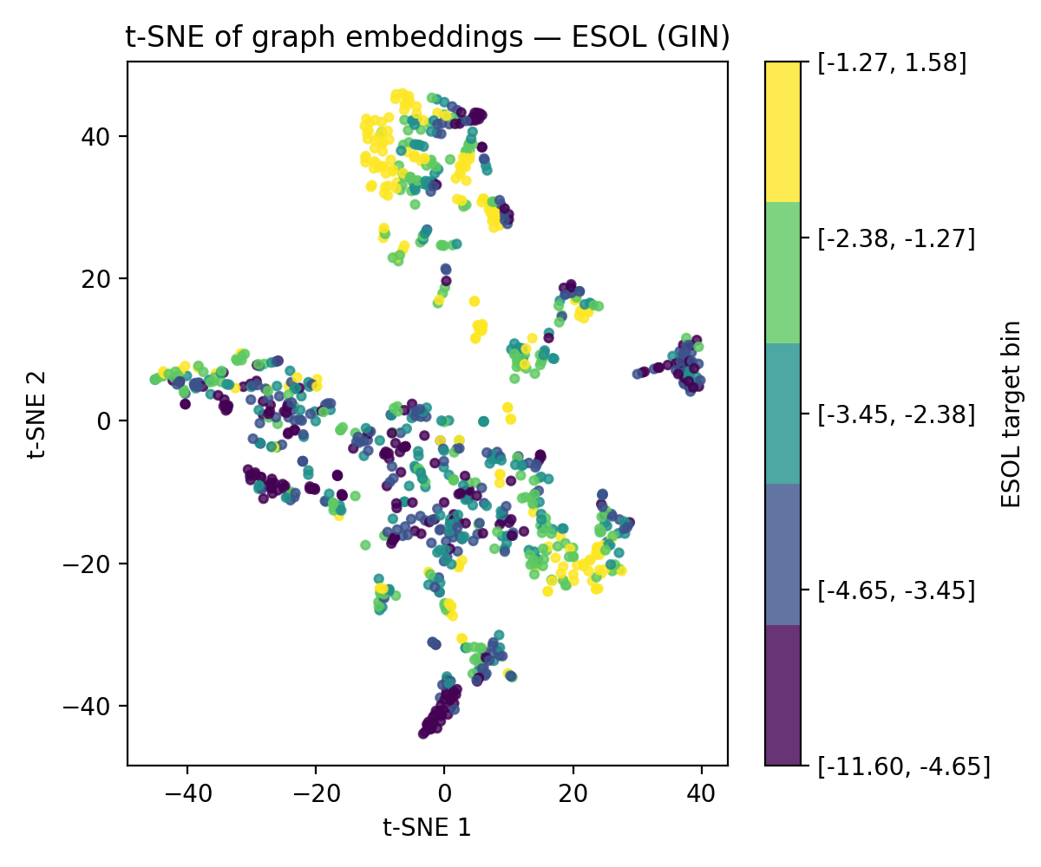
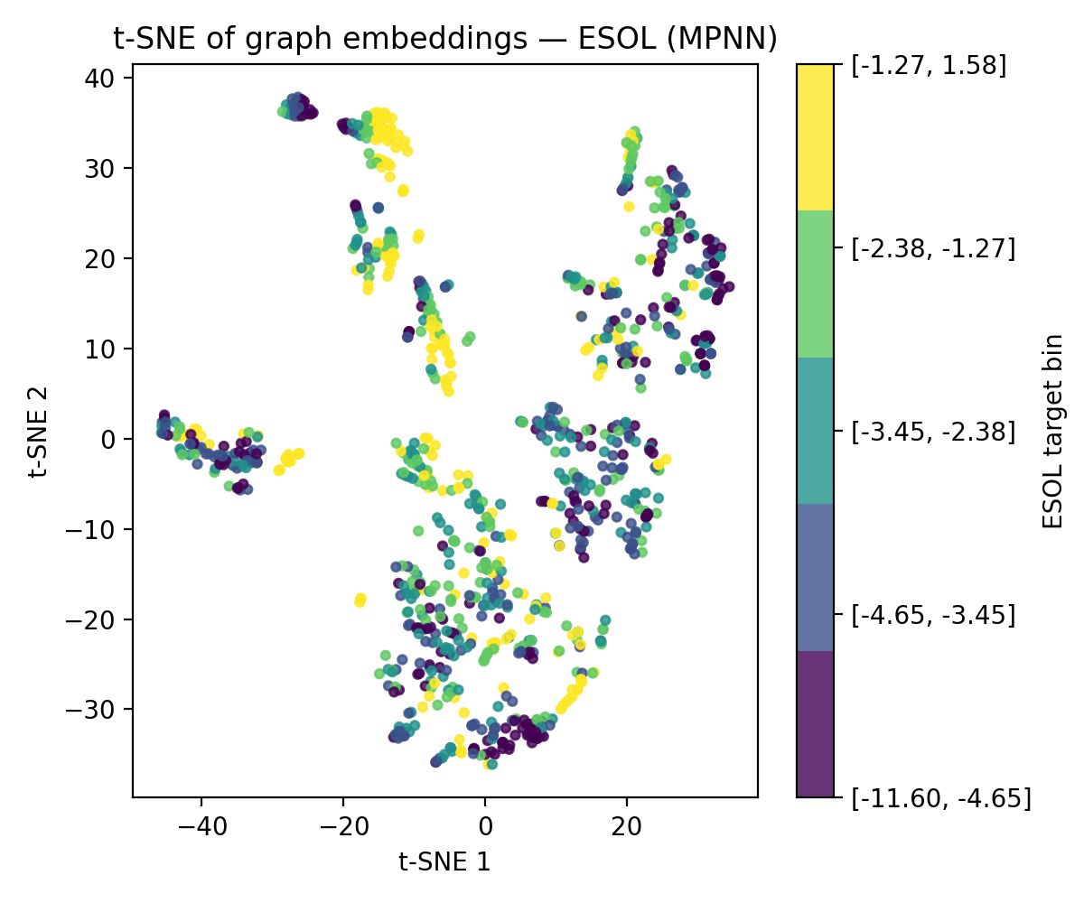
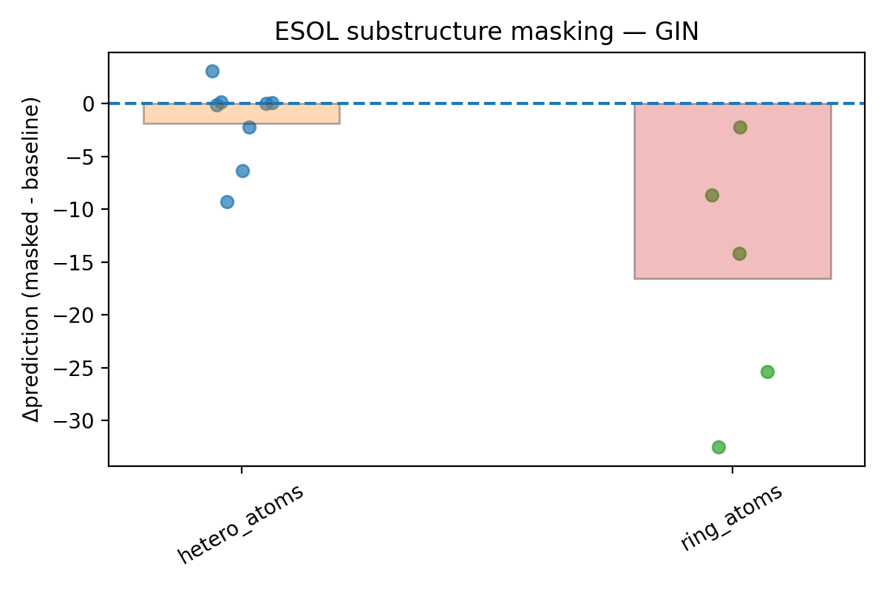
RESULTS – INTERPRETABILITY (EMBEDDINGS & SUBSTRUCTURES)
t-SNE embeddings show that learned graph embeddings cluster molecules by scaffold and solubility.
Substructure masking reveals that aromatic rings and heteroatom-rich fragments strongly influence predictions.
Trends align with chemistry: many ring systems and heavy hetero motifs reduce solubility; polar heteroatoms can increase it.

Slide 8
FINAL CONCLUSION & TAKEAWAYS
Data used: ESOL dataset with 1128 molecules and aqueous solubility (logS) targets, split into train/val/test.
Goal: compare GIN and MPNN to Ridge and Random Forest under random and scaffold splits with a reproducible pipeline.
Train–test split: both random and Bemis–Murcko scaffold splits, with shared indices across all models.
Results: GIN is the best overall model, especially on the scaffold split, outperforming classical baselines.
Conclusion: for small, scaffold-structured datasets like ESOL, a well-regularized, moderate-depth GIN offers an excellent balance of accuracy, stability, and interpretability.

Slide 9
Q & A

