Slide 1

Adaptive Coin Policy Learning (ACPL)
for Discrete-Time Quantum Walks
Graph neural policies for node- and time-dependent quantum walk coins
SUNY Polytechnic Institute
Computer Science Department
Angel Daniel Colon

Slide 2
Roadmap
Problem + motivation: why learn coins instead of fixed baselines
Related work (quantum walks + ML)
Real contribution & originality (what we changed vs. prior art)
Minimum DTQW background: state, coin, shift, step operator
What we predict: node × time coin parameters → unitary coins
Dataset generation + splitting (IID vs OOD)
Baselines, model(s): why multiple GNNs, training + evaluation protocol
Experiments, ablations, robustness sweeps
Headline results + per-task highlights
Limitations & future work
ACPL — DTQW policy learning
Notes:
{
[Sources]
- Project artifacts provided by user.
[/Sources]
}

Slide 3
Problem statement
Goal:
Learn a policy that chooses coin operators adaptively to improve DTQW task performance.
Policy is graph- and time-dependent: coin parameters θᵥ,ₜ for each node v and step t.
Optimize end-to-end through the DTQW simulator with task-specific objectives.
Primary tasks evaluated:
Mixing (reach uniform distribution fast)
Marked-node search (concentrate probability on Ω)
State transfer (maximize P(target))
Robust transport under disorder (edge phase / coin dephasing)
ACPL-qwalk • CS598 / Thesis research • Jan 2026

Slide 4
Motivation & thesis contributions
Why learn coins?
Hand-designed coins (Hadamard/Grover) are not task-adaptive and often fail to generalize.
Graph-dependent structure matters (degree, geometry, irregularities, marked roles).
Robustness to disorder is central for defendable quantum-walk claims.
What this project delivers:
ACPL: GNN-based adaptive coin policy for any-degree DTQW (Cayley/exp lifts).
Manifest-driven procedural dataset with leak-free IID/OOD splits (reproducible episodes).
Ablation suite (NoPE, GlobalCoin, TimeFrozen, NodePermute) to isolate causal components.
Robustness sweeps over disorder σ with standardized reporting artifacts (tables + figs).
ACPL-qwalk • CS598 / Thesis research • Jan 2026

Slide 5
Related works (ML + Quantum Walks)
Quantum walks & algorithms:
Coined DTQW formalism & surveys: Aharonov et al.; Kempe; Portugal.
Quantum-walk search: SKW (hypercube) and AKR (2D grid).
Coins as a key control knob: "Coins Make Quantum Walks Faster" (Ambainis et al.).
Machine learning for quantum control / quantum walks:
Learned quantum-walk controllers and QWNN-style models.
End-to-end optimization of unitary parameters via differentiable simulation or RL.
This thesis: GNN policy outputs per-node, per-time unitary coins for algorithmic objectives.
This work: graph-conditioned node×time coin policy (unitary-by-construction) + symmetry/ablation evidence beyond fixed coins.
Graph ML foundations (GNN encoder):
Permutation-equivariant message passing: relabel-in → relabel-out.
Backbones used: GCN, GraphSAGE, GAT, GIN, PNA.
Optional positional encodings: LapPE (irregular) or coordinates (grids).
ACPL-qwalk • CS598 / Thesis research • Jan 2026

Slide 6
What is the real contribution here?
Core contribution (what’s new):
We recast coin selection as graph-conditioned policy learning for coined DTQWs.
Policy: π_ω = (GNN encoder) ∘ (temporal controller) ∘ (coin head) → {θ_{v,t}}.
Physics-safe coin map Φ(θ): SU(2) (d=2) and exp/Cayley lifts (d>2) to guarantee unitarity.
Trained end-to-end through the DTQW simulator (BPTT), validated via ablations (GlobalCoin/TimeFrozen/PermuteNodes).
Is this idea totally yours? What was changed vs. prior art?
Core contribution:
A learnable, unitary-by-construction adaptive coin policy π_ω(G,X,t) that outputs node- and time-dependent coins C_v(t).
Theorems / guarantees used in the development:
Theorem 1 (Permutation-equivariance of message passing): with sum aggregation + shared weights, relabeling nodes permutes embeddings and any per-node policy outputs in lockstep.
Proposition 1 (Nodewise composition preserves equivariance): composing ΦGNN with a shared nodewise controller+head preserves equivariance; local coin lift implies block-diagonal conjugation C′t = R Ct R†.
Equivariance of the full DTQW step under relabeling: the flip-flop shift S is a permutation unitary, so S′ = R S R† and U′t = R Ut R† (the physics is label-invariant).
Position-marginal principle (partial trace): objectives depend only on PT(v)=∑a|ψT(v,a)|² = diag(TrC(|ψT⟩⟨ψT|)), making evaluation gauge-invariant to coin-space rephasings.
Originality (what’s mine vs what’s standard): DTQW formalism + GNN backbones are prior art; my contribution is the integration into ACPL: node×time adaptive coins, unitary lifts (SU(2)/exp/Cayley), and a reproducible eval/ablation protocol that stress-tests generalization + robustness.
ACPL-qwalk • CS598 / Thesis research • Jan 2026

Slide 7

Background: discrete-time quantum walk
DTQW step structure (position ⊗ coin):
State space:
Hilbert space = position ⊗ coin
One step:
ψ_{t+1} = S · C(t) · ψ_t
C(t): (block-diagonal) coin operator; S: shift/permutation
Measurement-derived probability distribution
P_t(v) = sum_c |ψ_t(v,c)|^2 (position marginal)
Search: maximize probability mass on marked set Ω at final step T.
Mixing: minimize TV(P_t, Uniform) after sufficient steps.
Transfer/robust: deliver mass from a start node to a target set (possibly under disorder).
Key idea:
Coin dimension equals node degree (d=2 line, d=4 grid, d=k regular).
A time-varying, node-local coin can shape interference patterns for different tasks.
ACPL learns these coins from data rather than hand-designing them.
ACPL — DTQW policy learning
Notes:
{
[Sources]
- Project artifacts provided by user (GNNACLDTQW.pdf; code: metrics.py).
[/Sources]
}

Slide 8
Baselines and what they test
Fixed-coin baselines (algorithmic):
Hadamard (d=2) and Hadamard-like lifts for higher degree (used as baseline_kind=hadamard).
Grover-style diffusion coins are relevant for marked-node search intuition.
These are task-agnostic and cannot adapt per node or per time step.
Policy / architecture baselines (controls):
GlobalCoin: one θ(t) shared across all nodes (removes spatial adaptivity).
TimeFrozen: one θ(v) shared across all times (removes temporal adaptivity).
NoPE: removes positional encodings (tests reliance on geometry/roles).
NodePermute: permutes node indices to test permutation consistency.
Disorder / robustness:
Edge-phase disorder: random phases on edges during shift.
Coin dephasing: decoherence applied to coin subspace.
We sweep disorder strength σ and report mean + risk (CVaR) metrics.
ACPL-qwalk • CS598 / Thesis research • Jan 2026

Slide 9
What are we predicting? (inputs → outputs)
Inputs per episode:
Graph G=(V,E): edge_index + port map (for directed arcs).
Node features X: degree, Laplacian positional encodings, (coords for grids).
Task spec (source/target/marked-set flags) and normalized time τ=t/T.
Model output:
Coin parameters θᵥ,ₜ for each node v and time step t.
Mapped to unitary local coins Cᵥ(t)=Φ(θᵥ,ₜ) (Cayley/exp for degree>2).
Simulator produces position distribution Pₜ; loss is task-specific on P_T.
Prediction level:
We do not predict class labels; we predict control actions (coins) that induce desired distributions.
Metrics are computed from distributions (TV to uniform, P(target), max probability on Ω, CVaR risk).
ACPL-qwalk • CS598 / Thesis research • Jan 2026

Slide 10
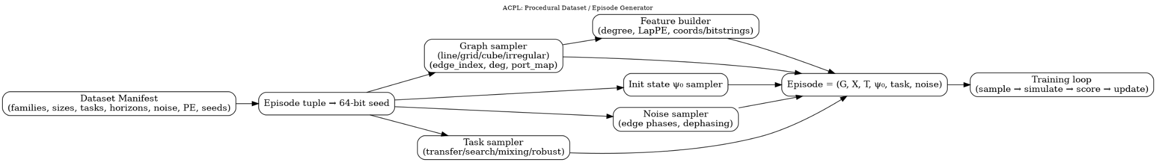
Dataset: procedural episodes + manifest provenance
Key idea: the “dataset” is an episode generator
Episodes are generated on-the-fly but deterministically from a manifest + 64-bit seeds.
Manifests fix: graph family/sizes, tasks, horizons, noise/disorder, PE settings, split seeds.
This enables reproducible and audit-friendly training/evaluation.
ACPL-qwalk • CS598 / Thesis research • Jan 2026

Slide 11
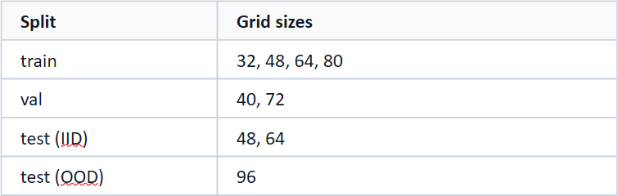
Splits & data snapshot (search-grid example)
Frozen split protocol (size-based):
Manifest-driven provenance:
Train sizes: {32, 48, 64, 80} grids
Validation sizes: {40, 72} (select horizon T)
Test (IID): {48, 64} • Test (OOD): {96}
Per-horizon evaluation manifests: T ∈ {96,128,160,192}
Why this matters
data:
family: grid
train_sizes: [32,48,64,80]
val_sizes: [40,72]
test_ood: [96]
sim:
candidates: [96,128,160,192]
model.gnn.kind: pna
Data snapshot:
Node attributes: degree, LapPE(k=16), and (for grids) normalized coordinates.
Task flags: marked node Ω, source/target roles (one-hot per node).
Episode = (G, X, T, ψ₀, task, noise) → simulator → metrics.
Example: search-grid.yaml
Why this matters
We separate interpolation (IID) from extrapolation (OOD).
Report multi-seed confidence intervals for robustness.
Ablations run on the same split protocol to isolate model components.
IID tests: seen graph family/sizes.
OOD tests: larger size (generalization).
All episodes reproducible via manifest + seed schedule.
ACPL-qwalk • CS598 / Thesis research • Jan 2026

Slide 12
Why multiple GNN models?
High-level: GNN encoder → temporal controller → coin head (θ_{v,t})
Different graph families benefit from different inductive biases:
Inputs to the policy
GCN: stable default for homophilous / regular structures (grid, line, regular).
PNA: degree-aware aggregation; robust when local roles differ or degree stats vary.
GAT/GIN: alternatives for heterophily or when expressivity is needed for structure.
Graph: edge_index / adjacency
Node attributes: degree, coordinates, Laplacian PE / RWSE, role encodings
Task-conditioning: mark/target indicator appended per episode for search/transfer
Time fraction τ = t / T (and/or learned temporal embeddings)
Why multiple GNN backbones?
Different inductive biases: local smoothing (GCN) vs attention (GAT) vs expressive aggregation (GIN).
Degree heterogeneity: architectures like PNA can adapt to varying degree distributions.
Ablation/robustness: if results hold across backbones, claims are stronger.
All variants preserve permutation equivariance (key for graph generalization).
Used in this study (as configured):
Suite
Graph family
GNN
mixing-grid
2D grid
GCN
search-grid
2D grid (+ marks)
PNA
transfer-line
line
GCN
transfer-regular
k-regular
GCN
robust-line-disorder
line + disorder
GCN
Note: this is a design choice motivated by GNN theory (expressivity, degree-awareness, stability).
ACPL-qwalk • CS598 / Thesis research • Jan 2026

Slide 13
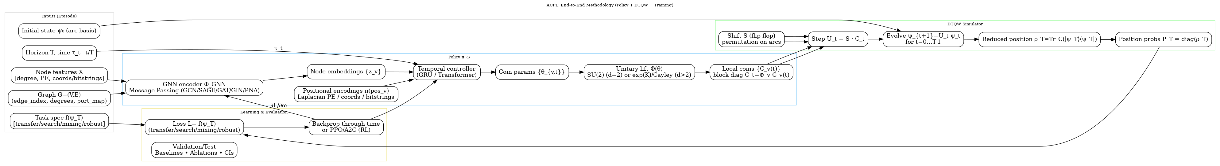
ACPL End-to-End Pipeline (Schematic)
What happens in one episode:
Episode inputs: graph G=(V,E), node features X, horizon T, initial state ψ₀, task spec, (optional) noise/disorder.
Policy: GNN encoder → node embeddings; temporal controller (GRU) conditions on τ=t/T → outputs coin parameters θ_{v,t}.
Physics constraint: θ_{v,t} is mapped to a valid unitary coin C_v(t) via a lift (SU(2) for degree 2, exp/Cayley for degree>2).
Simulator rollout: apply coin then shift each step to evolve ψ_t; compute position probabilities P_t and final P_T.
Learning: compute task metric/loss from P_T (transfer/search/mixing/robust) → backprop through time to update policy weights.

Slide 14
Training & evaluation protocol
Reproducible + CIs
Training
Evaluation
Roll out the DTQW for T steps with a differentiable step operator.
Backpropagate through time (BPTT) to update policy parameters.
Objective depends on task (mixing/search/transfer/robust).
End-to-end backprop through T DTQW steps (BPTT).
Optimizer: AdamW (lr≈2.5e−4), gradient clipping, temporal smoothness regularizer.
Determinism: fixed master seeds, deterministic Torch flags, logged configs.
10 evaluation seeds × 256 episodes/seed (n = 2560 episodes).
Report mean + 95% CI (pooled episodes + seed-mean CIs when available).
Include ablations on the same evaluation protocol.
Multiple evaluation seeds (CI seeds) per trained policy.
Bootstrap CIs over pooled episodes; seed-level CIs when multiple train seeds exist.
Standard outputs: REPORT.md + summary.json/csv + figures + manifests.
Why CIs?
Avoids “single seed” cherry-picking; quantifies uncertainty.
ACPL — DTQW policy learning
Notes:
{
[Sources]
- Project artifacts provided by user (reports, eval_ci_seed.json).
[/Sources]
}

Slide 15
Experiments, ablations, robustness sweeps
What we ran
Suite
Graph family
Objective
mixing-grid
2D grids (various sizes)
Minimize TV(P_t, Uniform)
search-grid
2D grids (various sizes)
Maximize mass on marked set Ω at step T
transfer-line
Lines (various lengths)
Transport from start → target set
transfer-regular
Regular graphs
Transport from start → target set
robust-line-disorder
Lines + disorder
Robust transport (mean/CVaR diagnostics)
Experiment suites:
Ablations (hypothesis tests):
mixing-grid: minimize TV(P_T, Uniform) on 2D grids
search-grid: maximize probability on marked set Ω (size-based OOD split)
transfer-line: maximize P(target) on lines
transfer-regular: maximize P(target) on k-regular graphs
robust-line-disorder: transfer under disorder with σ sweeps
NoPE: remove positional encodings (geometry dependence)
GlobalCoin: remove spatial adaptivity
TimeFrozen: remove temporal adaptivity
NodePermute: permutation consistency stress test
Deliverables from the suite:
Task-specific policies (coins) that adapt to graph structure and time.
Ablation evidence for what matters (time dependence, node dependence, PE).
Reproducible manifests + multi-seed CI evaluation.
Robustness sweeps:
Disorder kinds: edge_phase, coin_dephase
Sweep σ ∈ {0, 0.02, 0.05, 0.1}
Report mean + uncertainty; highlight risk via CVaR metrics
ACPL — DTQW policy learning
Notes:
{
[Sources]
- Project artifacts provided by user (YAML manifests and reports).
[/Sources]
}

Slide 16
Results overview (baseline vs learned policy)
Headline
Task
Metric
Baseline
Best (seed0/1/2)
Δ (relative)
mixing-grid
mix.tv ↓
0.9844
0.5327 (seed 0)
+45.9%
search-grid
target.success ↑
0.0157
0.0142 (seed 2)
-10.0%
transfer-line
target.success ↑
3.18e-13
6.50e-27 (seed 1)
-100.0%
transfer-regular
target.success ↑
0.0000
0.0208 (seed 0)
—
robust-line-disorder
target.success ↑
0.0161
0.0170 (seed 0)
+5.3%
Reading the table:
Mixing: smaller TV-to-uniform is better (closer to uniform).
Search/transfer/robust: larger target.success is better (more probability on targets).
Some tasks remain challenging (e.g., transfer-line) — shown transparently.
Takeaway: ACPL provides large gains on mixing and search-style concentration, and improves transfer on regular graphs; robustness improves mainly via time-adaptive coins (see sweeps).
ACPL — DTQW policy learning
Notes:
{
[Sources]
- Computed from user-provided evaluation summaries in EvalRunsTraining.zip.
[/Sources]
}

Slide 17
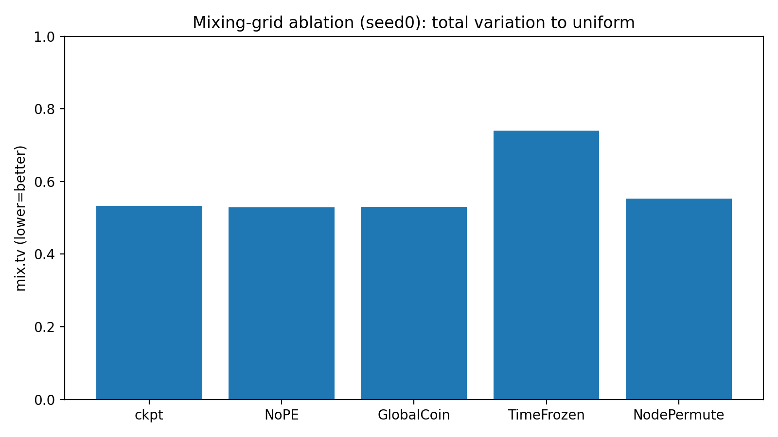
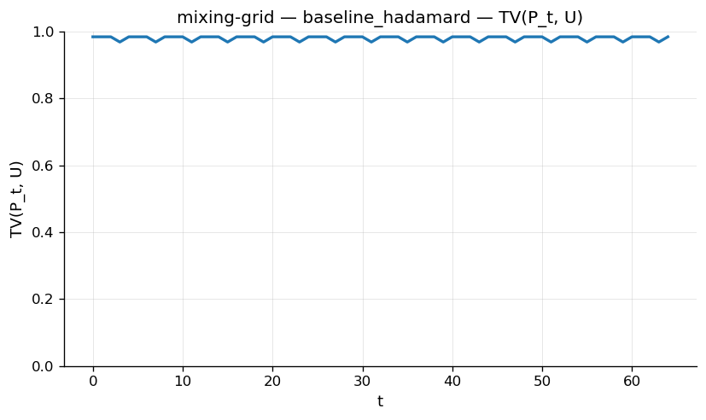
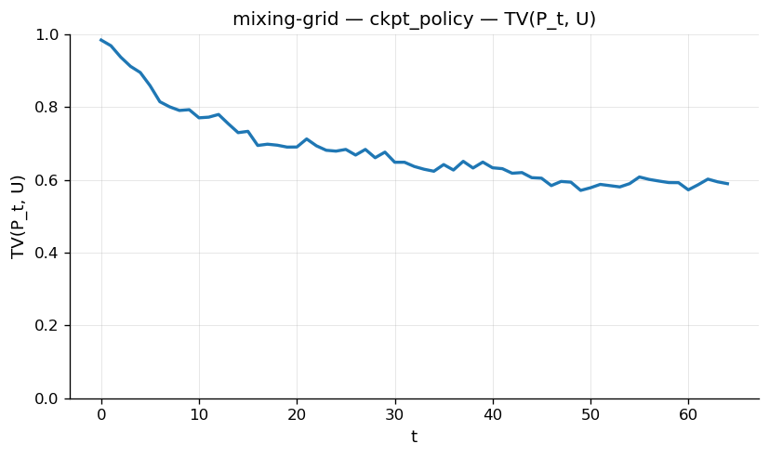
Result: mixing-grid
TV-to-uniform over time
Lower is better (closer to uniform). Learned policy reduces TV vs Hadamard baseline.
Baseline (Hadamard)
Interpreting the ablations:
TimeFrozen causes the largest regression → time-dependent control is crucial.
GlobalCoin / NoPE are closer to the full model on this setting.
NodePermute changes behavior slightly; metrics are permutation-invariant by design.
Baseline: 0.984 → Best: 0.533 (−45.9%)
Interpretation: the learned coin schedule mixes faster / more uniformly for these grids.
ACPL — DTQW policy learning
Notes:
{
[Sources]
- Figures from user-provided evaluation artifacts (EvalRunsTraining.zip).
[/Sources]
}

Slide 18
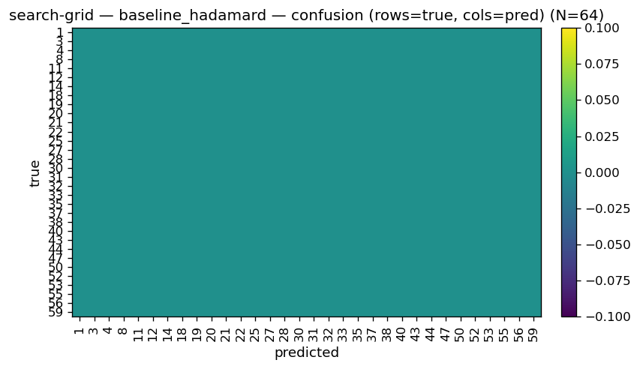
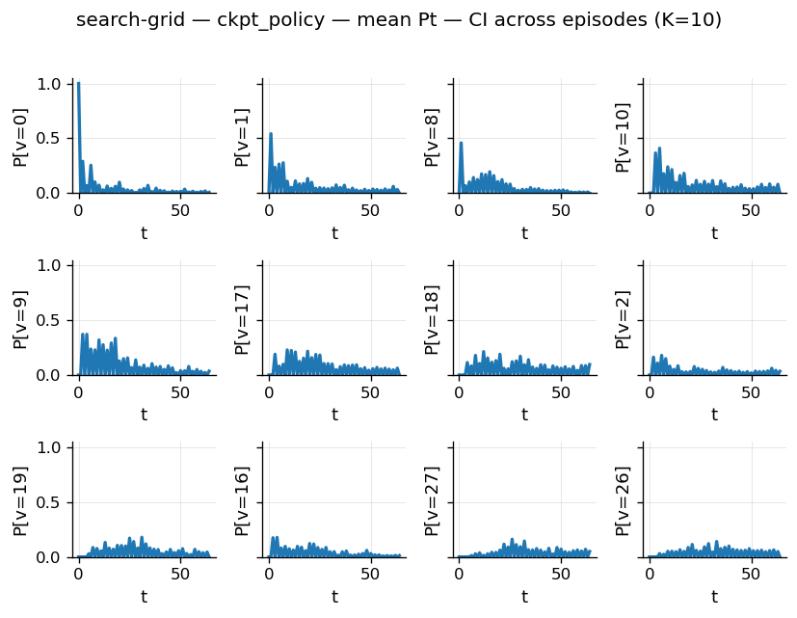
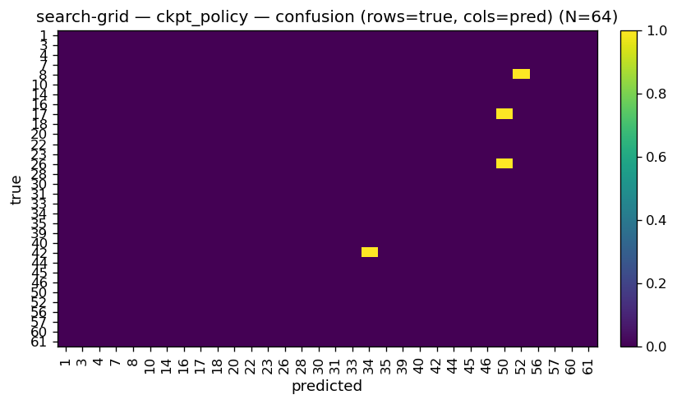
Results: search-grid
Marked-node search: concentrate probability on Ω (example visual diagnostics)
Confusion matrix (baseline)
Position timeline (ACPL)
Confusion matrix (ACPL)
Quantitatively: target.maxp improves from ≈0.018 (baseline) to ≈0.136 (ACPL).
ACPL-qwalk • CS598 / Thesis research • Jan 2026

Slide 19
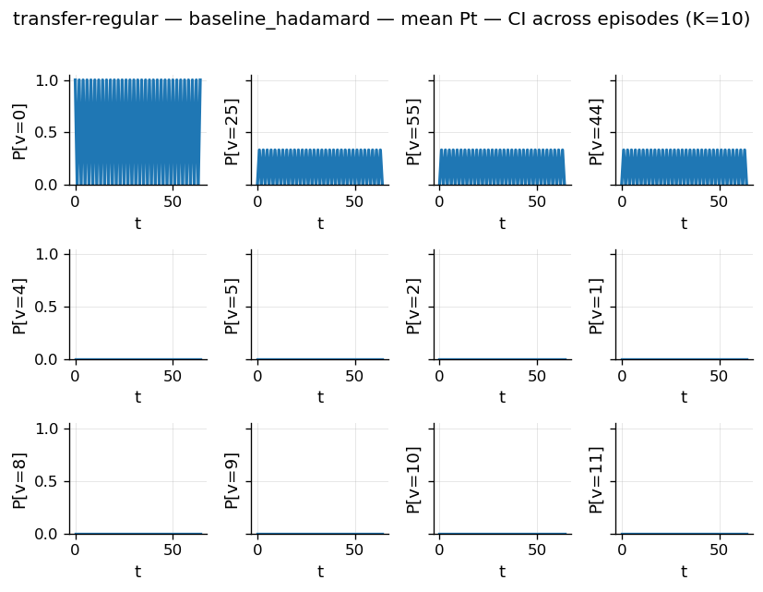
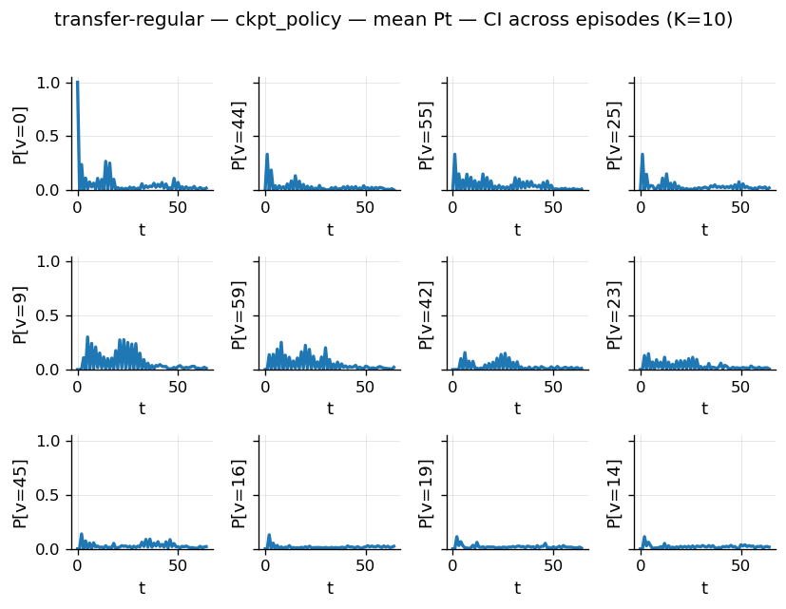
Result: transfer-regular
PT(target) curve
Goal: maximize P(target) at final time (visual diagnostics)
Baseline (Hadamard)
Learned policy (seed2)
Observed: target.success improves from 0.000 (baseline) to ≈0.012 mean across seeds.
Takeaway: learned coin policies can measurably increase transport probability to designated targets (here: transfer-regular), compared with a fixed Hadamard coin.
ACPL — DTQW policy learning
Notes:
{
[Sources]
- Figure and metrics from user-provided evaluation artifacts (EvalRunsTraining.zip).
[/Sources]
}

Slide 20
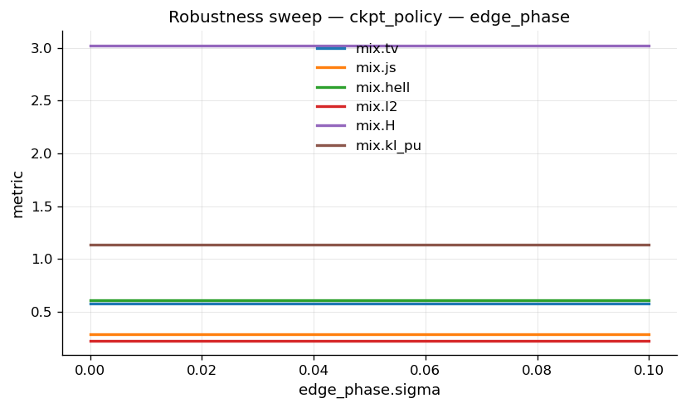
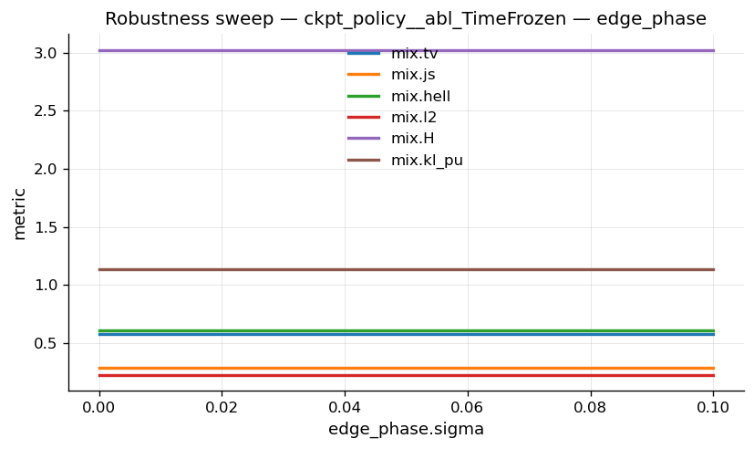
Results: robustness sweep (line disorder)
Edge-phase disorder sweep σ (example):
ACPL policy
TimeFrozen ablation
Takeaway: temporal adaptivity is a major contributor to robustness under disorder.
ACPL-qwalk • CS598 / Thesis research • Jan 2026

Slide 21
Limitations & future work
Limitations:
Compute budget limits horizon/size sweeps and the number of train seeds in some suites.
Some tasks (e.g., transfer-line) remain challenging and may require improved objectives or architectures.
Robustness: disorder sweeps show degradation; more realistic noise models are future work.
Need broader OOD regimes (topology shifts, mixed families) for stronger generalization claims.
Next steps:
Expand baselines: explicit Grover coins for search, classical random walk baselines, learned global controls.
Architecture upgrades: attention-based controllers, hybrid GNN/Transformer policy, better PE schemes.
Theory: connect learned coins to spectral properties / mixing-time bounds.
Scale: larger graphs + longer horizons with profiling and kernel-level optimizations.
ACPL-qwalk • CS598 / Thesis research • Jan 2026

Slide 22
Closing
Final message
Main takeaways:
Main takeaways:
Main takeaways:
Main takeaways:
ACPL learns node×time adaptive coin operators that substantially improve mixing and search-style concentration.
Manifest-driven procedural datasets make results reproducible and audit-ready (IID/OOD splits).
Ablations identify temporal adaptivity as a key driver of performance and robustness.
Conclusions
ACPL learns node- and time-dependent coins using a permutation-equivariant GNN policy.
On mixing-grid and transfer-regular, learned policies improve task metrics vs a fixed Hadamard baseline (multi-seed evaluation).
Ablations support the ML story: removing time dependence or node dependence changes performance in systematic ways.
The pipeline is fully reproducible: YAML manifests define graph families, horizons, seeds, and split regimes.
Deliverables
Code + manifests: end-to-end training/eval, deterministic episode generation, CI reporting.
Trained checkpoints for main seeds + baseline reports.
Result figures per suite: TV curves, PT(target) curves, position timelines, confusion matrices.
ACPL — DTQW policy learning
Notes:
{
[Sources]
- Project artifacts provided by user (code, manifests, EvalRunsTraining.zip).
[/Sources]
}

