Slide 1
DDOS Prevention System using AWS Serverless-
Architecture
Group -5
Topic 1
Group Members:
Aryan Deshmukh
Anamay Brahme
Chanakya Patil
Asad Vathare

Slide 2
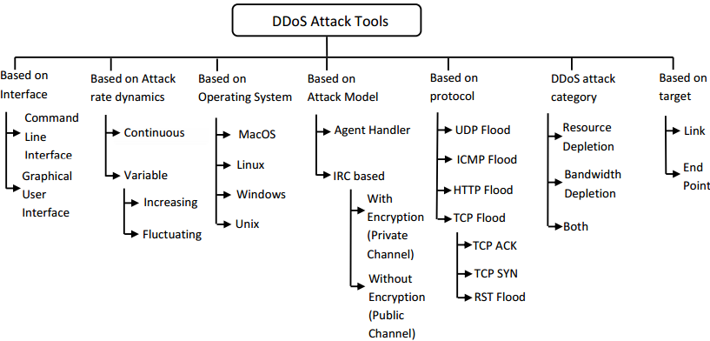
What is DDOS ?
A distributed denial-of-service (DDoS) attack is a malicious attempt to disrupt the normal traffic of a targeted server, service or network by overwhelming the target or its surrounding infrastructure with a flood of Internet traffic.

Slide 3


What is AWS ?
Amazon web service is an online platform that provides scalable and cost-effective cloud computing solutions.
AWS is a broadly adopted cloud platform that offers several on-demand operations like compute power, database storage, content delivery, etc., to help corporates scale and grow.

Slide 4
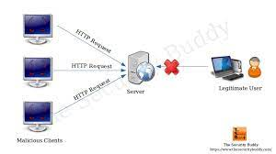
The MAIN IDEA
The main idea of the architecture is to monitor the frequency of HTTP requests in the form of invocation frequency of a serverless function that bridges the Web server and the Internet. If the invocation frequency goes above a threshold, it sets off an alarm, which triggers another serverless function to add high frequency requesters to a denial list.
Hypertext Transfer Protocol (HTTP)-based distributed denial-of-service (DDoS) attacks are extremely common and damaging to both on-premise and cloud-based Web servers.

Slide 5
Objectives
Develop a scalable and reliable serverless architecture to filter HTTP requests based on frequency to prevent DDoS attacks.
Implement a cost-effective solution that minimises the amount of resources required to run the system.
Implement an algorithm to track the frequency of HTTP requests and compare it against a predetermined threshold.

Slide 6
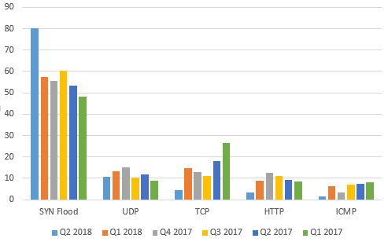

Slide 7
A proof-of-concept architecture is designed and implemented using Amazon Web Services (AWS) resources including
Lambda serverless functions
API Gateway
CloudWatch
DynamoDB
Simple Notification Service (SNS)
EC2 Web Server
The architecture is deployed using AWS CloudFormation following the
Infrastructure-as-code approach.

Slide 8
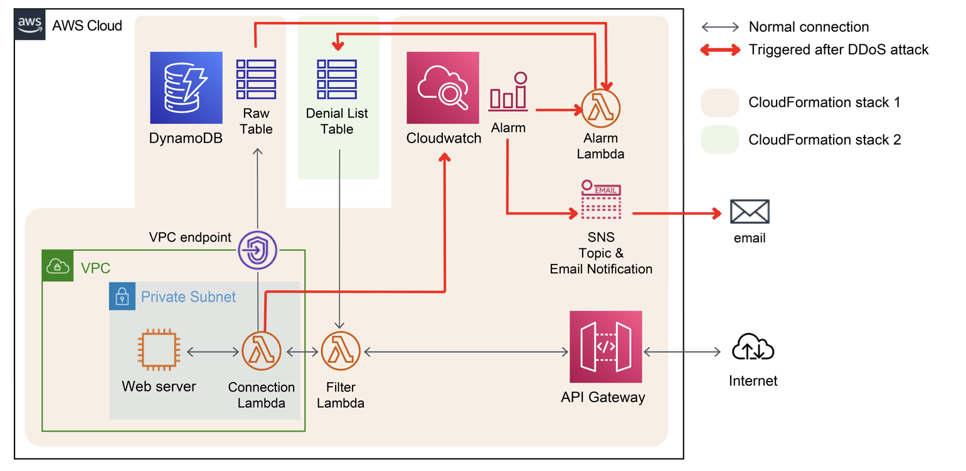
Design and Architecture

Slide 9
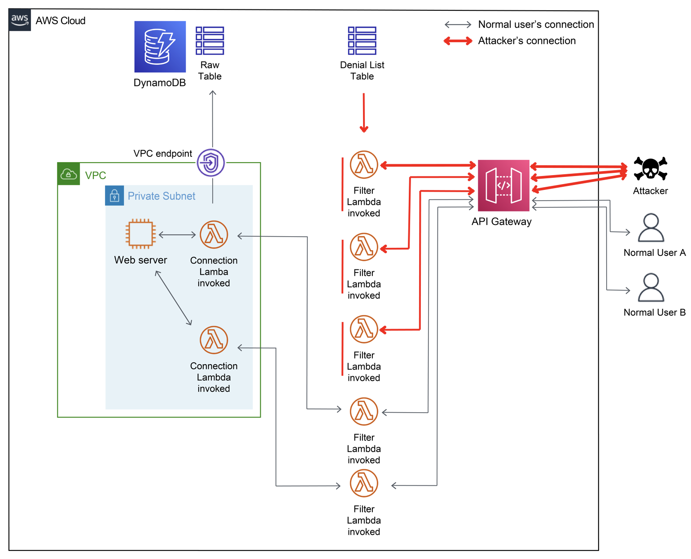
Implementation

