Slide 1





Mathematical and statistical necessities for population genomics
Probability
Leo Speidel

Slide 2
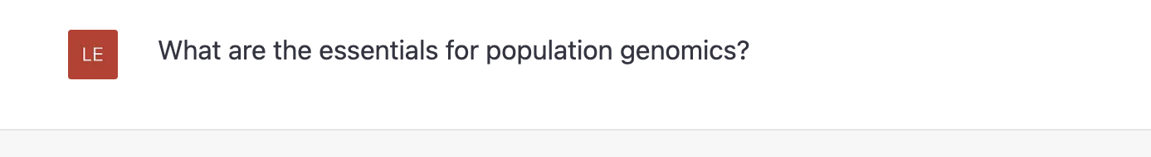
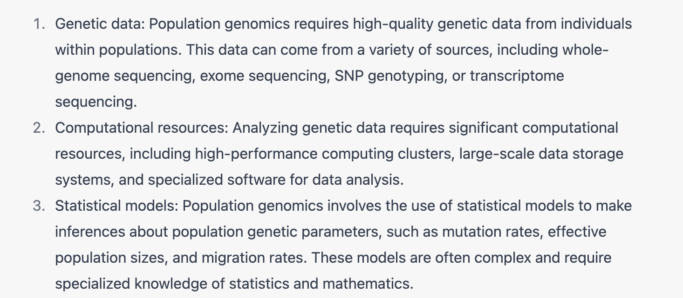

What are the essentials for population genomics?
ChatGPT:

Slide 3
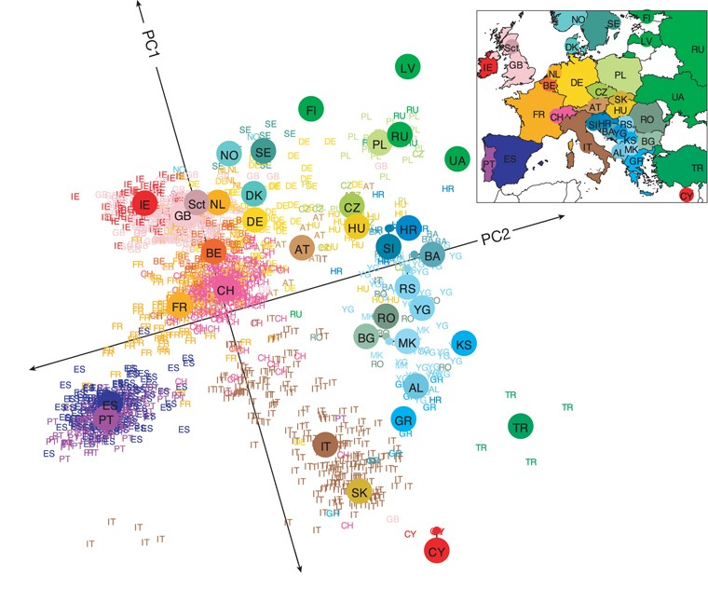
Randomness in population genetics
Our sample is a random subset of the whole population
Genetic inheritance is random
Mutation
Recombination
Mating choices
But there are patterns

Slide 4
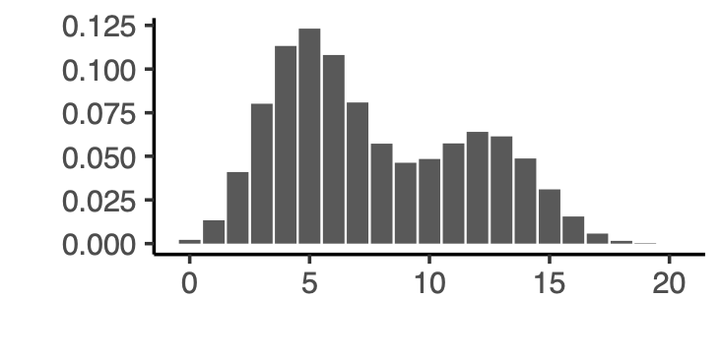
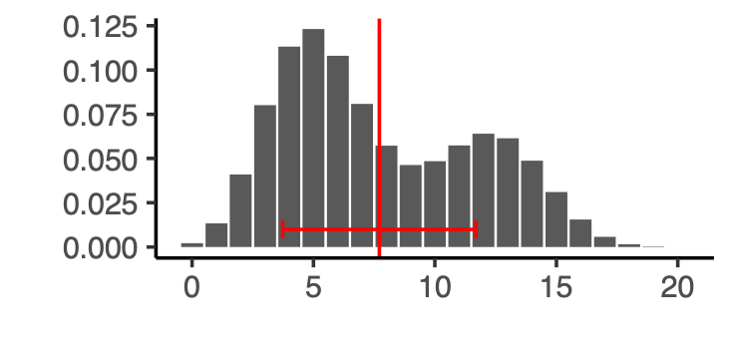
What are probability distributions?
Mathematical function describing how likely each outcome is
Mean (expected value)
Standard deviation
Probability
outcome
Discrete probability distributions
Continuous probability distributions
Outcome takes discrete values e.g., (0,1,2,3,…,20)
Probability mass function $P\left(X=k\right)$ $\sum_{alloutcomesk}{P\left(X=k\right)}=1$
Outcome takes continuous values e.g., any number between 0 and 20
Probability density function f(X = t)
$\int_{alloutcomest}{f\left(X=t\right)dt}=1$

Slide 5

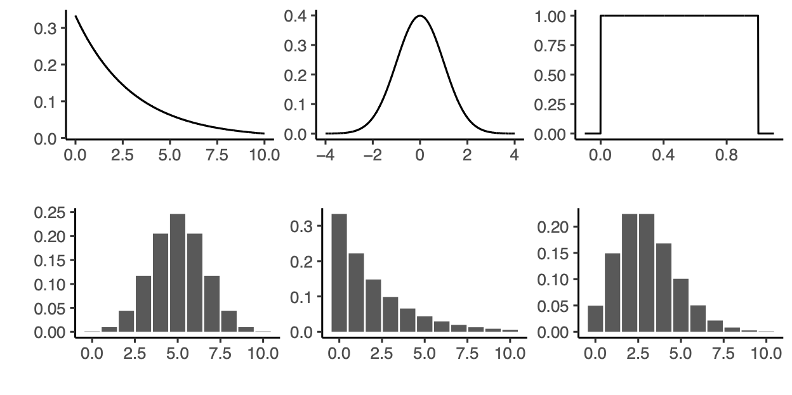
Common probability distributions
Uniform distribution
“no information / p-values under the null”
Normal distribution
“everything & if in doubt”
In R:
Binomial distribution
Poisson distribution
runif()
rnorm()
rbinom()
rpois()
rgeom()
rexp()
“counting the number of a type”
“counting the number of events”
Geometric distribution
Exponential distribution
“time until first failure / next event”
Practical will explore these distributions in the context of population genetics!

Slide 6
Statistical inference
(genetic) data
Formula / algorithm / estimator
estimated parameter
true parameter
Statistics provides us with both
Link between data and parameter is often the likelihood $\text{P}\text{(}\text{data}\text{|}\text{parameter}\text{)}$ “What is the probability of the data given parameters?” “E.g. what is the probability of my genetic data assuming the mutation rate is x”
For any formula, some desirable properties: - Unbiased: On average, it should give the right answer - Small variance: How far off the true value do I expect my estimated parameter to be?
the estimator/formula
some description of the relationship between estimated and true parameters
Notes:
Descriptive statistics

Slide 7
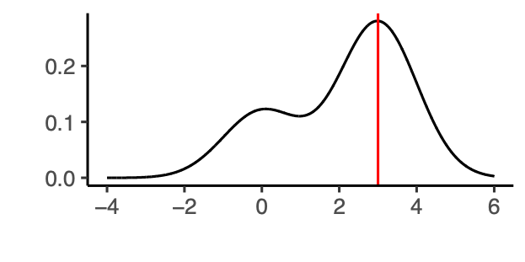
Likelihood: the link between the data and parameters
Key is to find some link between the data and our parameters of interest
P(data | parameter)
estimated parameter
Data
Two common strategies
Maximum likelihood:
Find the parameter value that maximises P(data | parameter)
P(data | parameter)
parameter
Bayesian inference:
Define a prior $P\left(parameter\right)$
$$P\left(parameter\right|data)=\frac{P\left(data\right|parameter)P(parameter)}{P(data)}$$
Practical will explore both strategies!
Notes:
Descriptive statistics
Credible sets

Slide 8
How to find the “best” parameters
P(data | parameter)
Best parameter
Data
“lots of parameters”
“dependencies between data points”
e.g.,
Individuals are genetically related through common ancestors
Mutations nearby in the genome are linked (linkage disequilibrium)
Two or more distinct processes generating similar patterns in the data: E.g., effective population size changes and natural selection
Group 1 (e.g. African)
Group 2 (e.g. European)
Target individual, e.g. African American
Some of the approaches we will encounter this week:
Markov-Chain Monte Carlo
Bootstrapping and jackknife
Approximate Bayesian Computation
Machine learning
Hidden Markov models

Slide 9

Overview of the practical
“Estimating the effective population size by hand”
“Maximum likelihood estimate of the time to the most-recent common ancestor”
Part 1 Coin toss, binomial distribution, geometric distribution
Part 2 Exponential distribution, Poisson distribution
(Solutions will be discussed ~15:00)
Part 3 Maximum likelihood estimation, Bayesian statistics
(Solutions will be discussed ~17:00)

