Slide 1
Machine Learning: Introduction
Dan Schrider

Slide 2
Outline
Overview of key supervised machine learning concepts
A few basic/old-school machine learning methods.
Deep Learning.

Slide 3
Breiman’s two cultures of statistical modeling
x
Nature
y
Two ways to think about modeling this process:
A process-based model (a “data model”)
An “algorithmic model”
Breiman 2001

Slide 4
Example of a “data model”
x
SweepFinder
y
x: allele frequencies
y: (composite) likelihood of sweep
Model: SweepFinder explicitly models the allele frequency spectrum at a given distance, r, from a beneficial mutation with selection coefficient, s.
Model validation: Traditionally, goodness-of-fit tests.
Nielsen et al. 2005; Breiman 2001

Slide 5
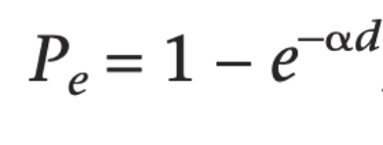

Model of directional selection in a large population
Crossover during sweep
Nielsen et al. 2005

Slide 6
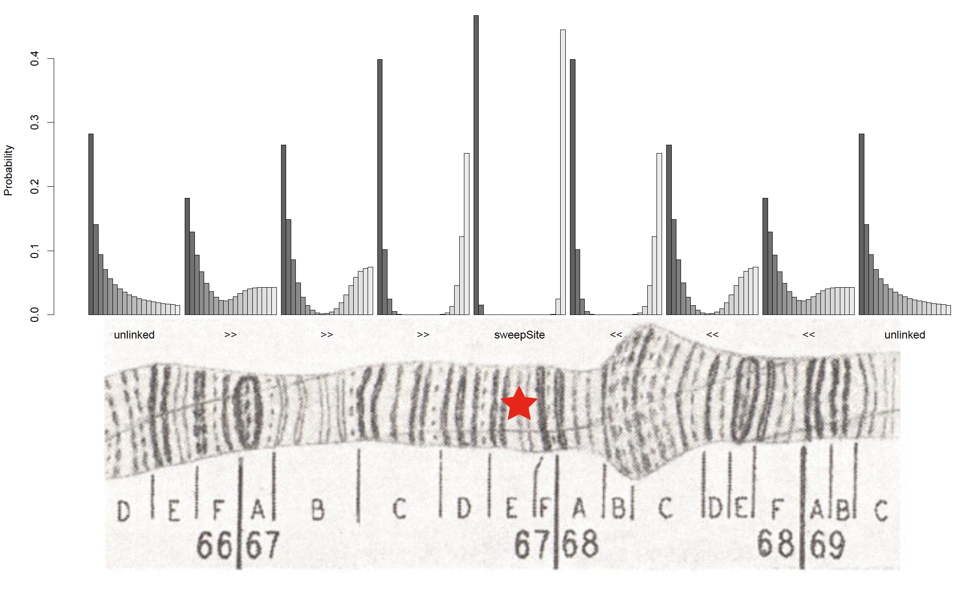
Illustration of SweepFinder model

Slide 7
Example of an “algorithmic model”
x
Artificial Neural Network (ANN)
y
x: vector of summary statistics
y: sweep or no?
Model: ???
Model validation: Predictive accuracy.
Breiman 2001

Slide 8

Machine Learning → Profit

Slide 9
What is supervised machine learning?
x: “feature vector” (input)
y: response variable (desired output: e.g. class label)
Given a set of <x, y> pairs, let’s learn a function f that accurately predicts y:
f (x) = y
Minimize some error or loss function L(f (x), y).

Slide 10
Example loss functions
Categorical data: classification error
Real-valued data: mean-squared error

Slide 11
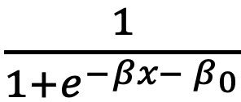
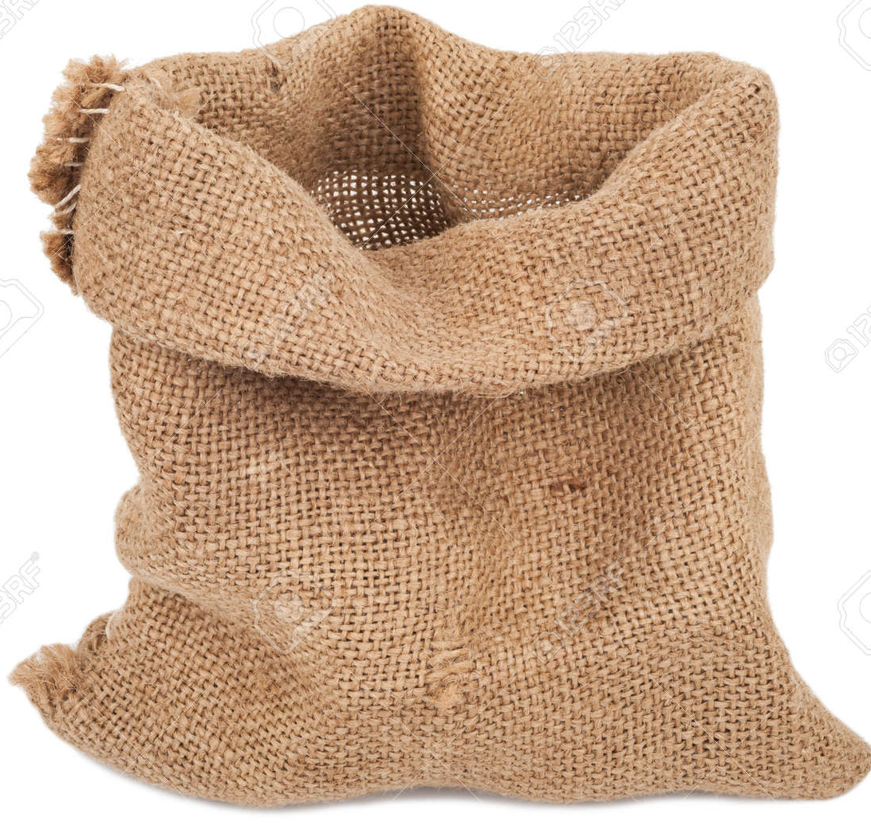

What is machine learning?
Tired: Logistic regression: $f\left(x\right)=\frac{1}{1+e^{−βx− β_{0}}}$
Wired: a bag of regressors!

Slide 12
Why machine learning?
Good for cases where mechanistic models are hard to come by
Supervised learning: good when lots of training data can be obtained
Good for high-dimensional data!

Slide 13
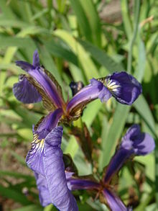
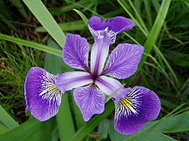
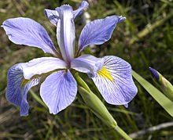
The Iris dataset
Iris versicolor
Iris virginica
Iris setosa
Goal: identify species
Multidimensional data (4 measures per flower)
Used by Fisher to illustrate a method for effective classification with multidimensional data
Should we use a mechanistic model of Iris development for this?

Slide 14
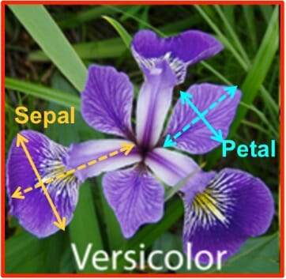
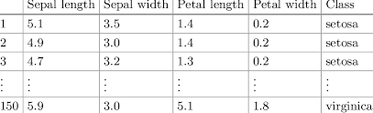
Iris data
X
y
This is a classification task (categorical response variable).

Slide 15
Some more thoughts on high-dimensional data
The curse of dimensionality: high-dimensional data sets may result in large, unwieldy models.
Consider ABC (using rejection sampling):
What if we have 100 dimensions?

Slide 16

High dimensionality: curse, or blessing?
Many weakly predictive features may together become highly predictive.
One dimension:

Slide 17
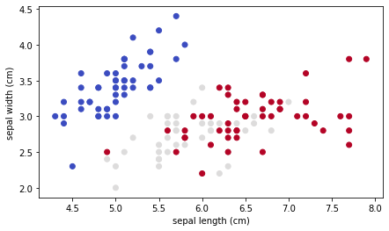
The Blessing of Dimensionality?
Many weakly predictive features may together become highly predictive.
Two dimensions:

Slide 18
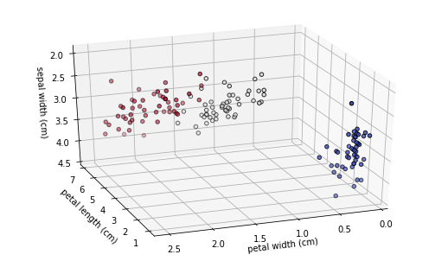
The Blessing of Dimensionality!
Many weakly predictive features may together become highly predictive.
Three dimensions:

Slide 19
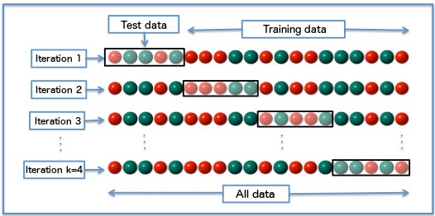
Training and test data
Important to hold out some data for our test set.
Gives an unbiased estimate of accuracy.
You don’t want a classifier that effectively “memorizes” your training set (won’t generalize)

Slide 20
Cross-validation
When training/test data are in short supply:
Why? Train on more data while still obtaining a precise assessment of accuracy (averaged across all k iterations, or “folds”)

Slide 21
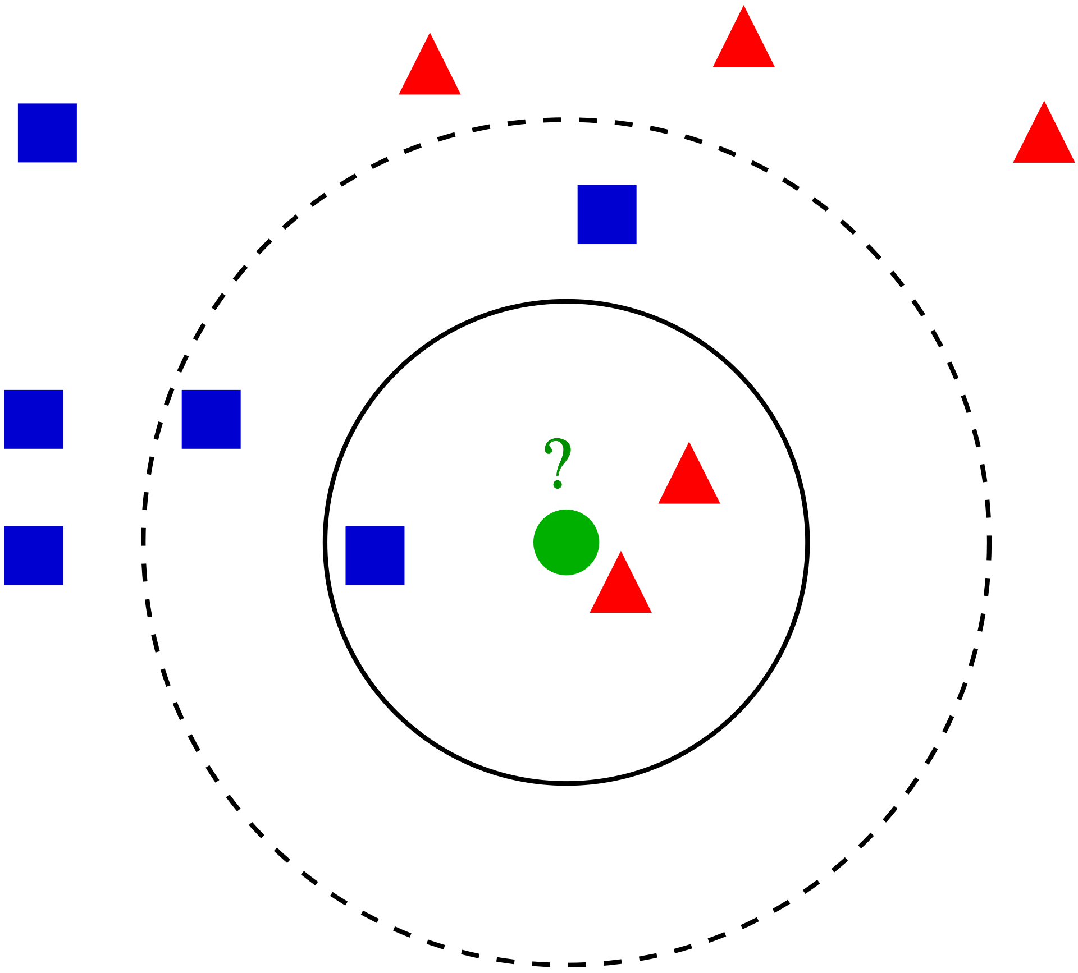
k-nearest neighbors
Given x, predicted y is obtained by looking at the k training points nearest x.

Slide 22
k-nearest neighbors
Given x, predicted y is obtained by looking at the k training points nearest x.
Classification: majority vote
Regression: average
That’s it!
Primitive, hokey, but useful for illustrating some core principles of supervised machine learning

Slide 23
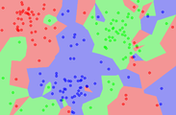
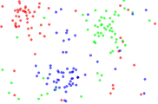
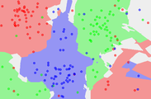
k-NN decision surfaces
1-NN decision surface
Training data
5-NN decision surface
Note that these decision surfaces are non-linear

Slide 24
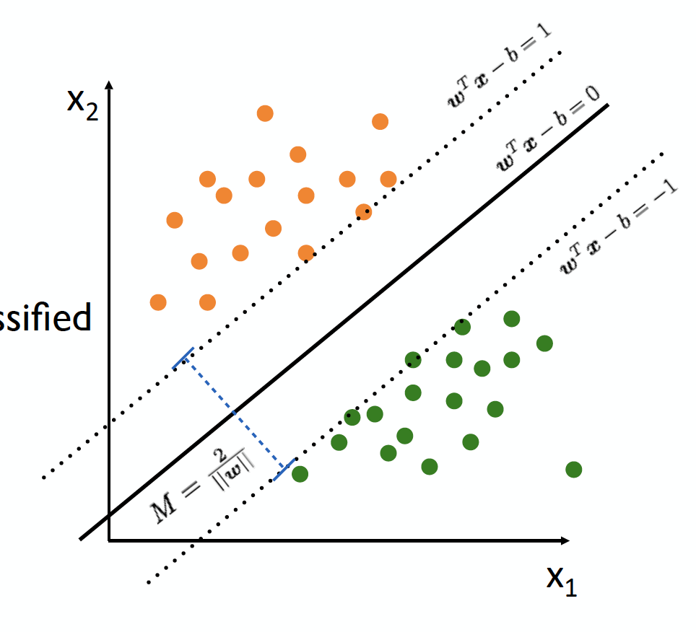
Support vector machine
(Cortes and Vapnik 1995; Vapnik and Chervonenkis 1963)

Slide 25
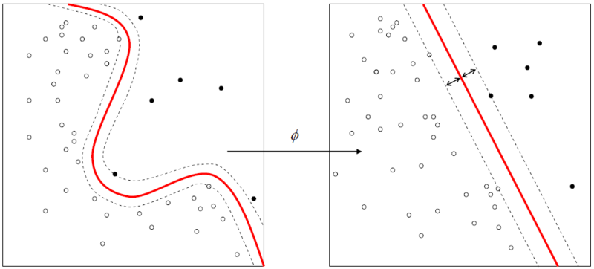
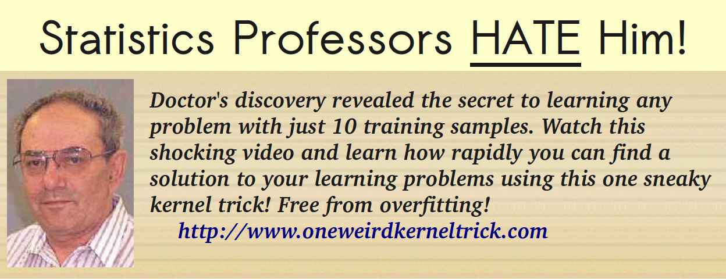
This one weird “Kernel Trick”
Note: don’t go to www.oneweirdkerneltrick.com
Notes:
Applications ranging from NLP, facial recognition, audio processing/classification

Slide 26
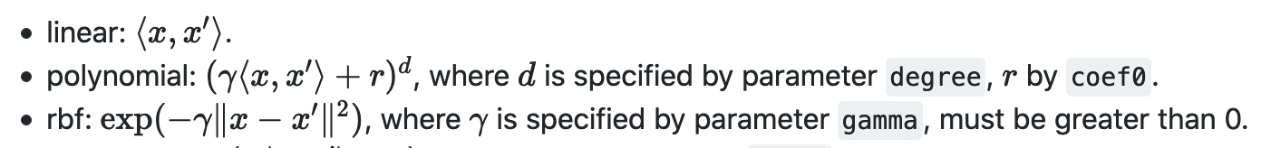
Commonly used kernels
From scikit-learn.org

Slide 27
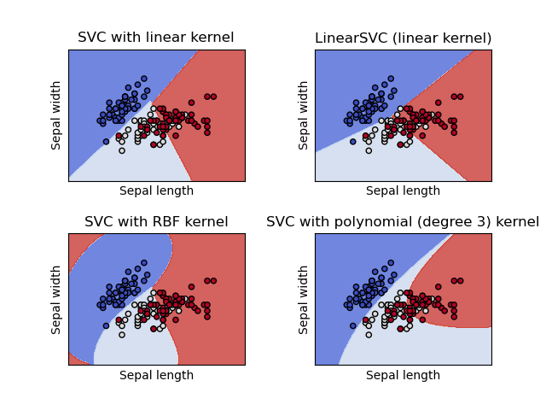
Example decision surfaces – SVM
From scikit-learn.org

Slide 28
More SVM decision surfaces
https://cs.stanford.edu/~karpathy/svmjs/demo/

Slide 29
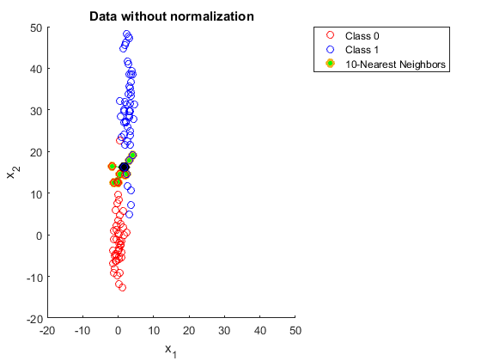
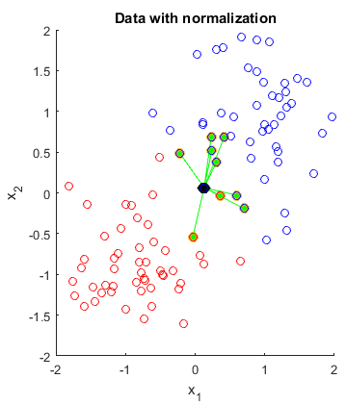
Preprocessing data
Many machine learning algorithms (including k-NN and SVM require standardized axes).
source

Slide 30
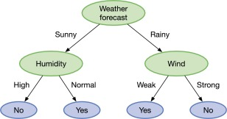
Decision tree
Should I go outside today?
Human-readable model!
Can be learned algorithmically

Slide 31
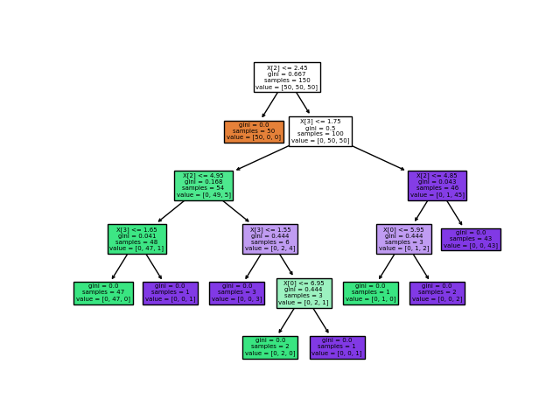
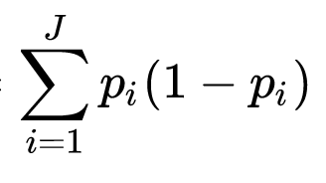
Decision tree for Iris dataset
Minimize:
Gini impurity:

Slide 32
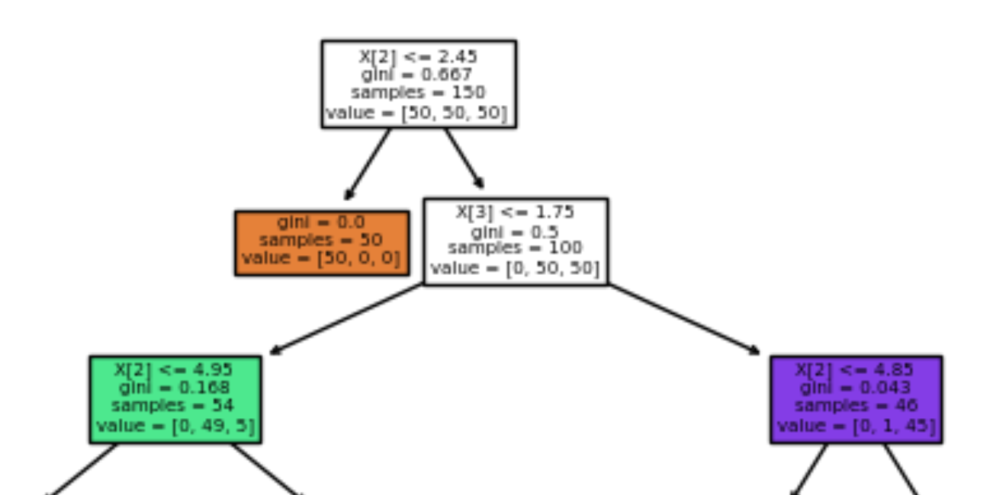
Decision tree for Iris dataset
1. Pick the <feature, threshold>
that optimally splits our data*
2. If no improvement is achieved,
emit the most frequent class
3. Otherwise, split the data and
continue in each branch.
*Minimize:
Gini impurity:

Slide 33
Decision tree: follow training data down to the leaves
83.33% red
75% red
100% red
75% blue

Slide 34
From trees to forests
Designing the best possible decision tree tends to not work that well for very difficult problems.
What if we instead make a not-so-great tree in a semi-random manner. And then make another, and another, and another…?

Slide 35
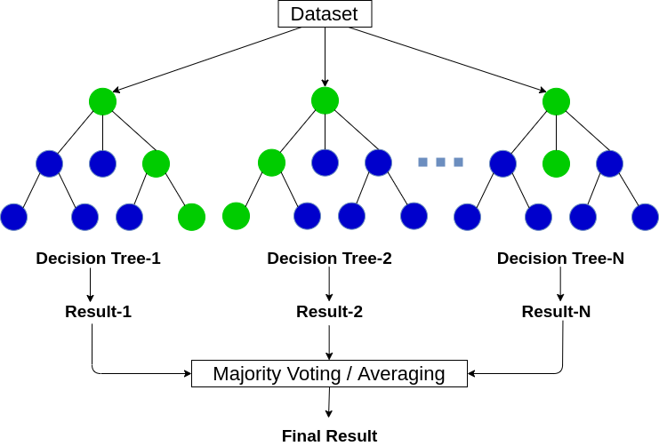
Random forests
Breiman (2001)

Slide 36
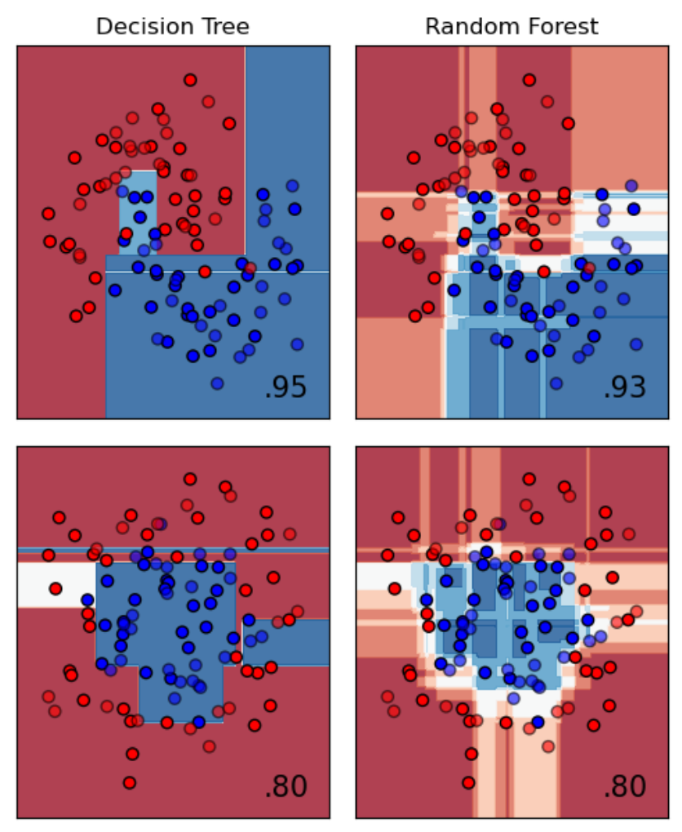
Non-linear decision boundaries with trees and forests
Dataset 1
Accuracy shown in bottom-right corner
Dataset 2
source

Slide 37
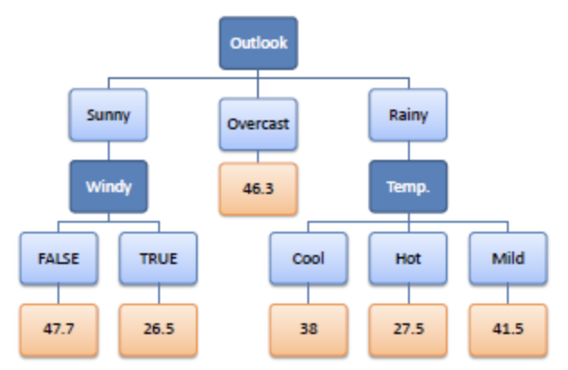
Regression with trees/forests
How many minutes will I spend outside today?
Instead of a class label, emit a real value!
(average of all training data reaching that leaf)
Note: k-NN and SVMs can also do regression

Slide 38
Advantages of random forests
No need to preprocess data
Works well out of the box—minimal hyperparameter tuning required
Overfitting is not a major concern, compared to SVM.
Can also be used to measure feature importance.
We’ll see RFs in action in the exercise!

Slide 39
Unsupervised learning
Up until this point we have been trying to predict a known response variable y. This is called supervised learning. Sometimes there is no predefined y, but we still want to learn something from our data. E.g:
-Clustering (e.g. PCA, k-means clustering)
-Anomaly detection (e.g. one-class SVM, isolation forest)
-Denoising (e.g. autoencoders)

Slide 40
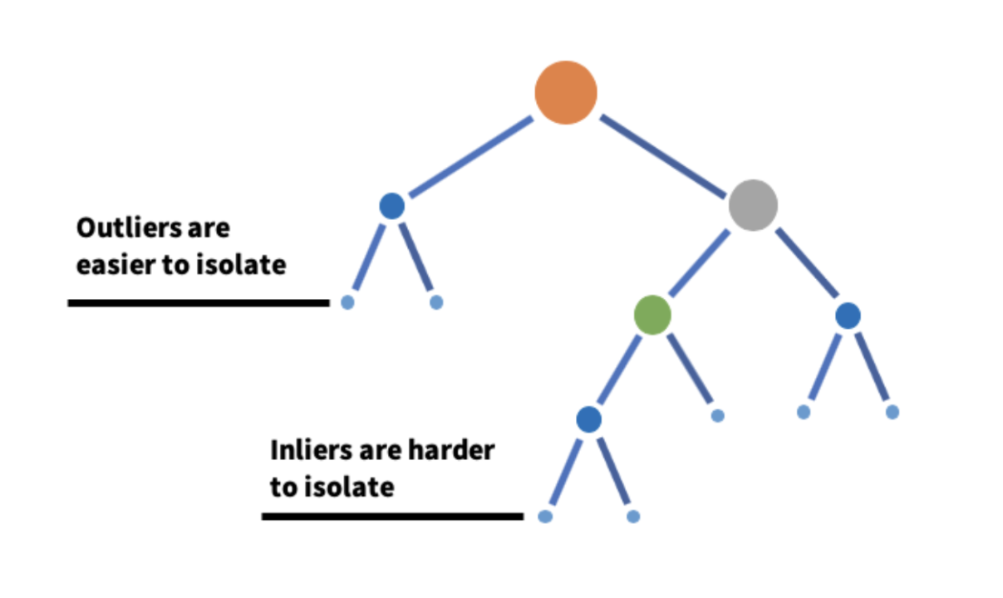
Isolation forests
Idea: randomly construct a decision tree and see when each data point is isolated (alone on a leaf).
Count path lengths for each leaf.
Make a forest of these bad boys and take the average path length to each example
Liu et al. (2008)

Slide 41
Back to supervised learning…
…and back in time.

Slide 42
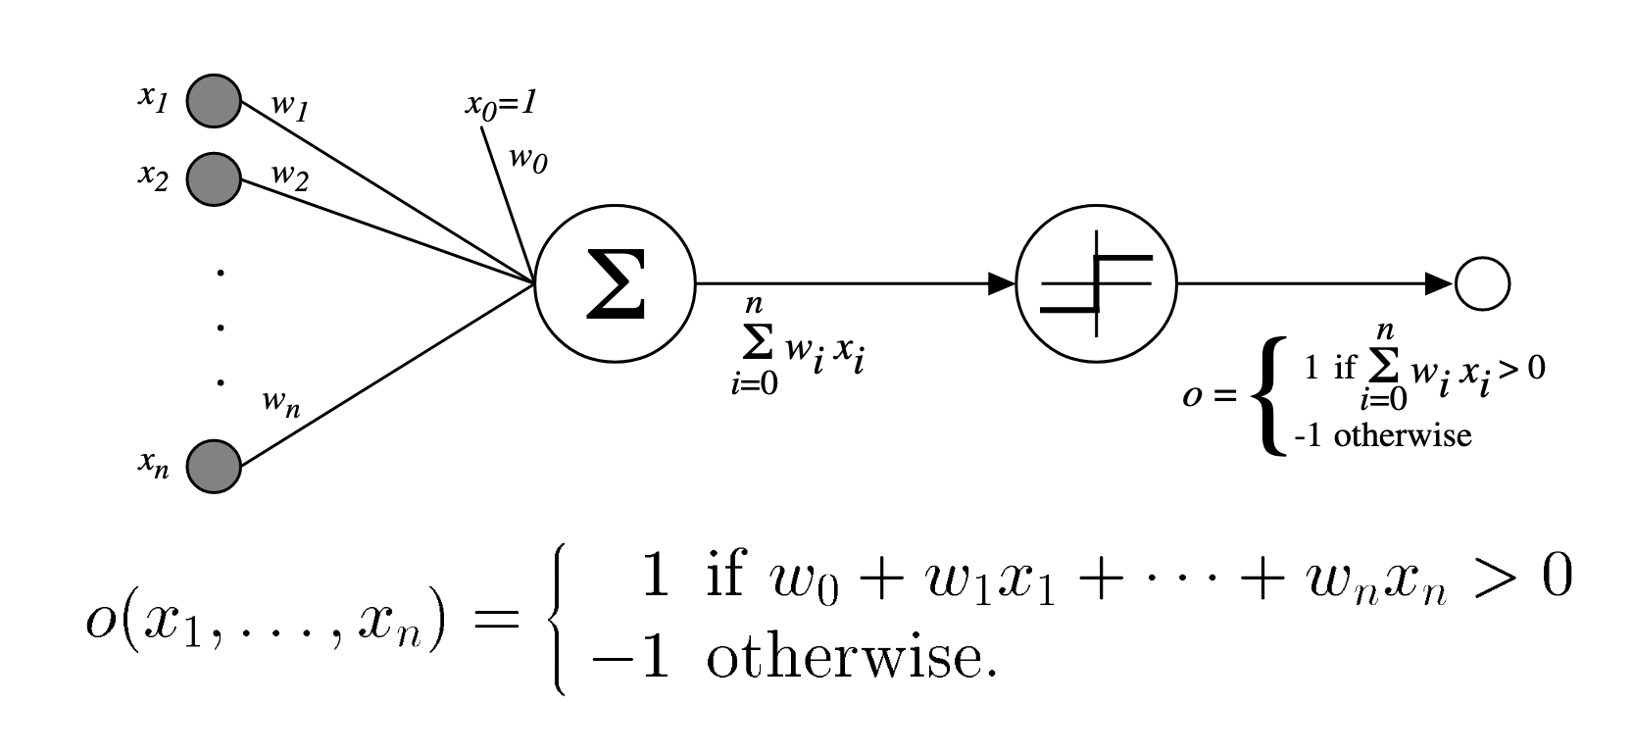
Perceptron
Rosenblatt (1957)

Slide 43
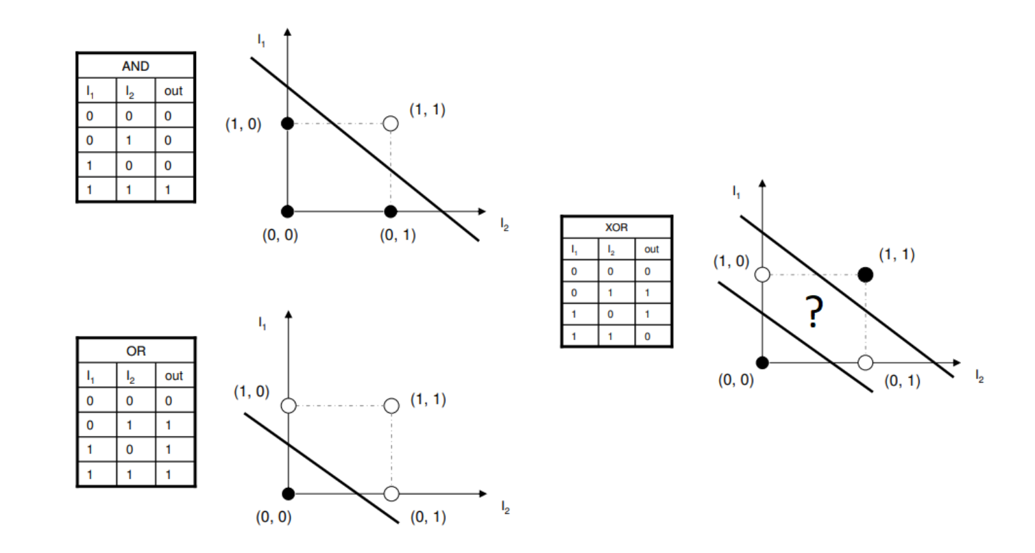
Limitation of perceptrons

Slide 44
Up next
Deep Learning!

Slide 45
But first
Let’s get our hands dirty!
Data preprocessing
Training and testing k-NN, SVM, random forest
Binary and multi-class classification
Accuracy metrics: sensitivity, specificity, precision, recall, confusion matrices!
All through the magic of the scikit-learn python module

