Slide 1
ALS biomarker discovery using whole genome bisulfite sequencing of cell-free DNA
Christa Caggiano
Zaitlen Lab Group Meeting
Biomedical Informatics
14 December 2017

Slide 2
Biological background
Cell-free DNA and ALS biology

Slide 3
Experiment
Samples and experimental design

Slide 4


cfDNA whole genome bisulfite sequencing experiment:
gDNA
bisulfite conversion
ssDNA fragments
Random primed DNA synthesis
3’ tagging
PCR
~24 ALS patients/controls (C. Lomen-Hoerth)
cfDNA extracted from a blood draw (B. Celona)
whole genome bisulfite sequencing of the cfDNA (B. Celona)

Slide 5
Sample information:
sample prefix | sample source | subject dob | sex | onset date | blood draw date
1_BC | ALS5 | 9/13/55 | M | Apr-15 | 4/19/17
2_BC | ALS8 | 3/12/60 | M | Jun-16 | 5/26/17
3_BC | ALS18 | 10/19/31 | M | Dec-16 | 8/18/17
4_BC | ALS19 | 12/16/53 | F | Mar-16 | 8/18/17
5_BC | CTRL1 | 11/7/56 | M | NA | 4/19/17
6_BC | CTRL8 | 1/10/58 | M | NA | 5/26/17
7_BC | CTRL11 | 1/21/34 | M | NA | 7/7/17
8_BC | CTRL19 | 5/30/55 | F | NA | 8/18/17

Slide 6
Lane | Project | % of the lane | % Perfect barcode | % >= Q30 bases | Mean Quality Score | % Alignment
1 | default | 17.04 | 100.00 | 89.90 | 35.19
1 | zaitlenn-1_BC | 8.19 | 100.00 | 94.04 | 36.01
1 | zaitlenn-2_BC | 11.74 | 100.00 | 93.31 | 35.89
1 | zaitlenn-3_BC | 11.70 | 100.00 | 93.88 | 35.98
1 | zaitlenn-4_BC | 10.25 | 100.00 | 93.49 | 35.92
1 | zaitlenn-5_BC | 9.74 | 100.00 | 93.96 | 36.00
1 | zaitlenn-6_BC | 10.69 | 100.00 | 94.17 | 36.03
1 | zaitlenn-7_BC | 11.70 | 100.00 | 93.73 | 35.96
1 | zaitlenn-8_BC | 8.94 | 100.00 | 93.66 | 35.95
2 | default | 16.96 | 100.00 | 89.88 | 35.19
2 | zaitlenn-1_BC | 8.20 | 100.00 | 94.05 | 36.01
2 | zaitlenn-2_BC | 11.76 | 100.00 | 93.32 | 35.89
2 | zaitlenn-3_BC | 11.70 | 100.00 | 93.88 | 35.99
2 | zaitlenn-4_BC | 10.27 | 100.00 | 93.47 | 35.92
2 | zaitlenn-5_BC | 9.74 | 100.00 | 93.97 | 36.01
2 | zaitlenn-6_BC | 10.71 | 100.00 | 94.17 | 36.03
2 | zaitlenn-7_BC | 11.71 | 100.00 | 93.74 | 35.96
2 | zaitlenn-8_BC | 8.96 | 100.00 | 93.67 | 35.95

Slide 7
Bioinformatic workflow

Slide 8
II. whole genome bisulfite sequencing data
preliminary analysis

Slide 9
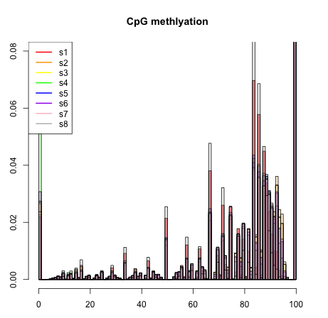

Proportion of methylated CpGs are similar for ALS and controls.
ALS1
ALS2
ALS3
ALS4
CTRL1
CTRL2
CTRL3
CTRL4
proportion
percent methylated CpGs per locus

Slide 10
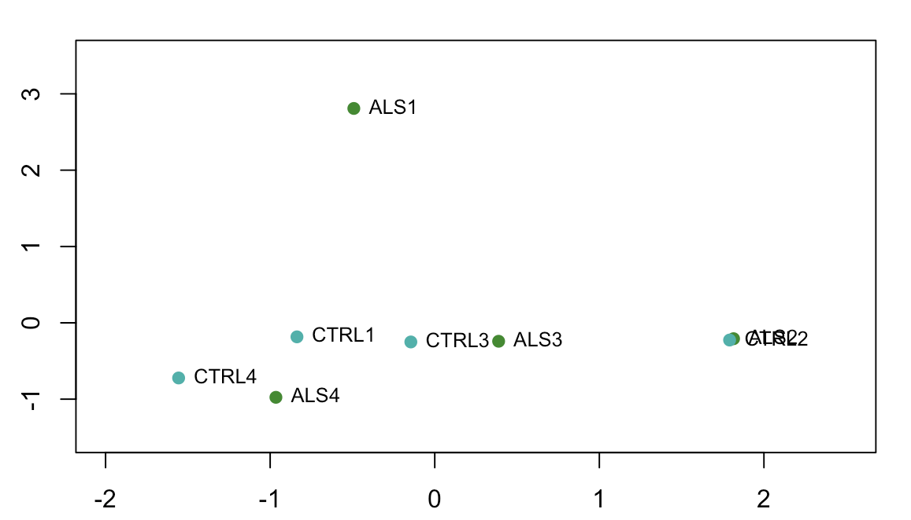
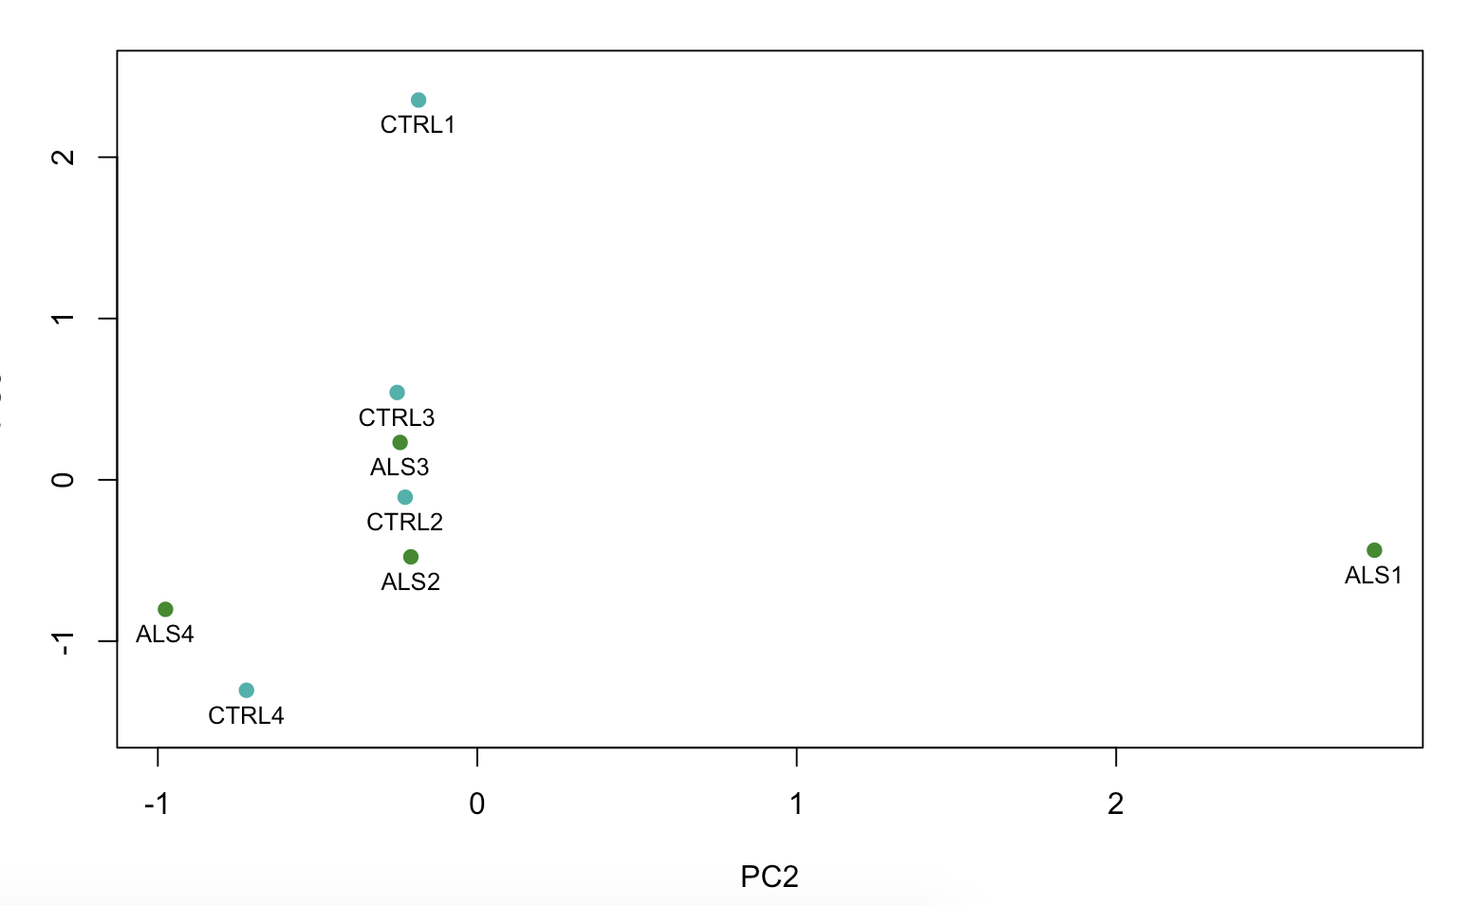
PCA decomposition does not separate healthy vs ALS but isolates specific samples regardless of disease state.
PC2 17% of var
PC3
PC1 20% of var
PC2
ALS
CTRL

Slide 11
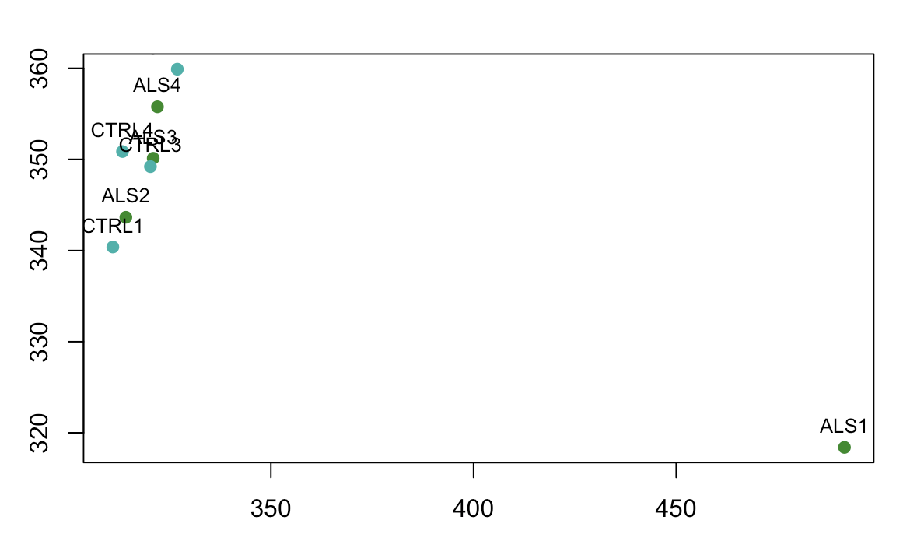
K-Means clustering recapitulates isolation of ALS1.
dim2
dim1
ALS
CTRL

Slide 12
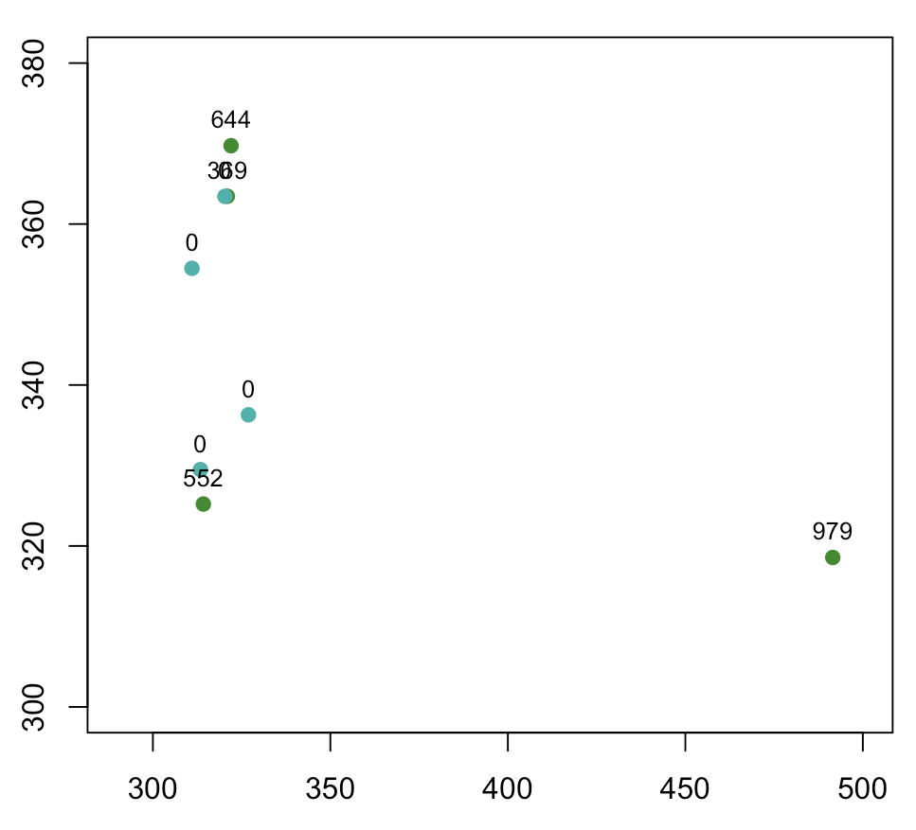
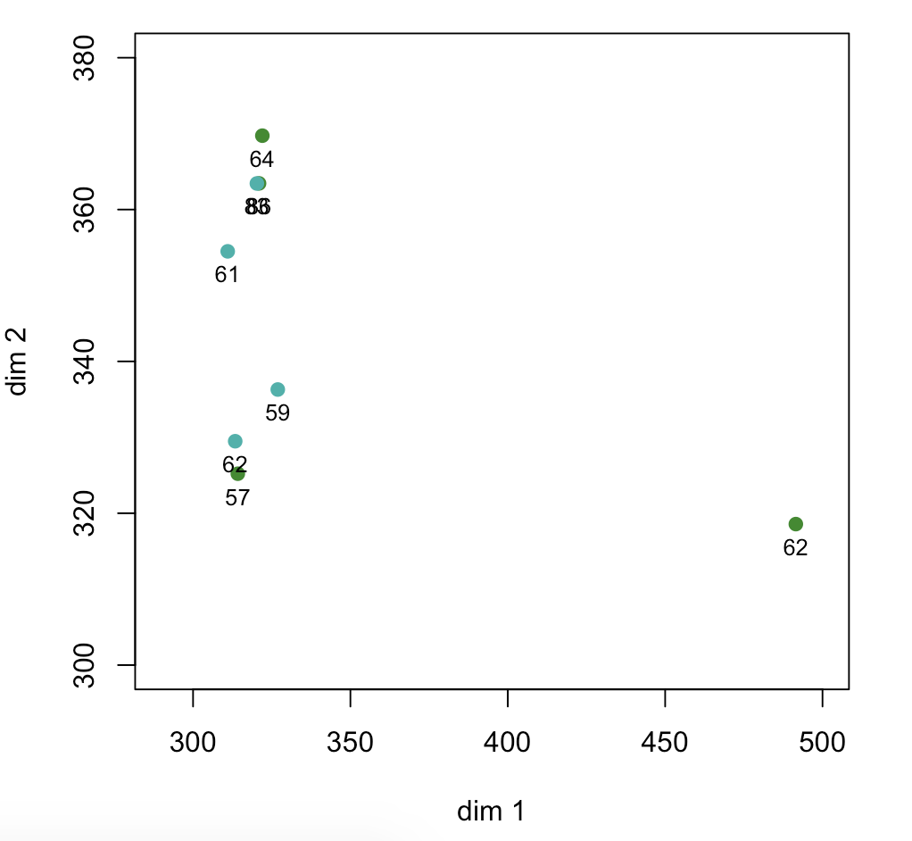
Number of days since onset of disease may be important factor
Days since ALS onset
Patient age
dim2
dim2
dim1
dim1
ALS
CTRL

Slide 13
III. deconvolution
preliminary work

Slide 14
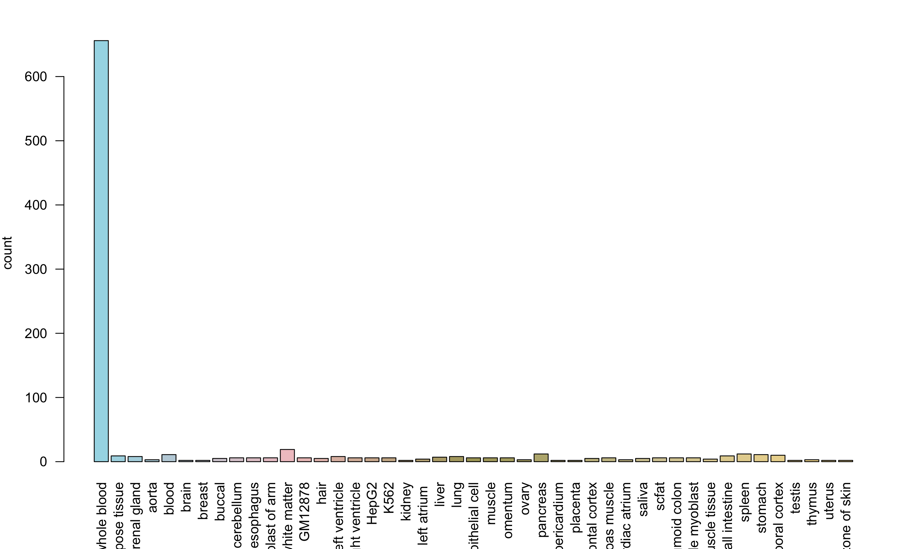
Methylation datasets were obtained to represent 45 tissues and 900 individuals.

