Slide 1
RRBS vs WGBS
ENCODE data
https://www.encodeproject.org/search/?type=Experiment

Slide 3
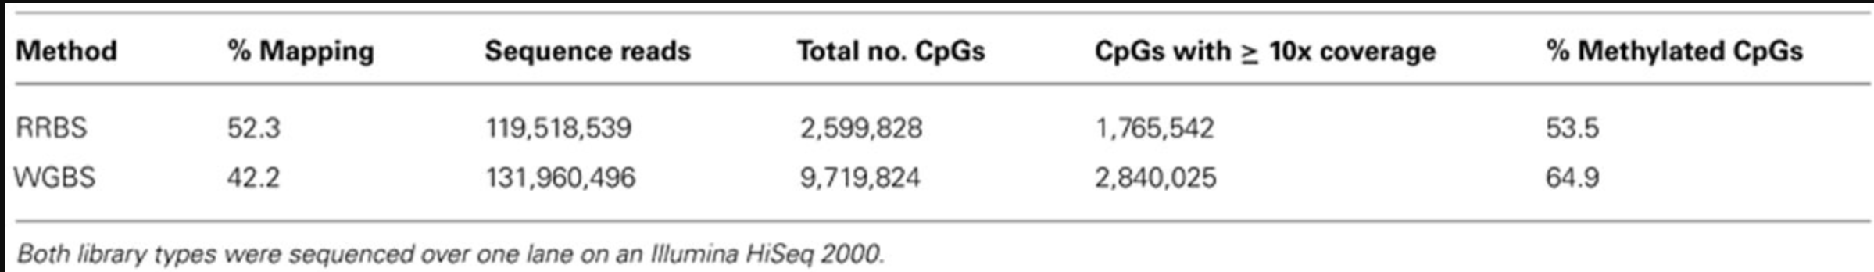
RRBS and WGBS samples –what is the motivation for different preps?
RRBS samples “CpG shores” – selects for CpG rich locations, like promoters and genes. Intergenic regions are underrepresented
Ex coverage- https://www.frontiersin.org/articles/10.3389/fgene.2014.00126/full

Slide 4
Fastqc checks

Slide 5
Read depth and number of methylation calls
RRBS
std: 157355
mean: 1256254
minimum: 960300
maximum: 2042125

Slide 6
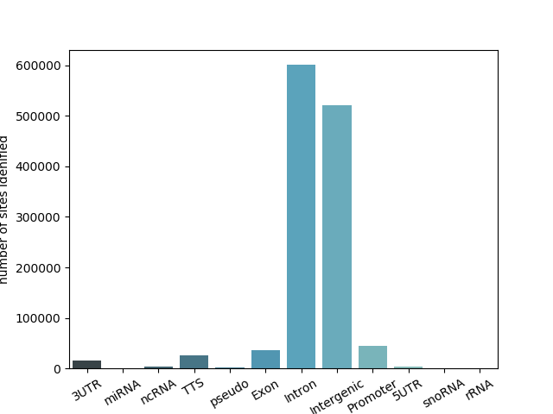
Genomic feature distribution
RRBS

Slide 7
Bed tools intersect: how many of these sites are shared between similar RRBS/WGBS samples

Slide 8
WGBS pipeline using bismark
https://github.com/christacaggiano/ENCODE_WGBS

Slide 9
Some runtime information
Entire pipeline takes ~ 24 hours to run
Splitting of fastq files into 18 million reads takes a while ~ 4-10 hours depending
Trim galore takes ~ 6 hours
Bismark takes ~7 hours to run
Could be some opportunities to parallelize splitting – then have trim galore and bismark on these split files take place on separate threads instead of sequentially

Slide 10
Maybe another slide about the pipeline?

Slide 11
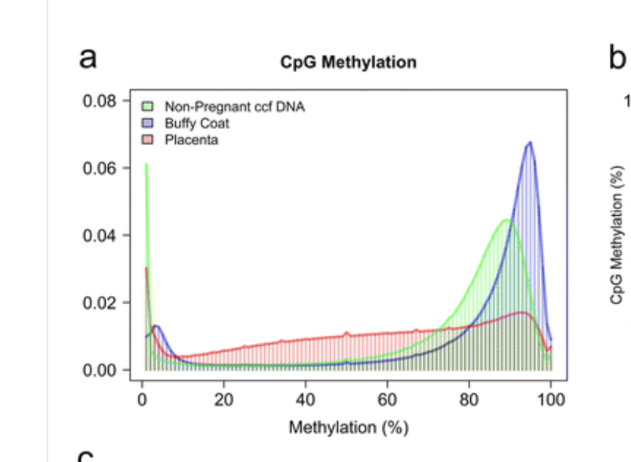
Replicate

Slide 12
WGBS pipeline using GEMBS
https://github.com/heathsc/gemBS

Slide 13
Solutions for matrix manipulation for our large ref matrix

