Slide 1
Color Coordinator Implementation
Benjamin Estremera, Paul Grubbs, Hampton Brewer

Slide 2
Project Definition
Matching clothes can be a difficult process for many people, whether it be due to a visual impairment or total lack of instinct.
ColorCoordinator will simplify the process for everybody, using simple pictures to determine whether your planned outfit matches or needs some work.
ColorCoordinator can help your daily wardrobe, help you learn color theory, and even help you when deciding what tie to buy to match your suit.

Slide 3
Project Scope
Develop a mobile app that assists users with and without vision impairment in matching their outfits.
The user will take pictures of clothing items to assemble an outfit.
The app will then assign that outfit a match rating with each addition of a clothing item using a k-means clustering algorithm.
Users can adjust the match ratings using the match threshold in the options menu.
App will be developed on the Android platform, version 4.0 (Ice Cream Sandwich) or later.

Slide 4
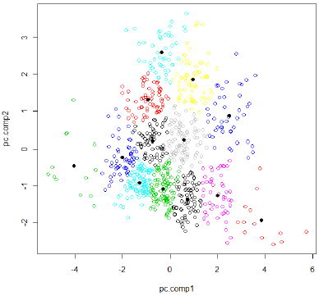
K-Means Clustering
Strategy:
Represent RGB colors in 3D space.
Randomly select K points as center of clusters.
Associate each point with nearest cluster
Recalculate center and repeat

Slide 5
How do you quantify a match rating?
Strategy:
Compare the degrees between colors in outfit.
Guess closest color scheme
See how far away from perfect that is, and subtract.

Slide 6
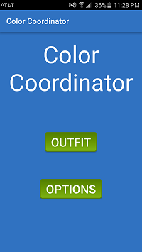
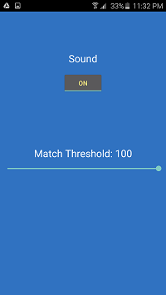
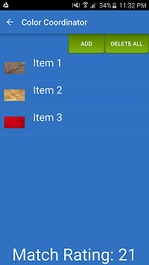
Color Coordinator Demo Examples
Color Coordinator

Slide 7
Final Thoughts
Project definition evolved throughout creation process.
Difficulties
Problems using Android storage methods.
Match Rating is very difficult to quantify.
Learning how to use Android Studio.
Problems with collaboration.

