Slide 1
Color Coordinator
Design
Benjamin Estremera, Paul Grubbs, and
Hampton Brewer

Slide 2
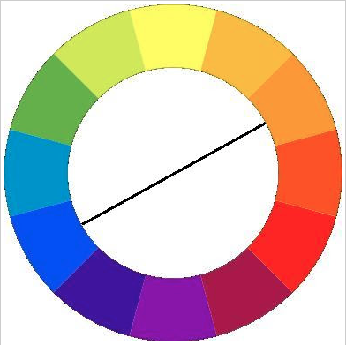
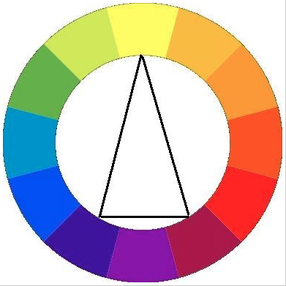
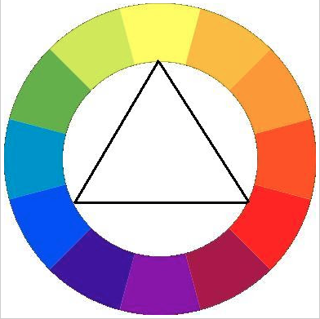
Problem Definition
Matching clothes can be a difficult process for many people, whether it be due to a visual impairment or total lack of instinct.
ColorCoordinator will simplify the process for everybody, using simple pictures to determine whether your planned outfit matches or needs some work.
ColorCoordinator can help your daily wardrobe, help you learn color theory, and even help you when deciding what tie to buy to match your suit.

Slide 3
Project Scope
Develop a mobile app that assists users with and without vision impairment in matching their outfits.
The user will take pictures of clothing items to assemble an outfit.
The app will then assign that outfit a match rating with each addition of a clothing item
App will be developed on the Android platform, version 4.0 (Ice Cream Sandwich) or later

Slide 4
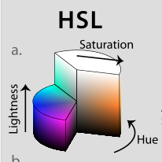

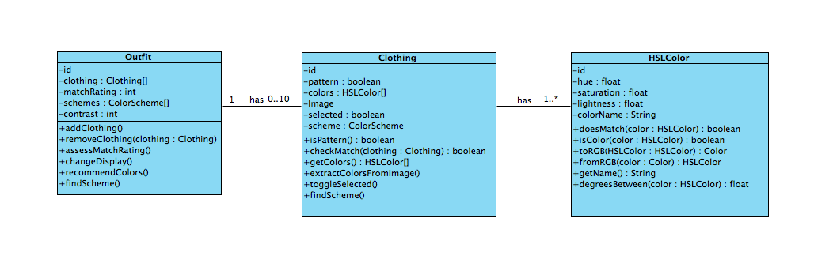
Class Diagram

Slide 5
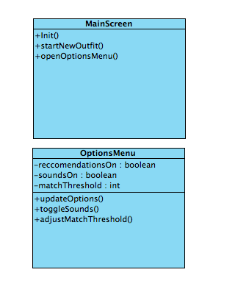
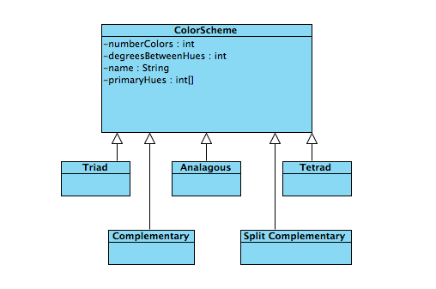
Class Diagram

Slide 6
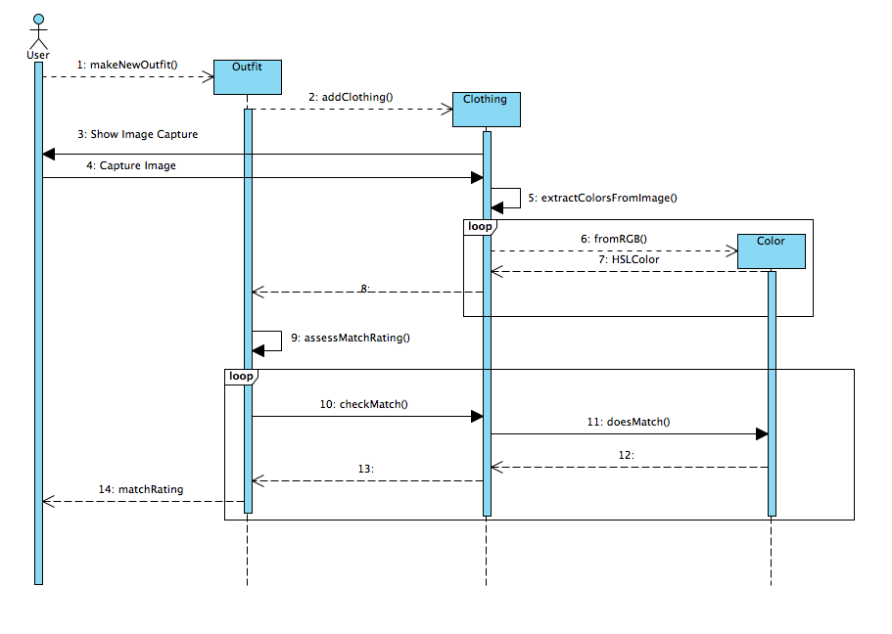
Make Outfit Sequence

Slide 7
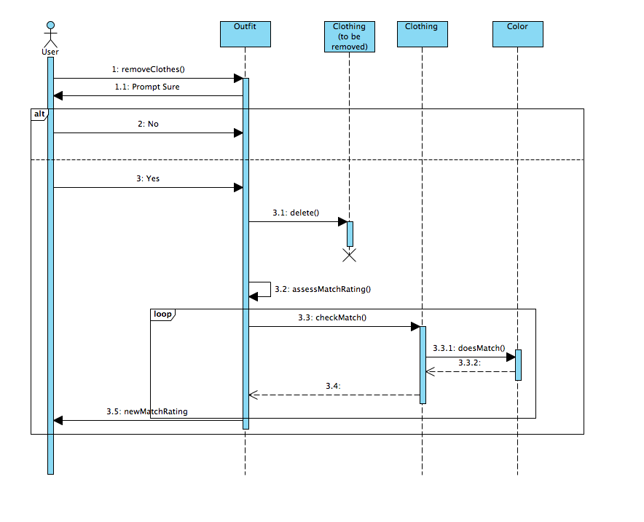
Remove Clothes Sequence

Slide 8
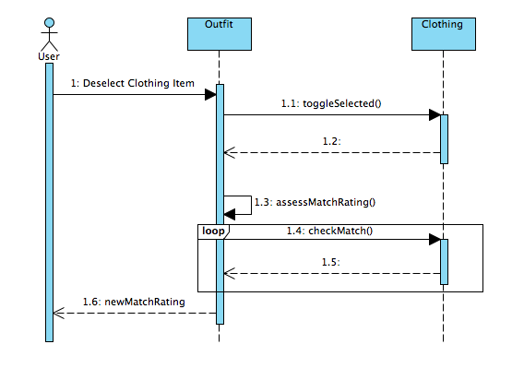
Deselect Clothes Sequence

Slide 9
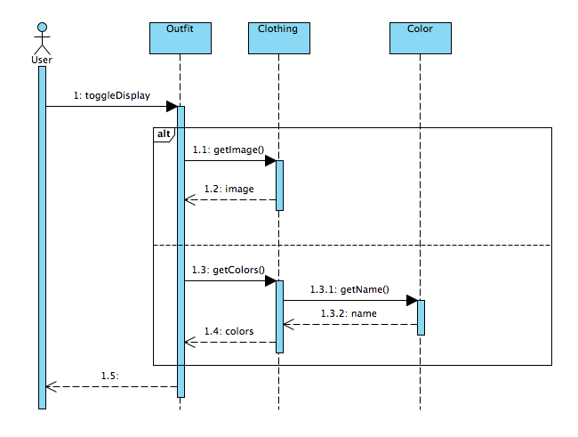
Toggle Display Sequence

Slide 10
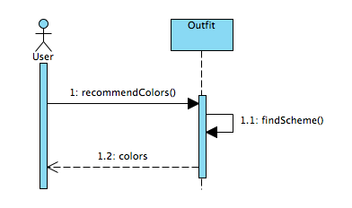
Recommend Colors Sequence

Slide 11
Project Changes
Added feature requirement that allows users to deselect items of clothing in an outfit to see the match rating without having to delete the picture

