Slide 1
Color Coordinator Requirements
Benjamin Estremera, Paul Grubbs, and
Hampton Brewer

Slide 2
Project Scope
Develop a mobile app that assists users with and without vision impairment in matching their outfits.
The user will take pictures of clothing items to assemble an outfit.
The app will then assign that outfit a match rating with each addition of a clothing item
App will be developed on the Android platform, version 4.0 (Ice Cream Sandwich) or later

Slide 3
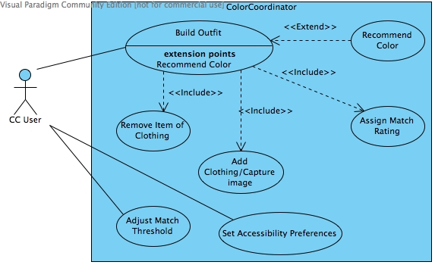
Use Case Diagram

Slide 4
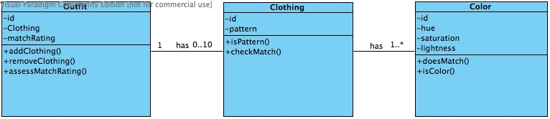
Class Diagram (High Level)

Slide 5
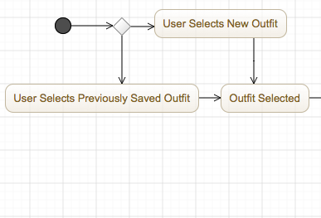
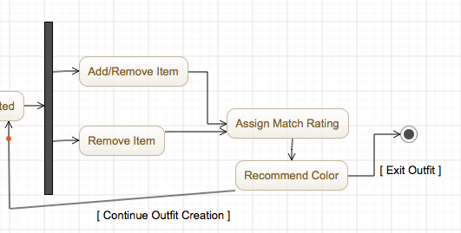
Activity Diagram - Build Outfit

Slide 6
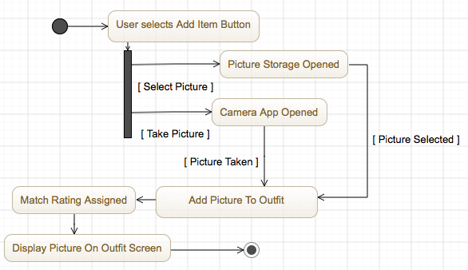
Activity Diagram - Add Item

Slide 7
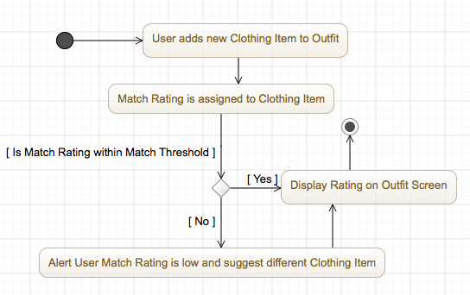
Activity Diagram - Assign Match Rating

Slide 8
Features
Required
Possible
An interface that is accessible to all users, including those with vision impairment
Allows users to create outfits based on pictures of clothing
Creates a match rating of outfits based on Color Theory
Allows changes to the rating threshold
Recommend colors when items do not match
Allow the user to save outfits for later reference
Allow users to include pictures taken elsewhere
Pattern recognition (future work)

Slide 9
Potential Risks
Creation of an accurate match rating system
Difficult to find many vision-impaired users for app testing
Broken camera hardware may affect user pictures
Users may ignore the instructions to take pictures in similar lighting conditions

