Slide 1
Ubiquitous Computing Driving Behavior Analysis
Spring 2016
Yufeng Yuan
Cheng Zhang
Zhaoqian Lu

Slide 2
Project Purpose
This system will collect data from OBD reader, google map, phone sensors, to analyze if the driver drives the auto appropriately.
Then the system will gives a report to user about their driving behaviors, and which part of driving behavior should be corrected.

Slide 3
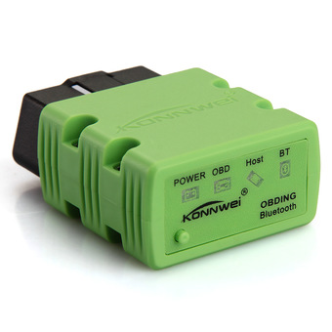

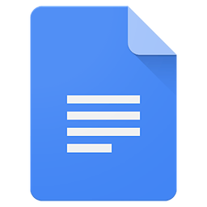



Web Server
OBD2
Report
Apache
PHP
HTML
Google Map

Slide 4
Data
OBD2
Phone
Speed
GPS Location
RPM
Time
Driving Duration
Google map Information
Lots of engine data
accelerometer
Notes:
To do:
[picture]: OBD [picture]: a phone
Add data feature for OBD and Phone
[picture]: about all feature we can get
We can get a large amount of data, but what is useful for driving behavior analysis.

Slide 5
Analysis
Example of Analysis:
Driving Speed is greater than limit speed information from google map
→ Speed too high
Engine start and stop time
→ Long time driving reminder
Speed increase or decrease change too fast in short time (4 secs)
→ Rush acceleration and hard break
Speed to high(30 miles) if bearing data greater than 75 degrees
→ Turning speed too fast
Notes:
Citation: Good and Bad behavior website
Features → Behavior

Slide 6
Report
Driving duration
Driving route showing in google map
Max speed, Avg speed
Full stop count
Hard break count
Over acceleration count
Driving suggestion(TBD)
Over speed limit count (TBD)
Remind if gas station or restaurant closed by car (TBD)
Notes:
Left:
Calculate on server and return a report to user’ phone
Score system
More information: Route, location, gas and so on
Right:
Demo for report

Slide 7
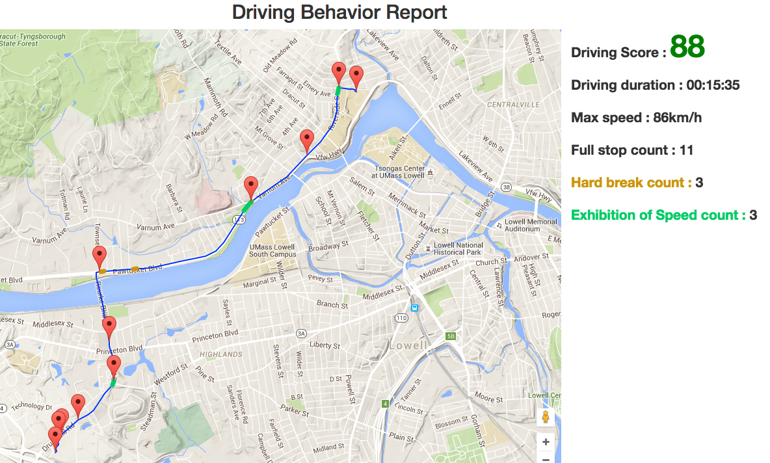
Demo
Notes:
data: http://weblab.cs.uml.edu/~zlu/DrivingBA/Server/showLog.php
report: http://weblab.cs.uml.edu/~zlu/DrivingBA/Server/analyse.php

Slide 8
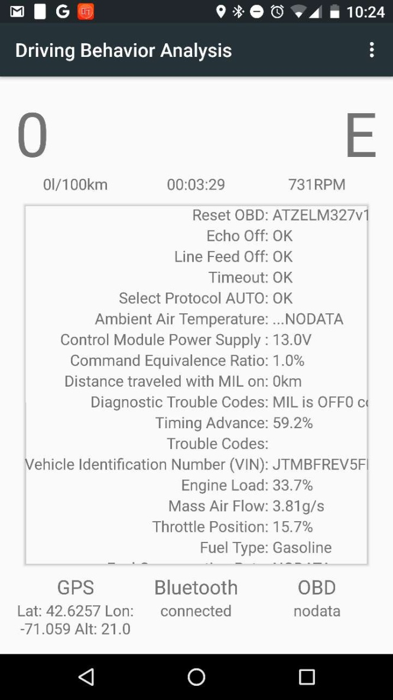
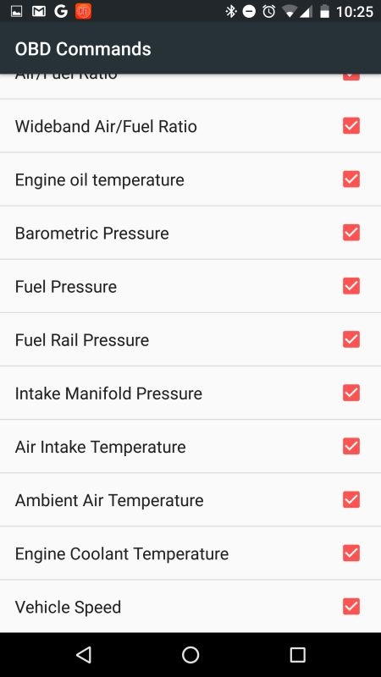
Demo
Notes:
data: http://weblab.cs.uml.edu/~zlu/DrivingBA/Server/showLog.php
report: http://weblab.cs.uml.edu/~zlu/DrivingBA/Server/analyse.php
app:

Slide 9
Video Demo
https://youtu.be/IDerP381ssE
Online Report
http://weblab.cs.uml.edu/~zlu/DrivingBA/Server/analyse.php

Slide 10
Big Picture
More accuracy data analysis algorithm
Find a way for calculating driving behavior score
Collect auto health report(Machine Learning Algorithm)
Could be useful for insurance company

