Slide 1
Clipart
School Supplies

Slide 2
Clipart
School Supplies

Slide 3
Clipart
School Supplies

Slide 4





School Supplies
Clipart

Slide 5
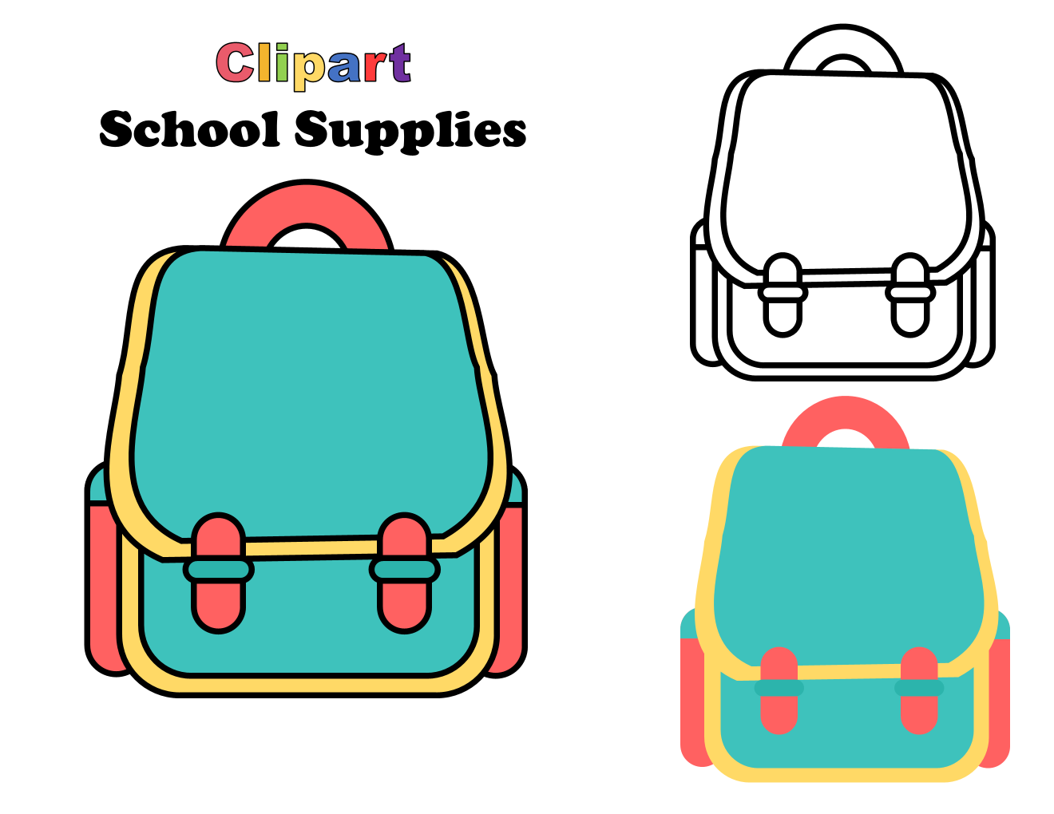
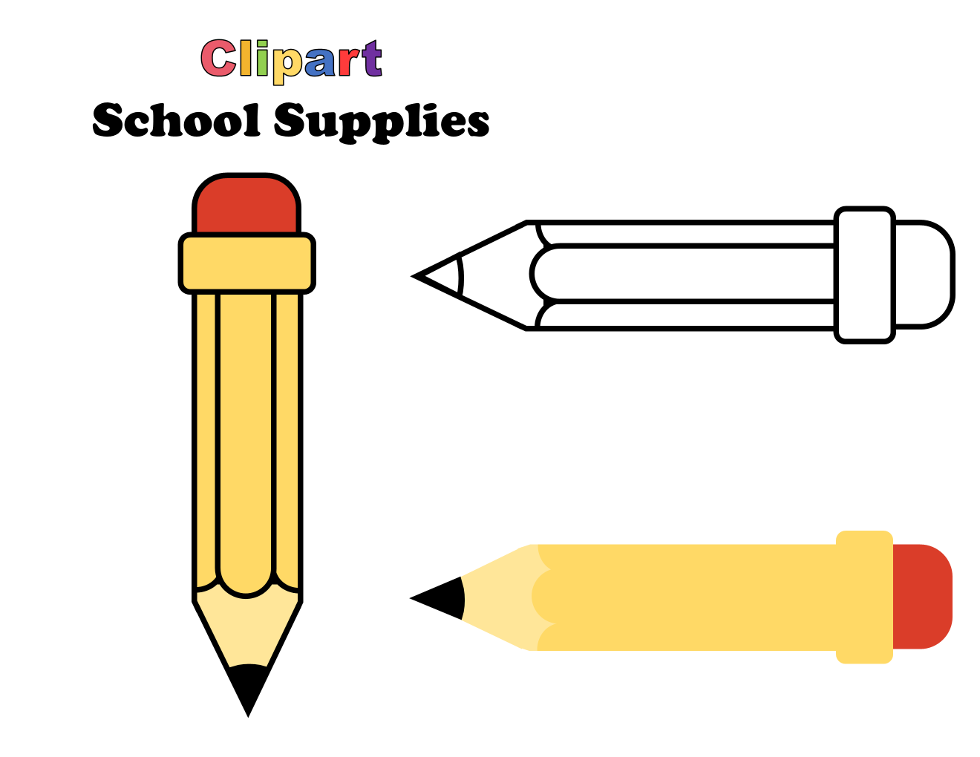
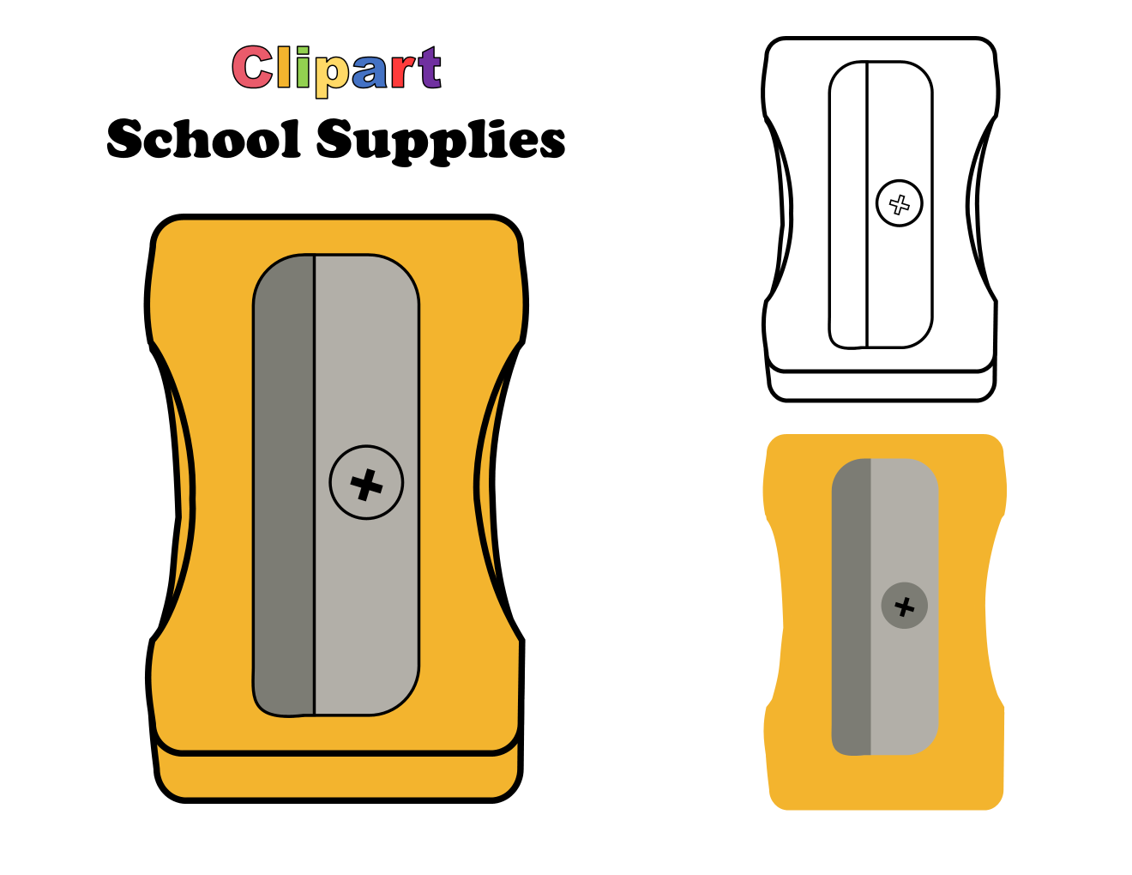

Slide 6
Trace & Color
My School Bag
Bag

Slide 7

Trace & Color
My School Bag
Pencil

Slide 8
Trace & Color
My School Bag
Pen

Slide 9
Trace & Color
My School Bag
Eraser

Slide 10
Trace & Color
My School Bag
Sharpener

Slide 11
Trace & Color
My School Bag
Ruler

Slide 12
Trace & Color
My School Bag
Book

Slide 13
Trace & Color
My School Bag
Notebook

Slide 14
Trace & Color
My School Bag
Crayons

Slide 15
Trace & Color
My School Bag
Scissors

Slide 16
Trace & Color
My School Bag
Glue Stick

Slide 17
Trace & Color
My School Bag
Folder

Slide 18
Trace & Color
My School Bag
Pencil Pouch

Slide 19
Trace & Color
My School Bag
Calculator
1
2
3
1
2
3
4
5
6
1
2
3
4
5
6
7
8
9
4
5
6
7
8
9
7
8
9

Slide 20
Trace & Color
My School Bag
Lunch Box

Slide 21
Trace & Color
My School Bag
Water Bottle

Slide 22
Trace & Color
My School Bag
Compass
N
N
N
W
E
W
E
W
E
S
S
S

Slide 23
Trace & Color
My School Bag
Paper Clip

