Slide 1




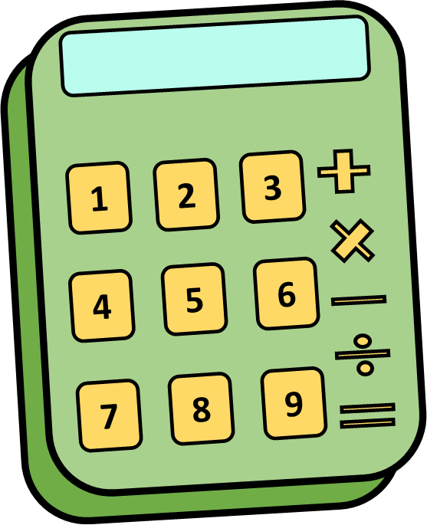
Sea Animals
Clipart

Slide 16
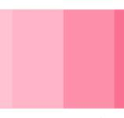
Clam

Slide 17
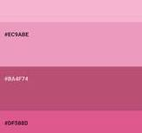
Scallop

Slide 18
Mussel

Slide 19
Oyster

Slide 20

Coral

Slide 22
Turtle

