Slide 1
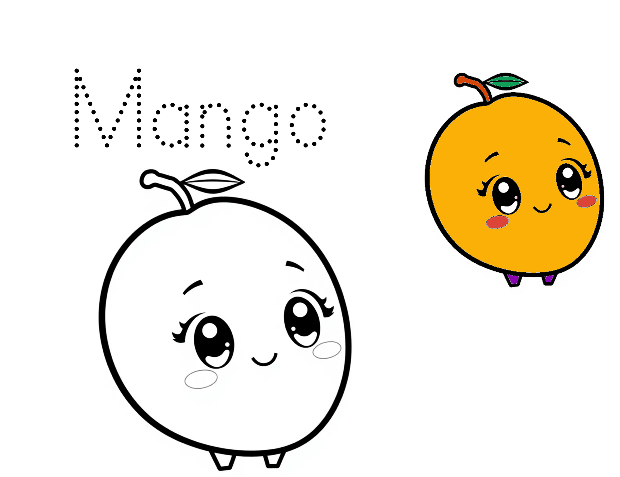
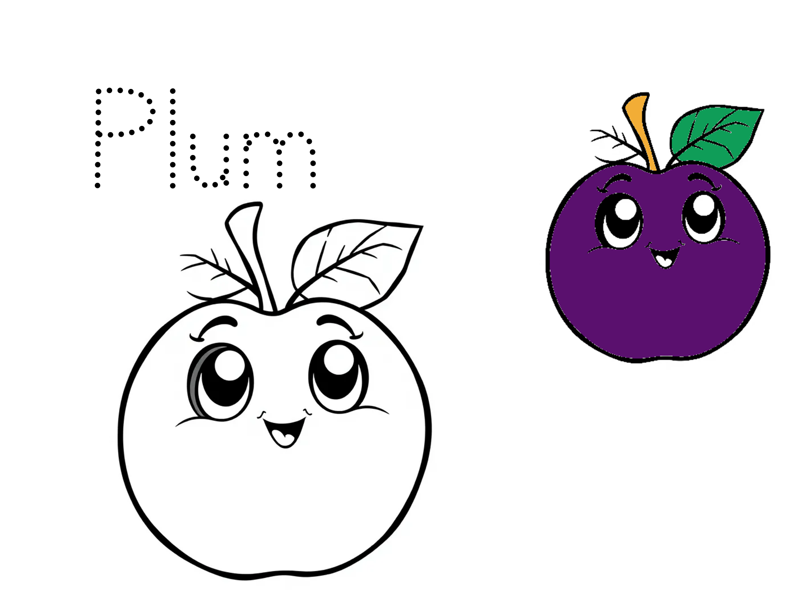
Fruit
Coloring Book

Slide 2
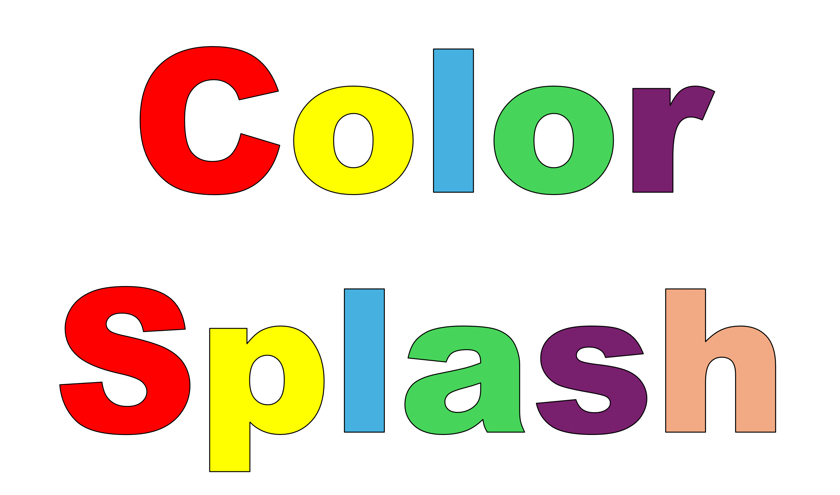
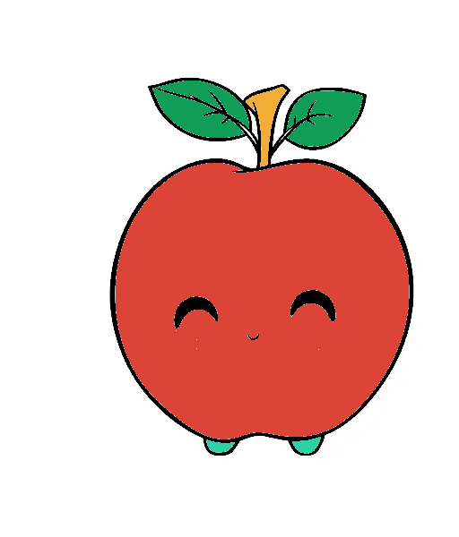

Color Splash
Apple
Blossomings.github.io
Color Splash

Slide 3


Color Splash
Orange
Blossomings.github.io
Color Splash

Slide 4


Color Splash
Banana
Blossomings.github.io
Color Splash

Slide 5
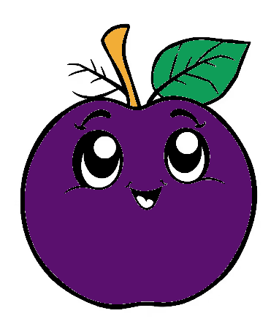
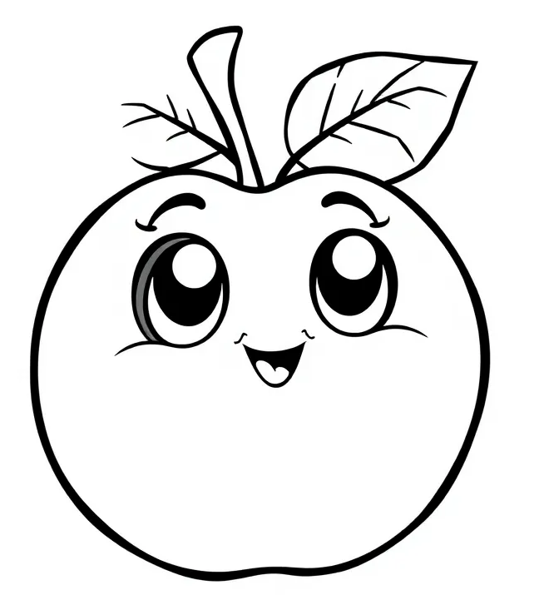
Color Splash
Plum
Blossomings.github.io
Color Splash

Slide 6
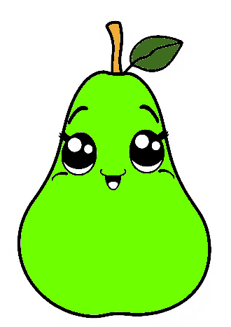

Color Splash
Pear
Blossomings.github.io
Color Splash

Slide 7
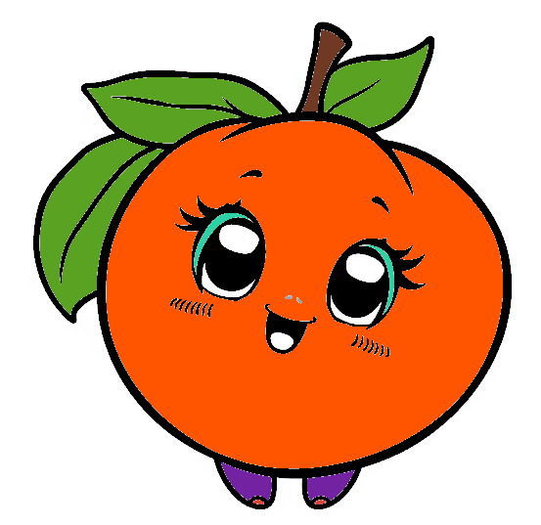

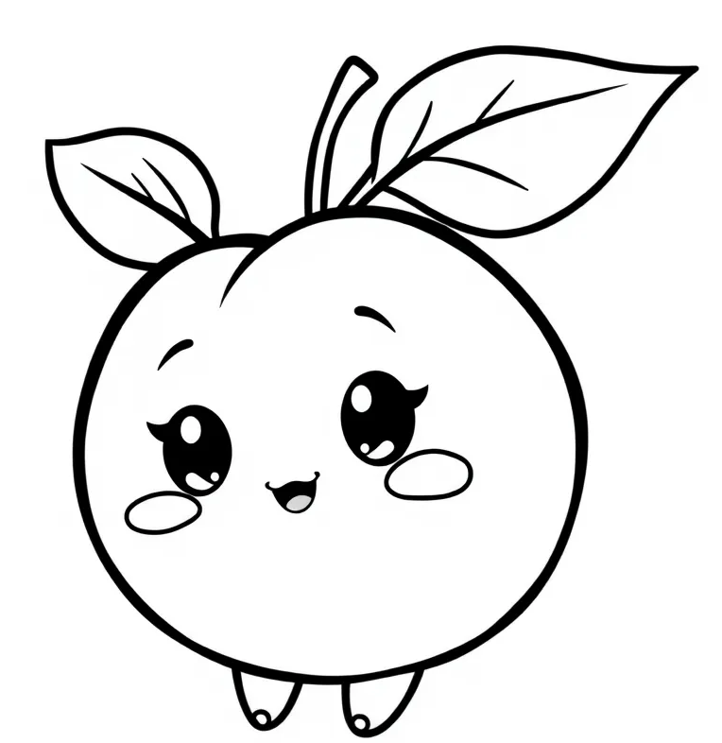
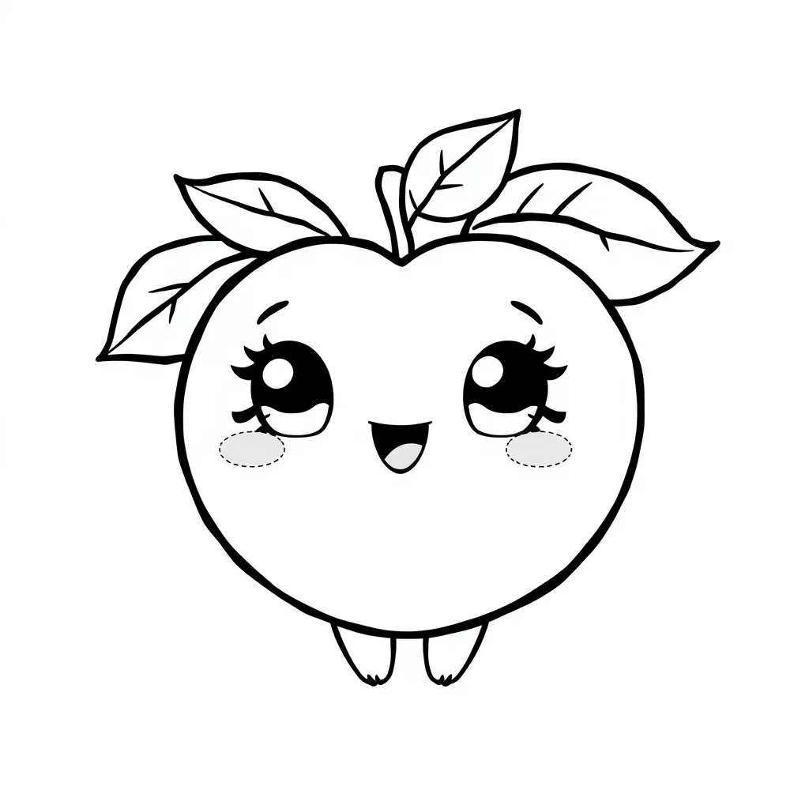
Peach
Blossomings.github.io
Color Splash

Slide 8
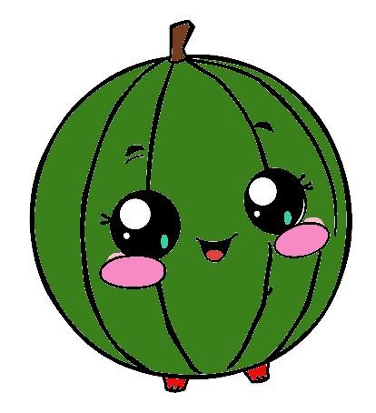

Blossomings.github.io
Watermelon
Color Splash

Slide 9
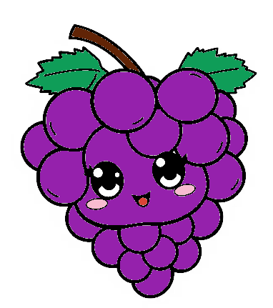

Grapes
Blossomings.github.io
Color Splash

Slide 10
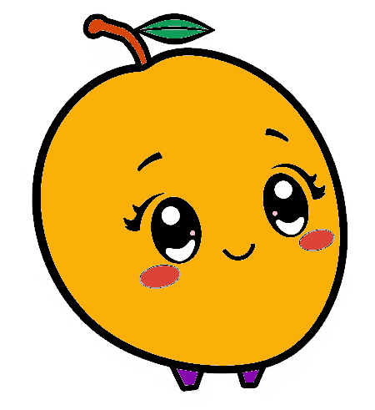


Mango
Blossomings.github.io
Color Splash

Slide 11
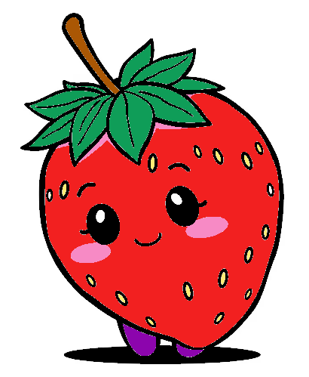
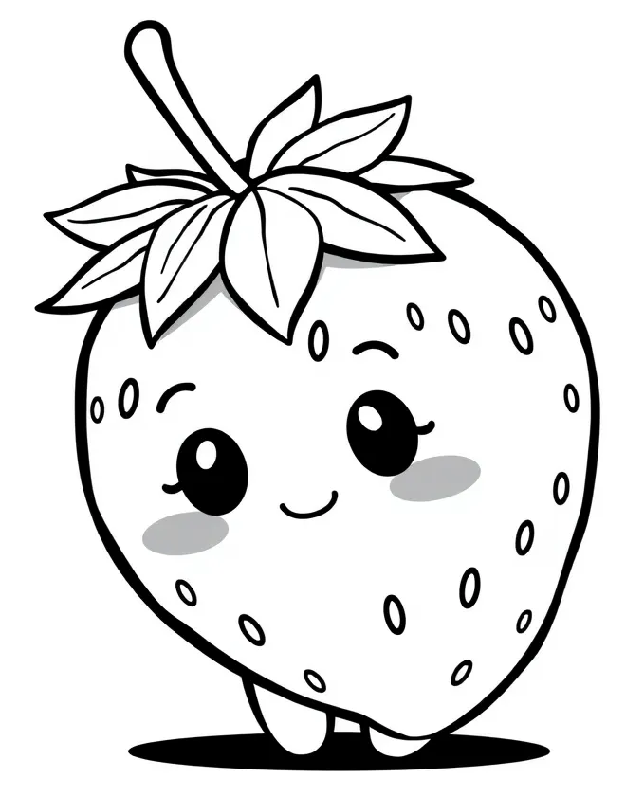
Strawberry
Blossomings.github.io
Color Splash

