Slide 1
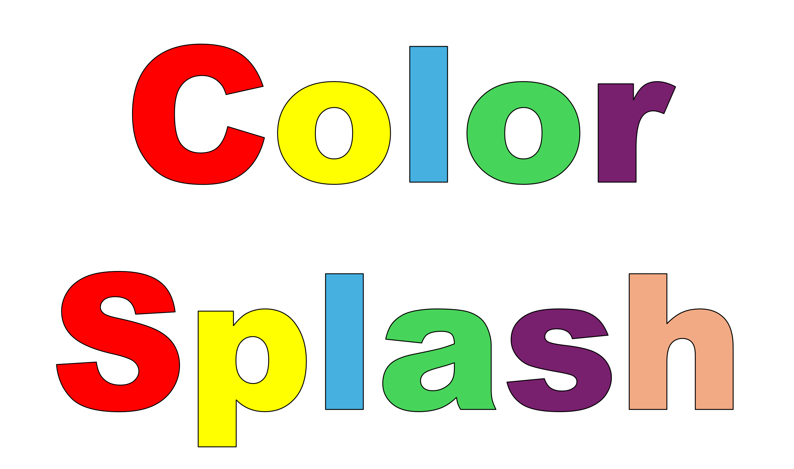
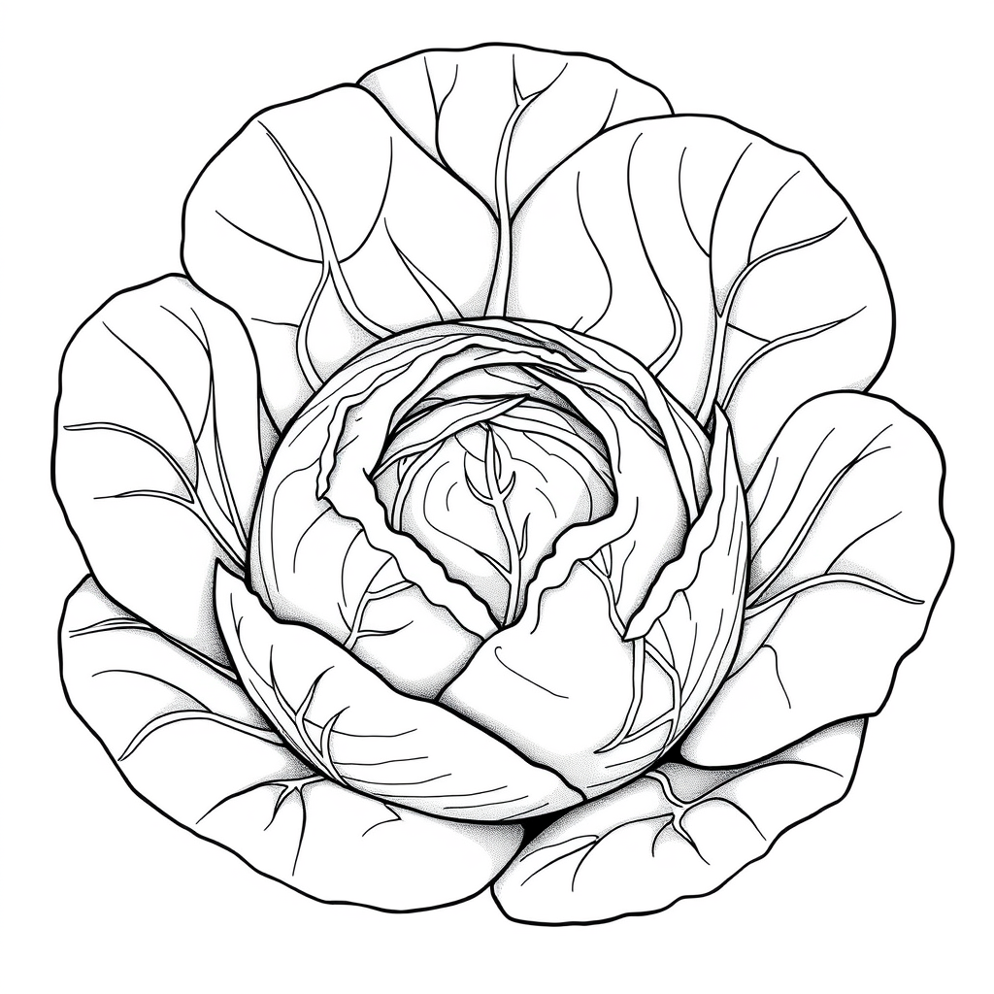
Color Splash
Blossomings.github.io
Cabbage
Color Splash

Slide 2

Color Splash
Blossomings.github.io
Broccoli
Color Splash

Slide 3

Color Splash
Blossomings.github.io
Cauliflower
Color Splash

Slide 4

Color Splash
Blossomings.github.io
Carrot
Color Splash

Slide 5

Color Splash
Blossomings.github.io
Eggplant
Color Splash

Slide 6
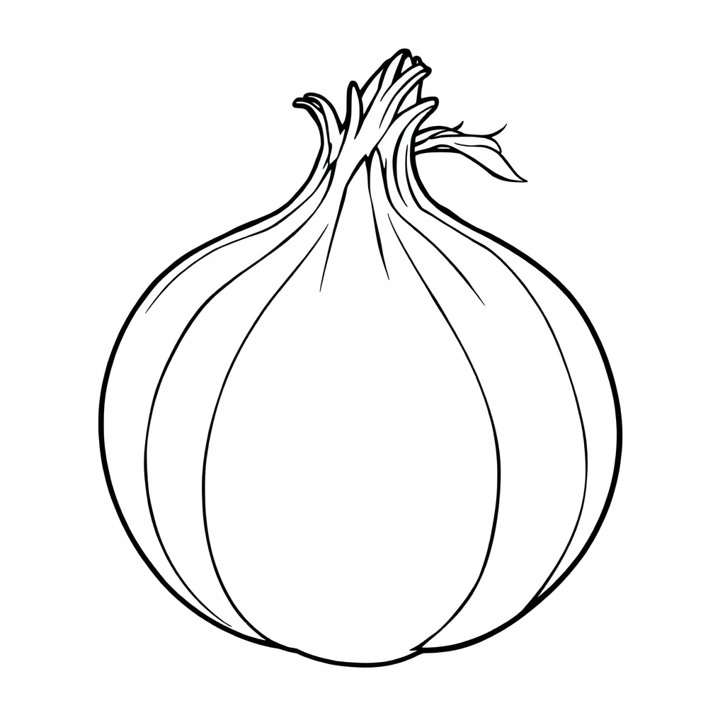
Color Splash
Blossomings.github.io
Onion
Color Splash

Slide 7
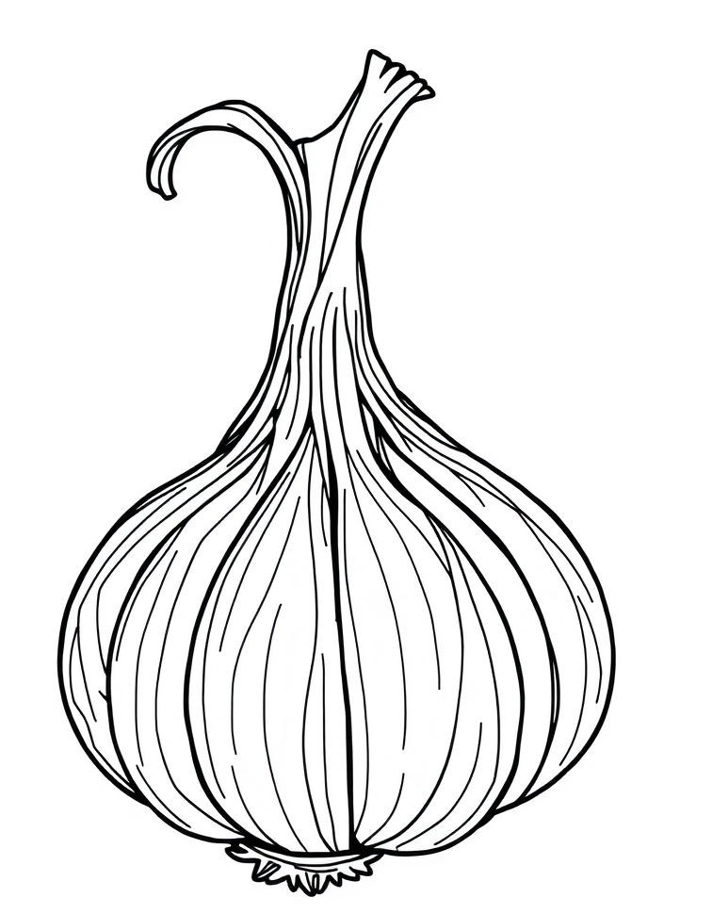
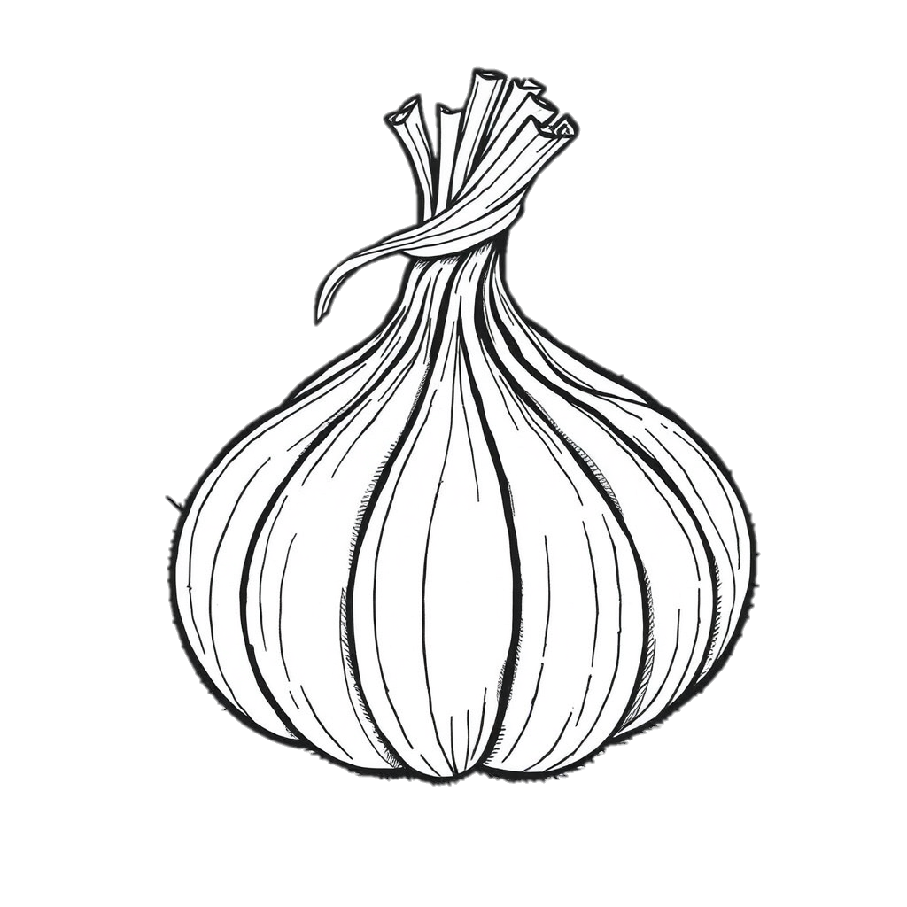
Color Splash
Blossomings.github.io
Garlic
Color Splash

Slide 8

Color Splash
Blossomings.github.io
Potato
Color Splash

Slide 9
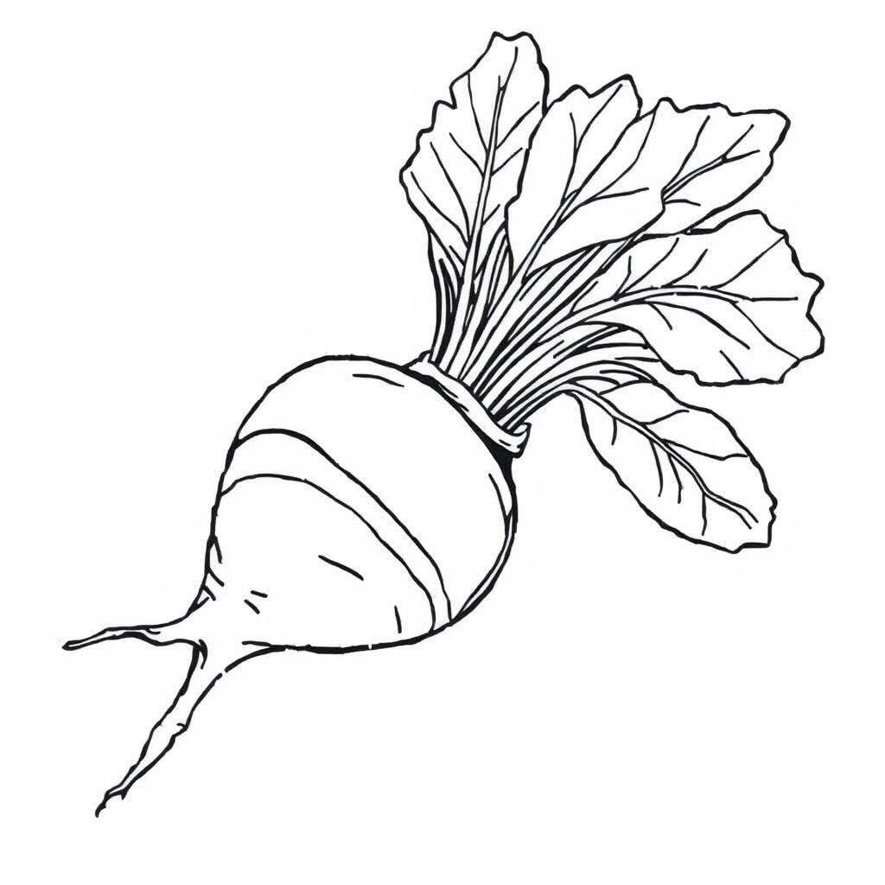
Color Splash
Blossomings.github.io
Beetroot
Color Splash

Slide 10

Color Splash
Blossomings.github.io
Artichoke
Color Splash

Slide 11

Color Splash
Blossomings.github.io
Kale
Color Splash

Slide 12
Blossomings.github.io
Color Splash
Color Splash
Please note: this PDF is copyrighted by blossomings.github.io and is for personal use only. Please do not upload it to any other website, socials or file-sharing service. Thanks!
Color Splash

