Slide 1
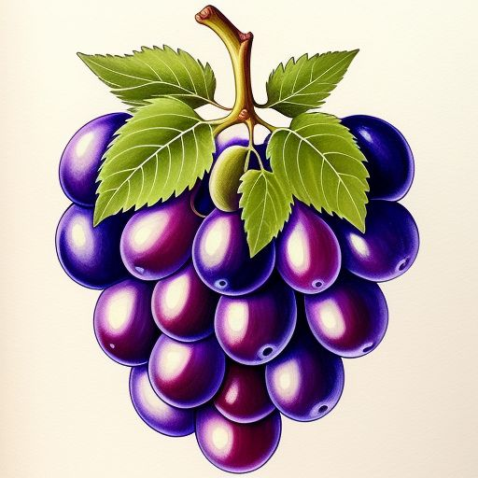
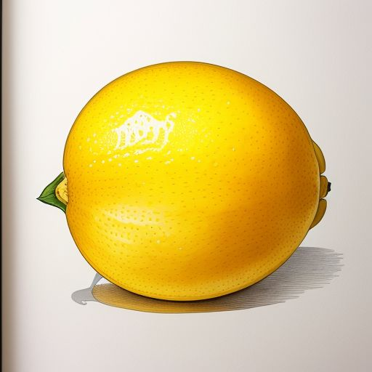

Fruits
Cut and Sort
Grapes
Lemon

Slide 2


Apple
Blossomings.github.io
Color Splash

Slide 3
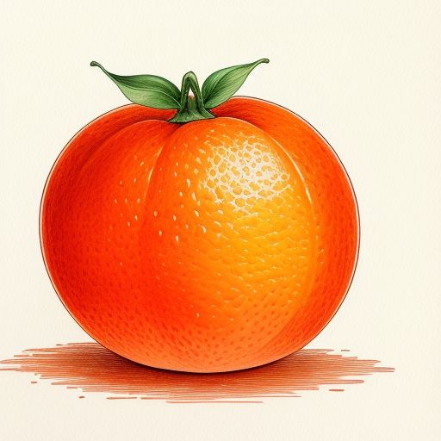
Blossomings.github.io
Orange
Color Splash

Slide 4
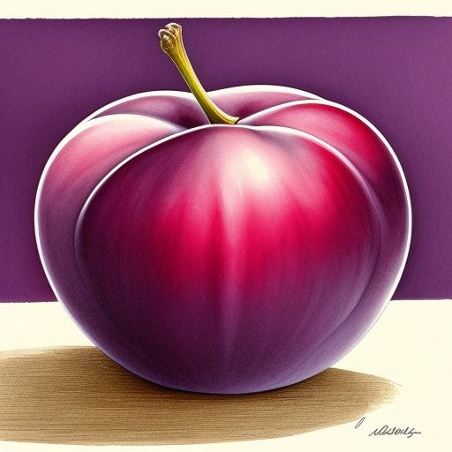
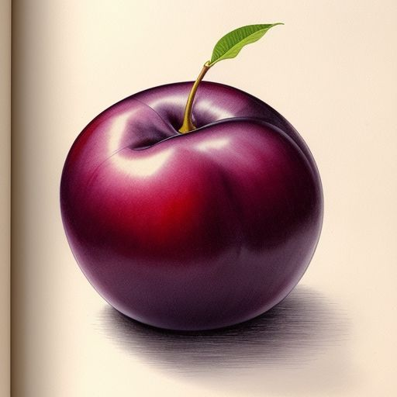

Plum
Blossomings.github.io
Color Splash

Slide 5
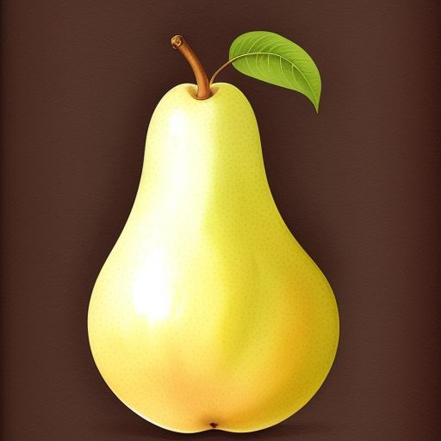

Pear
Blossomings.github.io
Color Splash

Slide 6
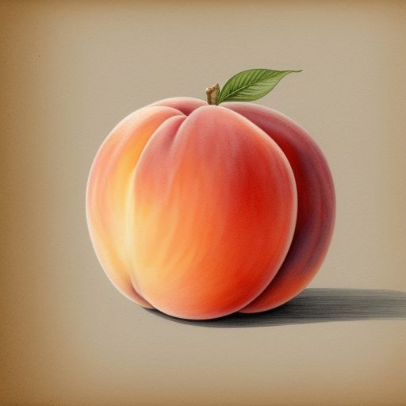
Peach
Blossomings.github.io
Color Splash

Slide 7
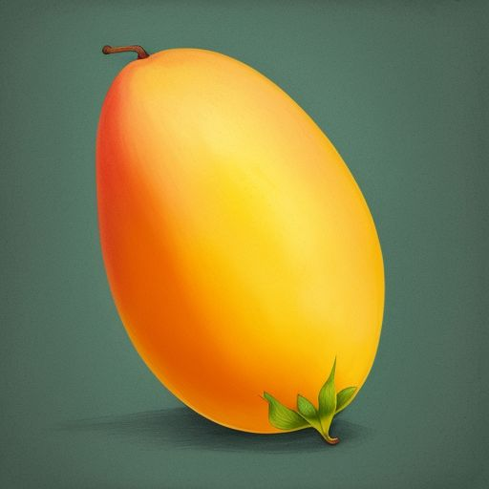
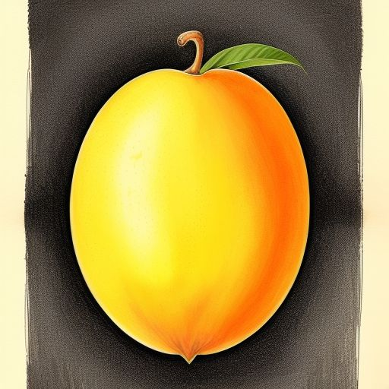

Mango
Blossomings.github.io
Color Splash

Slide 8
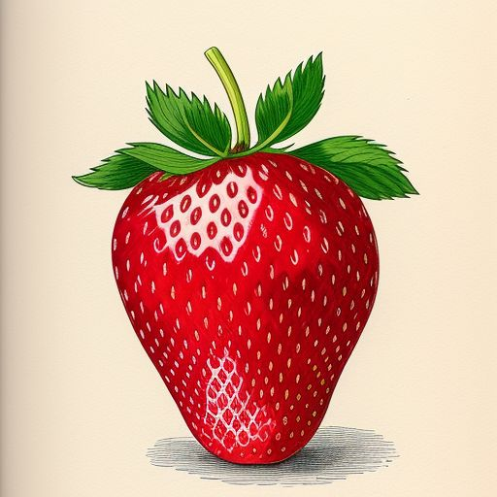

Strawberry
Blossomings.github.io
Color Splash

Slide 9
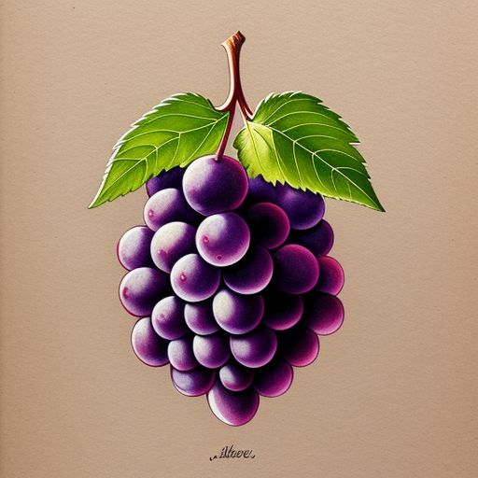
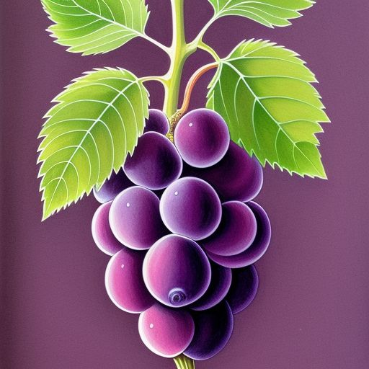
Grapes
Blossomings.github.io
Color Splash

Slide 10

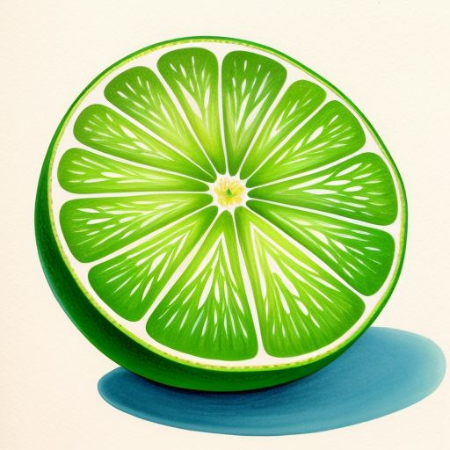
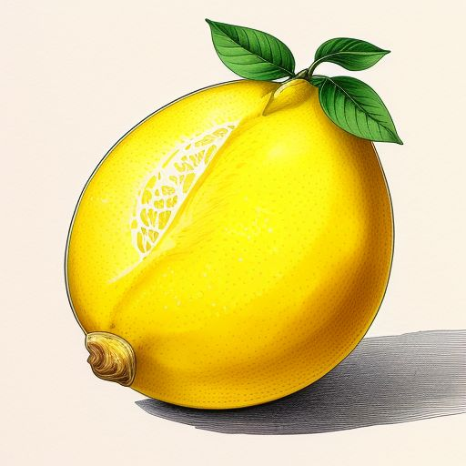

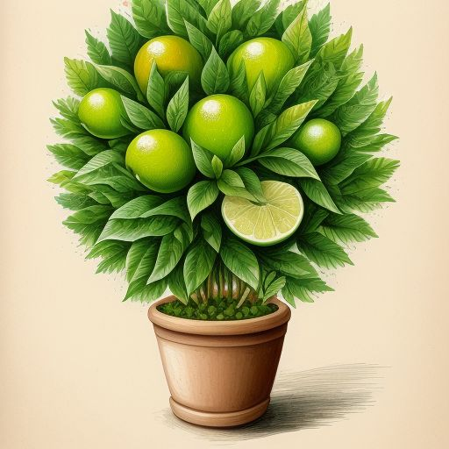
Lemon
Blossomings.github.io
Color Splash

Slide 11
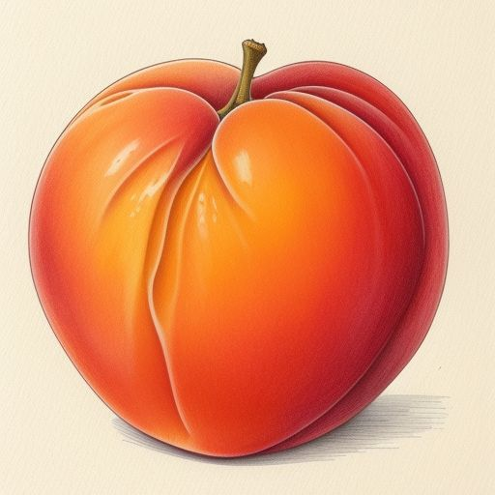
Apricot
Blossomings.github.io
Color Splash

Slide 12

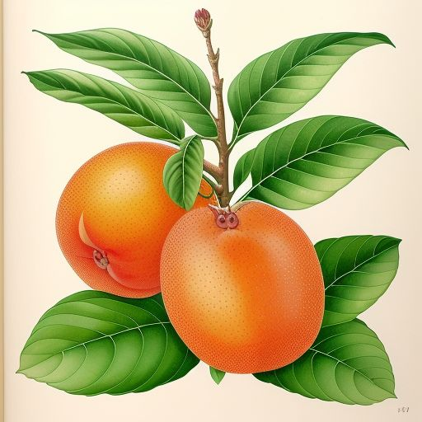

Loquat
Blossomings.github.io
Color Splash

Slide 13
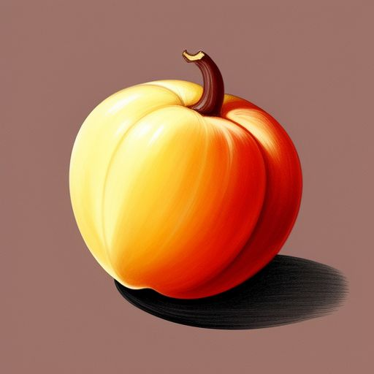
Cashew
Blossomings.github.io
Color Splash

