Slide 1
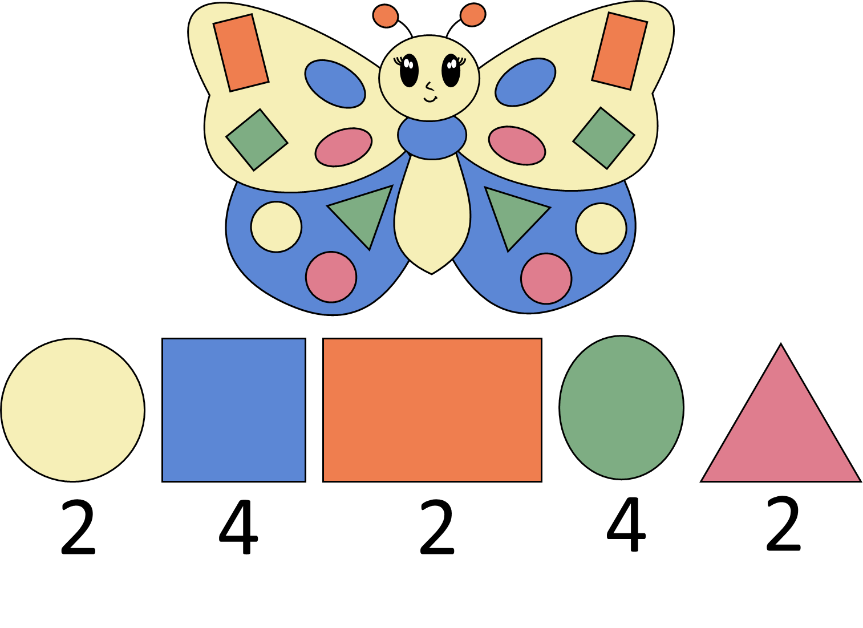
Numeral Fun
Activity

Slide 5
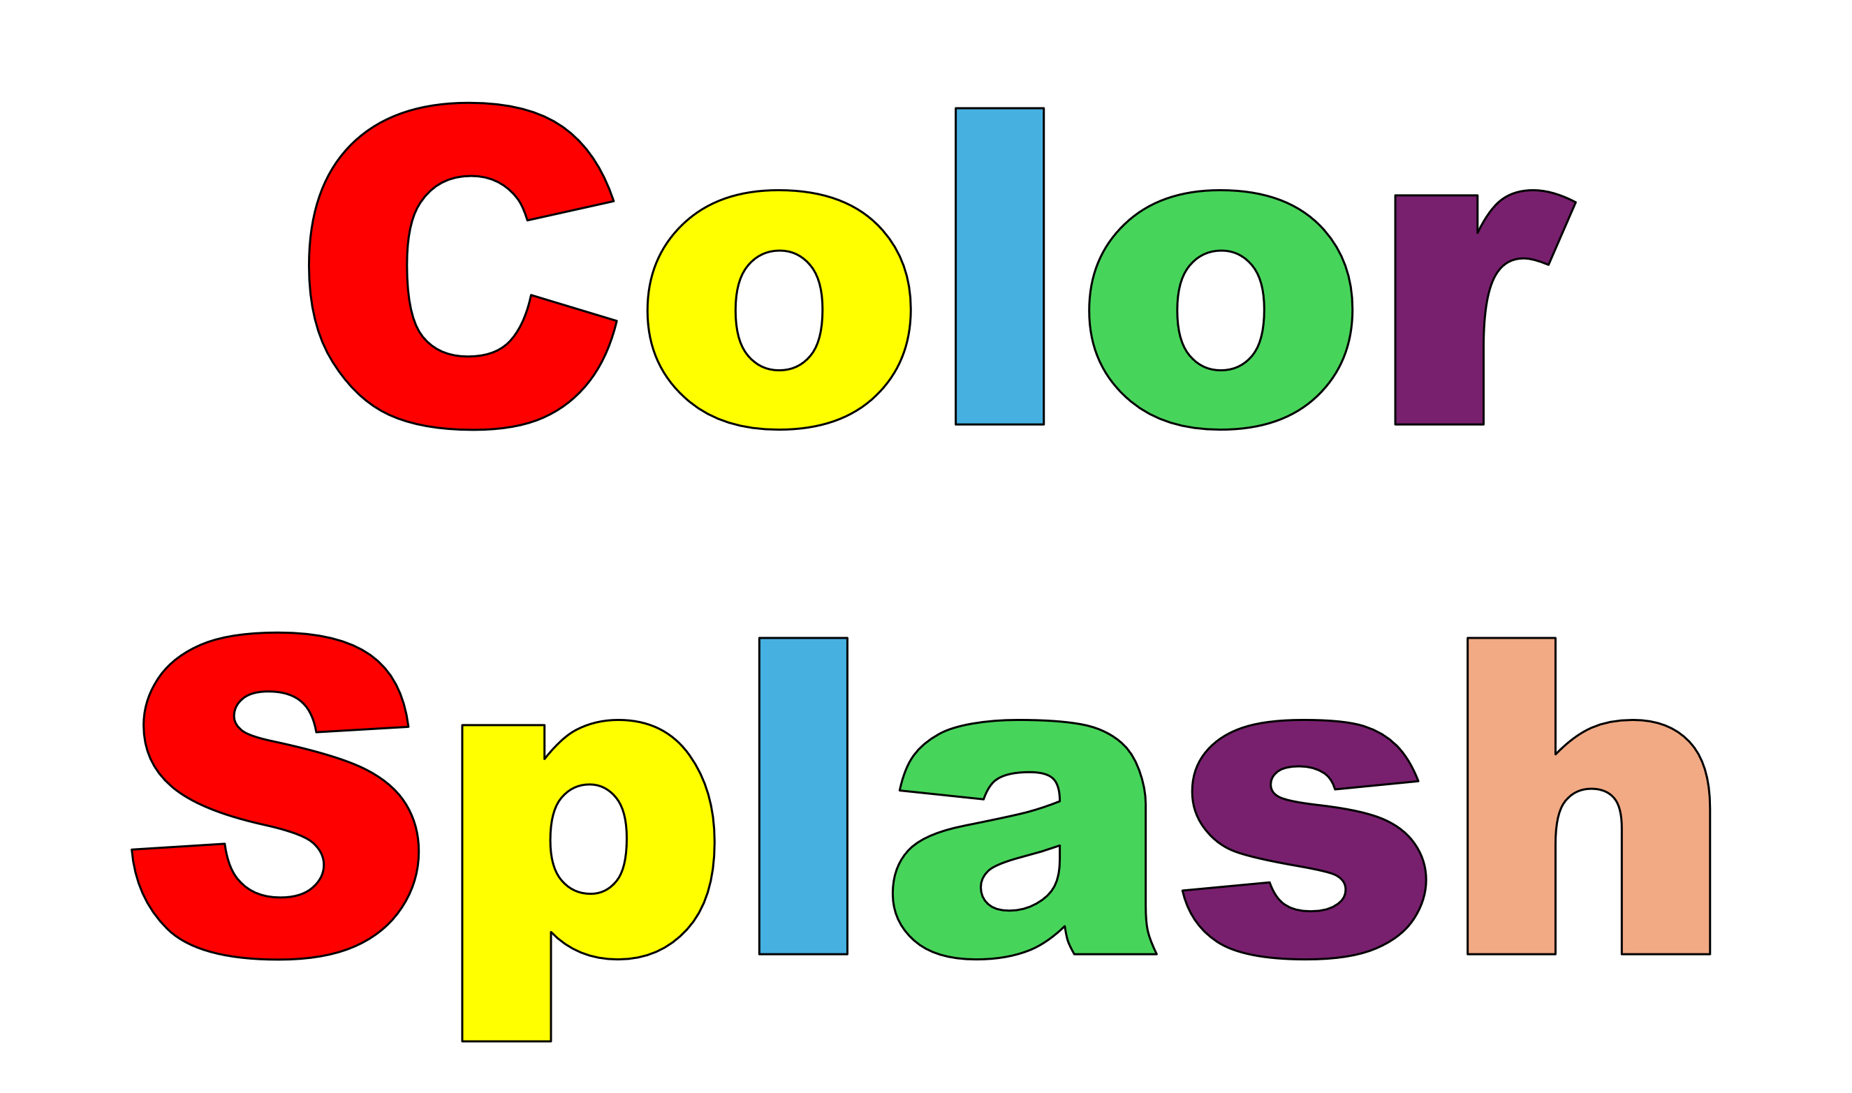
Blossomings.github.io
My Shape Butterfly
Color Splash
2
4
2
4
2

Slide 6
Blossomings.github.io
Let’s Add Up
Color Splash
Color Splash
14
Name:
Color Splash

Slide 7
Blossomings.github.io
Cut the Cards
Color Splash
Color Splash
Color Splash
Color Splash

Slide 8
Blossomings.github.io
Let’s Add Up
Color Splash
Color Splash
Name:
Color Splash

Slide 9
Blossomings.github.io
Let’s Minus
Color Splash
Color Splash
Name:
Color Splash

Slide 10
Blossomings.github.io
Let’s Divide
Color Splash
Color Splash
Name:
Color Splash

Slide 11
Blossomings.github.io
Let’s Multiply
Color Splash
Color Splash
Name:
Color Splash

Slide 12
Blossomings.github.io
Color Splash
Color Splash
Please note: this PDF is copyrighted by blossomings.github.io and is for personal use only. Please do not upload it to any other website, socials or file-sharing service. Thanks!
Color Splash

