Slide 1
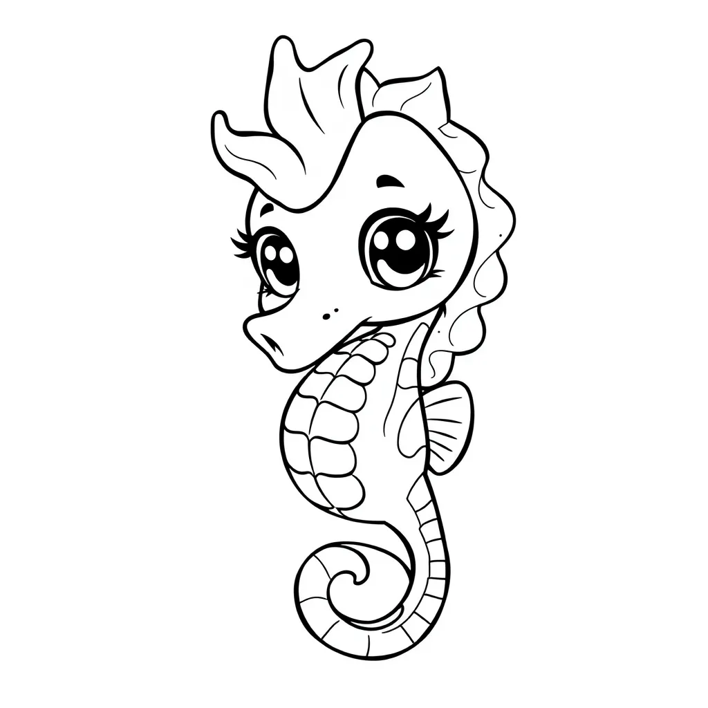

Sea Animals
Coloring Book

Slide 2
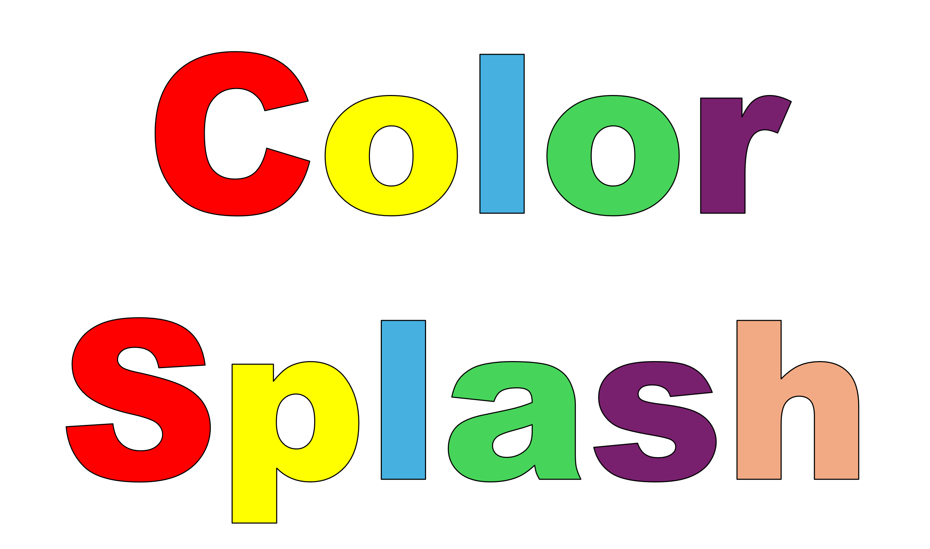
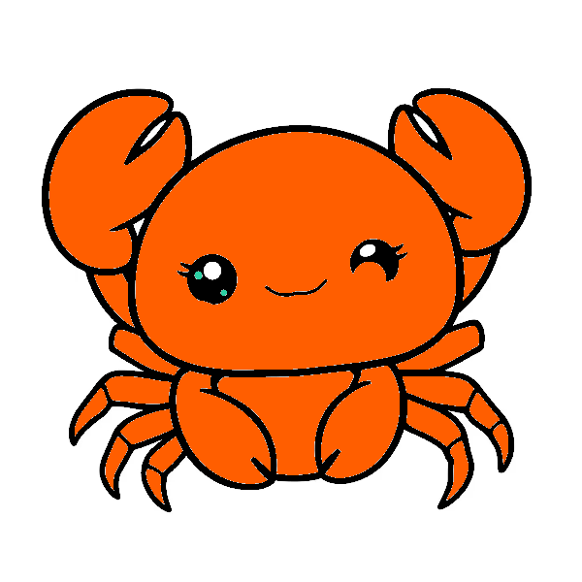
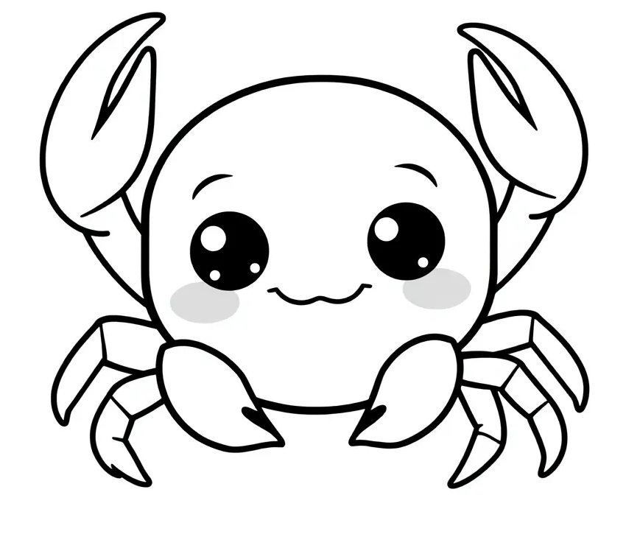
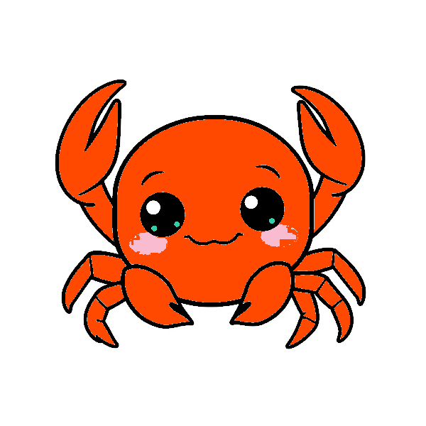
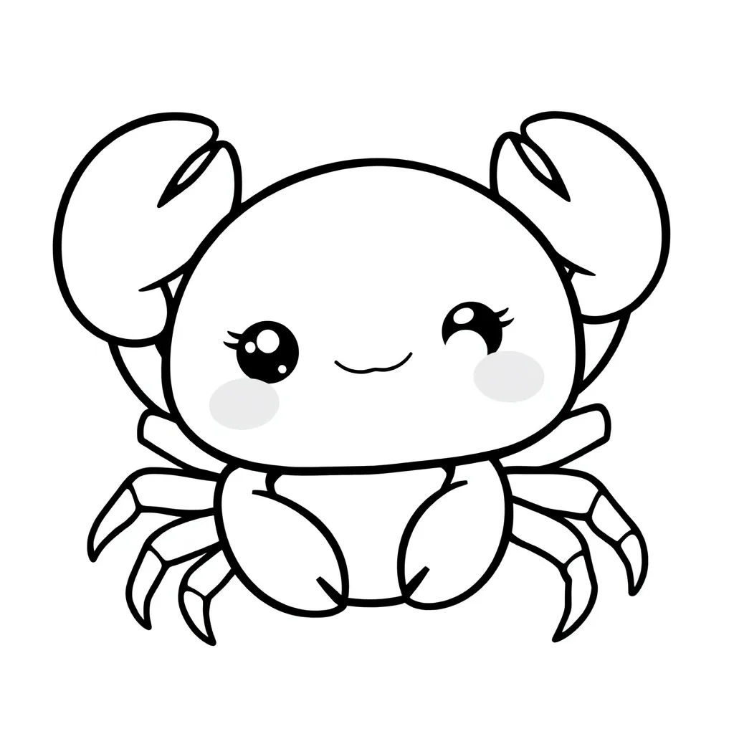
Color Splash
Crab
Blossomings.github.io
Color Splash

Slide 3
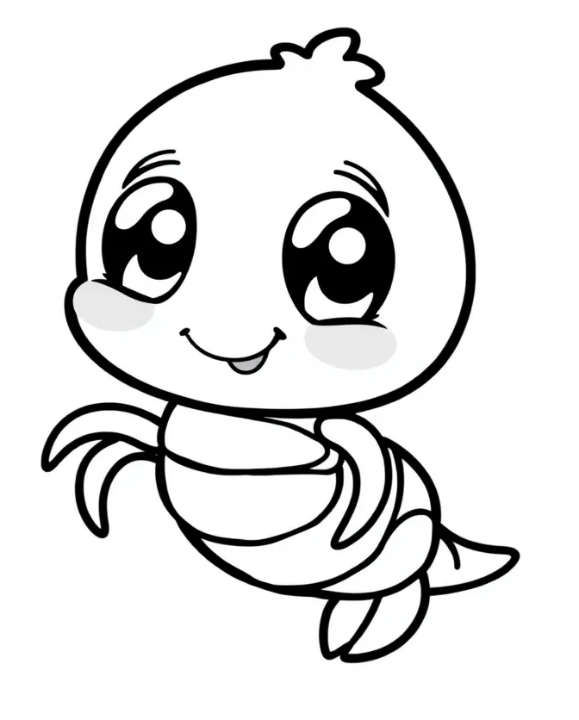


Color Splash
Shrimp
Blossomings.github.io
Color Splash

Slide 4

Color Splash
Whale
Blossomings.github.io
Color Splash

Slide 5

Color Splash
Blossomings.github.io
Shark
Color Splash

Slide 6

Color Splash
Dolphin
Blossomings.github.io
Color Splash

Slide 7
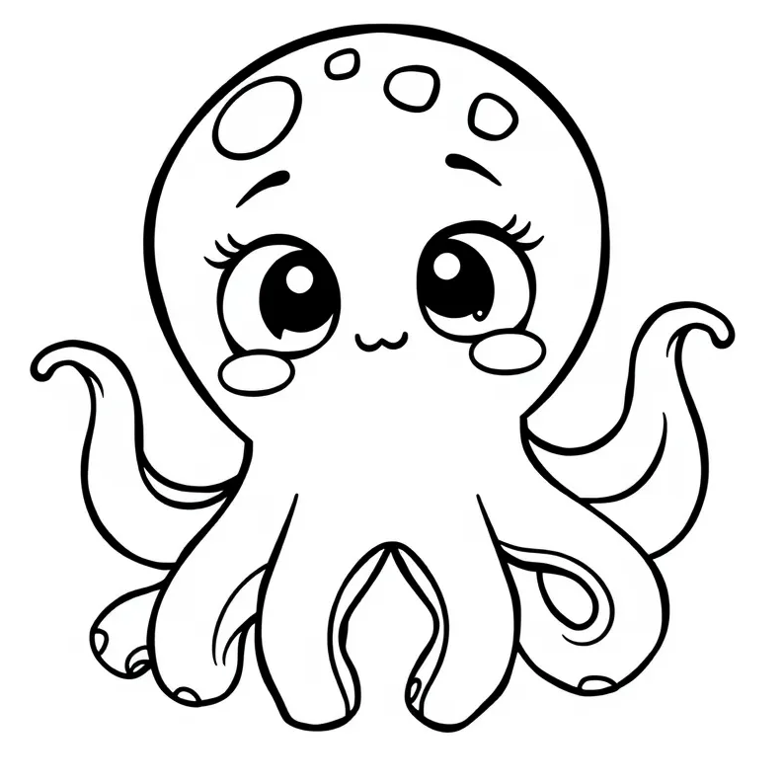
Color Splash
Octopus
Blossomings.github.io
Color Splash

Slide 8
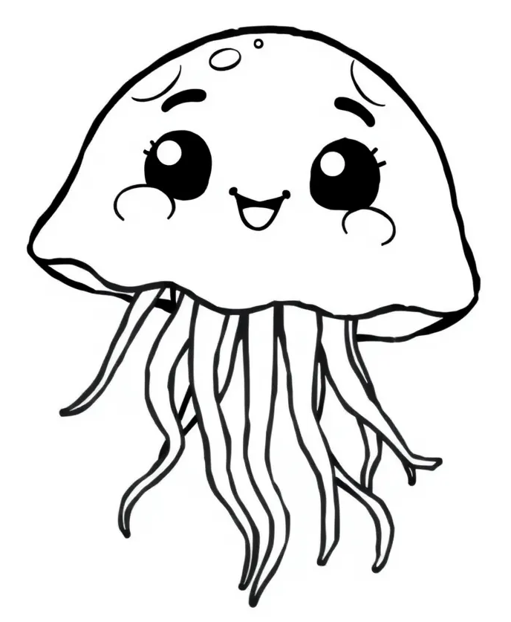
Color Splash
Jellyfish
Blossomings.github.io
Color Splash

Slide 9
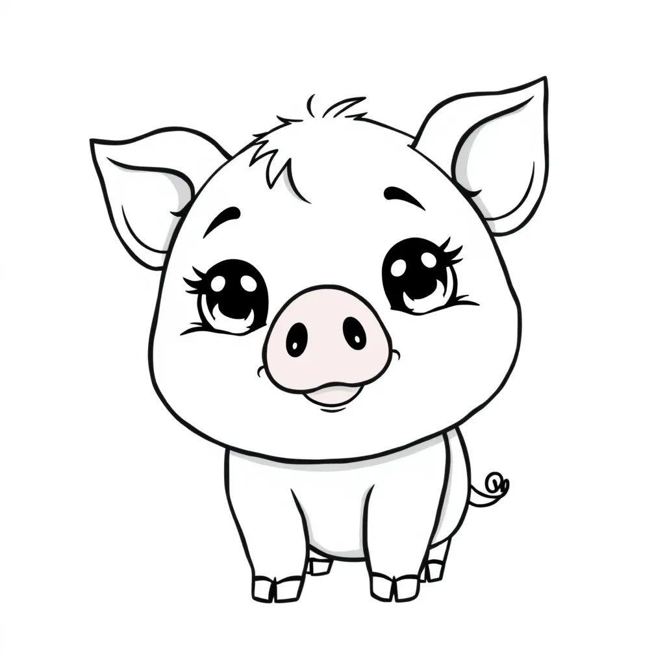

Color Splash
Starfish
Blossomings.github.io
Color Splash

Slide 10

Color Splash
Seal
Blossomings.github.io
Color Splash

Slide 11
Color Splash
Seahorse
Blossomings.github.io
Color Splash

Slide 12
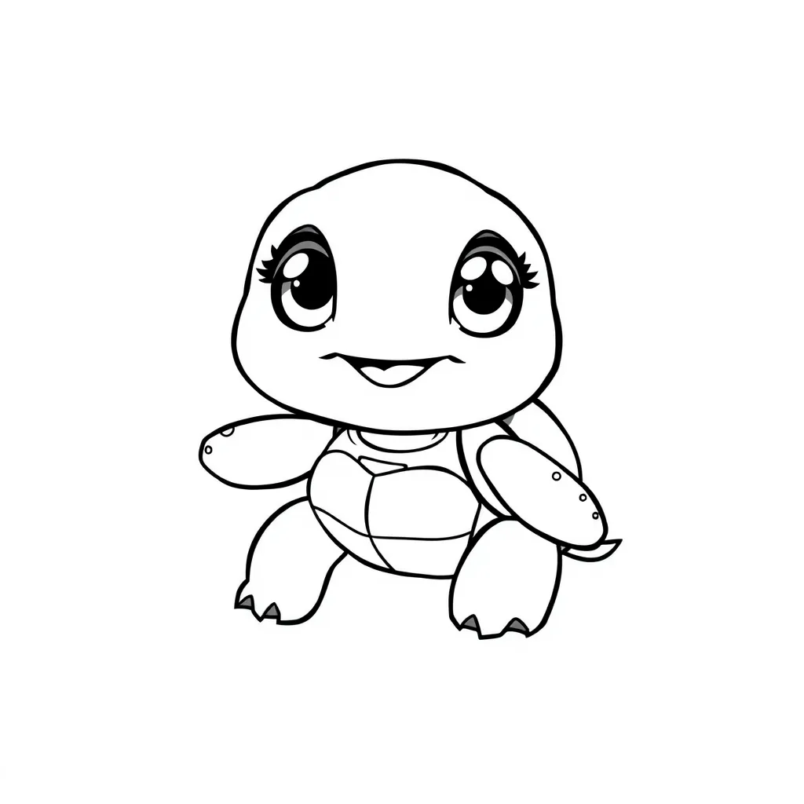
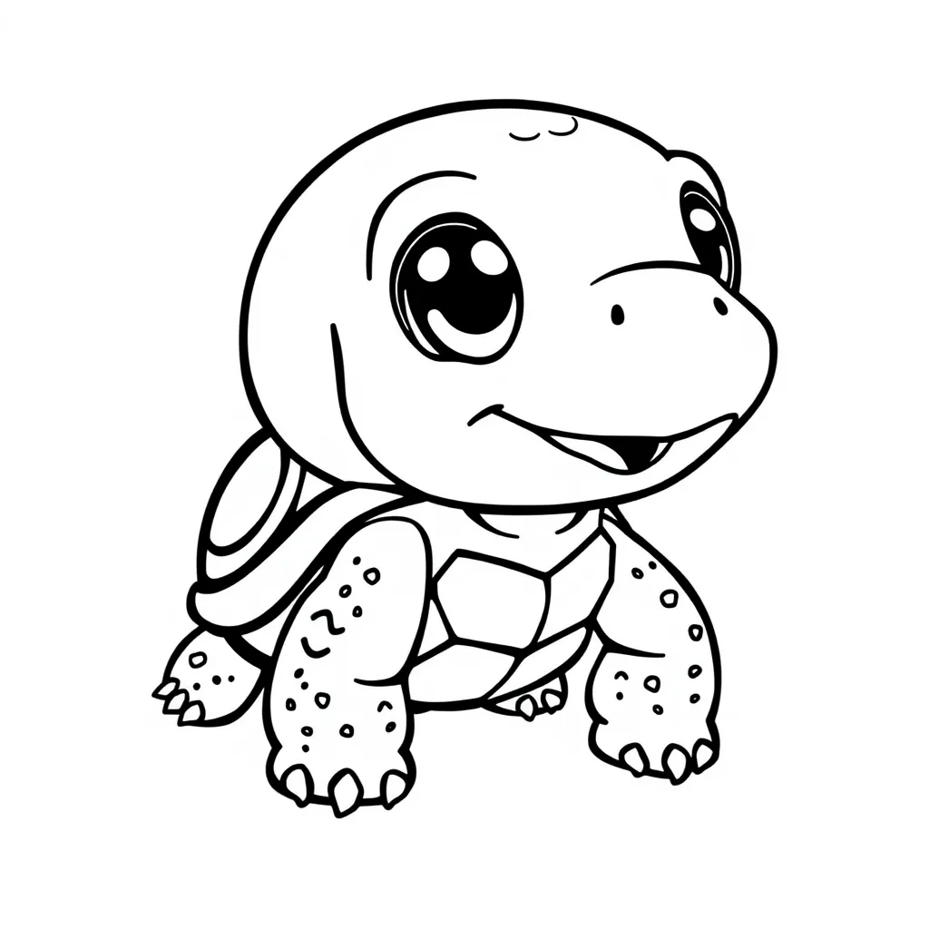

Stingray
Blossomings.github.io
Color Splash

Slide 13
Blossomings.github.io
Color Splash
Color Splash
Please note: this PDF is copyrighted by blossomings.github.io and is for personal use only. Please do not upload it to any other website, socials or file-sharing service. Thanks!
Color Splash

