Slide 1
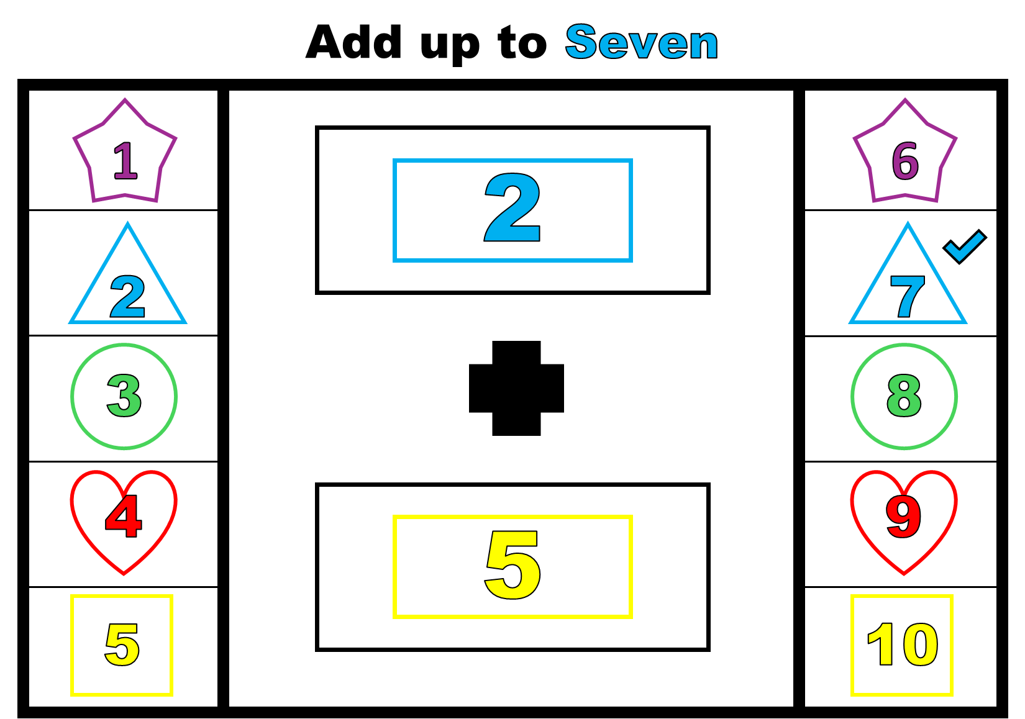
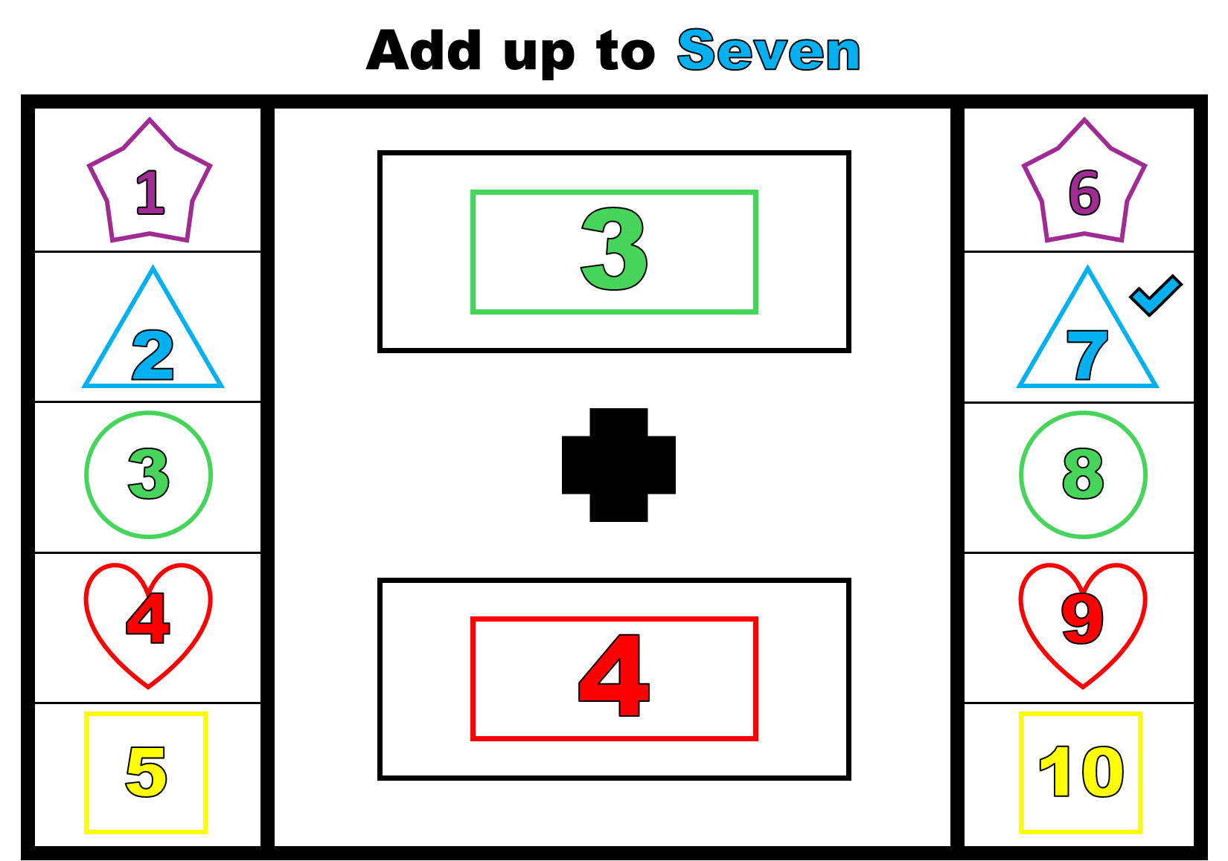
Number Addition
Activity

Slide 2
Add up to Seven
1
6
2
2
7
3
8
4
9
5
5
10

Slide 3
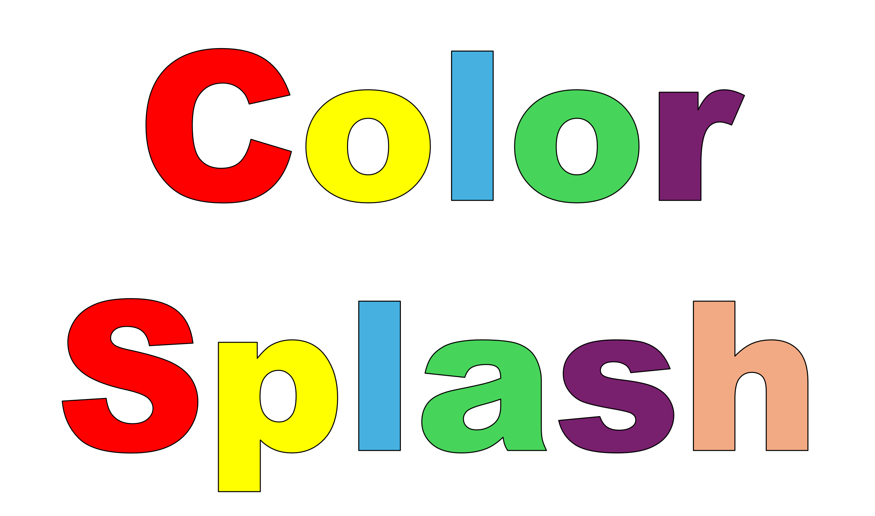
Let’s add up!
Blossomings.github.io
1
6
2
7
Color Splash
3
8
4
9
5
10

Slide 4
Add up to Seven
Blossomings.github.io
1
6
2
2
7
Color Splash
3
8
4
9
5
5
10

Slide 5
Add up to Seven
Blossomings.github.io
1
6
3
2
7
Color Splash
3
8
4
9
4
5
10

Slide 6
Add up to Seven
Blossomings.github.io
1
6
1
2
7
Color Splash
3
8
4
9
6
5
10

Slide 7
Cut the Cards
Blossomings.github.io
1
6
2
7
Color Splash
Color Splash
3
8
4
9
5
10

Slide 8
Add up to Two
Blossomings.github.io
1
6
2
7
3
8
Color Splash
4
9
5
10

Slide 9
Add up to Three
Blossomings.github.io
1
6
2
7
Color Splash
3
8
4
9
5
10

Slide 10
Add up to Four
Blossomings.github.io
1
6
2
7
Color Splash
3
8
4
9
5
10

Slide 11
Add up to Five
Blossomings.github.io
1
6
Color Splash
2
7
3
8
4
9
5
10

Slide 12
Add up to Six
Blossomings.github.io
1
6
2
7
3
8
Color Splash
4
9
5
10

Slide 13
Add up to Seven
Blossomings.github.io
1
6
2
7
3
8
Color Splash
4
9
5
10

Slide 14
Add up to Eight
Blossomings.github.io
1
6
2
7
3
8
Color Splash
4
9
5
10

Slide 15
Add up to Nine
Blossomings.github.io
1
6
2
7
3
8
Color Splash
4
9
5
10

Slide 16
Add up to Ten
Blossomings.github.io
1
6
2
7
3
8
Color Splash
4
9
5
10

Slide 17
Blossomings.github.io
Color Splash
Color Splash
Please note: this PDF is copyrighted by blossomings.github.io and is for personal use only. Please do not upload it to any other website, socials or file-sharing service. Thanks!
Color Splash

