Slide 1
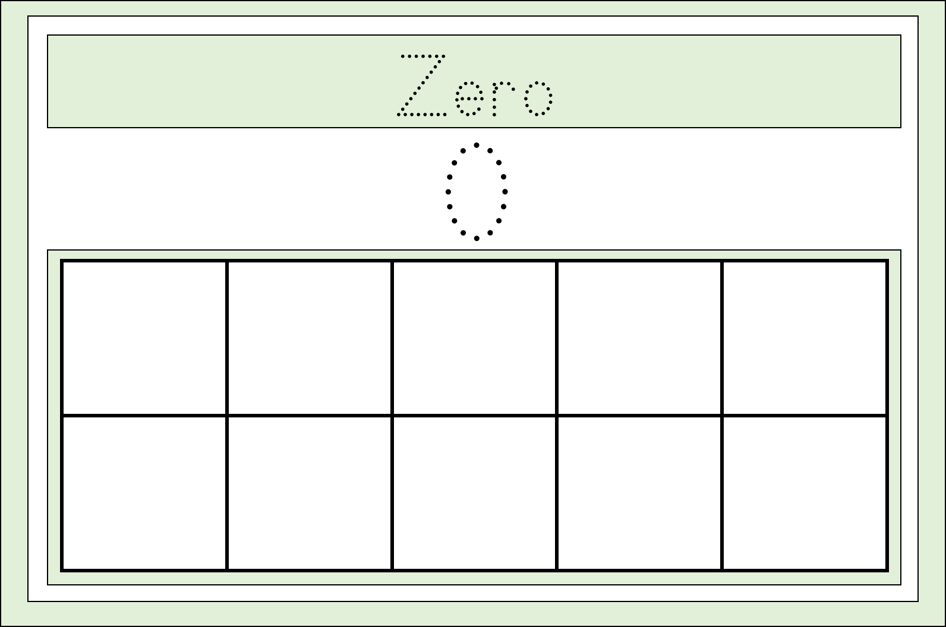
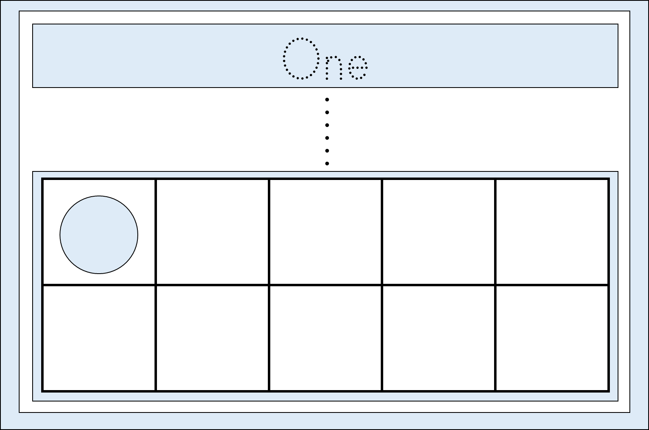
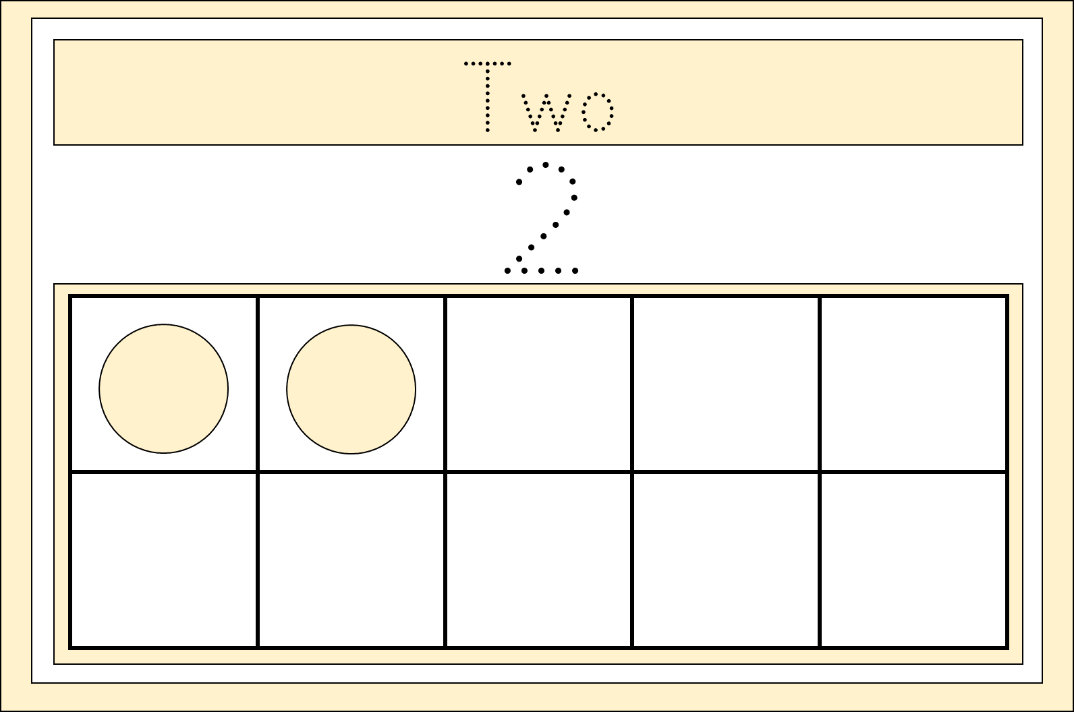
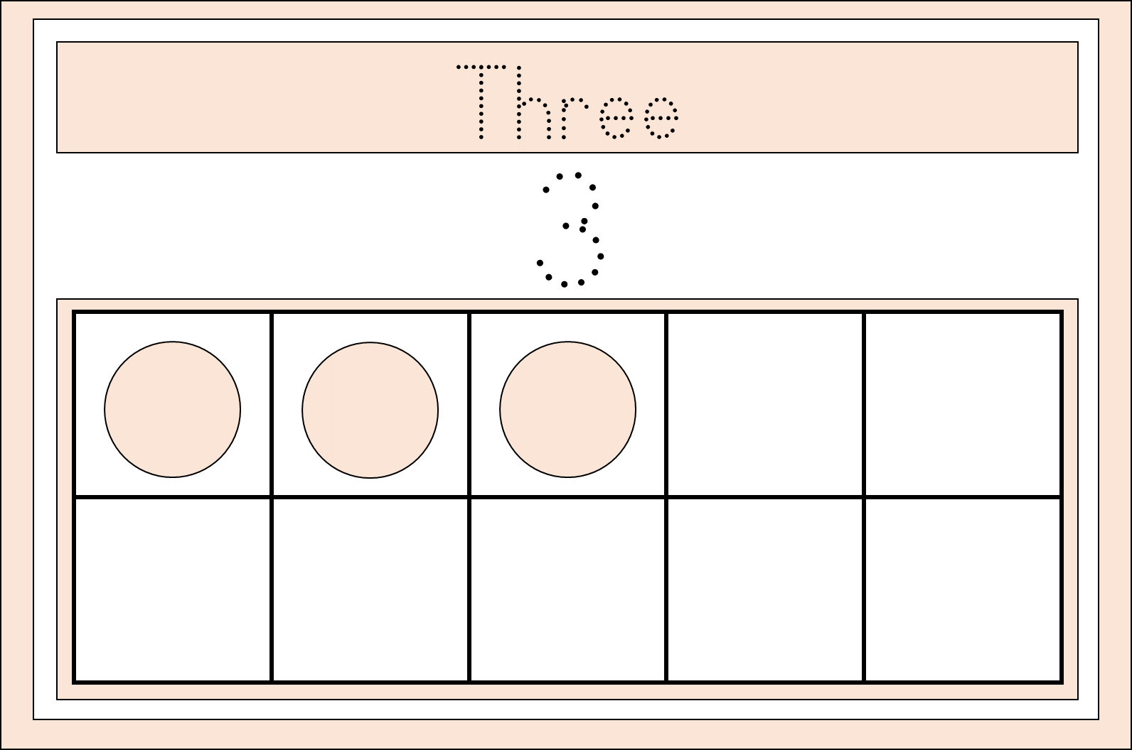
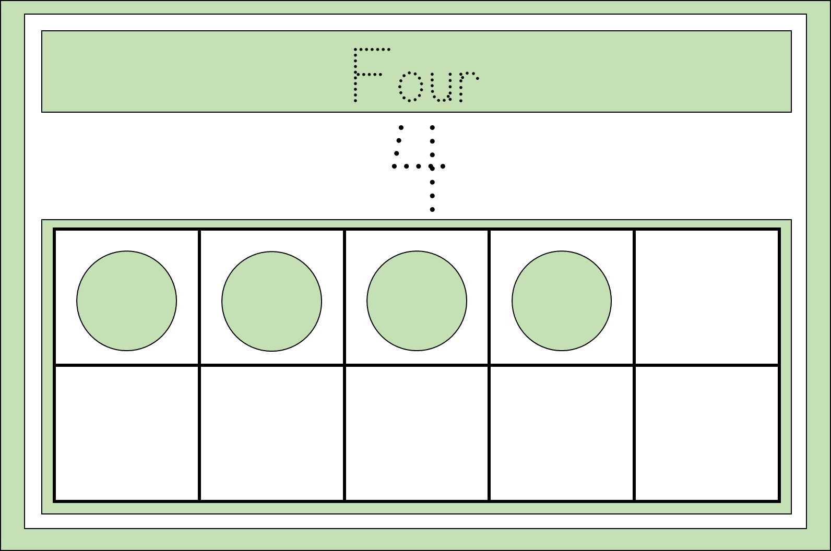
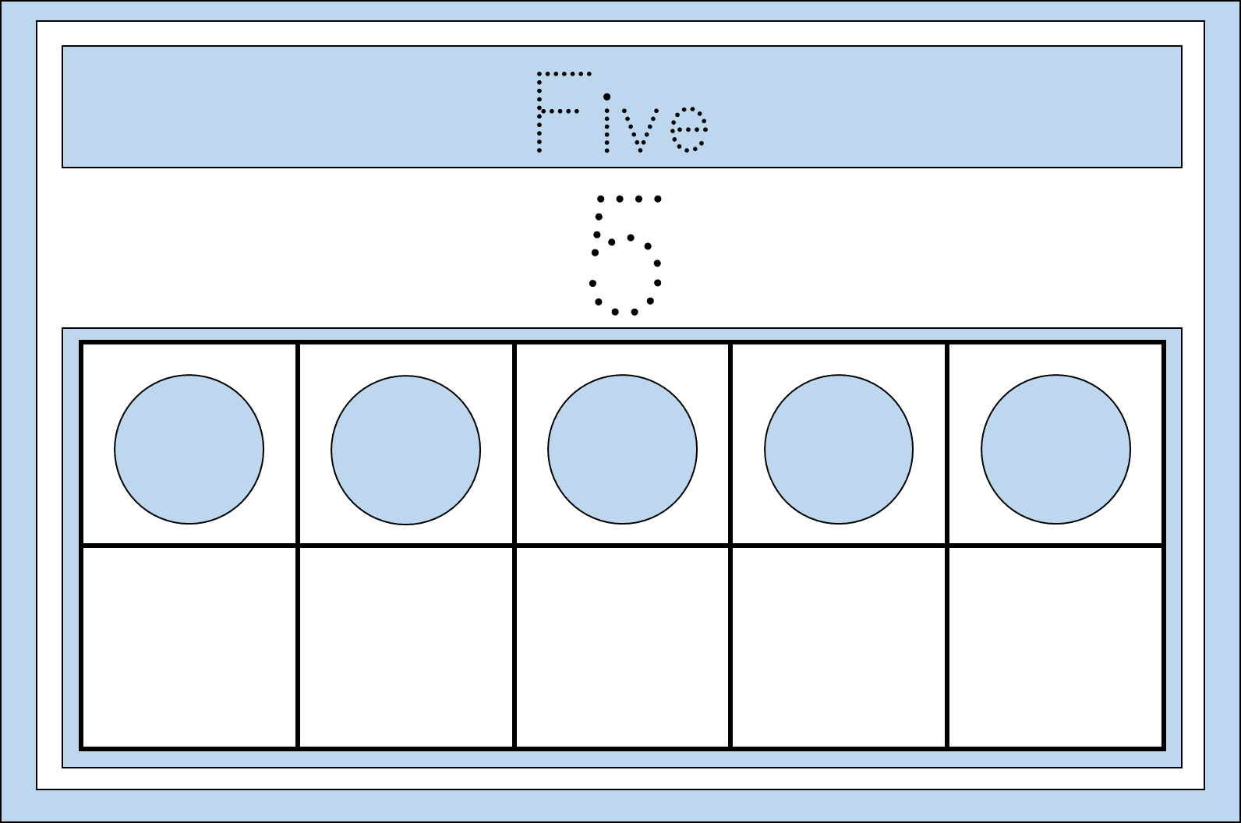
Number Tracing
Flashcards

Slide 2

Numbers
Blossomings.github.io
Zero
0
Color Splash

Slide 3
Numbers
Blossomings.github.io
One
1
Color Splash

Slide 4
Numbers
Blossomings.github.io
Two
2
Color Splash

Slide 5
Numbers
Blossomings.github.io
Three
3
Color Splash

Slide 6
Numbers
Blossomings.github.io
Four
4
Color Splash

Slide 7
Numbers
Blossomings.github.io
Five
5
Color Splash

Slide 8
Numbers
Blossomings.github.io
Six
6
Color Splash

Slide 9
Numbers
Blossomings.github.io
Seven
7
Color Splash

Slide 10
Numbers
Blossomings.github.io
Eight
8
Color Splash

Slide 11
Numbers
Blossomings.github.io
Nine
9
Color Splash

Slide 12
Numbers
Blossomings.github.io
Ten
10
Color Splash

