Slide 1
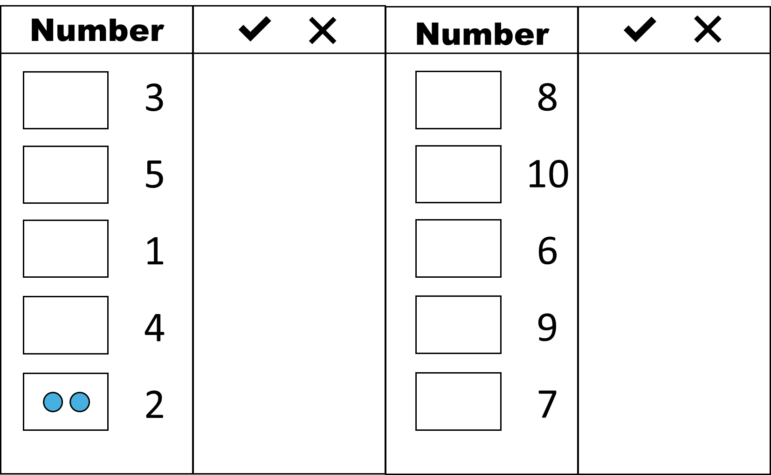
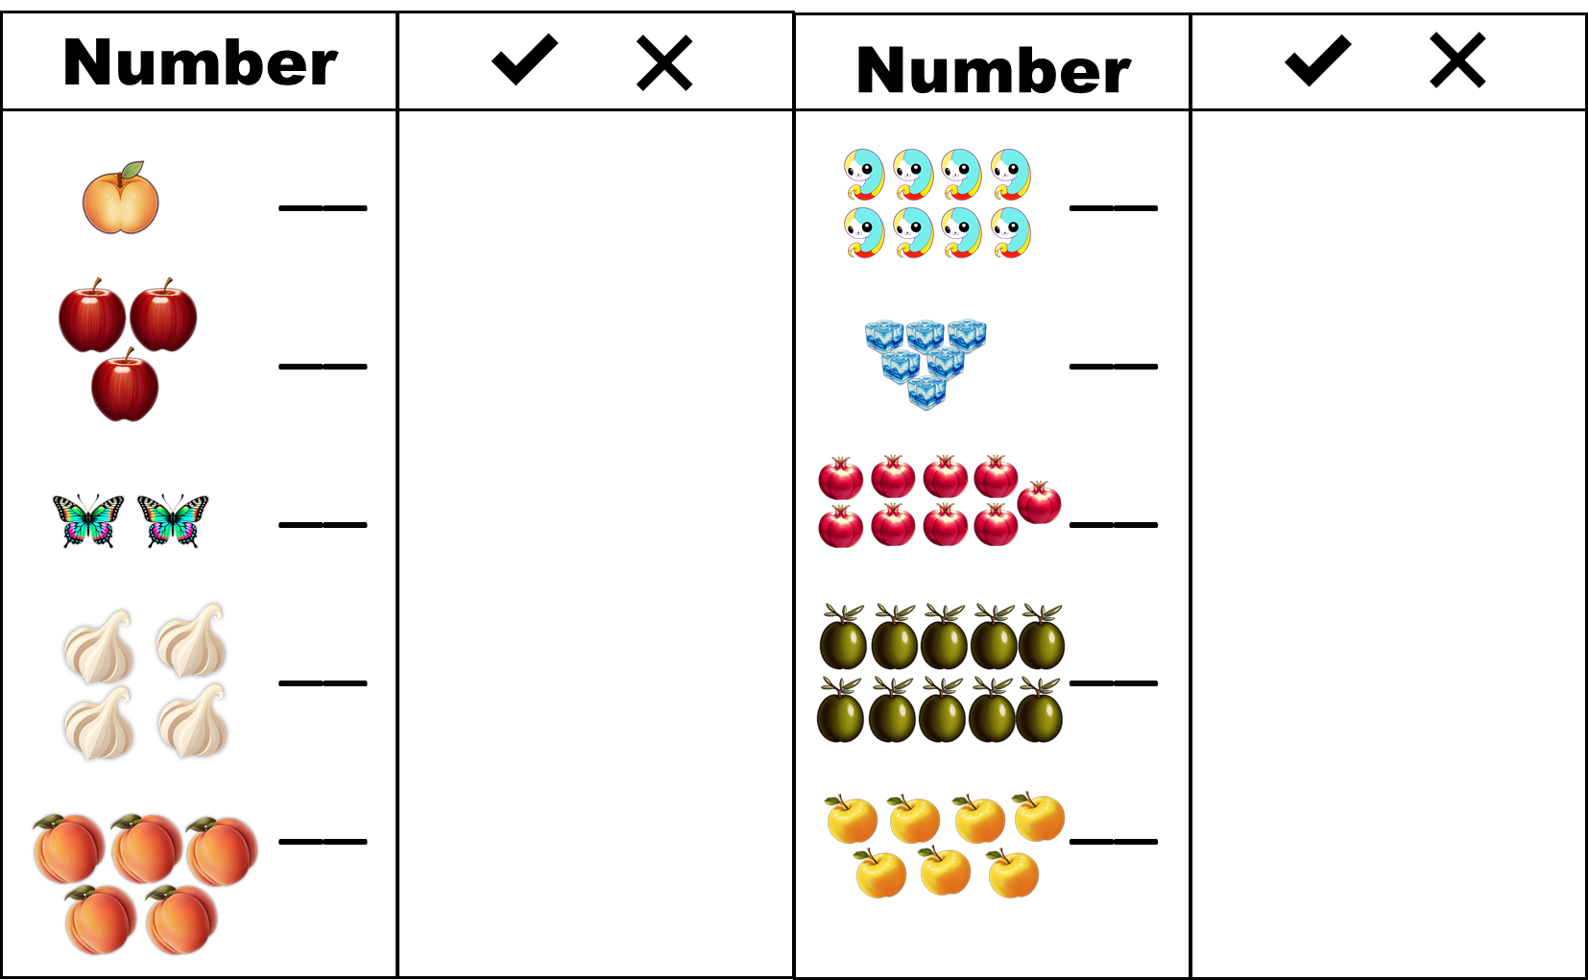
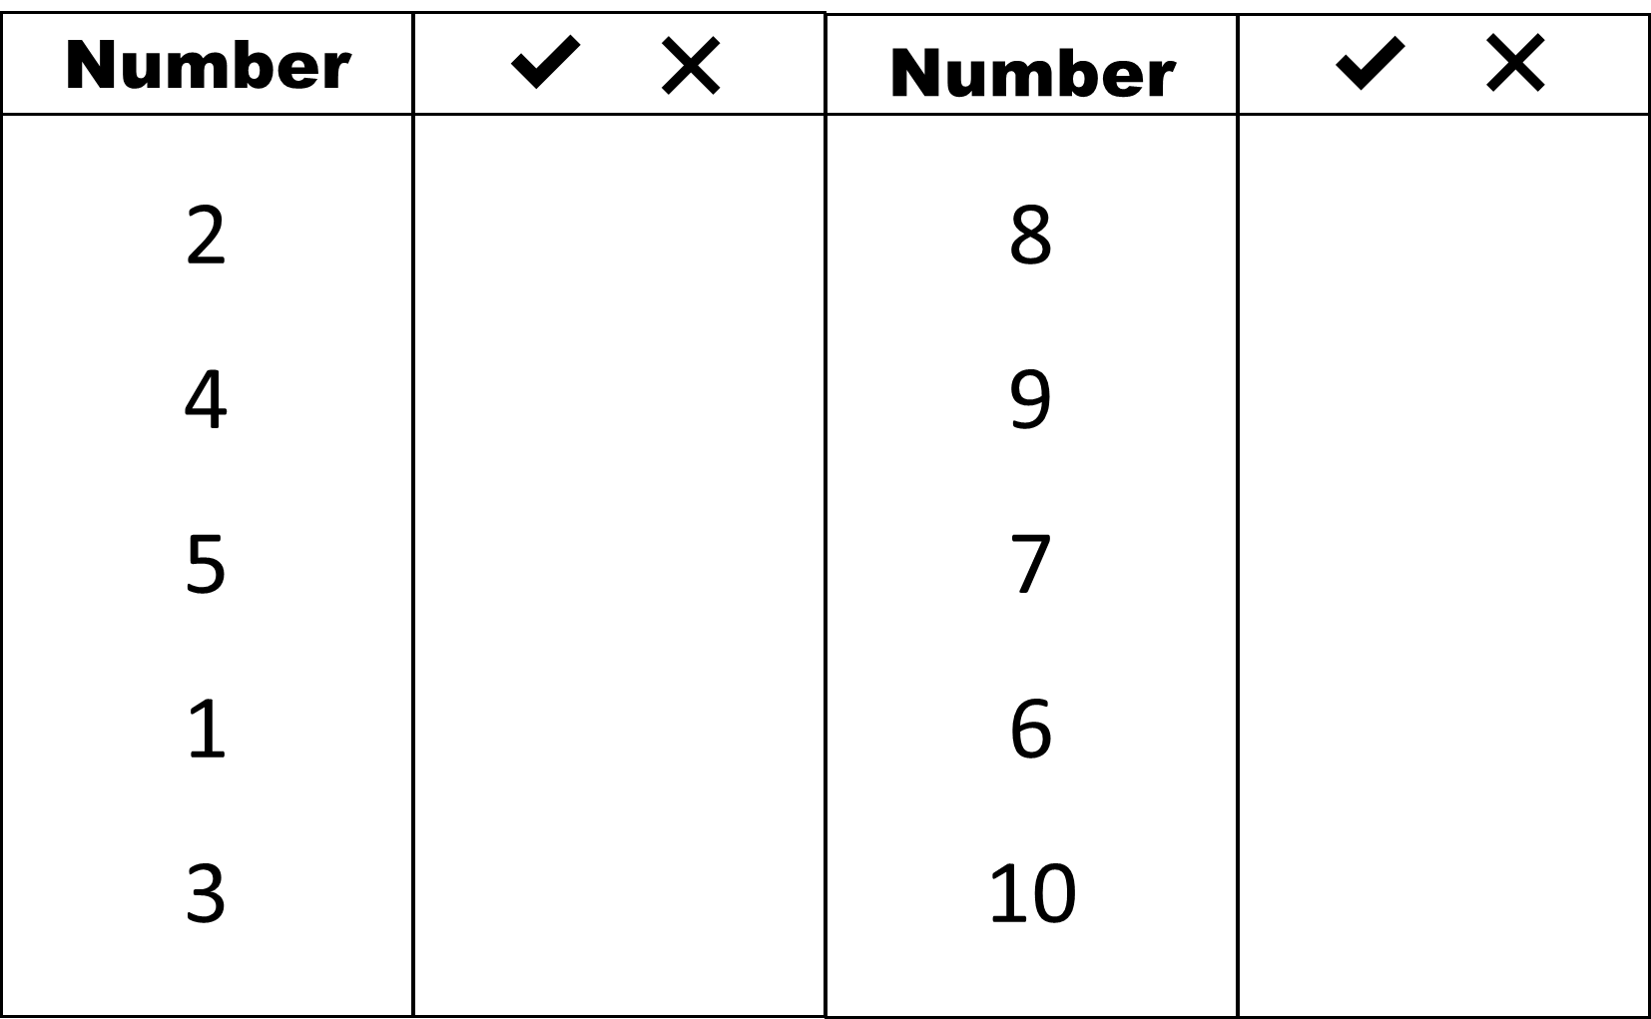
Number Recognition
Recording Sheet

Slide 2

Number 1-10
Blossomings.github.io
Number
✔
❌
Number
✔
❌
Color Splash
1
2
3
4
5
6
7
8
9
10

Slide 3
Number 1-10
Blossomings.github.io
Number
✔
❌
Number
✔
❌
2
4
5
1
3
8
9
7
6
10
Color Splash

Slide 4




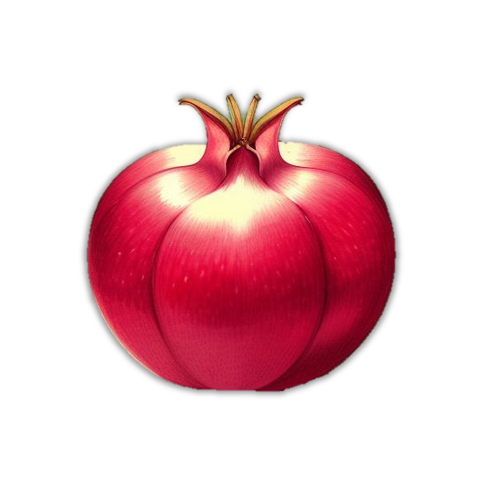





Number 1-10
Blossomings.github.io
Number
✔
❌
Number
✔
❌
__
__
__
__
__
__
__
__
__
__
Color Splash

Slide 5
Number 1-10
Blossomings.github.io
Number
✔
❌
Number
✔
❌
3
5
1
4
2
8
10
6
9
7
Color Splash

