Slide 1
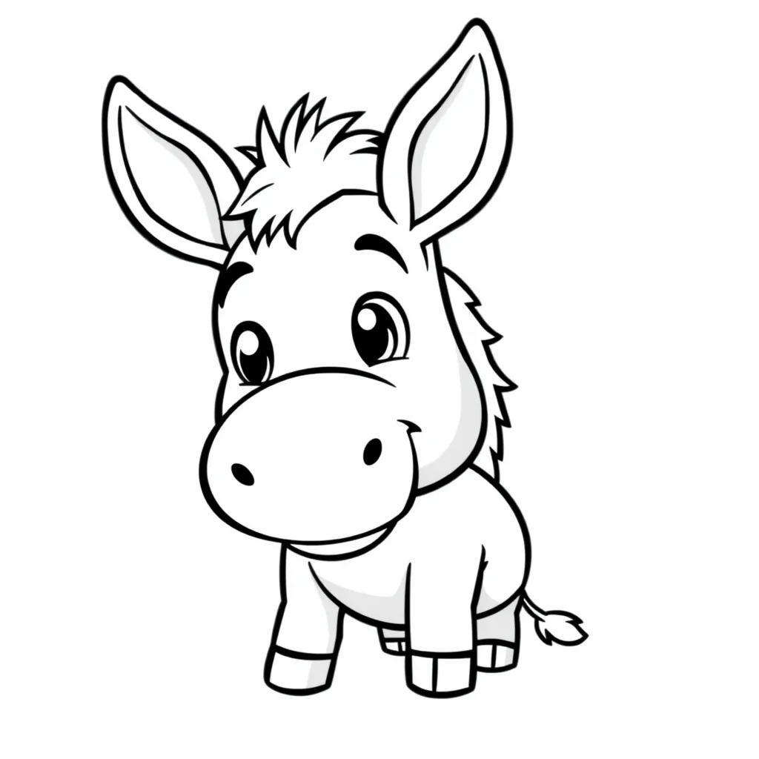
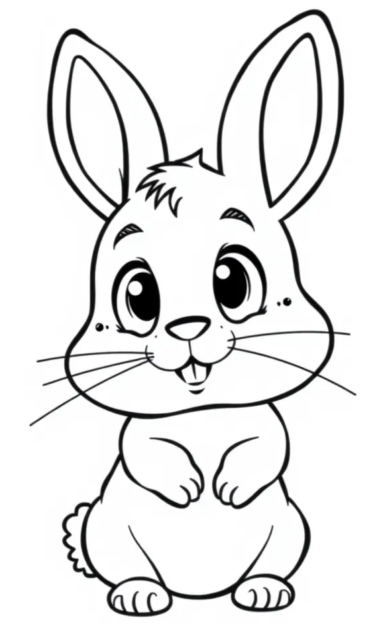
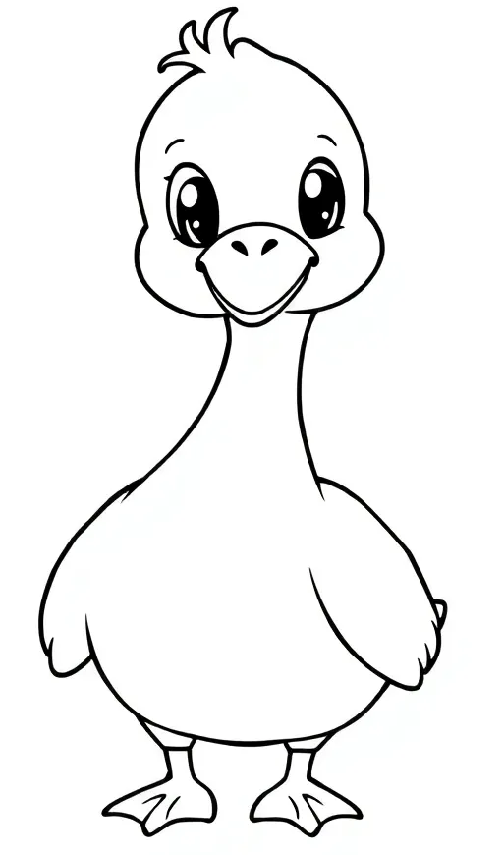
Farm Animals
Coloring Book

Slide 2
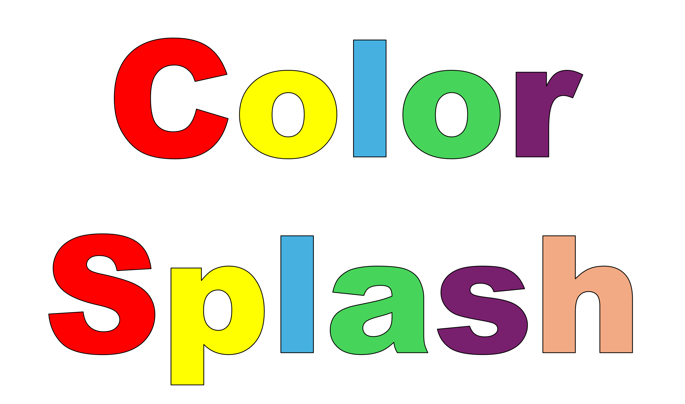
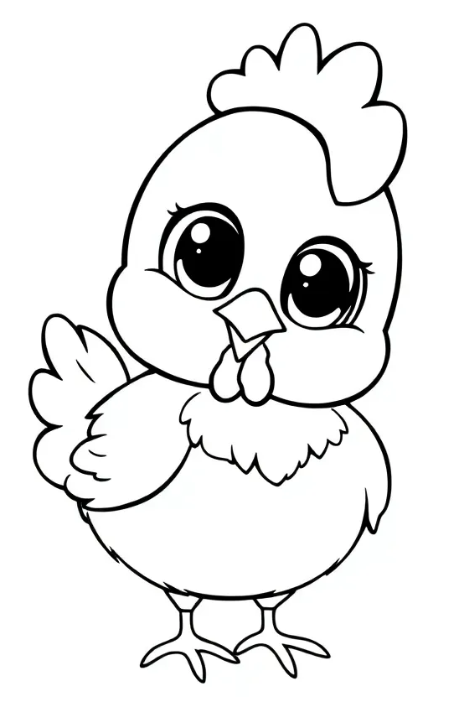
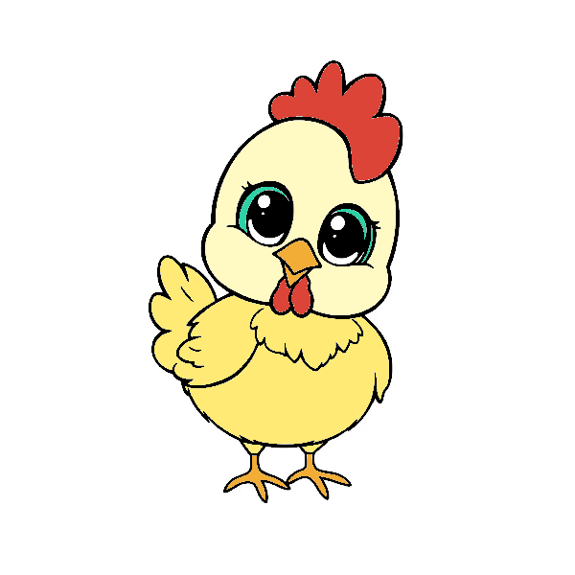
Color Splash
Chicken
Blossomings.github.io
Color Splash

Slide 3
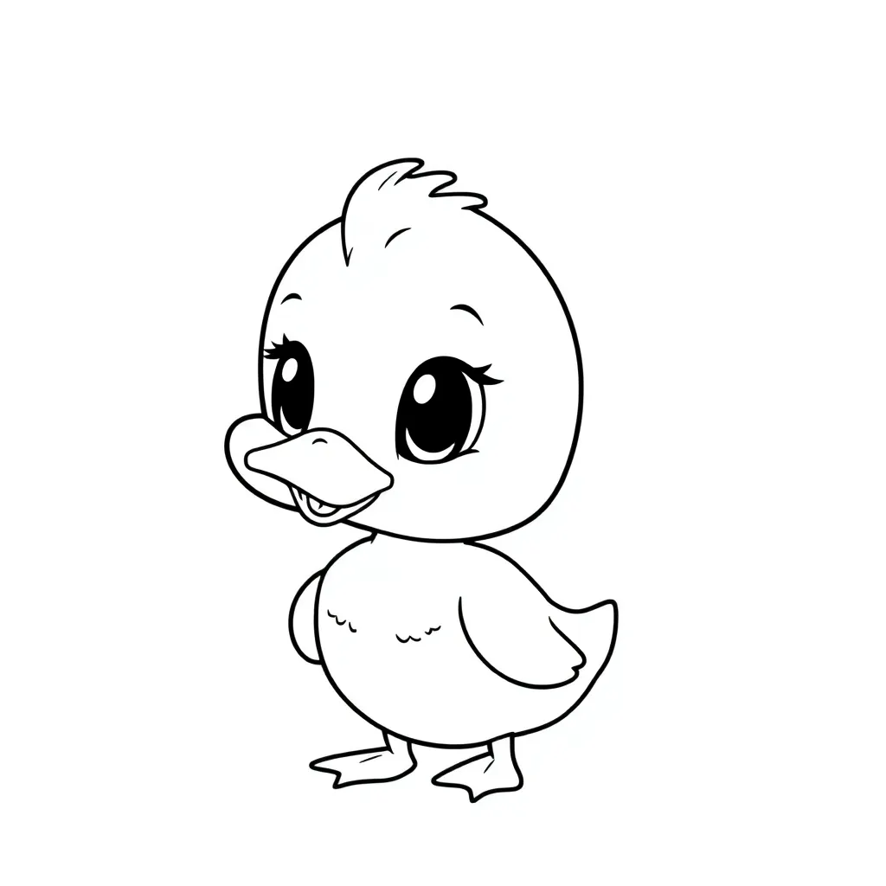
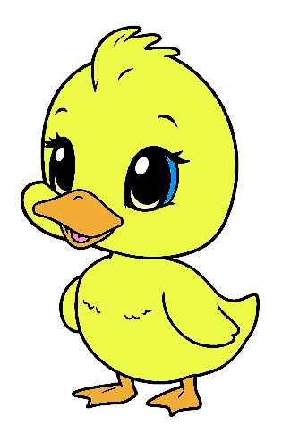
Color Splash
Duck
Blossomings.github.io
Color Splash

Slide 4
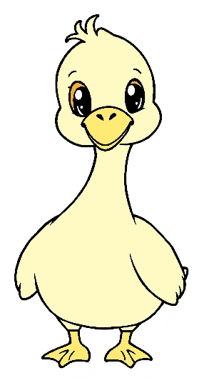
Color Splash
Goose
Blossomings.github.io
Color Splash

Slide 5
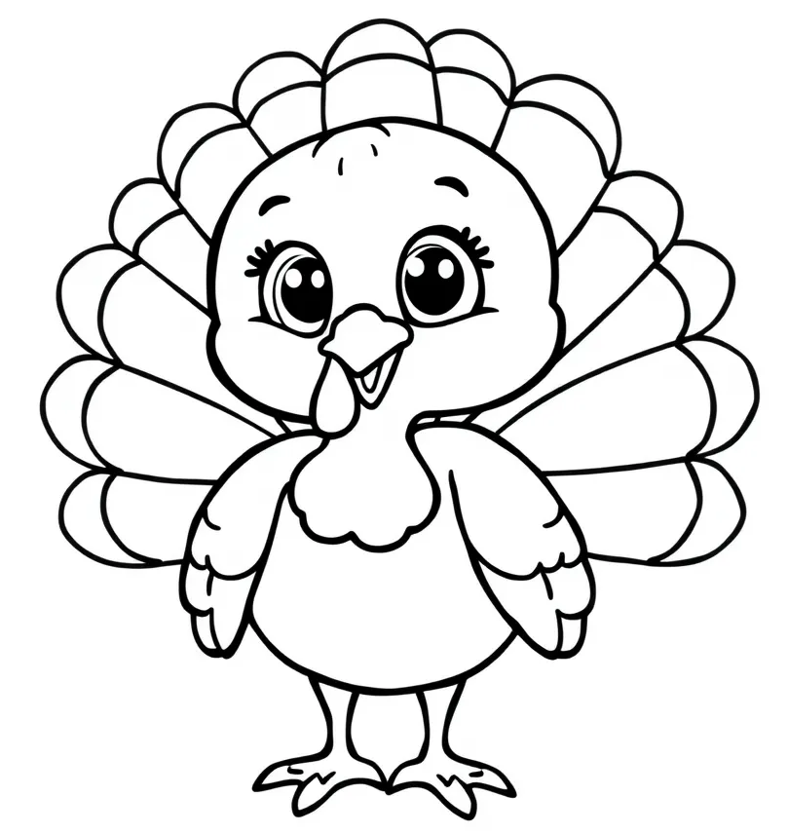
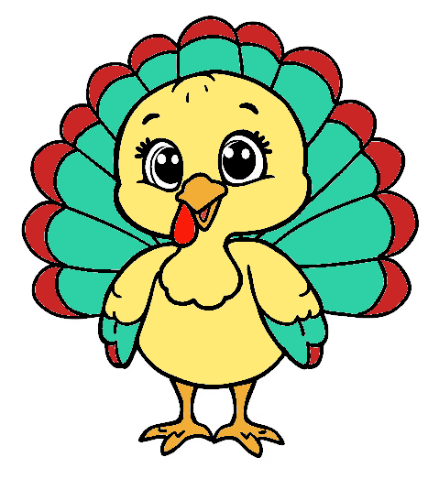
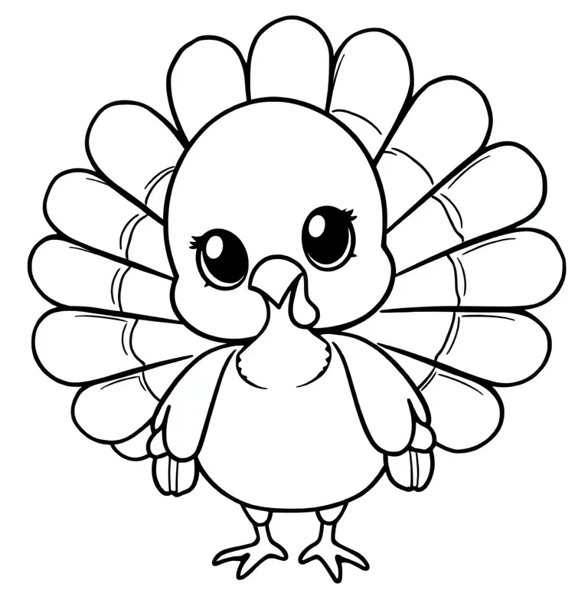
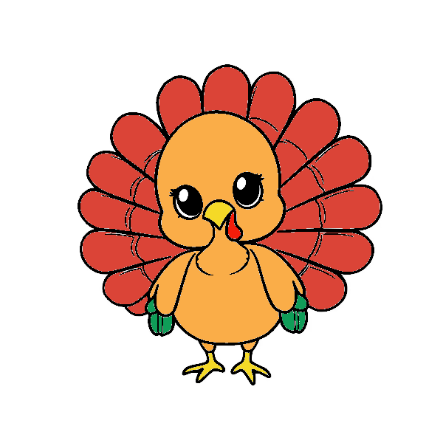
Color Splash
Blossomings.github.io
Turkey
Color Splash

Slide 6
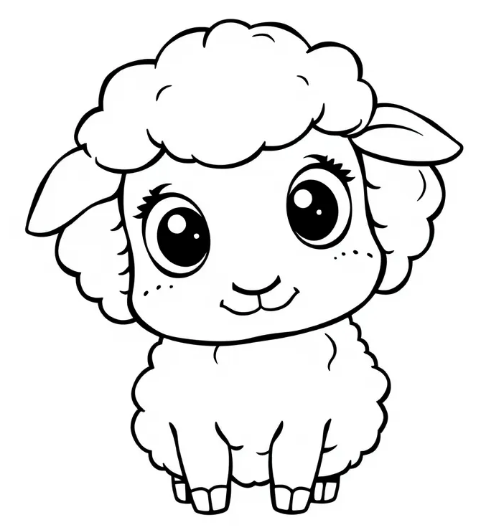
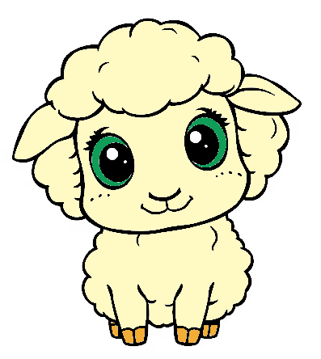
Color Splash
Sheep
Blossomings.github.io
Color Splash

Slide 7
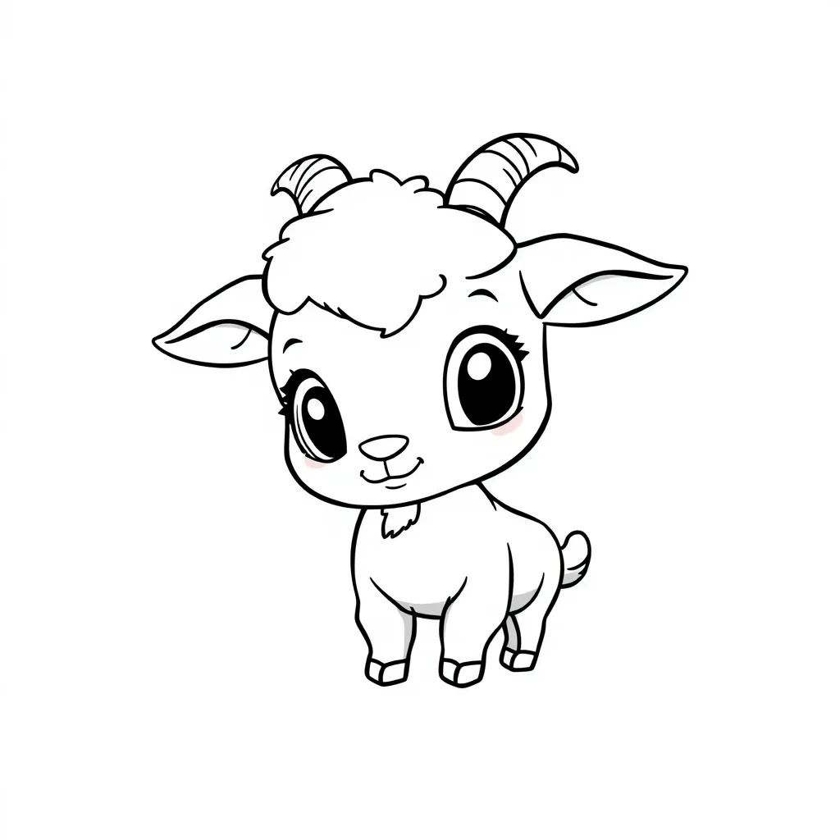
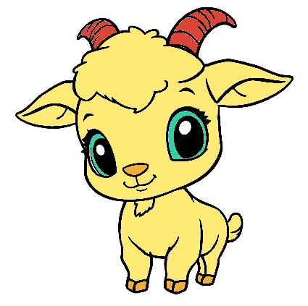
Color Splash
Goat
Blossomings.github.io
Color Splash

Slide 8
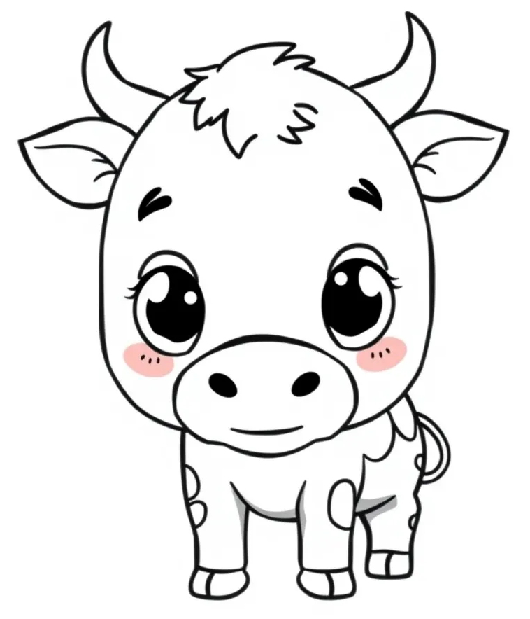
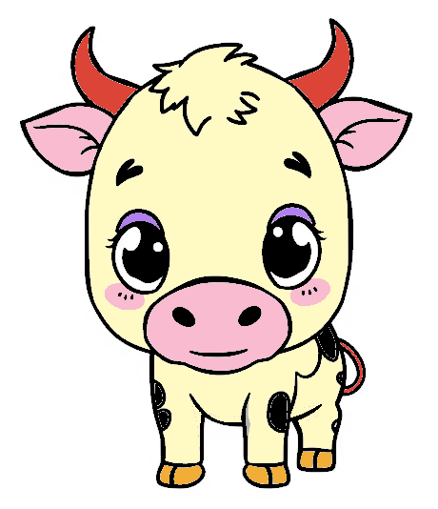
Color Splash
Cow
Blossomings.github.io
Color Splash

Slide 9
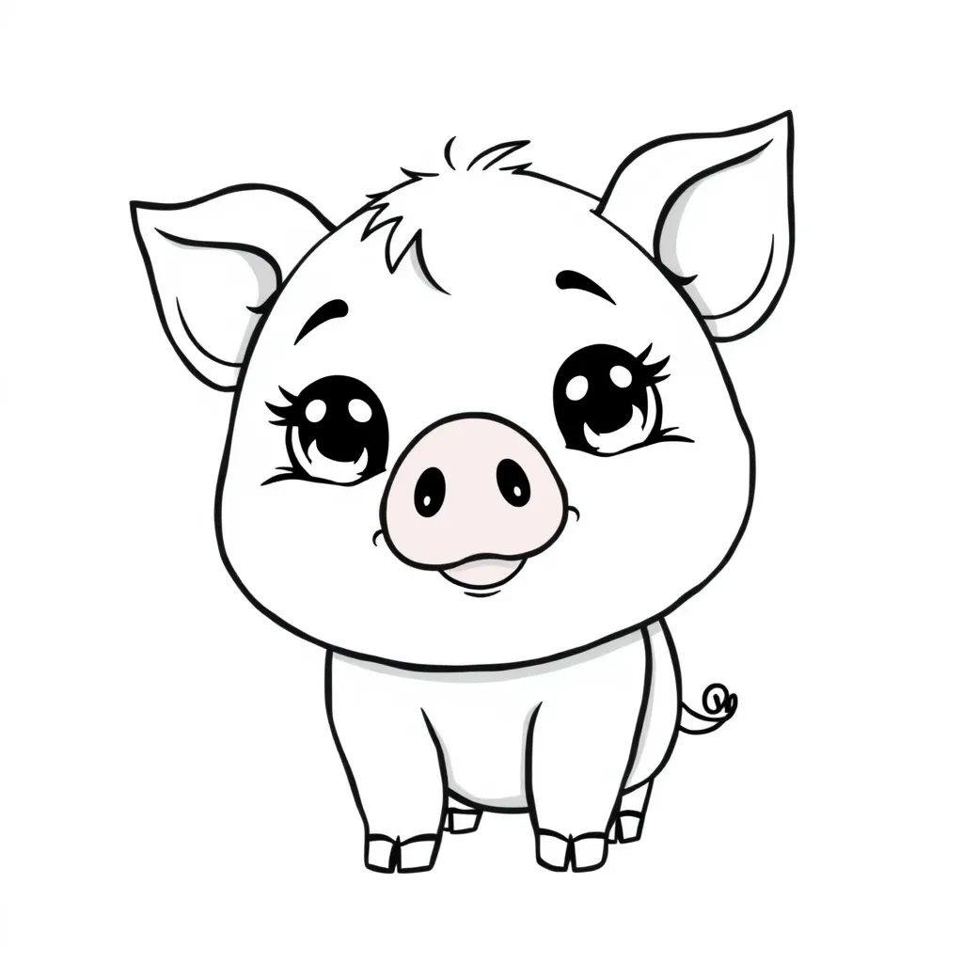
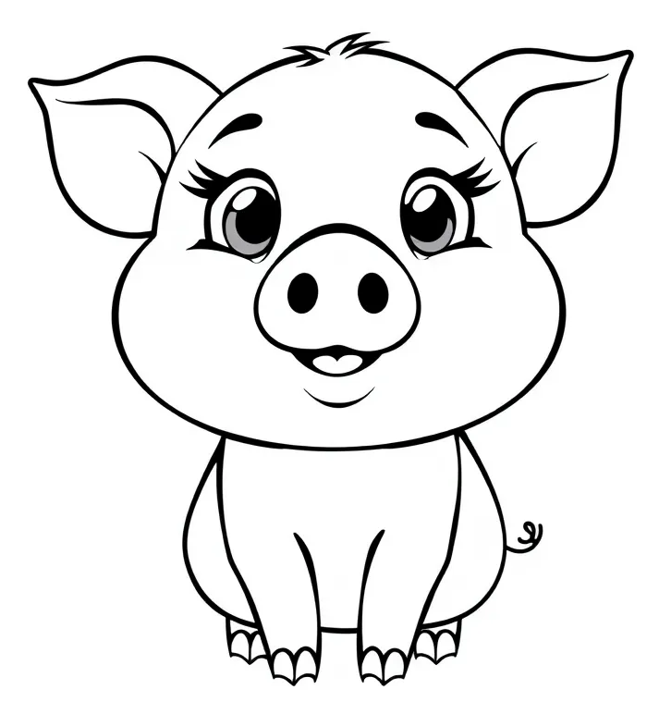
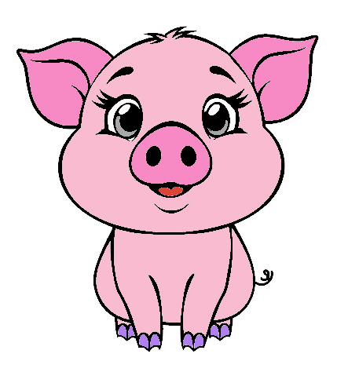
Color Splash
Pig
Blossomings.github.io
Color Splash

Slide 10
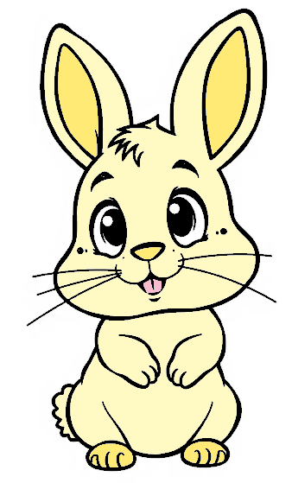
Color Splash
Rabbit
Blossomings.github.io
Color Splash

Slide 11
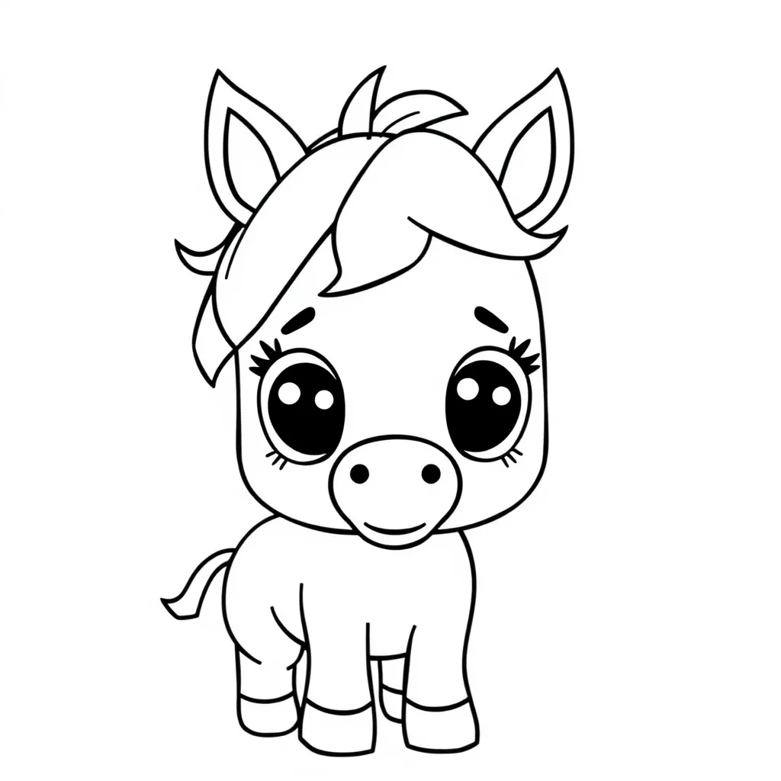
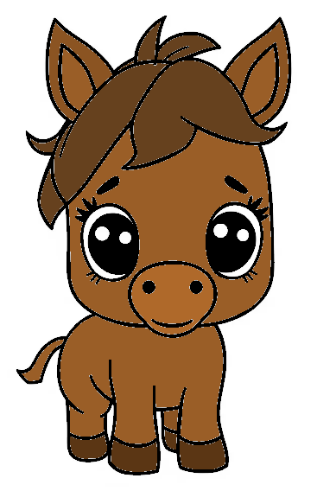
Color Splash
Horse
Blossomings.github.io
Color Splash

Slide 12
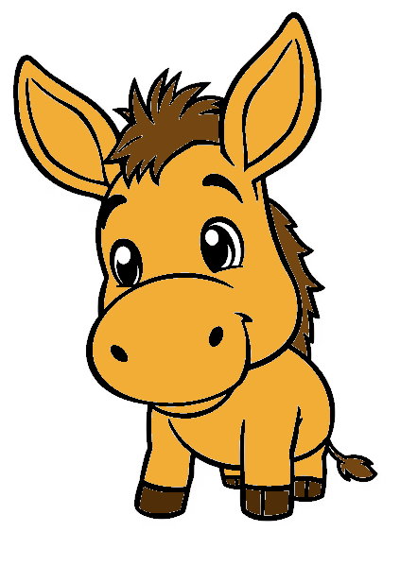
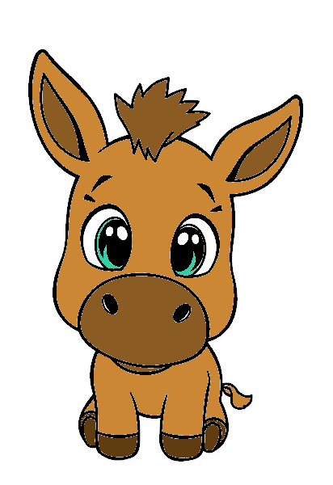
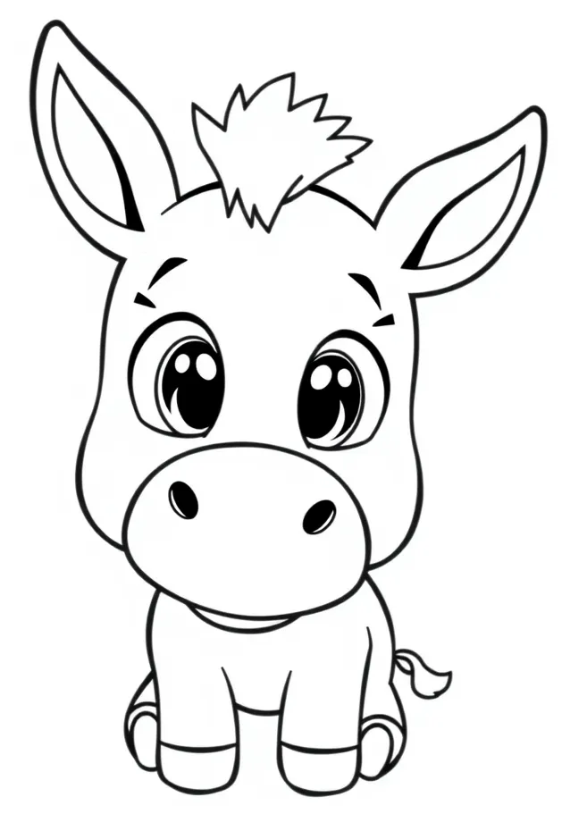
Color Splash
Donkey
Blossomings.github.io
Color Splash

Slide 13
Color Splash
Blossomings.github.io
Chicken
Color Splash

Slide 14
Color Splash
Blossomings.github.io
Duck
Color Splash

Slide 15
Color Splash
Blossomings.github.io
Goose
Color Splash

Slide 16
Color Splash
Blossomings.github.io
Turkey
Color Splash

Slide 17
Color Splash
Blossomings.github.io
Sheep
Color Splash

Slide 18
Color Splash
Blossomings.github.io
Goat
Color Splash

Slide 19
Color Splash
Blossomings.github.io
Cow
Color Splash

Slide 20
Color Splash
Blossomings.github.io
Pig
Color Splash

Slide 21
Color Splash
Blossomings.github.io
Rabbit
Color Splash

Slide 22
Color Splash
Blossomings.github.io
Horse
Color Splash

Slide 23
Color Splash
Blossomings.github.io
Donkey
Color Splash

Slide 24
Blossomings.github.io
Color Splash
Color Splash
Please note: this PDF is copyrighted by blossomings.github.io and is for personal use only. Please do not upload it to any other website, socials or file-sharing service. Thanks!
Color Splash

