Slide 1
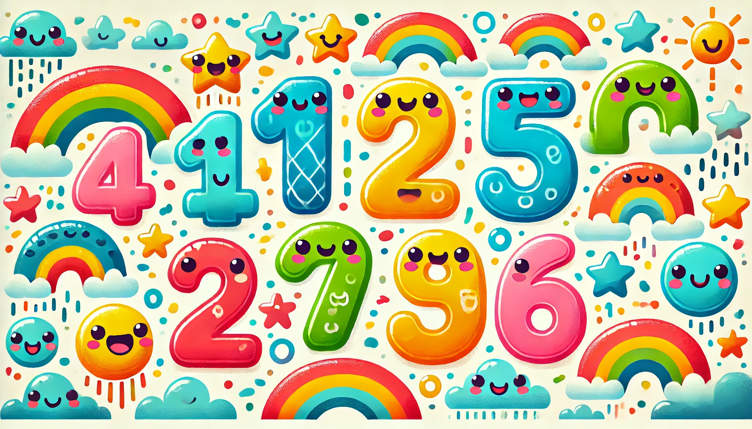
Little Counters
Coloring Book

Slide 2
Trace & Color
Numbers
One - 1
1
1

Slide 3
Trace & Color
Numbers
Two - 2
1
2
1
2

Slide 4
Trace & Color
Numbers
Three - 3
1
2
1
2
3
3

Slide 5
Trace & Color
Numbers
Four - 4
1
2
1
2
3
4
3
4

Slide 6
Trace & Color
Numbers
Five - 5
1
2
1
2
3
3
4
5
4
5

Slide 7
Trace & Color
Six - 6
Numbers
1
2
1
2
3
4
3
4
5
6
5
6

Slide 8
Trace & Color
Numbers
Seven - 7
1
2
3
4
5
6
7
1
2
3
4
5
6
7

Slide 9
Trace & Color
Numbers
Eight - 8
1
2
3
4
5
6
7
8
1
2
3
4
5
6
7
8

Slide 10
Trace & Color
Numbers
Nine - 9
1
2
3
4
9
5
6
7
8
1
2
3
4
9
5
6
7
8

Slide 11
Trace & Color
Numbers
Ten - 10
1
2
3
4
5
6
7
8
9
10
1
2
3
4
5
6
7
8
9
10

