Slide 1


Smart Data Analytics Challenge 2018
Notes:
Use this powerpoint template to create a standardized view of the analysis so that the judges have uniform entries for the review process.
In addition to providing this high level summary, use the GitHub repository to store relevant code, analysis methods, results and other related information.
The prize for competing is your information in the repository as a contribution to the wealth of data available for the State of Colorado.
Your goal should be to create good analysis and documentation of your project and process so others can visit the GitHub Organization and see all the great work from teams.

Slide 2
Problem Solved
We experimented around several topics, these are the two we invested the most time in.
Problem 1: Changing scenario of water and population in CO with focus on Public Supply for Domestic uses and Irrigation use (the largest use of water sources)
The reasons are: (Source: Citizen's Guide to Where Your Water Comes From)
Significant increase in competition for water will result from population growth, agricultural use and increases in 2. environmental and recreational demand.
Projects and management improvements already scheduled by water providers could meet 80% of projected municipal and industrial needs through 2030.
If these projects and management improvements are not successful, more water will be taken from agriculture to meet all needs.
Specific questions asked:
Q1: Have there been changes in water usage patterns for domestic and irrigation uses in regions/ counties in the state of CO?
Q2: Surface water and Population growth of CO – what is in store for our future?
Q3: We cannot control population and economic growth, but we can control how we use water. Can efficient methods of irrigation help mitigate water losses?
Problem 2: Given the Environmental Protection Agency’s 2016 report on the impact of hydraulic fracking on water, how can we use Colorado data to answer their call for “decision-makers [to] focus their attention on the combinations of hydraulic fracturing water cycle activities and local- or regional scale factors that are more likely than others to result in more frequent or more severe impacts” on water?
Specific questions asked:
1. Given that Flint, Michigan required a lot of action from residents before water issues were considered a crisis, how can we encourage community science and awareness in Colorado?
2. Can we understand the EPA’s report enough to come up with meaningful graphs & maps to help a community with assessment?
3. How do we balance our attempt to simplify the factors for assessment with usefulness?
2018 Submission Template
Notes:
Problem statement, hypothesis, and/or the specific question driving the analysis.

Slide 3
2. Impact
Problem 1: Subject Matter experts are looking at challenges arising due to increasing population and also tackling water shortage. While researchers and government water resource agencies are already working on it, this part of the project’s aim is two-fold: 1) to simplify CO marketplace water data for everyone through visuals, storytelling and exploratory analysis and, 2) to create predictive model using CO Marketplace data for efficiency in water use.
Problem 2: Examining the impact of hydraulic fracturing on water highlights the topics of supply, conservation, and education. The need for better education for Colorado residents is exemplified by the rhetoric of the pro/con factions for proposition 112 during the 2018 midterm elections. There was a range of opinions around the impacts of oil, gas, and hydraulic fracking on our economy and environment. 44.88% of voters said yes, 55.12% said no. We believe a data driven approach might help bridge the conversation between the perspectives. We know from historical water events (Flint, Niagara Falls’ Love Canal, Philadelphia’s Legionnaires disease) that consistent, accurate, and transparent communication are important. We have found tools that address different aspects of the EPA’s report, but nothing that pulls it all together for Colorado. Therefore we think this tool is needed.
2018 Submission Template
Notes:
Does the analysis seek to address a problem or answer a question that state subject matter experts in the topic area currently experience? How much impact can the insights from the data analysis have on solving the problem or answering the question?
Teams should clearly show how their analysis responds to actual needs of the subject matter experts and how the insights from the analysis are new and different from what is currently available.

Slide 4
3. Methodology
Problem 1: County-wise Public Supply data has been looked at in relation to the county designation – Urban, Rural, Frontier. Given the population and economic growth, there is going to be a demographic shift and this means that there will be a change in water usage- quantity and patterns.
We have looked how in the past 30 years (1985-2015) , how this looks- aggregates and percentage changes. This helped us understand how the future looks. Tools used- MS Excel, MS Power BI
To meet the future demands there is a need to bring efficiencies. Using predictive modelling techniques, we build a linear regression model to see if regions using efficient methods like sprinkler irrigation also have lower conveyance losses. This suggests that if efficient technology is used in irrigation, then even the supply channels are efficient. Tools used- MS Excel, IBM SPSS Modeler.
Model fit and significance of independent variables were a priority. If there was access to different data sets like climate or a more complete dataset, it would be interesting to see if more robust models can be built.
Problem 2: The main goal was education. We researched Flint, Michigan and examined the factors that lead to action on the water crisis. The factor we chose was community science. Read the EPA’s executive summary, paying attention to the data they used to inform their 6 conclusions. Identified datasets that might be used to assess the EPA’s 6 conclusions and first pass at getting something useful out of them. Identified information and questions to educate the user on the hydraulic fracturing water cycle. First pass at design of website and evaluation if project goals are attainable. We focused on 2 of the EPA’s conclusions to flesh out: Spills during the management of hydraulic fracturing fluids and Disposal or storage of hydraulic fracturing wastewater.
2018 Submission Template
Notes:
Is the analytical method valid and appropriate to the question being answered? Did the team take a logically and scientifically sound approach to the analysis? Were quality techniques were used to add value to and draw conclusions from the data? Is the data utilized appropriate to represent the content of the issues and their solution?
Judging will be based on whether the analysis was technically sound and used innovative, comprehensive but efficient, and appropriate analytical methods

Slide 5
4. The Data
Problem 1: Data used
Challenges
Different time periods (e.g. daily/monthly/annual)
Missing data. For example, water supply was missing entire year of 2000, and many variable were missing for 2000, 2005, and 2015. For the regression model data from years 1985, 1990, 1995 was used as the remaining years the data is missing
Incongruent data. For example water supply couldn't be used with drought data, it was county-wise. We couldn’t find that for climate/weather.
Standardizing data. For surface water, variable for storage amounts are in two units-based on storage or flow (AF and CFS). Analysis required converting all units into gallons. Records with null values were not used.
Problem 2: Data for the EPA’s conclusions
Spills that result in large volumes or high concentrations of chemicals: Additives used in chemical mixing, Spills
Times or areas of low water availability: Well Water Levels, Surface Water Supply Index, Drought Conditions (CSU), US Drought Monitor, Well Density/Uses
Wells with inadequate mechanical integrity/directly into groundwater: Mechanical Integrity Test, Rule Violations, Ages of Wells
Wastewater in unlined pits: Location of pits
Discharge of inadequately treated hydraulic fracturing wastewater: Changes in salinity levels of water
Challenges
We found data on CIM that wasn’t updated with the same frequency as the original data (ex: Oil Spills on CIM, source)
Lack of domain knowledge around data. For example, trying to understand which wells were used for hydraulic fracking by use type. Or trying to understand what constitutes a low level of water for a well.
Census
Water Supply (USGS)
County Designations
Surface Water
2018 Submission Template
Notes:
Ideally teams will public data sets from the Colorado Information Marketplace, although other state public data may be used. Has the team used multiple public data sets from the State of Colorado? Has the team added value to the public data and cogently used it as part of the analysis to draw conclusions?
Teams must provide descriptions of the data used, data sources and methods for obtaining and preparing the data for analysis.
Explicitly state what datasets you are using and specify (with a url link where possible) where you got them from.

Slide 6
5. Feasibility
Problem 1: Part of the analysis, mostly descriptive is complete. For the prescriptive part more data is required. Other data sets that we tried to look for but could not find in useful format are- Precipitation, drought (collected monthly for CO as a whole, no county or region breakup)
Missing data, USGS data collected every five years and any other data sets that could be used in conjunction with this have different time periods-e.g. daily/monthly/ annual data collections.
Time series analysis could not be done due to missing data for some variables in the years 2000, 2010, 2015.
No data found on conveyance of irrigation water supply. More data points like type, seepage, evaporation etc. could help in refining our predictive model to estimate conveyance losses. It can also help narrow the best practices in water conveyance that could be scaled up and water losses can be minimized.
Problem 2: Analysis is far from complete. This project is a minimum viable project (mvp) to assess if the concept is possible. How can we implement the EPA’s call for monitoring of hydraulic fracturing on water in our communities? We think the concept has possibilities, but has run into our current insufficient resources (time/knowledge). Given a state or local person with one or more of the following resources: understanding of the water, hydraulic fracturing datasets, access to folks who understand the datasets, a deeper understanding of the EPA’s report, and/or design thinking.
2018 Submission Template
Notes:
Is the analysis complete? Could it be implemented by state or local subject matter experts? What special expertise is required to implement it? Would there be any scaling issues based on the technology or data used to larger data sets or new information in the future? What level of resources will be required to implement the analysis at scale?
Teams must explain how further resources could advance the analysis and insights. Judging will also review the availability of the data used.

Slide 7
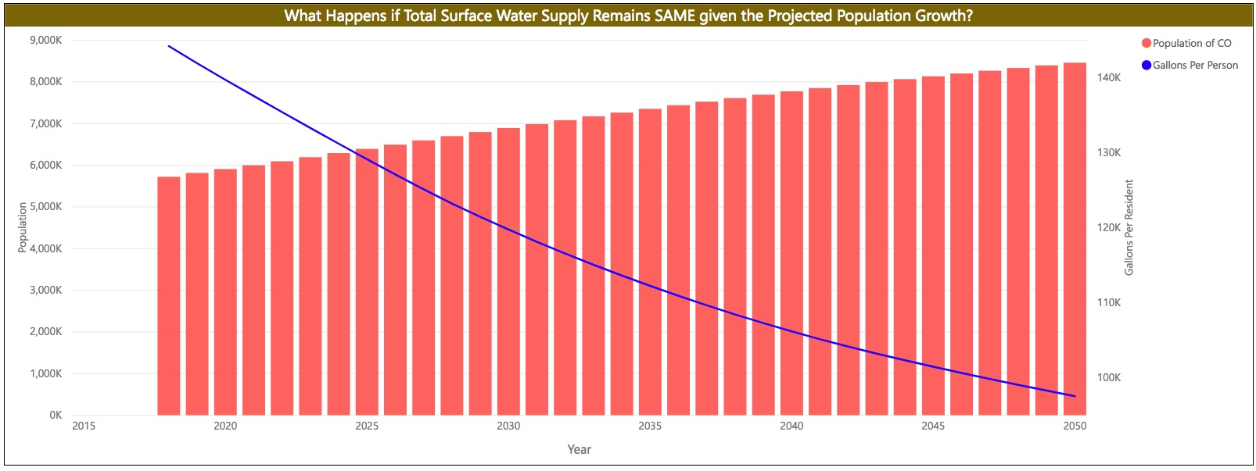
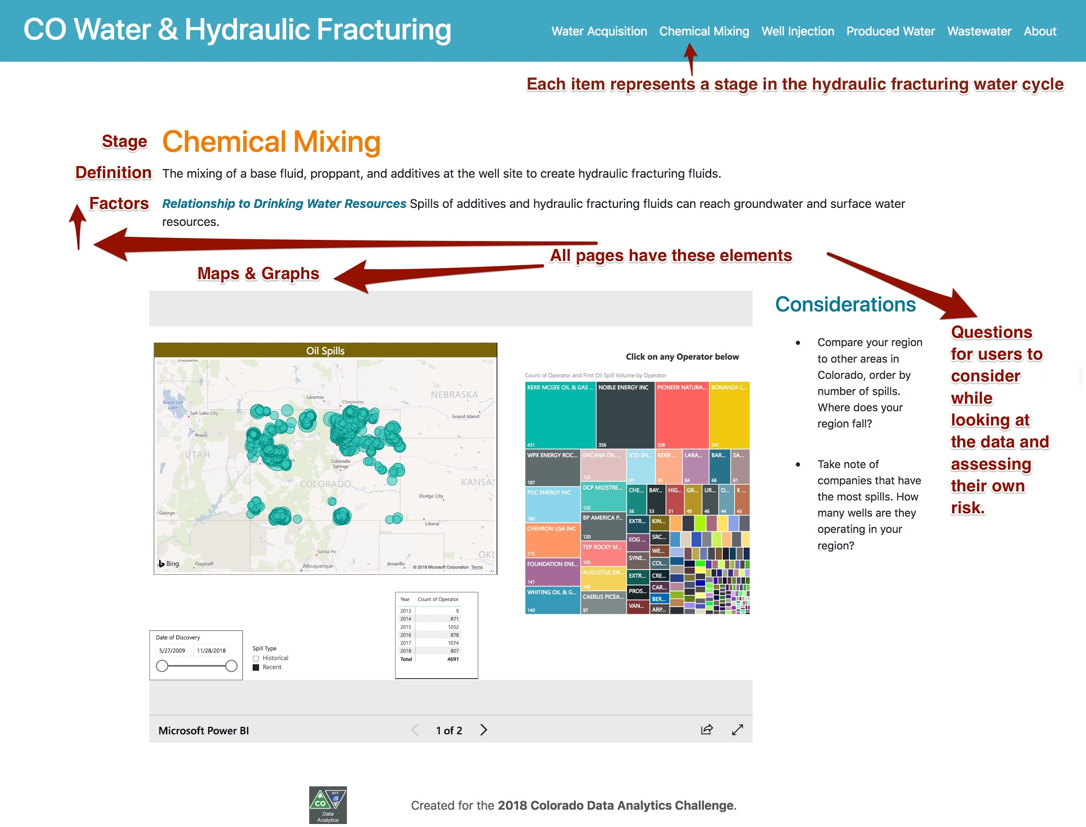
6. Results
Problem 1: Link to problem 1 results.
Problem 2: Link to problem 2 results.
Regression Equation:
Total Conveyance loss, in Mgal/d
= Total self-supplied groundwater withdrawals, in Mgal/d * 0.4524 +
Total self-supplied surface-water withdrawals, in Mgal/d * 0.3773 +
Total sprinkler irrigation, in thousand acres * -0.4019 +
Total surface irrigation, in thousand acres * -0.2908 + -2.164
As Urban population increases in CO, more and more public supply deliveries for Domestic uses will be for Urban counties. This also means that there will be a change in the usage patterns (how water is used)
Population growth demands new ways to look at water usage (Surface water visual is an indicator of this).
The increasing trend usage of sprinkler systems in irrigation ( 20% to 47%) shows that shift towards better technology use in agriculture.
As sprinkler irrigation increases, the impact of efficiency through technology is visible in conveyance of water too.
We plan to continue working on this. Our website is a work-in-progress as we’ll continue our research and make this tool public..
We’d appreciate recommendations from y’all on who we can talk to once we’ve created a list of additional datasets.
In the meanwhile we are connecting with industry experts and interviewing them to understand the technical and their view points on this topic.
We’d like to present this as a workshop to the Society of Environmental Journalists at their conference next year in Fort Collins.
2018 Submission Template
Notes:
Provide screenshots or a link to your results. Explain or show any progress you’ve made on design and creation. This helps judges evaluate your ability to implement your idea.

Slide 8
Smart Data Analytics Challenge 2018

