Slide 1


CropArray
What is CropArray?
CropArray is a python library to organize and visualize crops of detected spots from super-resolution microscope images.
Available at:
pip install croparray
https://github.com/Colorado-State-University-Stasevich-Lab/croparray.git
https://croparray.readthedocs.io/en/latest/

Slide 2

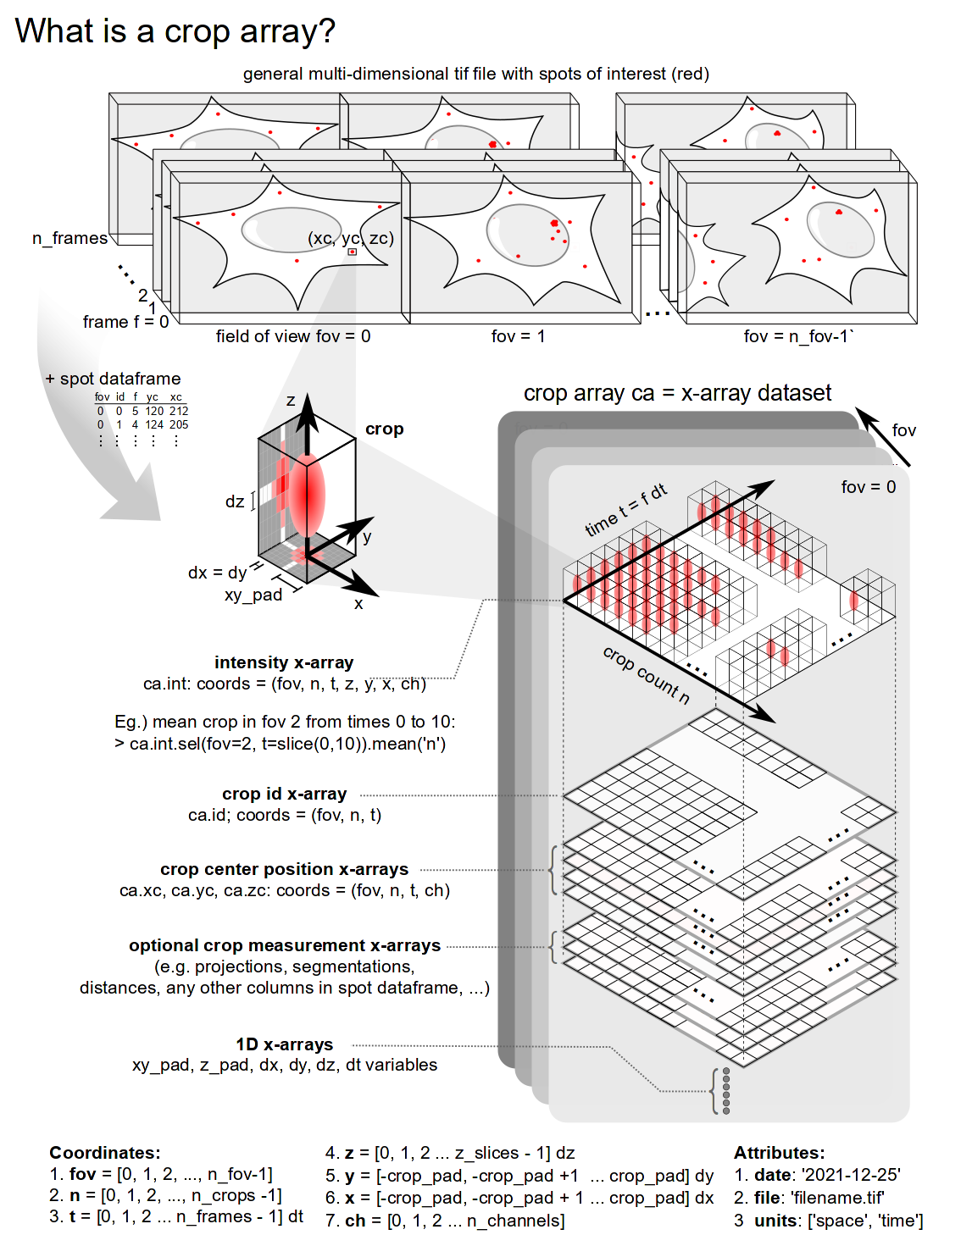
CropArray
CropArray in a nutshell
Organizes crops in a convenient x-array format for reduced filesize and more open and reproducible analyses.
Calculates the best maximum projection for each crop containing a detected spot.
Measures intensity of detected spots within crops.
Calculates central tendency measurements in datasets.
Integrates with Napari for fast and convenient review of crops of detected spots.

Slide 3

CropArray
2D or 3D Video/Image
Fixed or live cells
Code Architecture
Pre-processing
Input: original video
- Spot detection
- Tracking 3D (2D+best-z)
- Video alignment
- Cell Segmentation
Output: Video & Dataframe
CropArray
Intput: video & dataframe
- Compressed Image
- Metadata
- Units
Output: x-array
Data Management
Data Analysis
Visualization
- Sorting by feature
- Grouping by layer
- Intensity calculation
- Descriptive statistics
- Time series
- 2D-matplotlib
- Napari representation
- Simulated Cell

Slide 4

CropArray
Roadmap to version 1.0
Source Code
Add more functions
CropArray
Stable Design
CLI
Easy to use
Github
Dev/test Branches
Documentation
readthedocs
Napari
GUI

Slide 5










CropArray
CropArray – Command Line Interface (CLI) for data processing
Data frame
Source code
User interacts with a CLI
Processed data

Slide 6

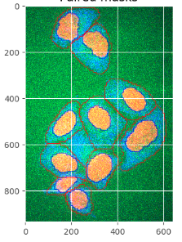
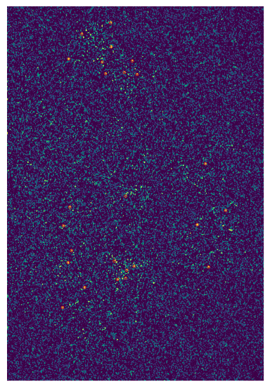
CropArray
Applications
Working with FISH images
Visualization and Interpretation

Slide 7
CropArray
Applications
Working with live-cell images

Slide 8




CropArray
The Team
Tim Stasevich
Team Leader
Luis Aguilera
Code development
TBD
Communication
TBD
Documentation
TBD
Testing

Slide 9

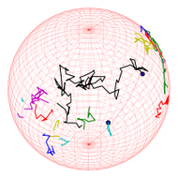
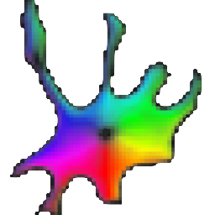

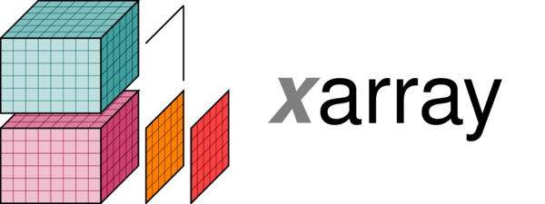


CropArray
Module Dependencies
x-array
trackPy
Napari
Cellpose
FISHQuant
rsnaped

