Slide 1


CropArray
What is CropArray?
CropArray is a python library to organize and visualize crops of detected spots from super-resolution microscope images.
Available at:
pip install croparray
https://github.com/Colorado-State-University-Stasevich-Lab/croparray.git
https://croparray.readthedocs.io/en/latest/

Slide 2

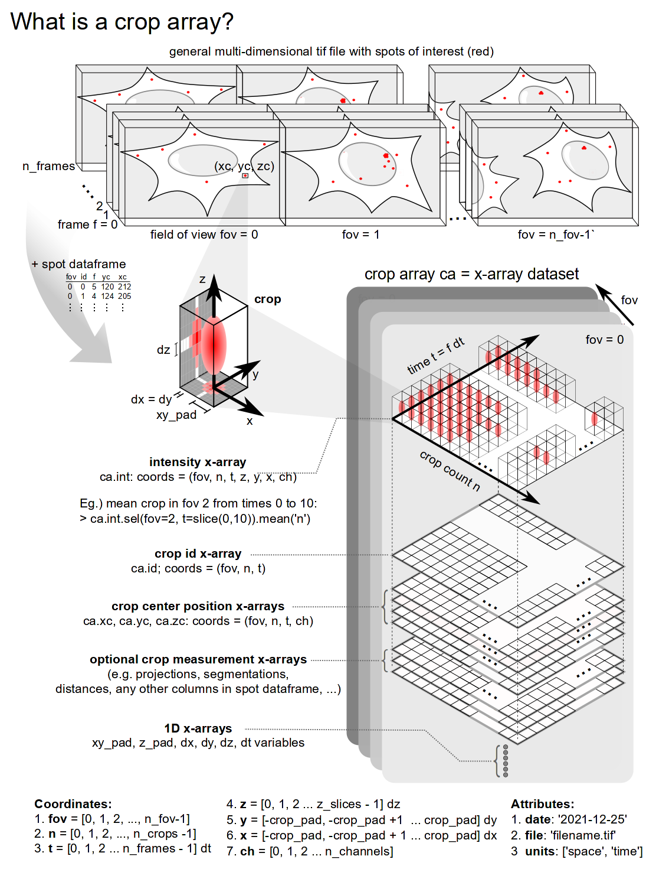
CropArray
CropArray in a nutshell
Organizes crops in a convenient x-array format for reduced filesize and more open and reproducible analyses.
Calculates the best maximum projection for each crop containing a detected spot.
Measures intensity of detected spots within crops.
Calculates central tendency measurements in datasets.
Integrates with Napari for fast and convenient review of crops of detected spots.

Slide 3

CropArray
Code Architecture
Functionality
Data management
Visualization
Video alignment
X-array representation
Napari visualizations
Spot Detection & Tracking
Metadata (units, attributes)
Descriptive Statistics
Cell Segmentation
Data sorting and grouping
Simulated Cell

Slide 4

CropArray
Road Map to version 1.0
Source Code
Add more functions
CropArray
Stable Design
API
Easy to use
Github
Dev/test Branches
Documentation
readthedocs
Napari
GUI

Slide 5

CropArray
Applications
Working with FISH images

Slide 6
CropArray
Applications
Working with live-cell images

Slide 7




CropArray
The Team
Tim Stasevich
Team Leader
Luis Aguilera
Code development
TBD
Communication
TBD
Documentation
TBD
Testing

Slide 8

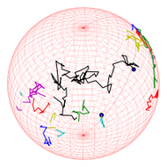
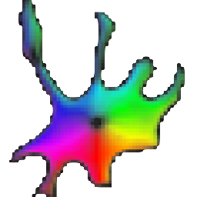
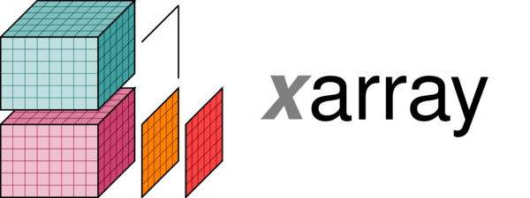

CropArray
Module Dependencies
x-array
trackPy
Napari
Cellpose

