Slide 1
CPE 314 · FINAL DEFENSE
FleetRent
Manage rental vehicles, and let renters book them
Team 04 · EDP 69323 · Theme Q: Vehicle Rental & Fleet Management
Gabasa, Dexter · Rosal, Wendil · Coloscos, Brent · Lagaya, John Carlo · Labra, Simone
Notes:
Good day. We are Team 04. Our project is FleetRent, a desktop app for vehicle rental shops. Keep this slide up while the demo computer is set up.

Slide 2
Defense plan
OVERVIEW
1
Live Demo 4 min
One realistic end-to-end task
Who speaks
Demo driver: Coloscos, Brent
Architecture: Gabasa, Dexter
Justification: Lagaya, John Carlo
Everyone: Q&A
2
Architecture Walkthrough 3 min
Class hierarchy, ER diagram, requirement-to-code map
3
Design Justification 2-3 min
Answer 1-2 instructor questions about a design choice
4
Individual Q&A 2-3 min each
Each member explains code they committed
Notes:
This is our plan. Demo first (4 minutes), then the architecture (3 minutes), then the design choices (2 to 3 minutes). After that, each member answers questions about the code he or she committed.

Slide 3
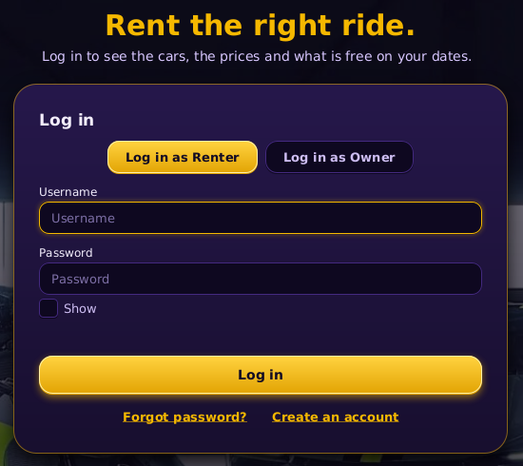
Project overview
OVERVIEW
What FleetRent is
Problem: paper logbooks make shops lose track of which vehicle is out and who is next in line.
Users: shop owners and renters.
Theme Q. Public REST API: NHTSA vPIC for makes and models (Wikipedia for car photos).
Features: rent, return, reserve and undo; a waiting list; a dashboard with charts.
Notes:
Small rental shops write rentals in paper logbooks, so it is easy to lose track of which vehicle is out, its mileage, and who is waiting. FleetRent keeps everything in one SQLite database. Owners run the fleet. Renters see the cars and book them. Makes and models come from the free NHTSA vPIC API.

Slide 4
Live demo: one end-to-end task
LIVE DEMO
Scenario script (4 min)
Start the app and log in as the owner
Vehicles tab: choose type, year, make and model from NHTSA
Add the vehicle, then rent it in the Rentals tab
Dashboard: open the chart and change the dates
Close the app and open it again: the data is still saved
Edge cases to show
Empty input: press Add Vehicle with empty boxes
Bad value: daily rate 0, or a plate that is already used
API offline: press Reload from NHTSA with no internet
Notes:
Run this on the real presentation computer. Show an empty form, a daily rate of 0 and a repeated plate: each gives a red message and nothing crashes. With no internet, the app says what is wrong and Make and Model can still be typed by hand.

Slide 5
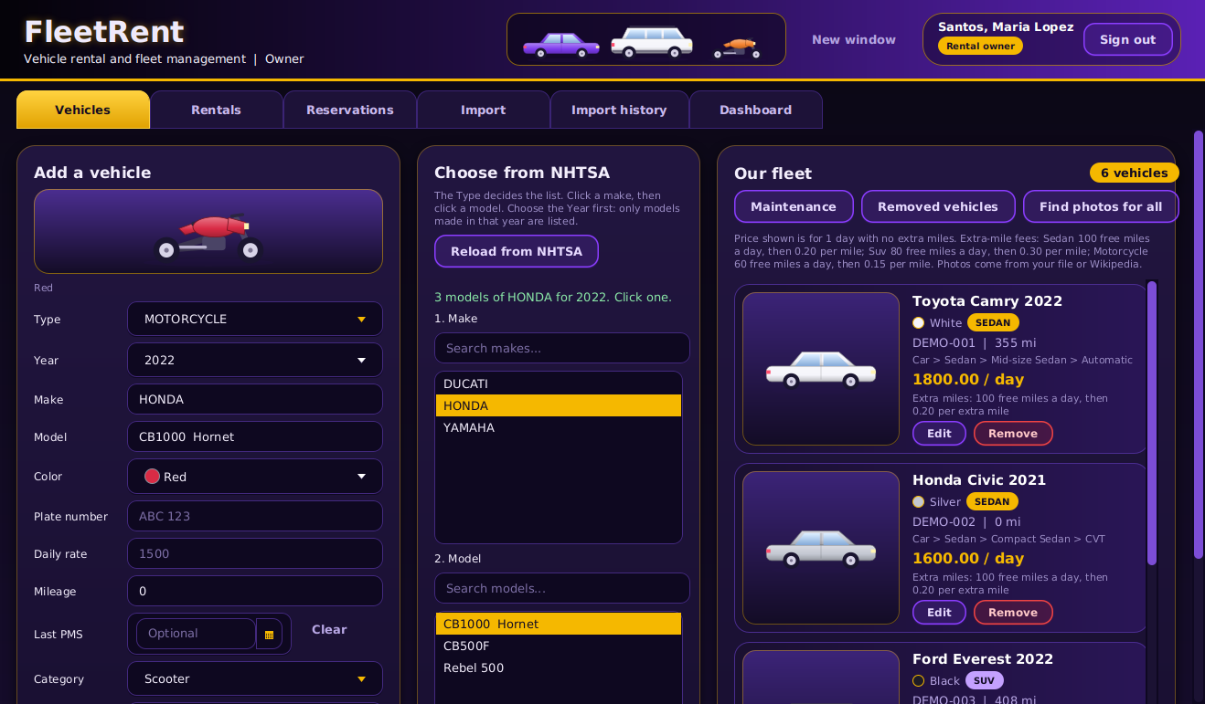
User interface: main screen
EVIDENCE: UI
Explain
Screen: Owner, Vehicles tab
The owner adds, edits and removes vehicles
Controls: type, year, make, model, Add Vehicle, Reload from NHTSA
Built by VehicleTab
Notes:
This is the owner screen, Vehicles tab. On the left the owner fills in a vehicle. In the middle the lists of makes and models come from NHTSA. On the right is the fleet. VehicleTab builds this screen.

Slide 6
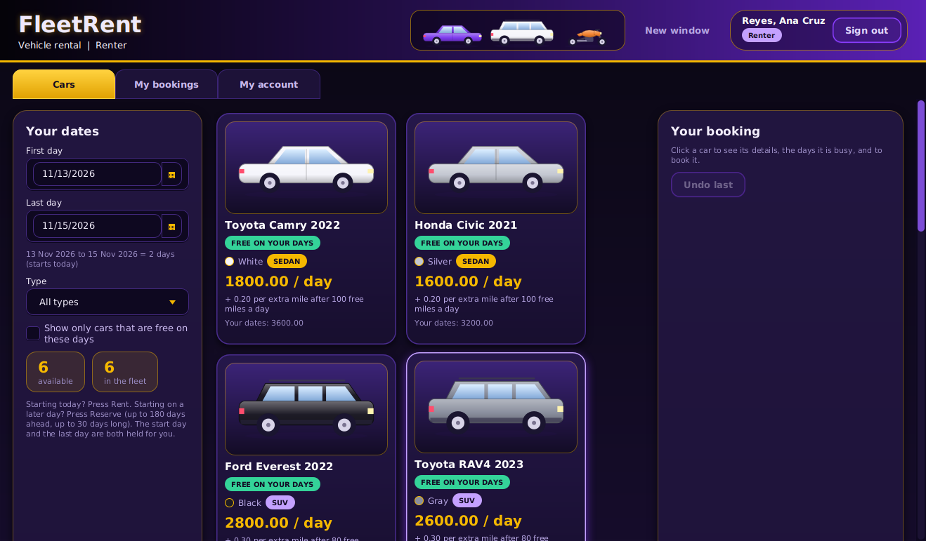
UI: second screen and controls
EVIDENCE: UI
Control | Event | Handler method
Button: Rent today | onAction | RenterBrowseTab.rent()
Button: Reserve these days | onAction | RenterBrowseTab.reserve()
Button: Undo last | onAction | RenterBrowseTab.undo()
ChoiceBox: Type filter | on change | RenterBrowseTab.refresh()
Notes:
This is the renter screen. The renter picks the dates, sees which cars are free and their price, and presses Rent, Reserve or Undo. Every control in the table is wired to a working handler.

Slide 7
Where each requirement lives
ARCHITECTURE
Requirement | Class / file | Where in demo
Object-Oriented Design | model.Vehicle, Sedan, Suv, Motorcycle | Vehicles tab, add a vehicle
Data Structure / Recursion | model.WaitingList, CheckoutHistory, CategoryNode | Rentals tab, Dashboard
Automated Testing (JUnit 5) | src/test: 49 classes, 452 tests | Run mvn test
Data Model + SQLite via JDBC | dao.Database, schema.sql | Add a vehicle, restart
API Consumption (REST + JSON) | service.VpicClient | Vehicles tab, Reload from NHTSA
Event-Driven GUI (3+ controls) | ui.VehicleTab, ui.RenterBrowseTab | Vehicles tab, Cars tab
Concurrency (background thread) | controller.Background | Dashboard, live question
Data Mining (aggregation) | service.FleetAnalytics | Dashboard
Data Visualization (chart) | ui.DashboardTab | Dashboard
Notes:
Each requirement points to a real class that we can open in the IDE right away.

Slide 8
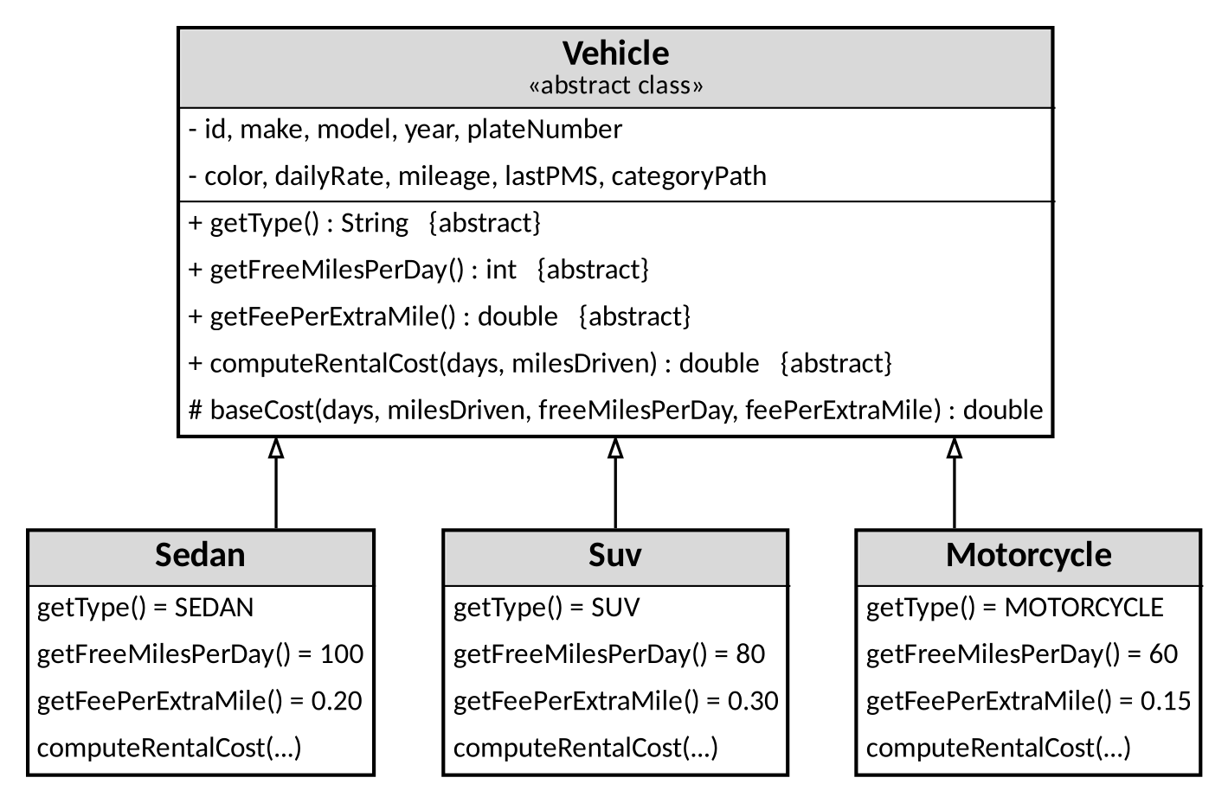
Class hierarchy
ARCHITECTURE
Point out
Abstract class: Vehicle
Subclasses: Sedan, Suv and Motorcycle, each with its own fee rule
One job per class: Database is the only class with SQL
Notes:
Vehicle is abstract. Sedan, Suv and Motorcycle extend it. Each subclass has its own fee per extra mile. VehicleFactory creates the right subclass. Each class has one job, for example Database holds all SQL.

Slide 9
Polymorphism in action
ARCHITECTURE
// FleetAnalytics.revenueByType
for (Rental r : filter(rentals, from, to)) {
Vehicle v = lookup.get(r.getVehicleId());
if (v == null) {
continue;
}
// costOf calls v.computeRentalCost(...)
result.merge(v.getType(),
costOf(r, v), Double::sum);
}
Say
computeRentalCost is overridden in Sedan, Suv and Motorcycle
Each type has its own free miles and fee per extra mile
No if/else on the type: the right method runs by itself
Notes:
The variable v is a Vehicle, but it can be a Sedan, an Suv or a Motorcycle. When costOf calls computeRentalCost, Java runs the method of the real subclass. Free miles are 100, 80 and 60 per day, and the fee per extra mile is 0.20, 0.30 and 0.15. We never check the type with if/else.

Slide 10
Data structure and recursion
ARCHITECTURE
Stack / Queue / Map
Queue: WaitingList. Stack: CheckoutHistory (both ArrayDeque)
Stores: renters waiting for a vehicle, and the last check-outs
Why: the first renter in line is served first; Undo must take back the last check-out first
Seen in: Rentals tab (waiting count, Undo last check-out)
Recursive method
CategoryNode.totalMileage()
Base case: a box with no children returns its own mileage
Recursive case: own mileage plus totalMileage() of every child
Why not a loop: the category tree can have any depth. Seen in the Dashboard
Notes:
The waiting list is a Queue: first in, first out. The check-out history is a Stack: undo removes the last check-out first. The category tree (Fleet, Car, Sedan, and so on) uses a recursive method to add up mileage for every branch. It is shown on the Dashboard as Mileage by category.

Slide 11
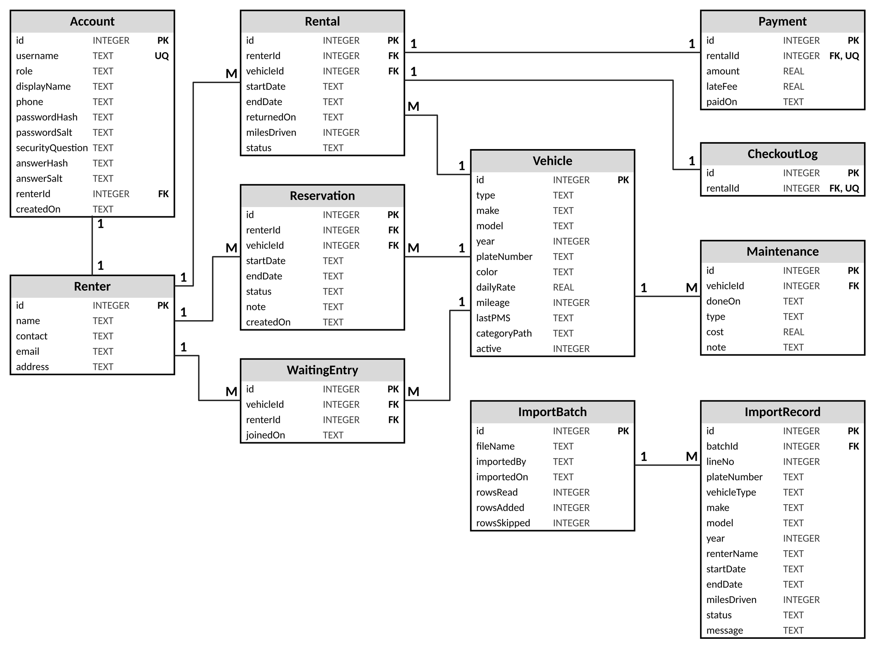
ER model and database schema
ARCHITECTURE
Point out
11 entities, for example Vehicle, Renter and Rental
Primary key id in every table; foreign keys such as renterId and vehicleId
Renter 1 to M Rental, and Vehicle 1 to M Rental
Matches schema.sql and the .db file
Notes:
The database has eleven tables. Every table has a primary key called id. A rental points to one renter and one vehicle, so Renter 1 to M Rental and Vehicle 1 to M Rental. The diagram matches schema.sql, and the app creates the fleetrent.db file from it.

Slide 12
JDBC and PreparedStatement
ARCHITECTURE
// Database.insertVehicle (shortened)
String sql = "INSERT INTO Vehicle (type, make,
model, ...) VALUES (?, ?, ?, ...)";
try (PreparedStatement ps =
connection.prepareStatement(sql,
Statement.RETURN_GENERATED_KEYS)) {
ps.setString(1, v.getType());
ps.setString(2, v.getMake());
// ... one setX call for each column
ps.executeUpdate();
}
Show
DAO class: dao.Database
Create: insertVehicle. Read: getAllVehicles. Update: updateVehicle
Delete: removeVehicle hides the vehicle (active = 0)
Notes:
All SQL is in the Database class. Every statement uses a PreparedStatement with question marks, never joined text. Create, read, update and remove all work for vehicles. A removed vehicle is only hidden, so old rentals keep their vehicle. Open the Vehicle table in a DB viewer to show the saved row.

Slide 13
API consumption
ARCHITECTURE
Request
NHTSA vPIC, answer in JSON
Makes endpoint: GetMakesForVehicleType
Models endpoint: GetModelsForMakeYear
JSON response
Object with a Results list
Makes: MakeName. Models: Make_Name, Model_ID, Model_Name
Read once with Gson
Used in app
Fills the Make and Model lists on the Vehicles tab
The chosen make and model are saved with the vehicle
When the call fails
Time limits: 10 seconds to connect, 30 seconds for the answer. The app shows a red message that says what is wrong (no internet, too slow, firewall), and Make and Model can be typed by hand.
Notes:
Full addresses: https://vpic.nhtsa.dot.gov/api/vehicles/GetMakesForVehicleType/car?format=json and .../GetModelsForMakeYear/make/HONDA/modelyear/2022?format=json. VpicClient calls the NHTSA vPIC service. The answer is JSON with a Results list. We read the names with Gson and show them in the lists. If the call fails, the app shows a clear red message and the user can type the make and model by hand. Tests use a fake local server, so no test needs the internet.

Slide 14
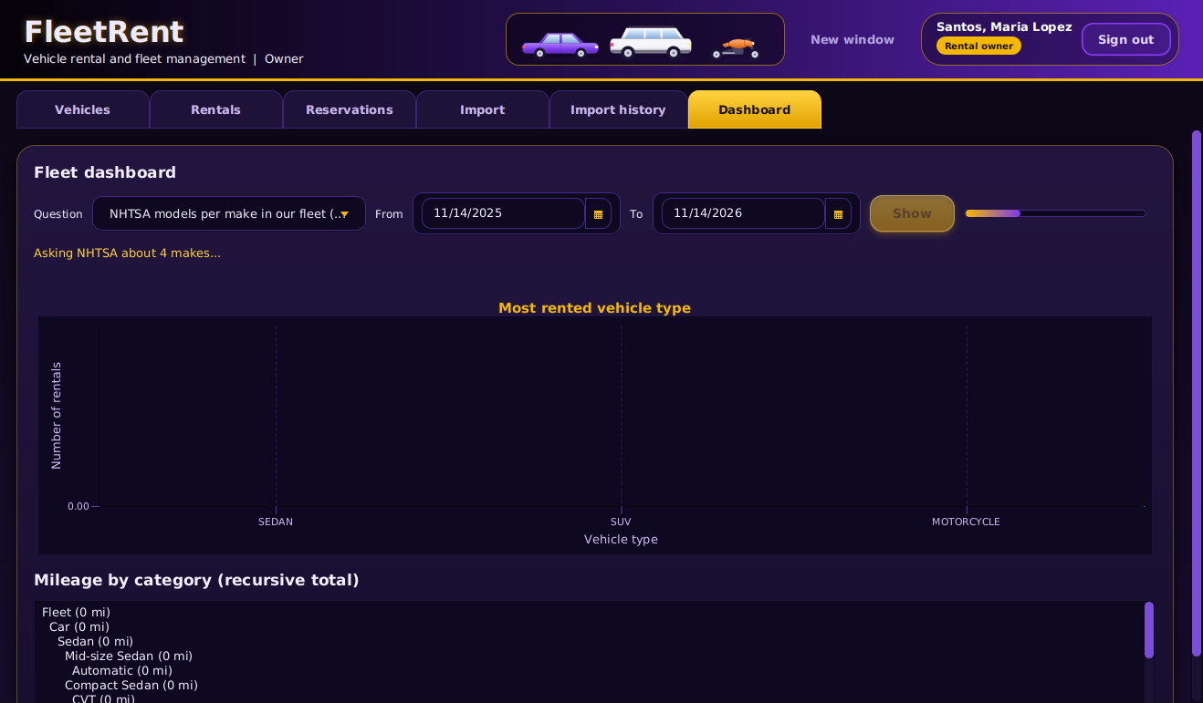
Concurrency: UI stays responsive
ARCHITECTURE
Explain
Slow work (NHTSA calls, CSV import) runs off the screen thread
A JavaFX Task runs on Background: one shared pool of 4 threads
Results come back on the JavaFX thread (Task success and failed handlers)
A progress bar shows and the Show button is disabled while it works
Notes:
On the Dashboard, the live question asks NHTSA about each make in our fleet. This is slow, so it runs in a Task on the shared pool. The window stays responsive: you can still click tabs. When the Task ends, the result is drawn on the JavaFX thread. The app never calls the API from the screen thread.

Slide 15
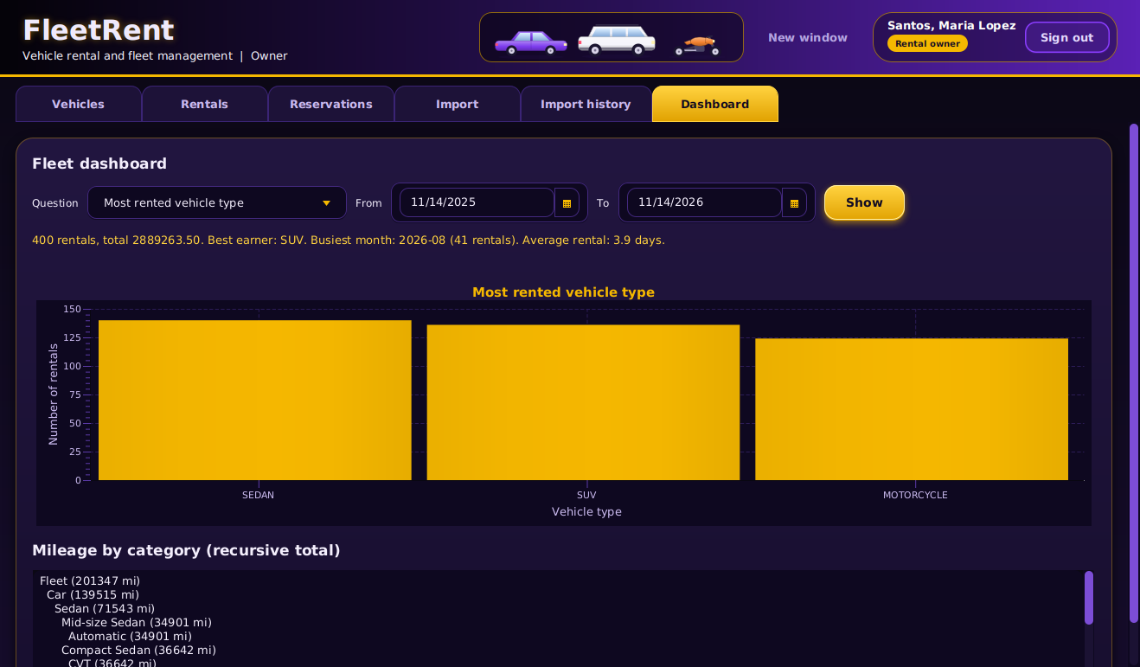
Data mining and chart
EVIDENCE: GRAPH
Explain
Step: count the rentals of each vehicle type (FleetAnalytics)
Data: the Rental table of the database
Bar chart to compare 3 types; line chart for change over months
Live: change the dates or the question, press Show, the chart changes
Notes:
The Dashboard counts rentals per vehicle type, revenue per type, rentals per month, fleet use per month and the top models. The bar chart compares types. The line chart shows change over time. The chart has a title and labeled axes. Change the dates and press Show to see it change.

Slide 16
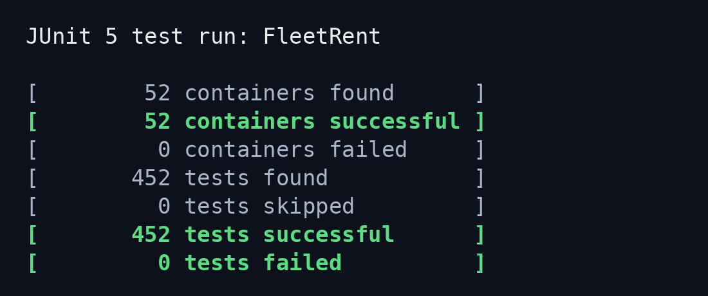
Automated tests
EVIDENCE: TESTS
Class tested | Edge case covered
QueueStackTest | serve or undo on an empty list
RentalMathTest | end before start, missing date
DuplicatePlateTest | same plate in other letter case
VpicClientTest | empty or bad JSON answer
Notes:
We have 452 JUnit 5 tests in 49 classes. Run them live on this computer with mvn test and show 0 failures. The table shows four classes and one edge case each.

Slide 17
Code quality and git history
EVIDENCE: CODE
Member | Commits | Lines added / removed | Main area
Gabasa, Dexter | 62 | +4,051 / -643 | Database, schema.sql, ERD
Rosal, Wendil | 45 | +5,325 / -922 | Accounts, validators, QA
Coloscos, Brent | 84 | +3,167 / -622 | Vehicle classes, controllers
Lagaya, John Carlo | 48 | +5,581 / -138 | Rental, queue, stack, import
Labra, Simone | 52 | +9,276 / -1,241 | JavaFX screens, dashboard
Naming conventions: camelCase methods, PascalCase classes, UPPER_SNAKE_CASE constants. Package layout: model, dto, dao, service, controller, ui, app.
Notes:
These numbers come from git log on the main branch: 291 commits in total, by five members. Lines are added and removed, text files only. Commit messages say what changed.

Slide 18
Who built what
EVIDENCE: CODE
Member | Classes / files committed | Can explain
Gabasa, Dexter | Database, schema.sql, RentalCsvExporter | How a return is saved in one transaction
Rosal, Wendil | PasswordHasher, Validators, VehicleTypes | How a password is hashed and checked
Coloscos, Brent | Vehicle, Sedan, Suv, Motorcycle, AppController | How the cost of a rental is worked out
Lagaya, John Carlo | RentalService, WaitingList, CheckoutHistory | Start a rental, the waiting line, undo
Labra, Simone | AuthScreen, VehicleTab, DashboardTab | How a click reaches the controller
Notes:
Each member can open these files and explain one flow from start to end.

Slide 19
Design justification
DESIGN DECISIONS
Decision 1
Choice: a Queue (ArrayDeque) for the waiting list
Alternative: a Stack
Why: a Stack serves the newest renter first, which is unfair. A Queue serves the first renter in line
Cost: only the front can be served; the owner serves the line by hand
Decision 2
Choice: one shared pool of 4 threads (Background)
Alternative: a new thread for every click
Why: fast double clicks cannot start many threads, and the window stays smooth
Cost: a job can wait in line, and a running import cannot be cancelled yet
Notes:
Question we expect: why a Queue and not a Stack? Because the line must be fair: first in, first served. A Stack is right for Undo, because Undo must remove the last check-out first.

Slide 20
Challenges and how we solved them
REFLECTION
Challenge | What we tried | How we fixed it
Same plate could be saved twice | Checked the plate only on the screen | Database unique index and DuplicatePlateException
A merge left merge markers in two files | Checked the build after the merge | Restored the correct files; 452 tests pass
Commits were not spread evenly (review) | At the first review the lead had about half | Each member committed own area from own account
Open: a running CSV import cannot be cancelled | It runs on a shared pool of 4 threads | Next: add a Cancel button
Notes:
Real problems, real fixes. The duplicate plate and the commit spread came from the instructor review. The merge markers appeared when we merged step 11, and we fixed them in pull request #54.

Slide 21
Lessons learned and future work
REFLECTION
What we learned
Technical: separate layers (screens, rules, SQL) made the code easy to test
Team: small pull requests, merged one by one, avoid conflicts
Differently: run mvn clean test on Windows after every merge
If we had more time
A server, so renters on other computers can book
Tell a waiting renter when it is his or her turn
A Cancel button for a long import, and controller tests with fake DAOs
Notes:
Keep this to 30 seconds. Name what we would do next.

Slide 22
Questions
Individual Q&A: each member explains code they committed
https://github.com/ColoscosBrent/cpe314-69323-capstone-team-04 · Team 04
Notes:
Leave this up during the individual Q&A.

