Slide 1


A novel way to identify translationally active bacteria
BONCAT
Connor O’Loughlin
Vick-Majors Lab meeting 30June25

Slide 2
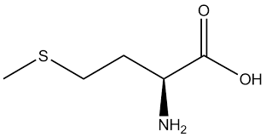
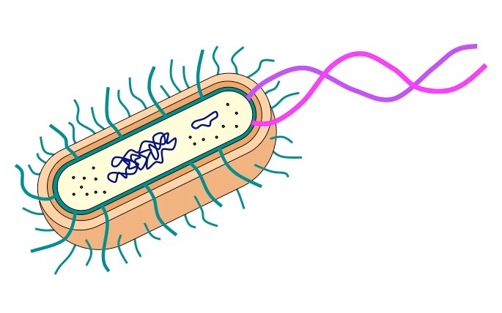
First some background
Methionine (Met)
Uptake
Met
Protein Synthesis
Leu
Pro
Incorporation into biomass
Met
Gly
Gln
Polypeptide chain

Slide 3
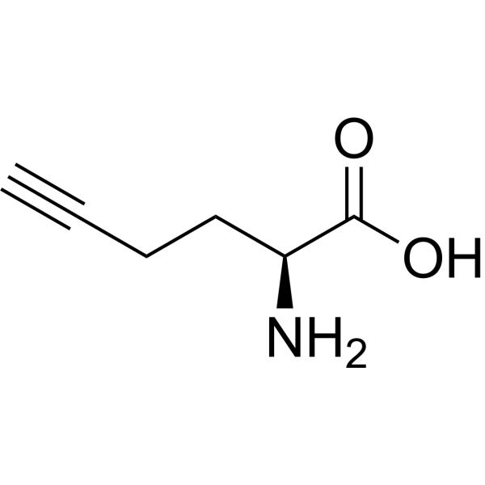
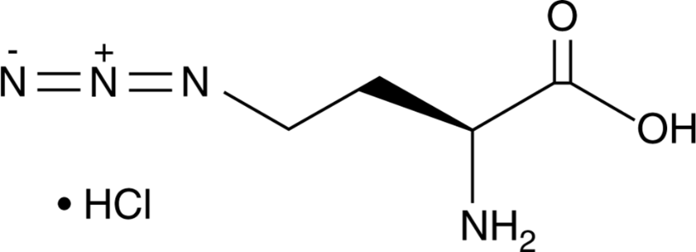

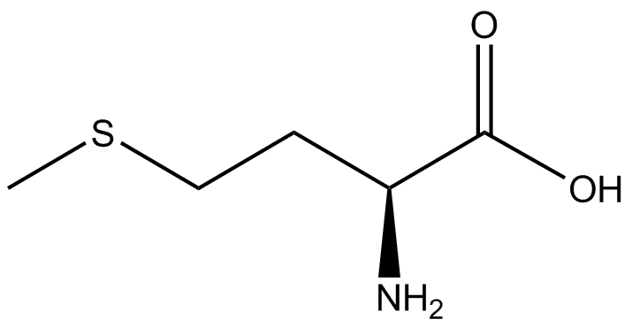
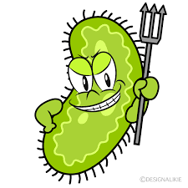
Let’s hijack this system!
Bioorthogonal non-canonical amino acid tagging or BONCAT
L-azidohomoalanine
(AHA)
L-homopropargylglycine
(HPG)

Slide 4

Proteinaceous Trojan Horse
L-azidohomoalanine (AHA)
Uptake
AHA
Protein Synthesis
Leu
Pro
Incorporation into biomass
AHA
Gly
Gln
Polypeptide chain

Slide 5


Hopefully, it “clicks”
Copper-catalyzed azide-alkyne cycloaddition (CuAAC)
“Click Chemistry”
Dye
Leu
Pro
Reaction for CuAAC
AHA
Gly
Gln

Slide 6
What can we do with this?!
Translationally active microbes are marked (theoretically), so…
Fluorescent active cell sorting and 16s rRNA gene sequencing
Flow cytometry
Fluorescence microscopy
Catalyzed Reporter Deposition-Fluorescence In Situ Hybridization (CARD-FISH)
Another labeling technique that amplifies fluorescent signals
All of these techniques can tell us about the morphology and genetic composition of microbial communities

Slide 7
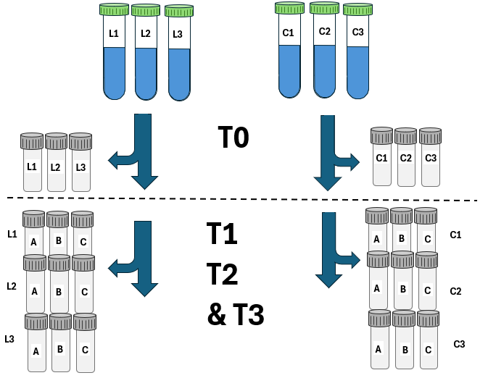
Met Analog incubation
1 Sample
3 Lives (5 nM AHA)
3 Controls (No added AHA)
T0 (Start of incubation)
1 mL aliquots for each replicate (n = 6)
T1, T2, and T3 (12, 24, and 48 hrs)
Three 1 mL aliquots from each replicate (n=18)
Total JGI aliquots: n = 60
-80°c in Gly:Te buffer
Dotted line (T 0.5, Next slide)
2 hrs into incubation

Slide 8
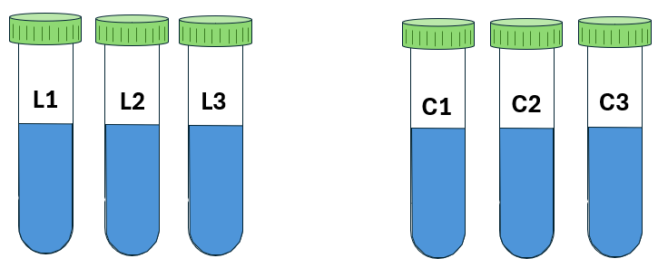
T 0.5 Samples for in house analysis
Resuspend:
1:1 PBS: EtOH
Aliquot:
1 mL from each replicate
Pellet:
15,000 RPM for 15 min

Slide 9
Prepping samples for click chemistry (Just one replicate shown, Preliminary method)
1.
2.
3.
(Repeat this step 2 more times with 80 and 95% EtOH
PBS: EtOH
50% EtOH
(250 uL)
Pellet
7.
6.
95% EtOH
(250 uL)
80% EtOH
(250 uL)
PBS
(221 uL)
Pellet
Pellet
5.
4.

Slide 10
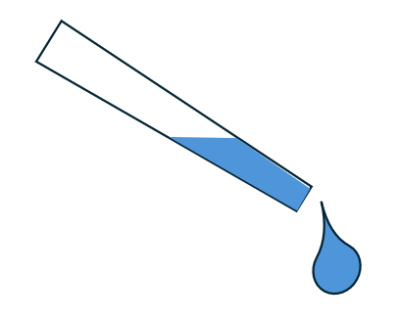
Click Chemistry (in solution) Preliminary method
Centrifugation (x4)
3 washes with PBS and 1 one with 50% EtOH
Incubation
30 minutes at room temp
In the dark
PBS: EtOH
Resuspend
Addition of pre-prepared dye mix
(Final dye concentration 1-5 uM)

Slide 11
End steps
The JGI samples will (hopefully) be sent off to be sorted for DNA extraction.
They will perform the click chemistry and flow cytometry on those samples.
The samples I will have collected
Will be analyzed via microscopy or flow cytometry (depending on flow protocol).
Should be able to provide community characteristics, as well as single-cell characteristics.

